Slide 1
Steps to create and deploy a MongoDB instance on IBM Kubernetes Service
Steps to create and deploy a MongoDB instance on IBM Kubernetes Service

Slide 2
Steps
Pre-reqs (see slides at end of deck: PRE-REQS):
  Create a free account on ibmcloud
  Install ibmcloud CLI
  Install kubernetes-service and container-registry CLI plugins
  Create Free Kubernetes cluster in ibmcloud
  Configure kubectl CLI to point to your ibmcloud IKS Kubernetes cluster
  Create your container registry namespace in the ibmcloud container registry
Download the files and these instructions:
  Download mongodb-in-ibmcloud-Kubernetes.pptx and the 4 files (deployment.yaml, Dockerfile, mongo-init.js, and service.yaml) from box folder
  Put the 4 files (deployment.yaml, Dockerfile, mongo-init.js, and service.yaml) into a folder - e.g. C:\projects\labreskill\mongodb_iks
Build the mongodb docker image:
  Open terminal or powershell window and cd to C:\projects\labreskill\mongodb_iks and build the docker image:
    docker build -t reskillmongodb:1.0 . ← make sure the dot is at the end
  Check that the docker image is in your local docker engine's image area:
    docker images
Test that you can create a local docker container from the docker image:
  docker container run -it --rm -p 27017:27017 reskillmongodb:1.0
  Stop the container and remove it using Ctrl-C
  Use the following commands if -it and --rm options were not specified when you ran docker container run
    docker container ls -a
    docker stop [containerId]
    docker rm [containerId]

Slide 3
Steps
Tag the docker image with the location of the container registry and your container registry namespace:
  docker tag reskillmongodb:1.0 us.icr.io/[your_container_registry_namespace]/reskillmongodb:1.0
    e.g. docker tag reskillmongodb:1.0 us.icr.io/mycrns/reskillmongodb:1.0
Push the docker image to the container registry using the image tag name:
  Log into ibmcloud and Container Registry if you're not logged in:
      ibmcloud login --sso
      ibmcloud cr login
      ibmcloud cr region-set us-south
  docker push us.icr.io/[your_container_registry_namespace]/reskillmongodb:1.0
    e.g. docker push us.icr.io/mycrns/reskillmongodb:1.0
  Verify that the image was pushed to the registry by going to
    https://cloud.ibm.com/kubernetes/registry/main/private
    https://cloud.ibm.com/kubernetes/registry/main/images
Configure kubectl on your laptop to point to your Kubernetes cluster in ibmcloud (in pre-reqs but repeated here):
  Open PowerShell (as administrator) or Terminal
  Log into ibmcloud (if you're not already logged in): ibmcloud login --sso
  Get your kubernetes cluster ID : ibmcloud ks cluster ls
  Configure kubectl CLI to point to your ibmcloud kubernetes cluster
    ibmcloud ks cluster config --cluster [your Kubernetes cluster id]
      e.g. ibmcloud ks cluster config --cluster br56h3gf0nrpp48gst50
  Check that kubectl is accessing your Kubernetes cluster: kubectl get nodes

Slide 4
Steps
Create the deployment (which will then create the POD) for mongodb:
  Change the deployment.yaml replacing your_container_registry_namespace with name of your Container Registry namespace:
    - image: us.icr.io/your_container_registry_namespace/reskillmongodb:1.0
      e.g. - image: us.icr.io/mycrns/reskillmongodb:1.0
  Create the Kubernetes deployment object for mongodb (in powershell or terminal):
    cd C:\projects\labreskill\mongodb_iks
    kubectl apply -f deployment.yaml
    Check that the Kubernetes deployment is created
      kubectl get deployment
    Check that POD's (deployment creates the POD) STATUS is Running (if the POD's STATUS is ContainerCreating, wait until that status changes)
      kubectl get pods
    If there are issues with the POD, check the POD's logs: kubectl logs [pod name]
Create the Kubernetes Service object for mongodb:
  Make sure the service's nodePort value is not in use:
    kubectl get services
    Look at services of TYPE = NodePort: check PORT(s) to see if any NodePort is using 30017 (it's the port after the colon - e.g. 9002:30082/TCP).
    If so, change service.yaml's nodePort: 30017 to use a different value instead of 30017 (in the range, 30000-32767)
  Create the Kubernetes service
      cd C:\projects\labreskill\mongodb_iks
      kubectl apply -f service.yaml
  Verify that the service is deployed. Can also be done through Kubernetes dashboard (IKS)
    kubectl get services
Get public ip of your Kubernetes cluster's worker node
  Log into ibmcloud (if you're not already logged in): ibmcloud login --sso
  Get your kubernetes cluster ID : ibmcloud ks cluster ls
  Get the worker node's public IP: ibmcloud.exe ks worker ls -cluster [Kubernetes cluster ID]
  The worker node's public IP is under the column, "Public IP "
You should now be able to connect to your MongoDB instance via [worker_node_public_ip]:30017. 30017 is the nodeport configured in service.yml

Slide 5
Connecting to the MongoDB Server
Connecting to the MongoDB Server

Slide 6
We Won't Be Using the restaurant database
In the following slides, we show how to connect to the containerized mongodb and specifically to the restaurant database that we created (see the Dockerfile and mongo-init.js)
We show the connection properties for 3 ways to connect:
  MongoDB Compass
  MongoDB Shell
  Spring Data's properties for mongodb
The 'restaurant' database is created when we create the docker container for mongodb.
We are NOT going to use this restaurant db. We just use it here to make sure we can connect (and show how to connect) to our containerized mongodb server.

Slide 7
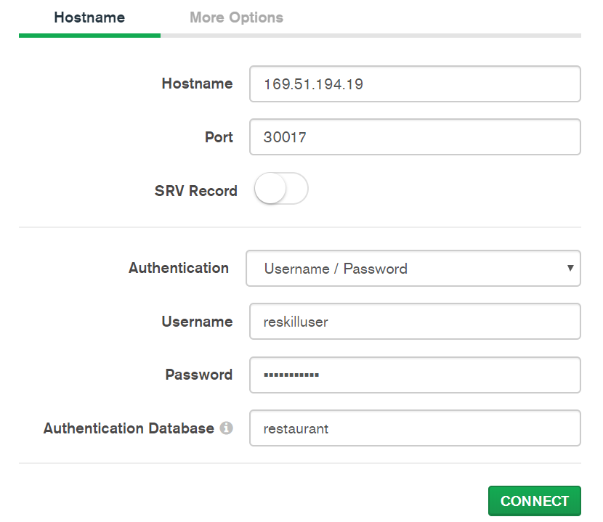
Use MongoDB Compass to Connect to restaurant db using the restaurant db's user and password
Use MongoDb Compass to connect to this database using:
Hostname: worker node public IP
Port: MongoDB Kubernetes service's NodePort
Authentication: Username / Password
Username: reskilluser
password: r3sk1llus3r
Authentication Database: restaurant
Notes:
mongo-init.js creates the database, restaurant, and a user for that database:
  user id: reskilluser
  password: r3sk1llus3r
mongo-init.js is run when the docker container for mongodb starts so ... the restaurant db is created in the mongodb container
Replace this with your worker node ip

Slide 8
Use MongoDB Shell to Connect to restaurant db using the restaurant db's user and password
Open a command prompt (not a power shell)
Run the mongo shell (where ever yours is installed):
  "C:\Program Files\MongoDB\Server\4.2\bin\mongo.exe"
Connect to the mongodb running in Kubernetes using your worker node IP (replace with yours) and NodePort port:
  > db = connect("169.51.194.19:30017");
Switch to the restaurant database (it's created when the docker container is created - see the Dockerfile and mongo-init.js):
  > use restaurant
Authenticate using the restaurant user that was created (see the Dockerfile and mongo-init.js):
  > db.auth(' reskilluser', 'r3sk1llus3r')

Slide 9
FYI - Spring Data's Properties for the restaurant database
Following are the properties we would set in src/main/resources/application.properties (again, though, we won't be using the restaurant database for our lab project's 3 microservices):
spring.data.mongodb.host=169.51.194.19
spring.data.mongodb.port=30017
spring.data.mongodb.authentication-database=admin
spring.data.mongodb.username=reskilluser
spring.data.mongodb.password=r3sk1llus3r
spring.data.mongodb.database=restaurant
Replace with your worker node IP

Slide 10
PRE-REQS
PRE-REQS

Slide 11
Pre-reqs
(1) Create a free account on ibmcloud
Connect to IBM Network (e.g. IBM VPN)
Open a browser and go to https://cloud.ibm.com/login
Create a free ibm cloud account if you don't have one (it creates an ibm cloud lite account)
  IBM Cloud account - you should have one already. Use your IBM w3 id (e.g. yours@us.ibm.com) to login and verify
Potential issues (work with ibm help and ibmcloud help if issues):
Get rid of trial accounts
Clear your browser's history and cookies
Some had an issue where they had to contact the IBM help desk to connect their IBM email id to ibmcloud account
(2) On your PC, install ibmcloud CLI - Follow instructions @ https://cloud.ibm.com/docs/cli?topic=cloud-cli-getting-started
E.g. for windows, the above as the following instructions:
Open Windows PowerShell as Administrator and run:
  [Net.ServicePointManager]::SecurityProtocol = "Tls12, Tls11, Tls, Ssl3"; iex(New-Object Net.WebClient).DownloadString('https://ibm.biz/idt-win-installer')
Verify that the install worked - Open Windows PowerShell as Administrator and run
  ibmcloud dev help
I had errors when installing ibmcloud CLI which were resolved by:
Uninstalled "IBM Cloud Command Line Interface" (windows - "Add or Remove Programs" - clicked on "IBM Cloud Command Line Interface" - Uninstalled
Then I rebooted
And ran the command again in a Windows PowerShell (opened as Administrator): [Net.ServicePointManager]::SecurityProtocol = "Tls12, Tls11, Tls, Ssl3"; iex(New-Object Net.WebClient).DownloadString('https://ibm.biz/idt-win-installer')
And when done it told me to restart the computer
(3) Install kubernetes-service and container-registry CLI plugins
Connect to IBM VPN
Open Windows PowerShell as Administrator and run the following commands:
  ibmcloud plugin install kubernetes-service
  ibmcloud plugin install container-registry
For these plugin installs ,it failed the first time I ran each command ("Unable to download the plug-in binary ... An existing connection was forcibly closed by the remote host. Try again later."). Fix: I ran the command again and it worked

Slide 12
Pre-reqs
(4) Create Free Kubernetes cluster in ibmcloud using the ibmcloud IKS dashboard:
Browser - https://cloud.ibm.com/catalog - 'Services' - 'Category' - Check the 'Containers' box - 'Kubernetes Service'
Select the 'Free' plan in the drop-down - Click on 'Create'
When done creating, Click on 'Kubernetes dashboard' to go to the Kubernetes dashboard just to check it out
(5) Configure kubectl CLI to point to your ibmcloud IKS Kubernetes cluster:
Open PowerShell (as administrator) or Terminal
Log into ibmcloud: ibmcloud login --sso
Get your kubernetes cluster ID : ibmcloud ks cluster ls
Configure kubectl CLI to point to your ibmcloud kubernetes cluster
  ibmcloud ks cluster config --cluster [your Kubernetes cluster id]
    e.g. ibmcloud ks cluster config --cluster br56h3gf0nrpp48gst50
Check that kubectl is accessing your Kubernetes cluster: kubectl get nodes
(6) Create your container registry namespace in the ibmcloud container registry
Open a terminal or windows powershell
Log into ibmcloud and Container Registry if you're not logged in
  ibmcloud login --sso
  ibmcloud cr login
  ibmcloud cr region-set us-south
Create a container namespace in the ibmcloud container registry:
  ibmcloud cr namespace-add [your_container_registry_namespace]
    e.g. ibmcloud cr namespace-add mycrns
Use ibmcloud's CR service dashboard to check that the docker registry namespace was created:
  https://cloud.ibm.com/kubernetes/registry/main/namespaces

Slide 13
APPENDIX
APPENDIX

Slide 14
Some notes on the mongodb Dockerfile and mongo-init.js
Dockerfile
FROM mongo:4.2.2
LABEL description="RestaurantDB"
ENV MONGO_INITDB_ROOT_USERNAME admin
ENV MONGO_INITDB_ROOT_PASSWORD pa55w0rd
ENV MONGO_INITDB_DATABASE admin
ADD mongo-init.js /docker-entrypoint-initdb.d/
It will use these environment variable values (set in the docker container) to create the admin user for the admin database
The admin user is for creating databases, creating db users, etc.
To be able to create databases and create users, we have to 'log in' (authenticate) as the admin user
Note - you 'always' have to first specify the database prior to 'logging in' (authenticating) as a user to that db ... even with the admin user
  e.g. if using mongo shell:S
    use admin ← the database, not the admin user of the same name
    db.auth('admin', 'pa55w0rd') ← log in as a user to the current db (= admin)
but in the case of when we're initializing the db with this docker image, we don't have to specify the database (it's assumed to be the 'admin' db)
mongo-init.js
db.auth('admin', 'pa55w0rd')
db = db.getSiblingDB('restaurant')
db.createUser({
user: 'reskilluser',
pwd: 'r3sk1llus3r',
roles: [
{ role: 'dbOwner',
db: 'restaurant' }
]
})
'restaurant' db doesn't exist. getting it will get the existing db or create one if it doesn't exist. By 'sibling', it means that it creates the db at the same level as the current db (which is 'admin') meaning...not as a nested db
We then create a user that is the owner of the restaurant db
When using this restaurant db, we have to first log into it (authenticate with it) using this user- e.g. if using mongo shell:
  use restaurant
  db.auth('reskilluser', 'r3sk1llus3r')

