Slide 1
Bayesian Modeling of Uncertainty for Glacier Runoff Models
Tommy Tang 9-25-23

Slide 2
Motivation
Explore frameworks for weighting individual models in complex climate ensemble models with regionally-varying uncertainty
Accurate climate projections with sophisticated uncertainty quantification

Slide 3
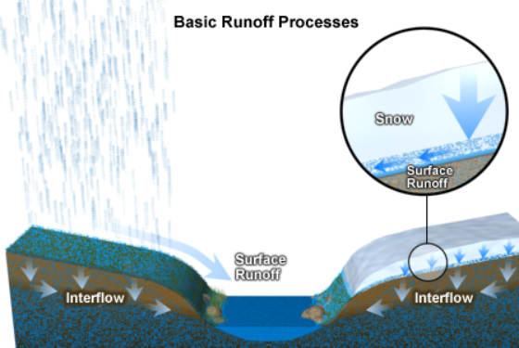
Background
When soil (or other land content) is saturated with water, any excess water cannot be absorbed and must “run off” into nearby areas
Patterns of surface runoff is expected to change in the next century
Interested in contribution of glacial melt to runoff

Slide 4
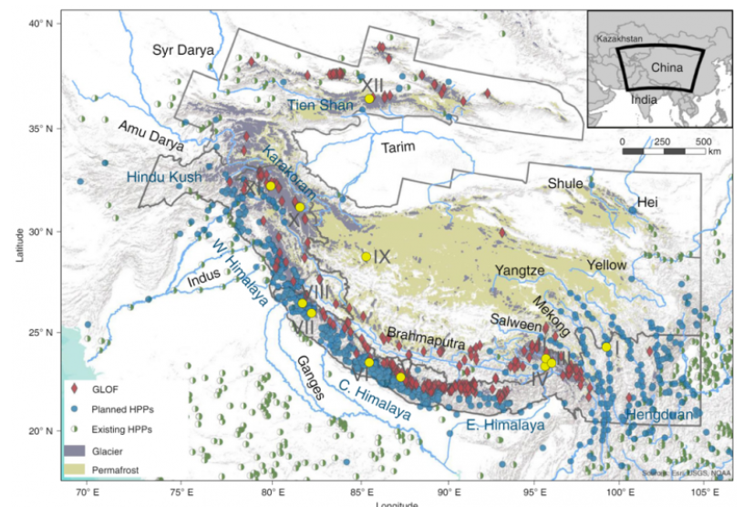
Background (cont’d)
Flooding has profound impacts on growing hydropower sector, food production, public safety
Increased temperatures are expected to lead to massive pattern changes, whose impacts must be understood

Slide 5
Data
22 GCMs from Coupled Model Intercomparison Project Phase 5 (CMIP 5) are calibrated against ERA-Interim over period 2000-2018
GCM temperature and precipitation are adjusted for each glacial region, and projections are calculated for glacier-related forcings:
Rain
Snow
Melt
Refreezing
Ablation
Runoff calculated via: runoff = precipitation + melt - refreezing

Slide 6
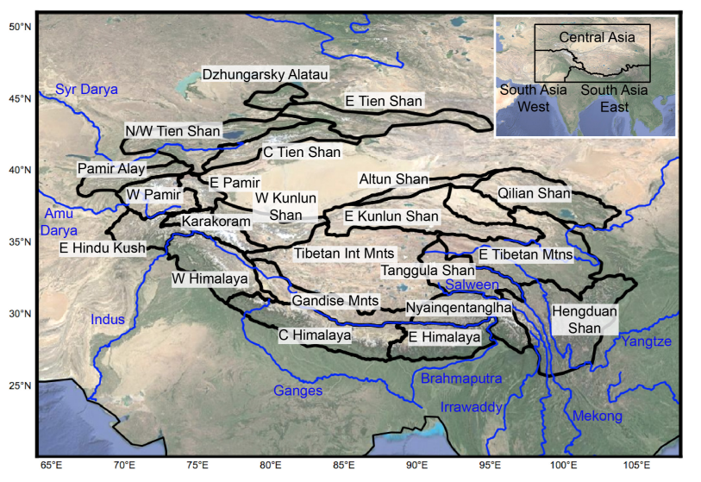
Data (notes)
Melt, refreezing, and ablation are all calculated via physical models as a function of precipitation, temperature, and elevation

Slide 7
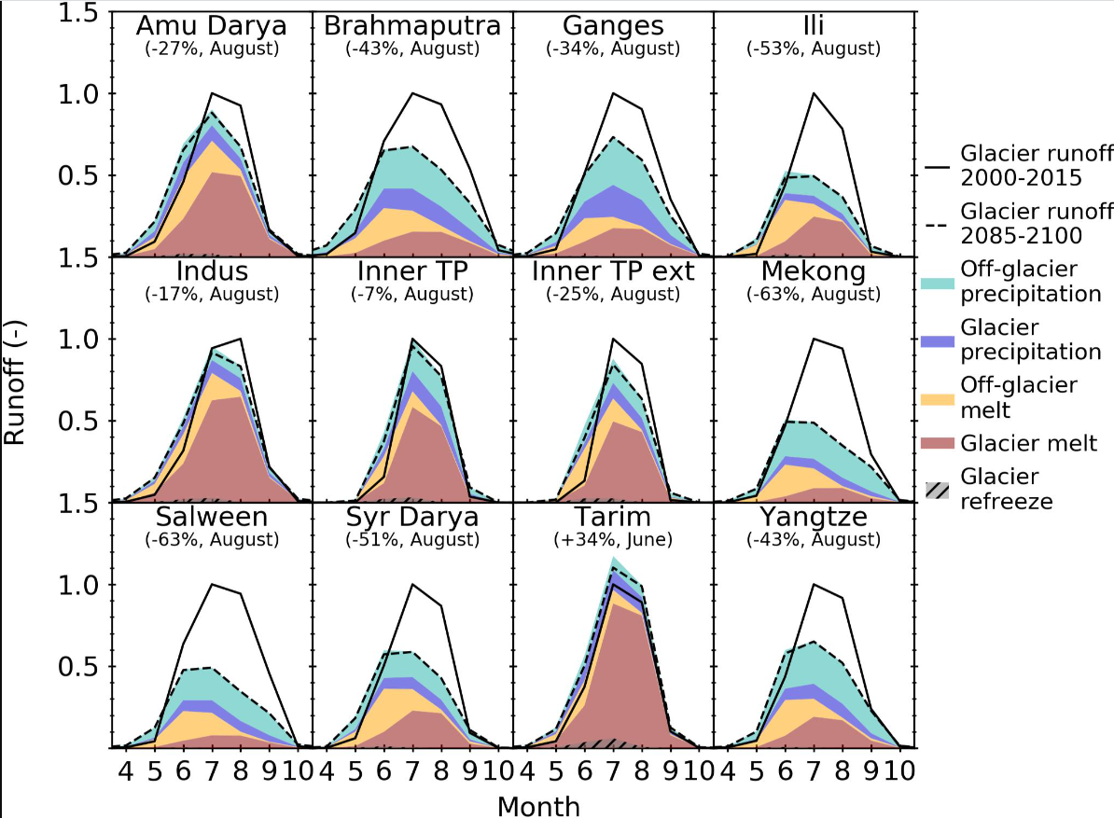
Data (exploration)

Slide 8
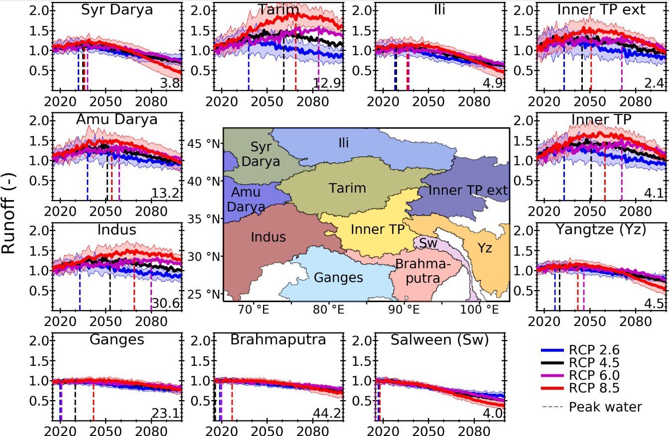
Data (exploration)

Slide 9
Modeling (setting and strategy)
Incorporate regionally varying uncertainty
Propagate Uncertainty Quantification
Define “current period”: 2000-2018
Future period: 2040-2060
Suppose we have M models and k regions

Slide 10
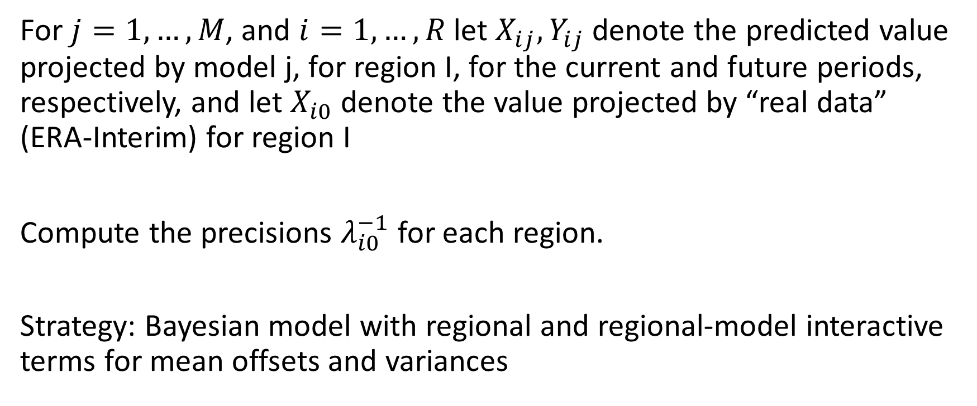
Modeling (variable definition)
For $j=1,…, M$, and $i=1,…, R$ let $X_{ij}, Y_{ij}$ denote the predicted value projected by model j, for region I, for the current and future periods, respectively, and let $X_{i0}$denote the value projected by “real data” (ERA-Interim) for region I
Compute the precisions $λ_{i0 }^{−1}$ for each region.
Strategy: Bayesian model with regional and regional-model interactive terms for mean offsets and variances

Slide 11

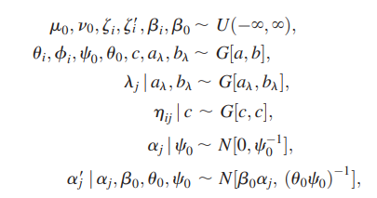



Modeling (Full Bayesian Hierarchy)

Slide 12
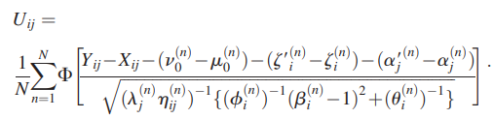
Modeling (validation, simplified)

Slide 13
References
Prusevich, A. A., D. S. Grogan, R. B. Lammers, and D. R. Rounce. (2021). High Mountain Asia Rasterized PyGEM Glacier Projections with RCP Scenarios, Version 1 [Data Set]. . . https://doi.org/10.5067/H118TCMSUH3Q. Date Accessed 09-25-2023.
Smith, Richard L., et al. "Bayesian modeling of uncertainty in ensembles of climate models." Journal of the American Statistical Association 104.485 (2009): 97-116.
Rounce, David R., Regine Hock, and David E. Shean. "Glacier mass change in High Mountain Asia through 2100 using the open-source python glacier evolution model (PyGEM)." Frontiers in Earth Science 7 (2020): 331.

