Slide 1
Runner Chaser Game
Tom Hadlaw
Zach Bearinger

Slide 2
Outline
Problem
System Environment
Agents
Chaser
Runner
AI
Results
Conclusion

Slide 3
Problem
We wanted to investigate how an agent would be able to pursue another agent through a graph
Each node contains a agent to represent the population and their willingness to help (NPC)
One agent will move through the graph and alert each node as to its destination (Runner)
One agent will poll at every node to follow the first (Chaser)
Purpose was to investigate the interplay between the agents

Slide 4
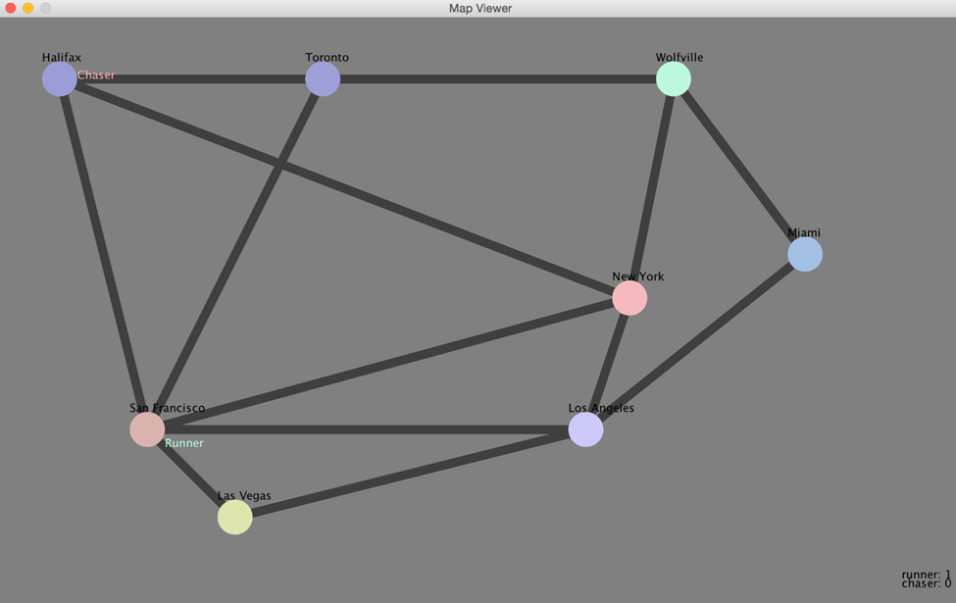
Environment
Each node represents a City
Each City contains an NPC Agent representing the population
Map was set to provide consistency throughout testing

Slide 5
Agents
Three Different Agents
NPC Agent resides in Cities
Runner Agent moves between Cities
Chaser Agent chases the runner between Cities

Slide 6
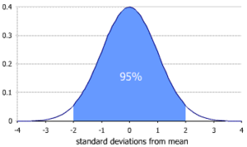
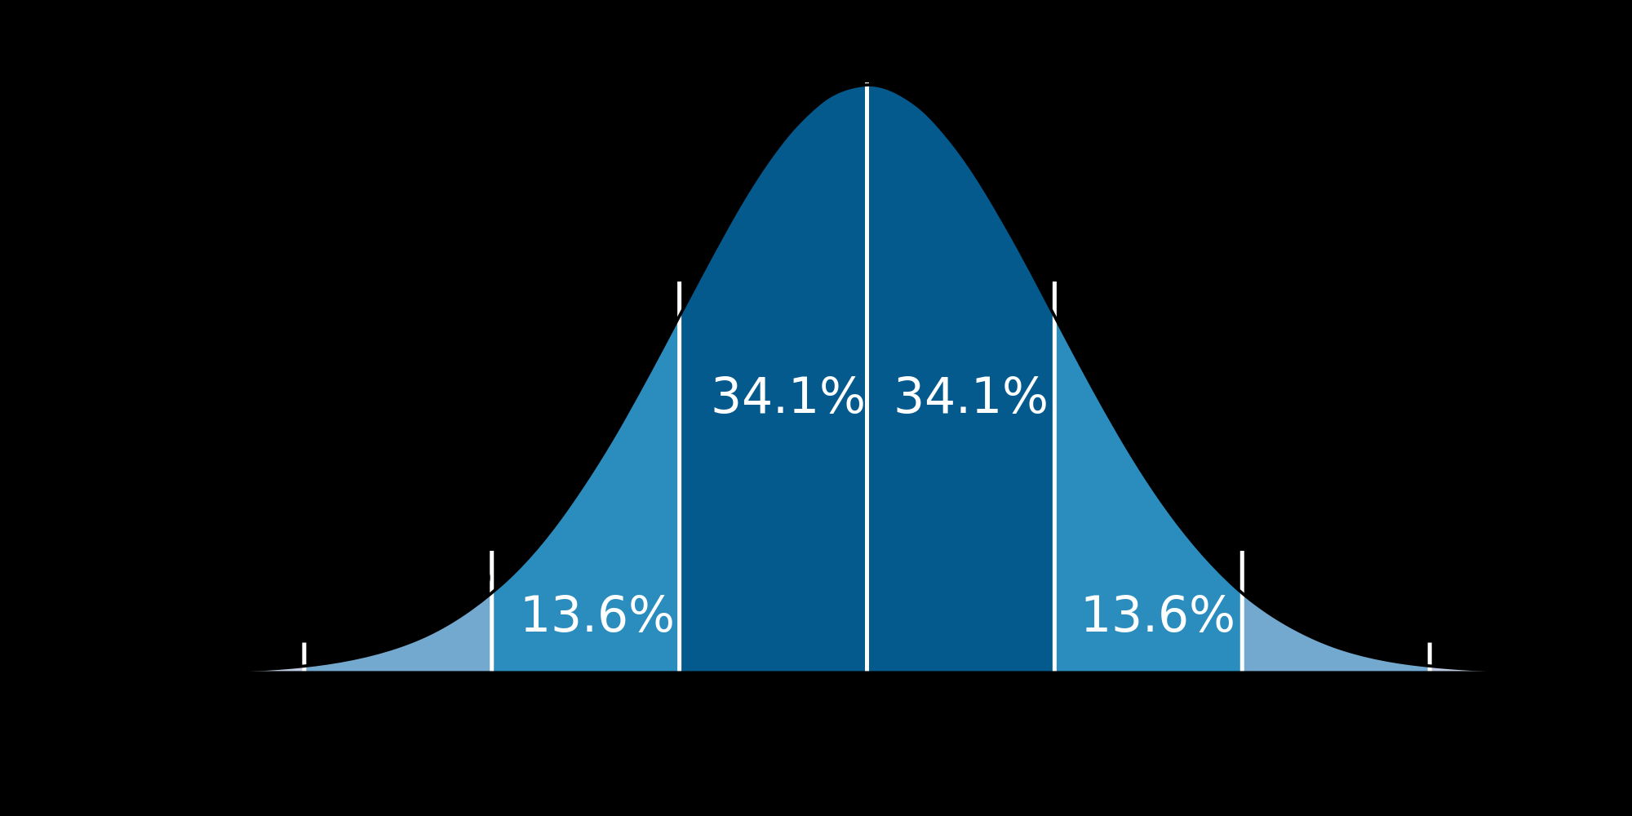
NPC Agent
This Agent simulates the entire population of a city
It follows a Gaussian Distribution as seen on the right
When questioned the agent will respond either with silence or the next known destination of the player
We used a mean of 20 and a standard deviation of 30

Slide 7

Runner Agent
Starts in a preset city
Will randomly advance through the graph
At each node before leaving the agent will alert the population as to its next destination.
If this agent collides with the chaser the simulation will end

Slide 8
Chaser Agent
Has an explicit goal of capturing the runner
Starts in the same city but after the runner has had time to flee
Will poll each node as it arrives
The poll will return either
The next runner location and it will move to there
A null response which will have the chaser wait then try again

Slide 9
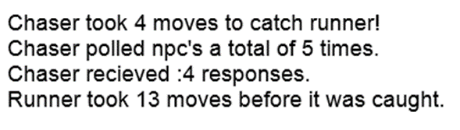
Results
Our program will output the number of moves by each agent
The number of polls and responses are also recorded
These results allowed us to monitor how our simulation ran

Slide 10
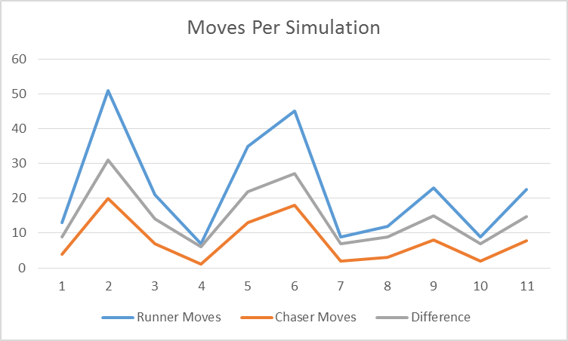
Movement Results
From the results you can see that the length of the simulation varied greatly
The shorter tests resulted from the runner entering a city with the chaser still inside

Slide 11
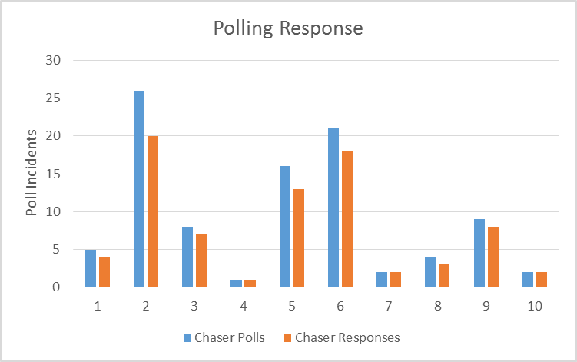
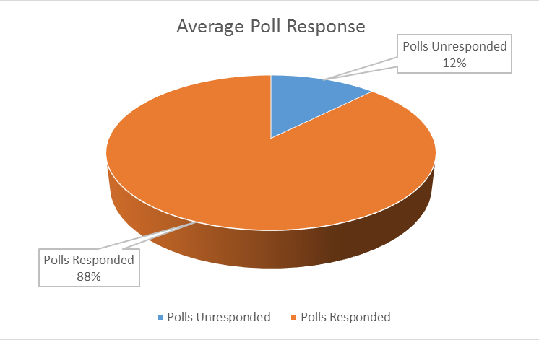
Polling Results
As you can see the results from polling was approximately 80%
You can see that the longer tests of 2, 5, 6 had the largest amount of error which most likely caused the longer tests
From the observation above we can see that having an uncooperative population leads to more interesting simulations

Slide 12
Conclusion
More testing on a larger map
Our simulation shows that the problem posed has a interesting interplay between two agents
Future integration in other projects is promising

Slide 13
Demonstration

