Slide 1

Computer Principles and
Java Programming
Introduction to Java

Slide 2
Hard and Soft
Physical devices comprising a computer system are referred to as hardware.
Computer programs that run on a computer are referred to as software.

Slide 3
Software: Program and Data
A computer program is merely a collection of instructions to process data.
This course is focused on how to design and produce quality software, i.e. writing complete and precise computer programs to control computers.

Slide 4
What is Data in Computer?
ICQ/Email message, web page
Movie, image, song
Teaching time table, Grade Point Average
ICQ/Phone/credit card number
Joy-pad button status, weapon list in Diablo II
Text document
Program
Basically anything in computer manageable form!

Slide 5
Compiler / Interpreter
Still remember the Pros & Cons of writing High-level & Low-level language?
Translators do the translation task for us
Program Written in
High-level Language
e.g. Pascal, C
Compiler/Interpreter
Executable Program in
Low-level Language
e.g. Intel x86 code

Slide 6
Really Cross Platform?!
SGI Octane
Pentium 4
Translate
Translate
Basic Program [hello.bas]
Translate
Translate
Translate
Macintosh
Sun UltraSparc
…

Slide 7
Pitfalls
Store and use different compiled versions
Availability of compiler(s) is a must
Compiler compatibility problem
Re-compile all versions after an update
How about a new machine/ computer architecture?

Slide 8
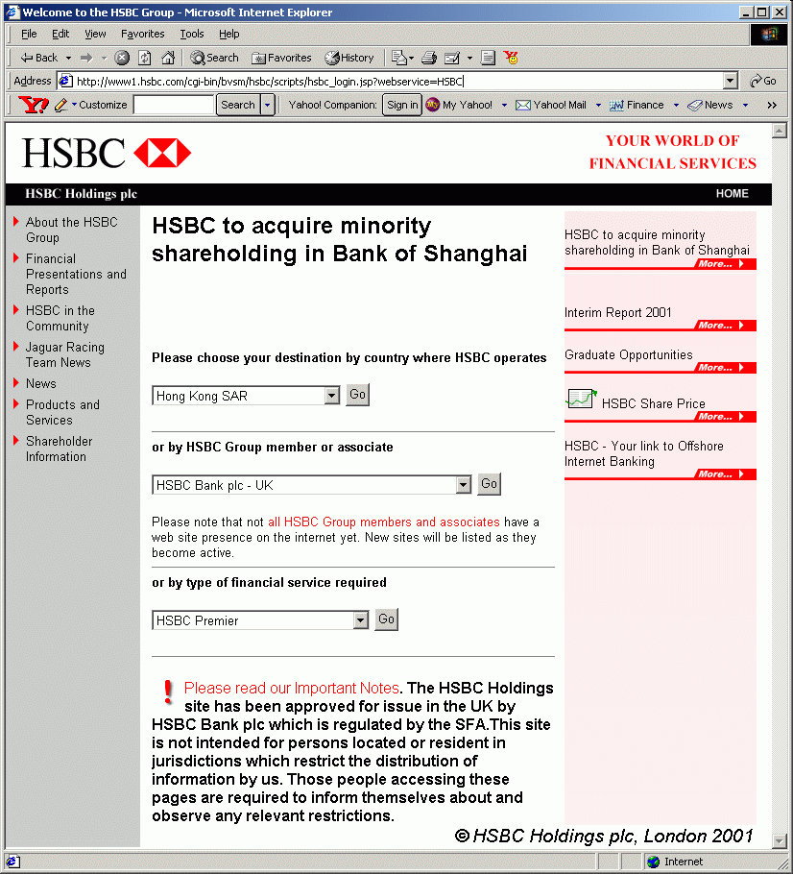
Java?
Widely-used in corporations!

Slide 9
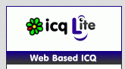


Java?
Web-based applications
Enterprise usage
Home usage
Set-top box, e.g. cable TV
Mobile usage
Android Apps
J2ME: CLDC/ MIDP

Slide 10
Java Compilation Model
Java Program [hello.java]
Java Compiler
Compile
Java Byte Code [hello.class]
We do this once

Slide 11
Java Compilation Model
Someone do this for us
native code
Intel x86
Java Byte Code [hello.class]
Translate
Smartphone
Mac
Java Virtual Machine (JVM)
Sun UltraSparc

Slide 12
Java Compilation Model
Java Program [hello.java]
The whole grand picture
native code
Java Compiler
Compile
Intel x86
Java Byte Code [hello.class]
Translate
Smartphone
Mac
Java Virtual Machine (JVM)
Sun UltraSparc

Slide 13

Scenario Explained
Now, each native speaker has an in-house translator who understands Java Byte Code and speaks the corresponding native language
We, as a foreigner, only need to prepare our instruction in Java Byte Code
However, Java Byte Code is still hard for human, so we learn the Java Language

Slide 14
Portability: 海納百川、有容乃大
Java is an Object-Oriented Programming Language, supporting
  standalone text and graphical applications
  client-side web development (applet)
  server-side web development (servlet, JSP)
  mobile applications (J2ME, MIDP, games, etc.)
  mobile platforms (Android Apps)
  embedded applications (Java card, set-top box)

Slide 15
Summary
Java is compiled to byte code and can be run on any platform that supports a Java Virtual Machine. [portable]
Java Platform is available in Standard Edition (SE), Enterprise Edition (EE), or Micro Edition (ME).
NetBeans is a graphical IDE bundled with Java for developing projects in Java.

