Slide 1
Assignment 4

Slide 2
Mark & Sweep
when G.C. fires we scan “memory”
Mark:
for each reference i
if not marked, mark it
[check each reference from that object] (not in A4)
→ recursive
Sweep:
for each object j
if unmarked, recycle (free the memory)
Notes:
this is an algorithm.
the implementation varies depending on our data structure

Slide 3
notes for assignment 4
We use reference counting to determine marked references
makes mark phase really simple
doing this because we don’t have program variable access
Our reference count is updated as the program makes object requests
We run G.C. when there’s no space left for an object (when an insertion would fail)

Slide 4
Memory Layout
0xFFFFFFFF
stack (function calls)
available memory
heap (dynamically allocated data)
global/static variables ("data segment")
code instructions ("text segment")
run-time stack
heap
static area
address
space
0x00000000

Slide 5
Heap (memory)
heap is a part of the memory
you can look at it like an array (but longer)
char * ptr = (char *)malloc( size );

Slide 6
Heap (memory)
heap is a part of the memory
you can look at it like an array (but longer)
char * ptr = (char *)malloc( size );

Slide 7
Memory Pool
insert( size );
insert( size );
insert( size );
insert( size );
insert( biggerSize );
Notes:
in our assignment, we are try to explore how we would manage our memory by implementing a simple memory abstract data type
our object manager has memory pool and we can allocate some memory for objects

Slide 8
What information we need to track for the memory objects?
starting address (index)
size in number of bytes
Memory Pool

Slide 9
What do we have to do when we are running out of space?
remove orange
remove yellow
insert( bigSize );
we have enough size but not contiguous
Memory Pool

Slide 10
Garbage Collection
Memory Pool
Notes:
after G.C. we want to move all items be close as possible
then we can add new object

Slide 11
Memory Fragmentation
This was memory fragmentation
We could scan memory looking for enough free space on every insert
A search which is slow
Which slot do we choose? First fit? Best fit? Worst fit?
All lead to more fragmentation (discussed in COMP 3430)
GC in A4 is defragmenting GC

Slide 12
Garbage Collection
Memory Pool
Memory Pool after G.C.
Notes:
after G.C. we want to move all items be close as possible
then we can add new object

Slide 13
Garbage Collection
because we are moving objects, we no longer can use pointer
address changes when we move an object
we can instead use an identifier
in addition, to distinguish between a live object and garbage, we can keep track of reference count
used for mark & sweep algorithm

Slide 14
We need the followings for a memory object
starting address (index)
size in number of bytes
reference identifier
reference count

Slide 15
How do we actually implement?
int numBytes;
int startAddr;
Ref ref;
int count;
Memory Pool
numBytes = 100;
startAddr = 0;
ref = 1;
count = 1;
numBytes = 100;
startAddr = 200;
ref = 3;
count = 1;
numBytes = 150;
startAddr = 400;
ref = 5;
count = 1;
Notes:
can we simply link these records?

Slide 16
Memory Block Node
typedef struct MEMBLOCK MemBlock;
struct MEMBLOCK
{ // Information needed to track our objects in memory
int numBytes; // how big is this object?
int startAddr; // where the object starts
Ref ref; // the reference used to identify the object
int count; // the number of references to this object
MemBlock * next; // pointer to next block. Blocks stored in a linked list.
};

Slide 17
How do we perform Garbage Collection?
numBytes = 100;
startAddr = 0;
ref = 1;
count = 1;
numBytes = 100;
startAddr = 200;
ref = 3;
count = 1;
numBytes = 150;
startAddr = 400;
ref = 5;
count = 1;

Slide 18
How do we perform Garbage Collection?
currBuffer

Slide 19
Initialization
we need to allocate two buffers; only one in use at any given time
and do any other necessary initialization

Slide 20
Ref insertObject( const int size )
memBlockStart
∅
memBlockEnd

Slide 21
Ref insertObject( const int size )
memBlockStart
memBlockEnd
numBytes = 100;
startAddr = 0;
ref = 1;
count = 1;
∅

Slide 22
Ref insertObject( const int size )
memBlockStart
freeIndex: 200
memBlockEnd
numBytes = 100;
startAddr = 0;
ref = 1;
count = 1;
numBytes = 100;
startAddr = 100;
ref = 2;
count = 1;
∅
∅

Slide 23
Ref insertObject( const int size )
memBlockStart
freeIndex: 300
memBlockEnd
numBytes = 100;
startAddr = 0;
ref = 1;
count = 1;
numBytes = 100;
startAddr = 100;
ref = 2;
count = 1;
numBytes = 100;
startAddr = 200;
ref = 3;
count = 1;
∅

Slide 24
Ref insertObject( const int size )
memBlockStart
freeIndex: 550
memBlockEnd
numBytes = 100;
startAddr = 0;
ref = 1;
count = 1;
numBytes = 100;
startAddr = 100;
ref = 2;
count = 1;
numBytes = 100;
startAddr = 200;
ref = 3;
count = 1;
numBytes = 250;
startAddr = 300;
ref = 4;
count = 1;
∅

Slide 25
Ref insertObject( const int size )
first, check if there is room to allocate
no space => compact() i.e., garbage collection
check if there is room
create an object node, and allocate space
return the new object’s reference or NULL_REF if failed

Slide 26
void addReference( const Ref ref )
addReference( 3 );
numBytes = 100;
startAddr = 0;
ref = 1;
count = 1;
numBytes = 100;
startAddr = 100;
ref = 2;
count = 1;
numBytes = 100;
startAddr = 200;
ref = 3;
count = 1;
numBytes = 250;
startAddr = 300;
ref = 4;
count = 1;
∅

Slide 27
void addReference( const Ref ref )
addReference( 3 );
numBytes = 100;
startAddr = 0;
ref = 1;
count = 1;
numBytes = 100;
startAddr = 100;
ref = 2;
count = 1;
numBytes = 100;
startAddr = 200;
ref = 3;
count = 2;
numBytes = 250;
startAddr = 300;
ref = 4;
count = 1;
∅

Slide 28
void dropReference( const Ref ref )
dropReference( 2 );
numBytes = 100;
startAddr = 0;
ref = 1;
count = 1;
numBytes = 100;
startAddr = 100;
ref = 2;
count = 1;
numBytes = 100;
startAddr = 200;
ref = 3;
count = 2;
numBytes = 250;
startAddr = 300;
ref = 4;
count = 1;
∅

Slide 29
void removeRef( const Ref ref )
addReference( 2 );
numBytes = 100;
startAddr = 0;
ref = 1;
count = 1;
numBytes = 100;
startAddr = 100;
ref = 2;
count = 0;
numBytes = 100;
startAddr = 200;
ref = 3;
count = 2;
numBytes = 250;
startAddr = 300;
ref = 4;
count = 1;
∅

Slide 30
void removeRef( const Ref ref )
addReference( 2 );
numBytes = 100;
startAddr = 0;
ref = 1;
count = 1;
numBytes = 100;
startAddr = 200;
ref = 3;
count = 2;
numBytes = 250;
startAddr = 300;
ref = 4;
count = 1;
∅

Slide 31
void removeRef( const Ref ref )
addReference( 2 );
make sure all links (including memBlockStart and memBlockEnd) are correct
numBytes = 100;
startAddr = 0;
ref = 1;
count = 1;
numBytes = 100;
startAddr = 200;
ref = 3;
count = 2;
numBytes = 250;
startAddr = 300;
ref = 4;
count = 1;
∅

Slide 32
static void compact( void )
numBytes = 100;
startAddr = 0;
ref = 1;
count = 2;
numBytes = 100;
startAddr = 200;
ref = 3;
count = 5;
numBytes = 150;
startAddr = 400;
ref = 5;
count = 2;
∅

Slide 33
static void compact( void )
numBytes = 100;
startAddr = 0;
ref = 1;
count = 2;
numBytes = 100;
startAddr = 200;
ref = 3;
count = 5;
numBytes = 150;
startAddr = 400;
ref = 5;
count = 2;
∅

Slide 34
static void compact( void )
buffer1
buffer2
currBuffer
nextRef: 6
freeIndex: 550
numBlocks: 3
memBlockStart
memBlockEnd
numBytes = 100;
startAddr = 0;
ref = 1;
count = 2;
numBytes = 100;
startAddr = 200;
ref = 3;
count = 5;
numBytes = 150;
startAddr = 400;
ref = 5;
count = 2;
∅

Slide 35
static void compact( void )
buffer1
buffer2
currBuffer
nextRef: 6
freeIndex: 0
numBlocks: 3
memBlockStart
memBlockEnd
numBytes = 100;
startAddr = 0;
ref = 1;
count = 2;
numBytes = 100;
startAddr = 200;
ref = 3;
count = 5;
numBytes = 150;
startAddr = 400;
ref = 5;
count = 2;
∅

Slide 36
static void compact( void )
buffer1
buffer2
memcpy( dst, src, bytes)
currBuffer
nextRef: 6
freeIndex: 0
numBlocks: 3
memBlockStart
memBlockEnd
numBytes = 100;
startAddr = 0;
ref = 1;
count = 2;
numBytes = 100;
startAddr = 200;
ref = 3;
count = 5;
numBytes = 150;
startAddr = 400;
ref = 5;
count = 2;
∅

Slide 37
static void compact( void )
buffer1
buffer2
currBuffer
nextRef: 6
freeIndex: 100
numBlocks: 3
memBlockStart
memBlockEnd
numBytes = 100;
startAddr = 0;
ref = 1;
count = 2;
numBytes = 100;
startAddr = 200;
ref = 3;
count = 5;
numBytes = 150;
startAddr = 400;
ref = 5;
count = 2;
∅

Slide 38
static void compact( void )
buffer1
buffer2
memcpy( dst, src, bytes)
currBuffer
nextRef: 6
freeIndex: 100
numBlocks: 3
memBlockStart
memBlockEnd
numBytes = 100;
startAddr = 0;
ref = 1;
count = 2;
numBytes = 100;
startAddr = 200;
ref = 3;
count = 5;
numBytes = 150;
startAddr = 400;
ref = 5;
count = 2;
∅

Slide 39
static void compact( void )
buffer1
buffer2
currBuffer
nextRef: 6
freeIndex: 200
numBlocks: 3
memBlockStart
memBlockEnd
numBytes = 100;
startAddr = 0;
ref = 1;
count = 2;
numBytes = 100;
startAddr = 100;
ref = 3;
count = 5;
numBytes = 150;
startAddr = 400;
ref = 5;
count = 2;
∅

Slide 40
static void compact( void )
buffer1
buffer2
memcpy( dst, src, bytes)
currBuffer
nextRef: 6
freeIndex: 200
numBlocks: 3
memBlockStart
memBlockEnd
numBytes = 100;
startAddr = 0;
ref = 1;
count = 2;
numBytes = 100;
startAddr = 100;
ref = 3;
count = 5;
numBytes = 150;
startAddr = 400;
ref = 5;
count = 2;
∅

Slide 41
static void compact( void )
buffer1
buffer2
currBuffer
nextRef: 6
freeIndex: 350
numBlocks: 3
memBlockStart
memBlockEnd
numBytes = 100;
startAddr = 0;
ref = 1;
count = 2;
numBytes = 100;
startAddr = 100;
ref = 3;
count = 5;
numBytes = 150;
startAddr = 200;
ref = 5;
count = 2;
∅

Slide 42
static void compact( void )
buffer1
buffer2
currBuffer
nextRef: 6
freeIndex: 350
numBlocks: 3
memBlockStart
memBlockEnd
numBytes = 100;
startAddr = 0;
ref = 1;
count = 2;
numBytes = 100;
startAddr = 100;
ref = 3;
count = 5;
numBytes = 150;
startAddr = 200;
ref = 5;
count = 2;
∅

Slide 43
static void compact( void )
buffer1
buffer2
currBuffer
nextRef: 6
freeIndex: 350
numBlocks: 3
memBlockStart
memBlockEnd
numBytes = 100;
startAddr = 0;
ref = 1;
count = 2;
numBytes = 100;
startAddr = 100;
ref = 3;
count = 5;
numBytes = 150;
startAddr = 200;
ref = 5;
count = 2;
∅

Slide 44
Global variables in ObjectManager.c
data structures for linked list
two arrays of buffers (unsigned char)
currBuf (which buffer is currently in use)
freeptr: next available position in the buffer
……

Slide 45
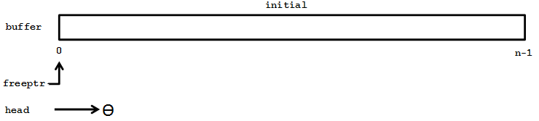
initPool(): initialize the object manager upon starting
set which of the two arrays that is currently in use
create the empty linked list
set freeptr = 0

Slide 46
insertObject(size): request a block of memory of given size from the object manager
check whether there is enough memory left on the buffer. Call garbage collector (compact()) if necessary
create a new node for this object and add the node to the end of linked list
update freeptr appropriately

Slide 47
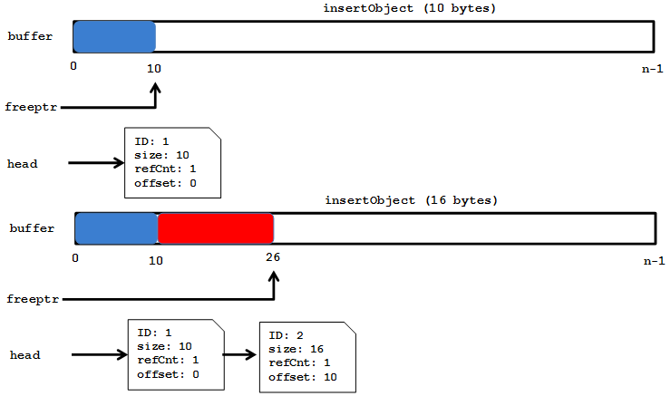
memory allocation after 2 allocations

Slide 48
retrieveObject(id): retrieve the address of an object, identified by the reference id
traverse the linked list to find the node with the reference id
return a pointer (void *) to the object

Slide 49
addReference(id): increment reference count for the object with reference id.
traverse the linked list to find the node with given reference id
increment the reference count of this node

Slide 50
dropReference(id): decrement reference count for the object with reference id
traverse the linked list to find the node with given reference id
decrement the reference count of this node
if the reference count becomes 0, remove the node from the linked list

Slide 51
compact(): initiate garbage collection. Note this function should be “static”
move the content (corresponding to memories currently in use) from one buffer to another
reset which buffer is currently in use
update freeptr appropriately
print some statistics:
the number of objects that exist
the current number of bytes in use
the number of bytes collected

Slide 52
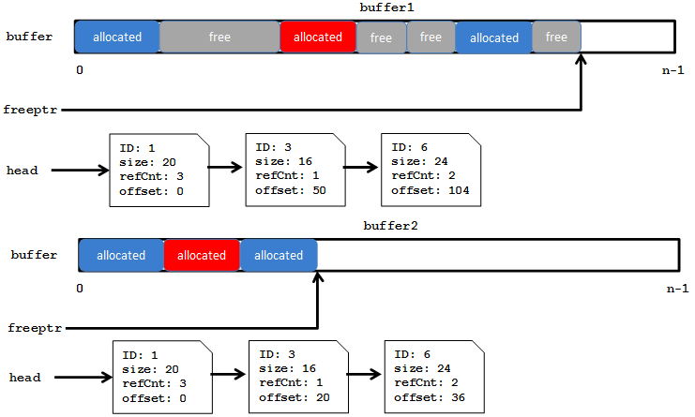
defragmenting memory by moving objects from buffer 1 to buffer 2

Slide 53
destroyPool(): clean up the object manager upon quitting
remove (free) the nodes in the linked list

Slide 54
dumpPool(): print info about each object currently allocated including its id, start address, size and reference count
traverse the linked list, print the information at each node

Slide 55
Suggestions
Start early
Do not try to write everything at once. Instead, write one component, test and debug to make sure it works. Then move on to the next component.

