Slide 1
Lecture 5
COMPS321F
Advanced Database and Data Warehousing
Transaction Management part i
Dr. Daisy Zhang
School of Science and Technology

Slide 2
Content
Importance of Transactions
Properties of Transactions
Concurrency Control
Serializability of Schedule
Recoverable Schedule

Slide 3



Background
Read stock: remaining = 1
Read stock: remaining = 1
UPDATE remaining = remaining-1
UPDATE remaining = remaining-1
Create order / Charge payment
Create order / Charge payment
Result: Oversold / Inconsistent Stock

Slide 4
Transaction Support
Transaction
Action, or series of actions, carried out by user or application, which reads or updates contents of database.
Logical unit of work on the database.
Application program is a series of transactions with non-database processing in between.
Transforms database from one consistent state to another, although consistency may be violated during transaction.

Slide 5
Transaction Support
Can have one of two outcomes:
Success
Transaction commits and database reaches a new consistent state.
Committing the transaction causes the database modifications to be permanently written to the database.
Committed transaction cannot be aborted or rolled back.
Failure
Transaction aborts, and database must be restored to consistent state before it started.
Aborting the transaction causes all modifications made to the database during the course of the transaction discarded.
Such a transaction is rolled back or undone.
Aborted transaction that is rolled back can be restarted (re-do) later.

Slide 6
Properties of Transactions
Four basic (ACID) properties of a transaction are:
Atomicity
‘All or nothing’ property.
Consistency
Must transform database from one consistent state to another.
Isolation
Partial effects of incomplete transactions should not be visible to other transactions.
Durability
Effects of a committed transaction are permanent and must not be lost because of later failure.

Slide 7
Need for Concurrency Control
Three examples of potential problems caused by concurrency:
Lost update problem.
Uncommitted dependency problem.
Inconsistent analysis problem.

Slide 8
Lost Update Problem
Successfully completed update is overridden by another user.
For example
An account with bal_{x} (stored in database), initially £100 (i.e., bal_{x} = £100).
T1 withdrawing £10 (i.e., bal_{x} = £100 - £10 = £90)
T2 depositing £100 into same account. (i.e., bal_{x} = £90 + £100 = £190)
Serially, final balance would be £190.

Slide 9
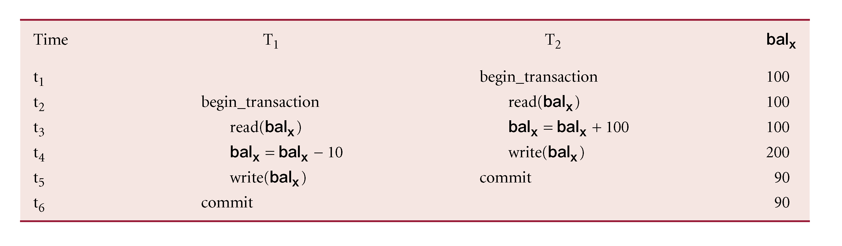
Lost Update Problem
Expected bal_{x} (stored in database) = £100 - £10 + £100 = £190
Actual bal_{x} (stored in database) = £90 (which is wrong!)

Slide 10
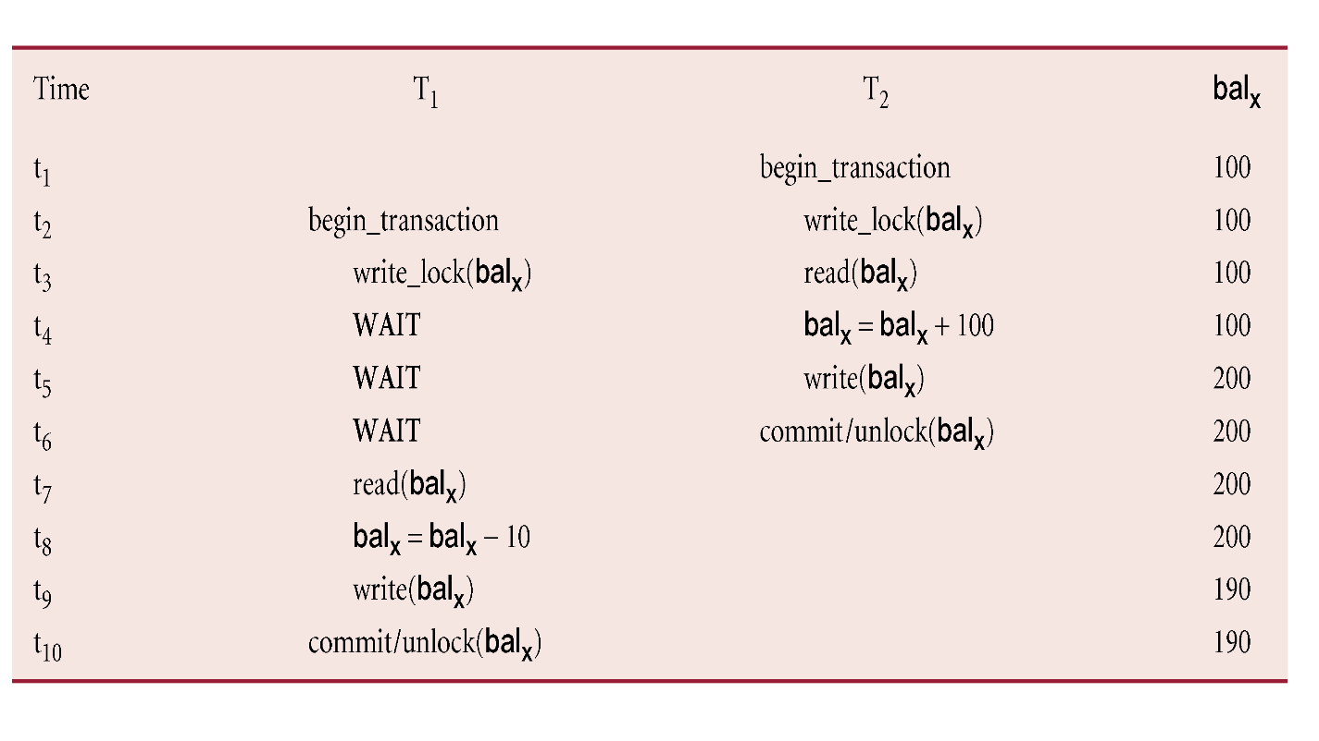
Lost Update Problem (Solution)
Loss of T2’s update avoided by preventing T1 from reading bal_{x} until after update.
More details will be discussed in the latter part.

Slide 11
Uncommitted Dependency Problem
Occurs when one transaction can see intermediate results of another transaction before it has committed.
For example
An account with bal_{x}, initially £100 (i.e., bal_{x} = £100).
T4 depositing £100 (updates bal_{x} to £200) but it aborts
so bal_{x} should be back at original value of £100 (i.e., bal_{x} = £100).
T3 withdrawing £10 but has read new value of balx (£200) before T4 aborts.
T3 uses value as basis of £10 reduction, giving a new balance of £190 (i.e., balx = £200 - £10 = £190)
The correct version should be £90 (i.e., balx = £100 - £10 = £90)
Serially, final balance would be £90.

Slide 12
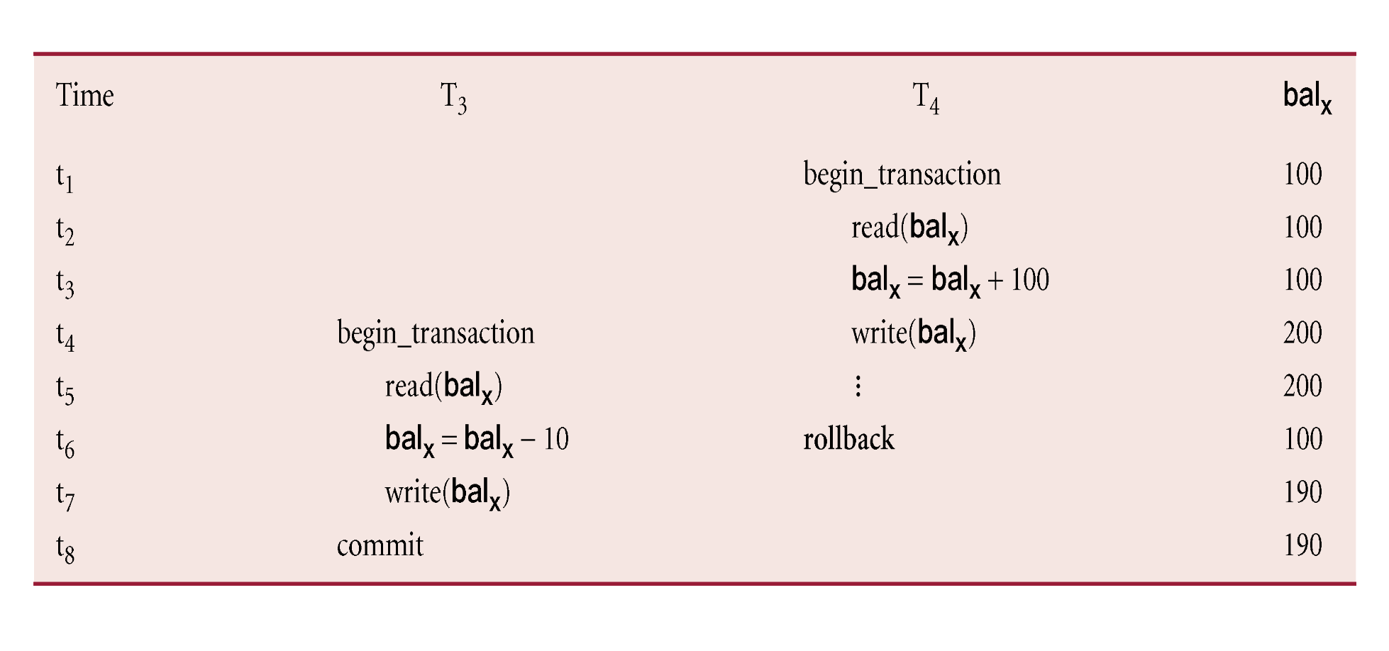
Uncommitted Dependency Problem
Expected bal_{x} (stored in database) = £100 - £10 = £90
Actual bal_{x} (stored in database) = £190 (which is wrong!)

Slide 13
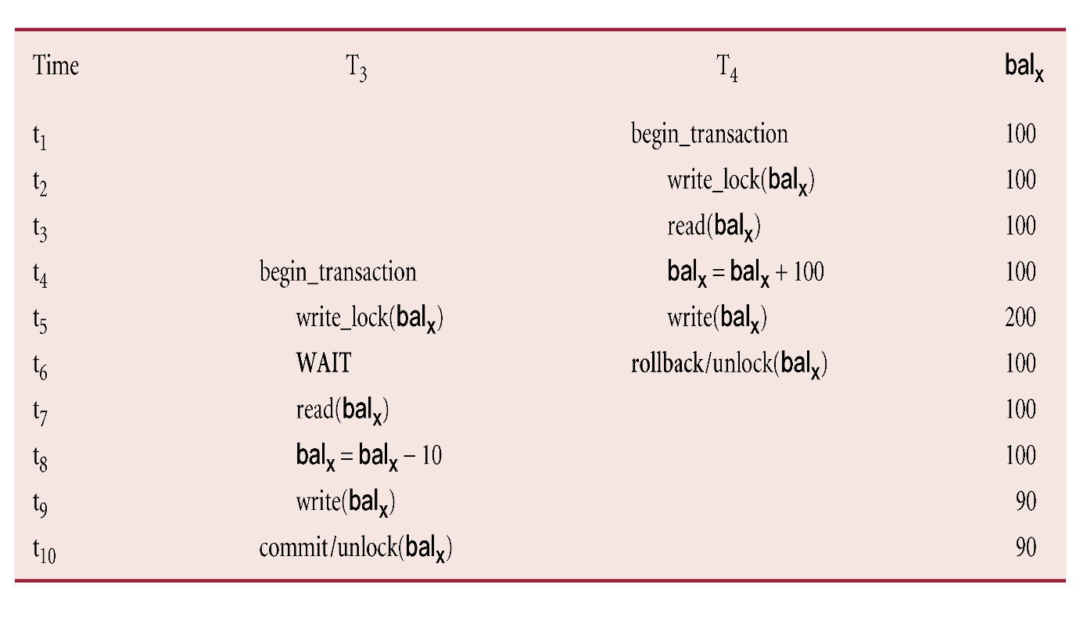
Uncommitted Dependency Problem (Solution)
Problem avoided by preventing T3 from reading bal_{x} until after T4 commits or aborts.
More details will be discussed in the latter part.

Slide 14
Inconsistent Analysis Problem
Occurs when transaction reads several values but second transaction updates some of them during execution of first transaction.
Sometimes referred to as dirty read or unrepeatable read.
For example
T6 is totaling balances of account x (£100), account y (£50), and account z (£25).
The totaling balance is initially £175 (£100 + £50 + £25)
Meantime, T5 has transferred £10 from bal_{x} to bal_{z}
Serially, final balance would be:
bal_{x} (£90), bal_{y} (£50), and bal_{z} (£35)
The totaling balance would also be £175 (£90 + £50 + £35)

Slide 15
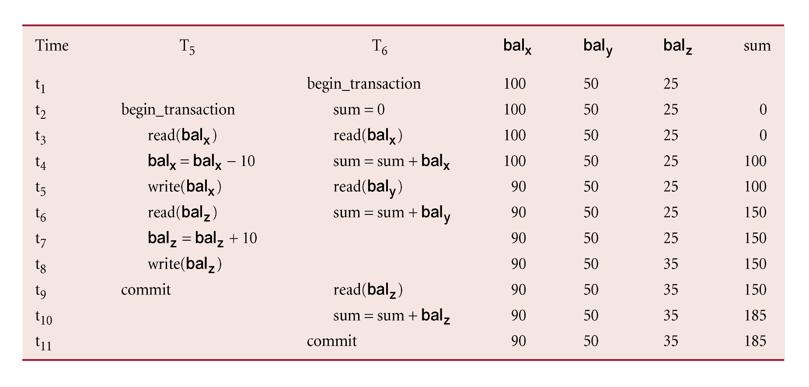
Inconsistent Analysis Problem
Expected totaling balance = £175 (£90 + £50 + £35)
Actual totaling balance = £185 (which is wrong!)

Slide 16
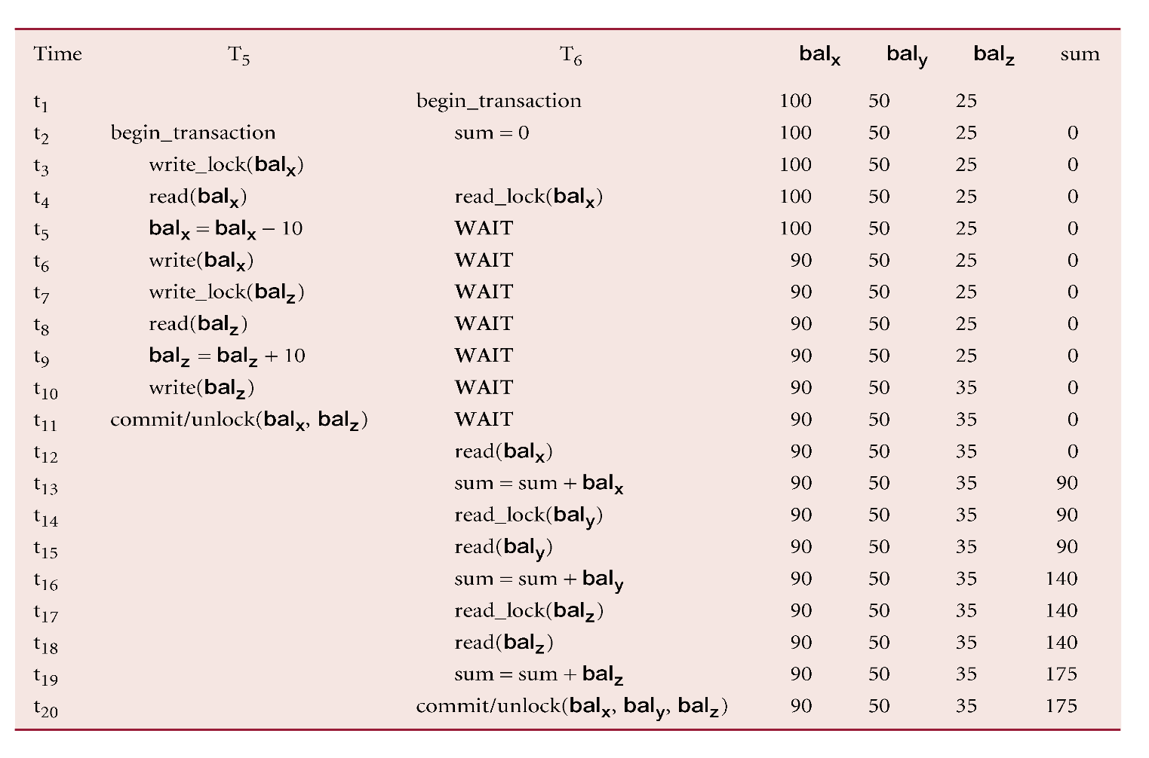
Inconsistent Analysis Problem
Problem avoided by preventing T6 from reading bal_{x} and bal_{z} until after T5 completed updates.

Slide 17
Serializability
Schedule
Sequence of reads/writes by set of concurrent transactions.
Serial Schedule
Schedule where operations of each transaction are executed consecutively without any interleaved operations from other transactions.
Non-serial Schedule
Schedule where operations from set of concurrent transactions are interleaved.
If the non-serial schedule is equivalent to serial schedule, it is conflict serializable. Otherwise, the non-serial schedule is not conflict serializable.

Slide 18
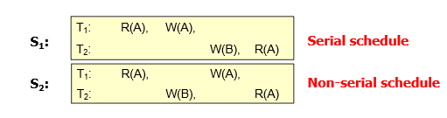
Schedule
A transaction (execution from left to right) consists of Read (R) or Write (W) operations on a variable (i.e. named as A and B)
E.g. T1 : R(A), W(A)
E.g. T2 : W(B), R(A)
Schedule
A sequence of operations from a set of transactions {T1, T2, …, Tn}
For the set of transactions {T1, T2}, several schedules are possible

Slide 19
Summary of Schedule
In summary, the follows shows the tree structure of different schedules:
Serial (no errors)
Conflict serializable
(no errors)
Schedule
Non-serial
Not conflict serializable (may have errors)

Slide 20
Non-conflicting Operations
(a) If two operations only read data items, they do not conflict.
(b) If two operations either read or write different data items, they do not conflict.

Slide 21
Non-conflicting Operations
Schedules with non-conflict operations
No error (execution from left to right)
E.g.
T_{i}: | R(X),
T_{j}: |  | R(X)
T_{i}: | W(X),
T_{j}: |  | R(Y)
T_{i}: | R(X),
T_{j}: |  | W(Y)
T_{i}: | W (X),
T_{j}: |  | W(Y)

Slide 22
Conflicting Operations
Schedules with conflicting operations may have errors
Two operations are conflicting if
They are operations from different transactions on the same data item
At least one of them is a Write operation
E.g.
T_{i}: | W(X),
T_{j}: |  | R(X)
T_{i}: | R(X),
T_{j}: |  | W(X)
T_{i}: | W (X),
T_{j}: |  | W(X)

Slide 23
Precedence Graph
Create a Precedence Graph:
Create a node for each transaction
Search for any conflicting operations as shown in previous page and add an edge for each conflicting pair.
If the precedence graph contains a cycle, it is not conflict serializable.

Slide 24
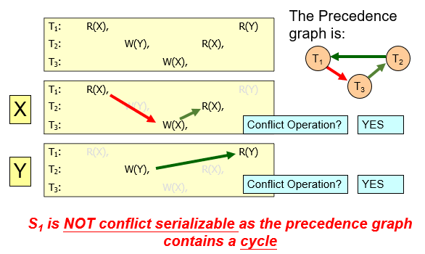
Precedence Graph – Example 1
Consider the schedule S1:

Slide 25
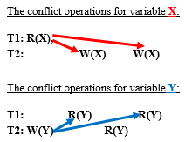

Precedence Graph – Example 2
Consider the schedule (execution sequence from left to right) as:
read(T1, X), write(T2, X), write(T2, X), write(T2, Y), read(T1, Y), read(T2, Y), read(T1, Y)
Consider every combination of Read-Write, Write-Read and Write-Write pairs.
The precedence graph is:
Since the graph contains a Cycle, so the schedule is not conflict serializable

Slide 26
Recoverability
Serializability identifies schedules that maintain database consistency, assuming no transaction fails.
If transaction fails, atomicity requires effects of transaction to be rolled back (undone).
Durability states that once transaction commits, its changes cannot be rolled back.

Slide 27
Recoverable Schedule
A schedule where, for each pair of transactions T_{i} and T_{j}, if T_{j} reads a data item previously written by T_{i}, then the commit operation of T_{i} precedes the commit operation of T_{j}.
For example (execution from left to right)
W_{i}(x), R_{j}(x), C_{i}, C_{j}
Once a transaction T is committed, it should never be necessary to rollback.

Slide 28
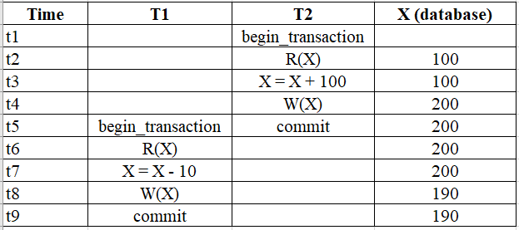
Example 1 – Recoverable Schedule
This schedule is recoverable:
Since W_{i}(x), R_{j}(x), C_{i}, C_{j}
Now, W₂(x), R₁(x), C₂, C₁

Slide 29
NOT Recoverable Schedule
Sometimes a transaction may not execute completely due to a software issue, system crash or hardware failure. In that case, the failed transaction has to be rolled back.
But some other transactions may also have used value produced by the failed transaction. So we also have to roll back those transactions.
However, once a transaction commits, its changes cannot be rolled back.
for example W_{i}(x), R_{j}(x), C_{j}, C_{i}

Slide 30
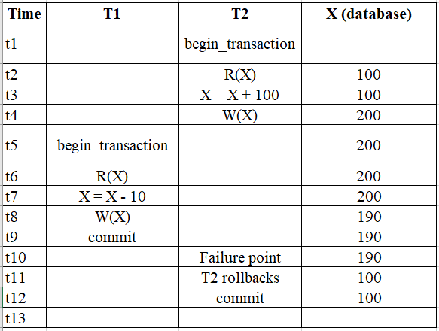
Example 2 – NOT Recoverable Schedule
This schedule is NOT recoverable:
Since W_{i}(x), R_{j}(x), C_{j}, C_{i}
Now, W₂(x), R₁(x), C₁, C₂
This schedule is not recoverable. We have W2(X) → R1(X) and C1 occurs before C2 (indeed, T2 aborts). Since T1 reads a value written by T2, T1 must not commit until T2 commits. When T2 aborts, T1 should also be rolled back (cascading rollback), but T1 has already committed, so recovery is impossible without violating atomicity. Hence, the schedule is not recoverable.

Slide 31
More Examples
S_{a}: r₁(X); r₂(X); w₁(X); r₁(Y); w₂(X); c₂; w₁(Y); c₁
: recoverable (since there is no W_{i}(x), R_{j}(x) pair, no rollback operations)
S_{b}: r₁(X); w₁(X); r₂(X); r₁(Y); w₂(X); c₂; c₁
: not recoverable (T1 should commit before T2, now T2 commits before T1)
S_{c}: r₁(X); w₁(X); r₁(Y); r₂(X); w₂(X); w₁(Y); c₁; c₂
: recoverable (T1 should commit before T2, now satisfied)

Slide 32
Reference
Chapter 22 of Connolly, T and Begg, C, Database Systems: A practical Approach to Design, Implementation, and Management (6th ed.), Boston: Pearson Education.

