Slide 1
Introduction to PHP

Slide 2
Introduction to PHP
Introduction
Syntax
Forms
Exercises

Slide 3
Introduction

Slide 4

Inleiding
PHP: PHP Hypertext Preprocessor
Scripting language => Interpreted
Since PHP5: object oriented
Server side
Open source
Notes:
PHP: recursief acroniem
Niet gecompileerd maar geïnterpreteerd
Vroeger niet OO

Slide 5





Introduction
Notes:
Sites die gebruik maken van php op de server side

Slide 6
Syntax

Slide 7
Syntax
Try examples on:
http://writecodeonline.com/php/
http://ideone.com/

Slide 8
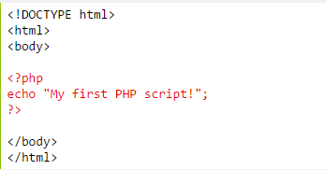
Syntax
Integration into HTML

Slide 9
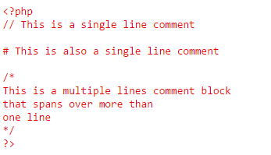
Syntax
Comments

Slide 10


Syntax
Capitals
Functienamen: NIET hoofdlettergevoelig
Variabelen: WEL hoofdlettergevoelig
Doesn’t exist!

Slide 11

Syntax
Variables
Loosely Typed!
Local, global of static
Start with $

Slide 12
Syntax
Global scope
Defined outside a function.
Not visible within a function!
Local scope
Defined within a function.
Only visible within a function!

Slide 13
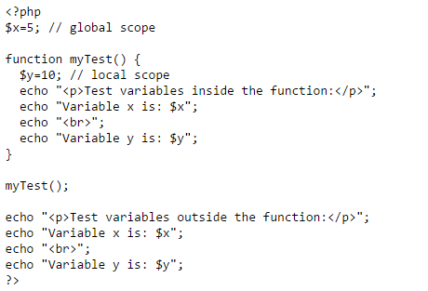
Syntax
Notes:
Vraag aan de lln welke output ze verwachten te zien.

Slide 14
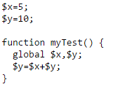
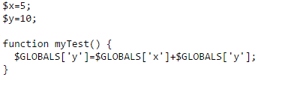
Syntax
Global variables within a function:
Through the global keyword
Through the $GLOBALS array

Slide 15
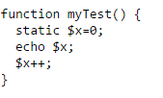
Syntax
Static variables
Through the static keyword.
Retains its value through the whole program execution.

Slide 16
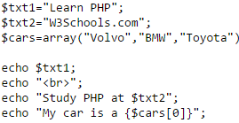
Syntax
echo en print
echo: doesn’t return a value.
print: always returns 1.
echo: can print multiple parameters.
print: prints only one parameter
echo: a little faster then print (negligible)
Can print variables!

Slide 17
Syntax
Datatypes
Loosley typed!!!
Get a variable type with the var_dump() function.
int:
$x = 302;
float:
$x = 10.423;
boolean:
$x = true;
array:
$cars = array(“Volvo”, “BMW”, “Toyota”);
!A variable can be null!

Slide 18
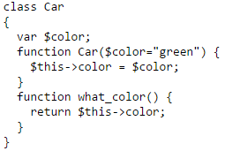
Syntax
Datatypes
Object

Slide 19
Syntax
Constants
Visible everywhere.
Create with the define() function.
Notes:
Parameters: naam, waarde, case-insensitive

Slide 20
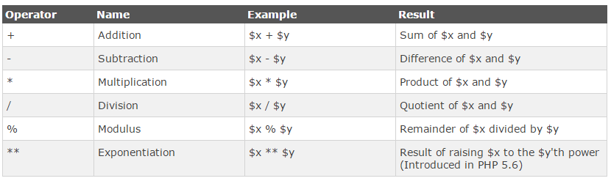
Syntax
Operators
Mathematical
Notes:
Merk op dat php een operator heeft om een macht te nemen

Slide 21
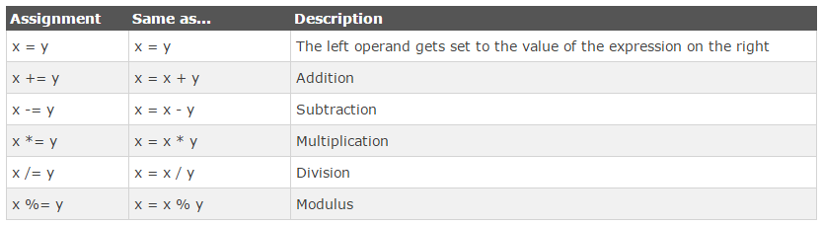
Syntax
Operators
Assignment

Slide 22
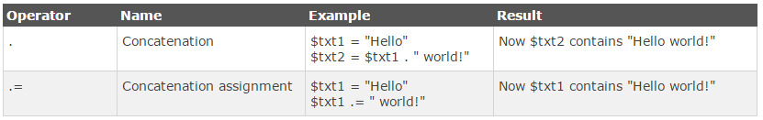
Syntax
Operators
strings

Slide 23
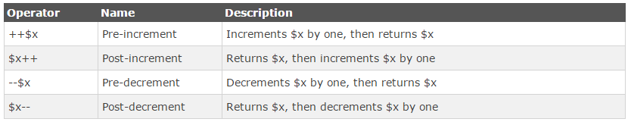
Syntax
Operators
Increment en decrement

Slide 24
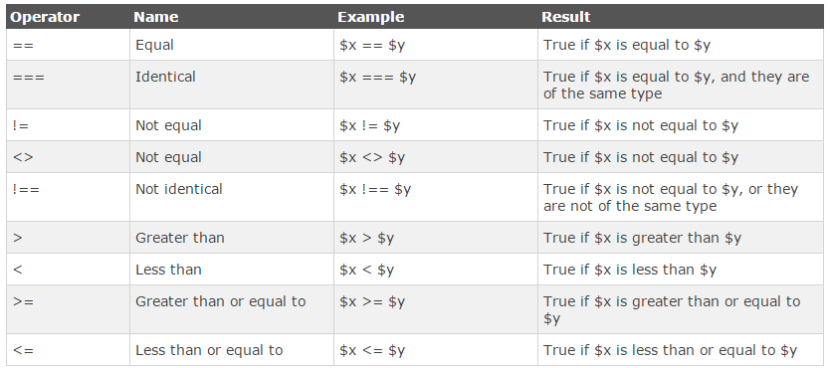
Syntax
Operators
Increment en decrement
Notes:
Merk op er zijn twee manier om op (on)gelijkheid te controleren, demonstreer aan de hand van de volgende code:
$x=100;
$y='100';
if ($x == $y){
echo "gelijk\n";
}else{
echo "niet gelijk\n";
}
if ($x === $y){
echo "gelijk\n";
}else{
echo "niet gelijk\n";
}
if ($x != $y){
echo "niet gelijk\n";
}else{
echo "gelijk\n";
}
if ($x !== $y){
echo "niet gelijk\n";
}else{
echo "gelijk\n";
}

Slide 25
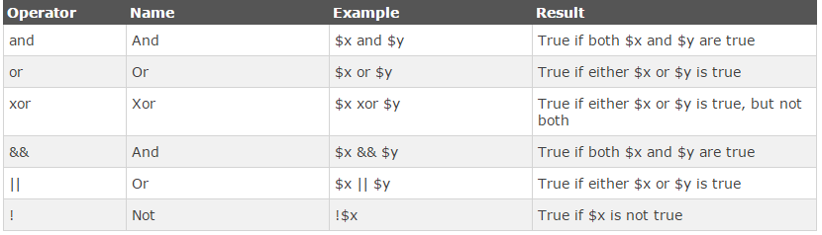
Syntax
Operators
Logical

Slide 26
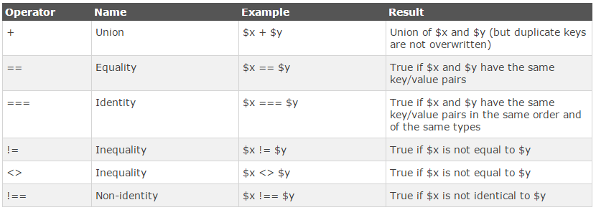
Syntax
Operators
array
Notes:
Op te merken: union, equality en identity operatoren

Slide 27
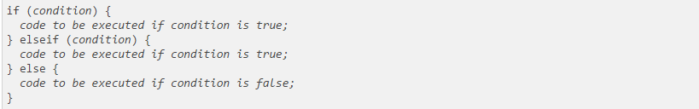
Syntax
Statements
if

Slide 28
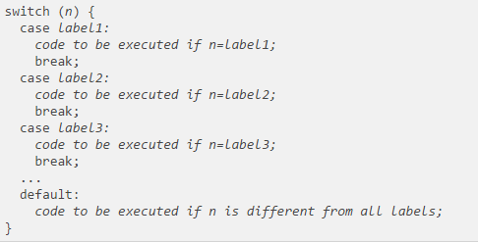
Syntax
Statements
switch

Slide 29


Syntax
loops
While
Do

Slide 30


Syntax
loops
for
foreach

Slide 31


Syntax
functions
!Name not case sensitive!
void

Slide 32


Syntax
functions
!Name not case sensitive!
Default values:
Return value:

Slide 33


Syntax
Arrays
standard
Associative

Slide 34
Syntax
Superglobals
Available everywhere
$GLOBALS: contains all global variables.
$_SERVER: contains server information.
$_REQUEST: contains the submitted form data.
$_POST: contains the form post data.
$_GET: contains the get request querystring data.
$_SESSION: contails all session data.
$_COOKIE: contains different cookie values.

Slide 35
Forms

Slide 36
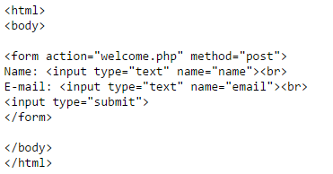
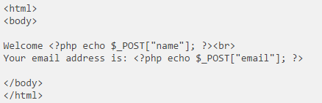
Forms
Handle POST
welcome.php

Slide 37
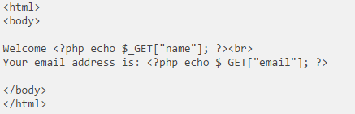
Forms
Handle POST
welcome.php

Slide 38
Forms
GET of POST?
GET: Maximum 2000 characters.
GET: Information visible in the url.
POST: No limit.
POST: Information in the request body => not visible.

Slide 39
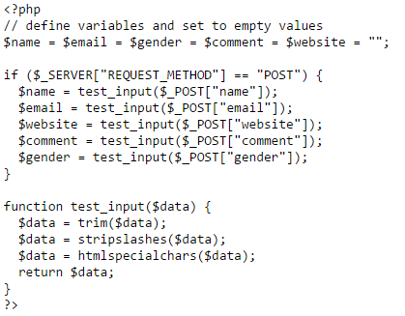
Forms
Validate input

Slide 40


Formulieren
Validate input
Required
regex

Slide 41
oefeningen

Slide 42
Oefeningen
If you have an AMP stack on your computer you can write your code in NetBeans or Brackets and put it in your www folder.
Otherwise you can use an online editor.

Slide 43
Oefeningen
Exercise 1
Create a php program which writes the squares of the numbers form one to hundred to a page.
Exercise 2
Create a PHP program that prints out a deck of cards in random order. Use strings of the following format to represent the cards: ‘K Hearts’ (for the king of hearts).
Exercise 3
Write a bubble sort algorithm in PHP.
Exercise 4
Go to https://www.codecademy.com/courses/web-beginner-en-StaFQ/0/1?curriculum_id=5124ef4c78d510dd89003eb8 and complete the php exercises.

