Slide 1
New York Airbnb
Tom Tran

Slide 2
Conceptualization
Potential Airbnb guests to visit New York from cost effective listings.
Solution: Using data analysis to identify best value options.
Data Visualization Strategy: Map of New York with Airbnb listings by price and location, and a bar chart of the average Airbnb prices by borough.

Slide 3
Dataset identification
https://www.kaggle.com/datasets/dgomonov/new-york-city-airbnb-open-data?rvi=1
Detailed Airbnb listing data of New York in 2019.
Columns providing information about the hosts, geolocations, prices, and etc.
id | name | host_id | host_name | neighbourhood_group | neighbourhood | latitude | longitude | room_type | price | minimum_nights | number_of_reviews | last_review | reviews_per_month | calculated_host_listings_count | availability_365

Slide 4
Data procurement and verification
Spatial Visualization (neighbourhood_group, neighbourhood, latitude, longitude, and price): No duplicates, consistent data types, no null values. Latitude and longitude are accurate for mapping.
Non Spatial Visualization (neighbourhood_group, price): No duplicates, consistent data types, no null values.

Slide 5
Data transformation and storage
Transformation techniques
Normalize price values for accurate color scaling.
Remove outliers for statistical analysis.
Aggregation functions for both visualizations.
Storage
MySQL

Slide 6
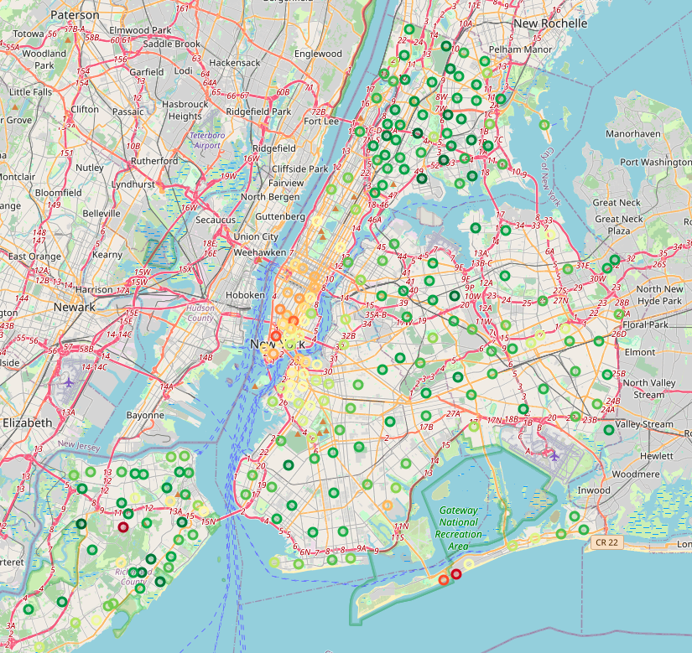
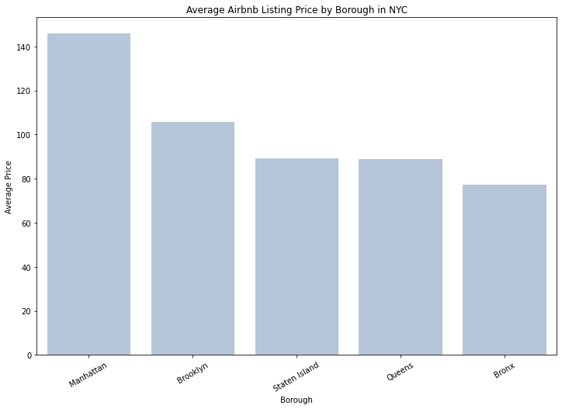
Data visualization

