Slide 1
Final Presentation
SLAM for FSTD
Students: Tom Norman
Supervisor: Vadim Indelman
Context: Project A
Semester: Spring, 2019

Slide 2
Project Goal
Create basic and robust SLAM system which detects cones in the environment.

Slide 3
Background
In previous project camera-based and LIDAR-based SLAM were tested and the conclusion was stereo-camera-based solution called SERVO.¹
SERVO uses modified stereo-ORB-SLAM (an open source SLAM package) with ROVIO (an open source Localization package).
For cones detection YOLO (an open source classification CNN) was chosen.¹

Slide 4
Chosen Solution
We chose to implement the most basic system first and then upgrade:
  cone_slam: Monocular ORB-SLAM + YOLO
  cone_slam2: SERVO + YOLO
  Those phases were chosen because we needed to demonstrate an autonomous driving at EcoMotion (11.7.19) and this was the fastest way to understand ORB-SLAM and implement.

Slide 5
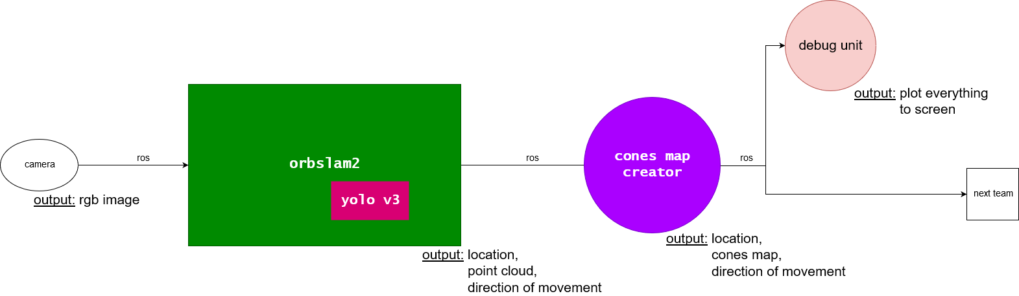
cone_slam

Slide 6
The pipeline
Step 1: Acquire image
Step 2: SLAM + Classification
Step 3: Clustering
Communication between steps: ROS (Robot Operating System)
Debug unit

Slide 7
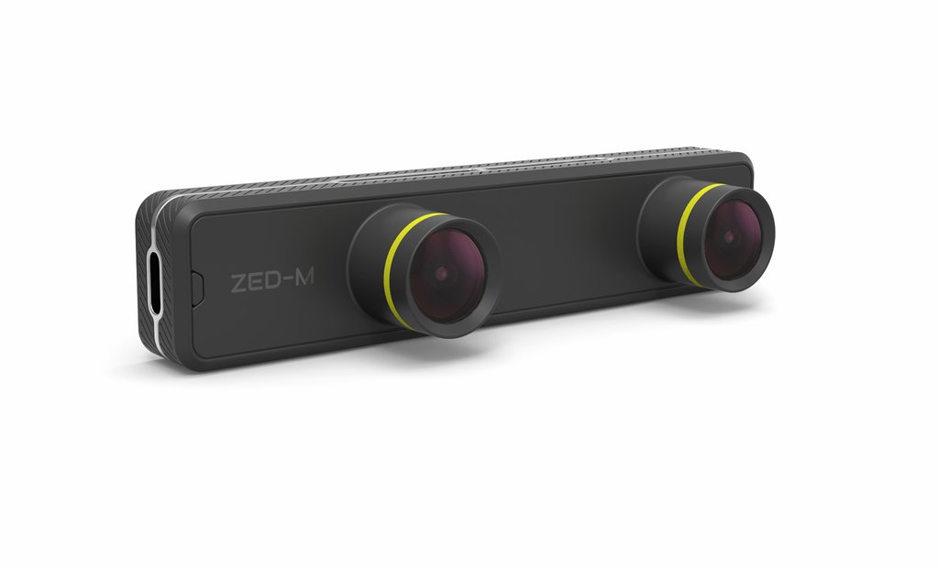
Step 1:
Acquire image
We used ZED Mini
  Has ROS wrapper
  Was available until the demo from GIP in CS

Slide 8
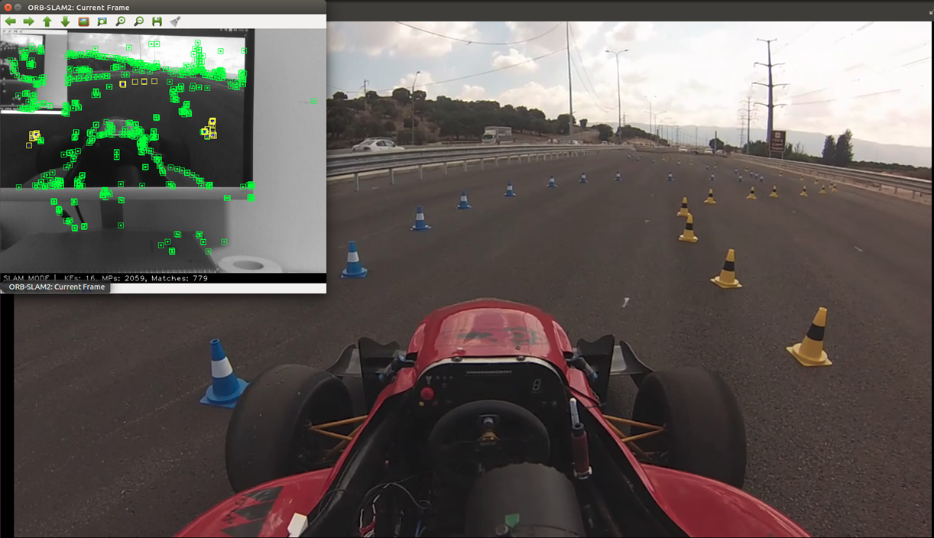
Step 2:
SLAM + Classification
SLAM solution: ORB-SLAM2
Classification solution: YOLO

Slide 9
SLAM- Simultaneous Localization And Mapping
Generate a map of the environment while finding current location in it.
Visual SLAM– using cameras instead of lasers to find the 3D coordinates of ‘interesting’ points in an image.
Monocular SLAM– using one camera (unlike stereo). Its scale independent, meaning the algorithm only gives ratios of distance, but faster than other methods.
With time there is error accumulation; solution is Loop Closing.
Loop Closing – deciding that current location was already visited and changing the map accordingly.

Slide 10
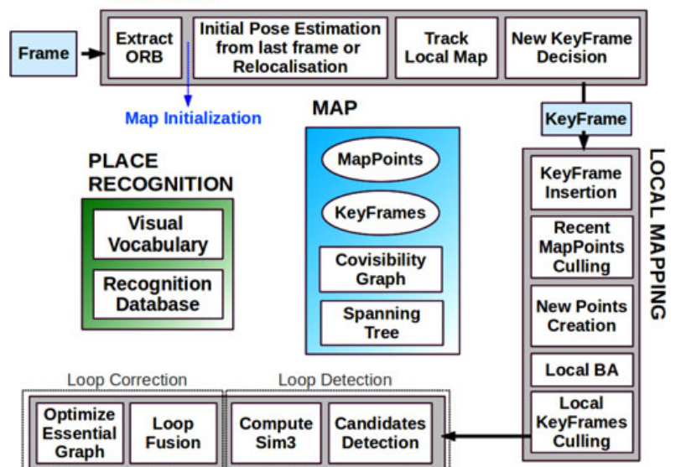
ORB-SLAM
The system works with 3 threads, each responsible with different task: Tracking, Mapping, Loop Closing.
The system is designed for real-time SLAM:
  only ‘interesting’ frames ,which will be called keyframes, are processed.
  uses ORB features which are very fast to compute.
  deciding where to put a new keyframe in the map is made by looking only on neighbor keyframes.
Loop Closing is made on global scale which make ORB-SLAM work in large scenes.

Slide 11
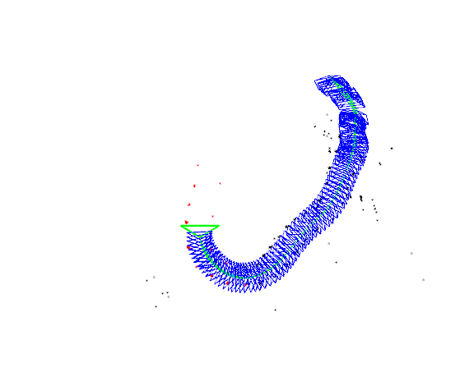
Tracking
Projects the map into the current image and searches for correspondences between ‘interesting’ points in the image and map points.
To make it fast it projects only a ‘local map’- only map points that appear also in neighbor keyframes.
Estimates the neighbor keyframes with constant velocity model from the last keyframe.

Slide 12
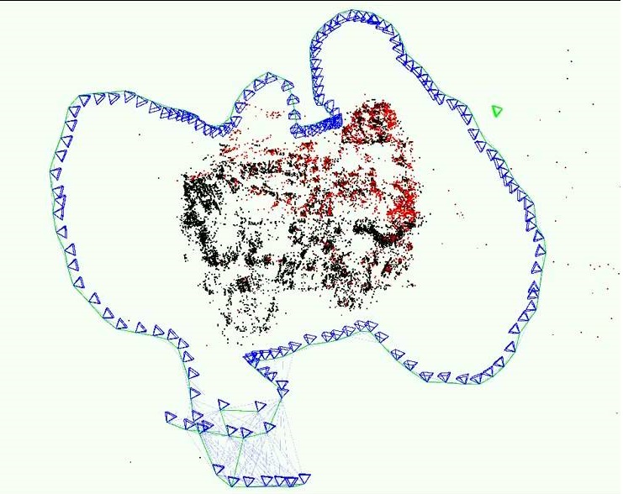
Local Mapping
Optimizes the actual location of the current keyframe using a method called Bundle Adjustments, using estimated neighbor keyframes.
Calculate bag of words for the new keyframe – a way to lower the dimensionality of a frame, will help later with Loop Closing.
Add new map points to the map from new keyframes.
Removes redundant keyframes and map points, for better scalabilty.

Slide 13
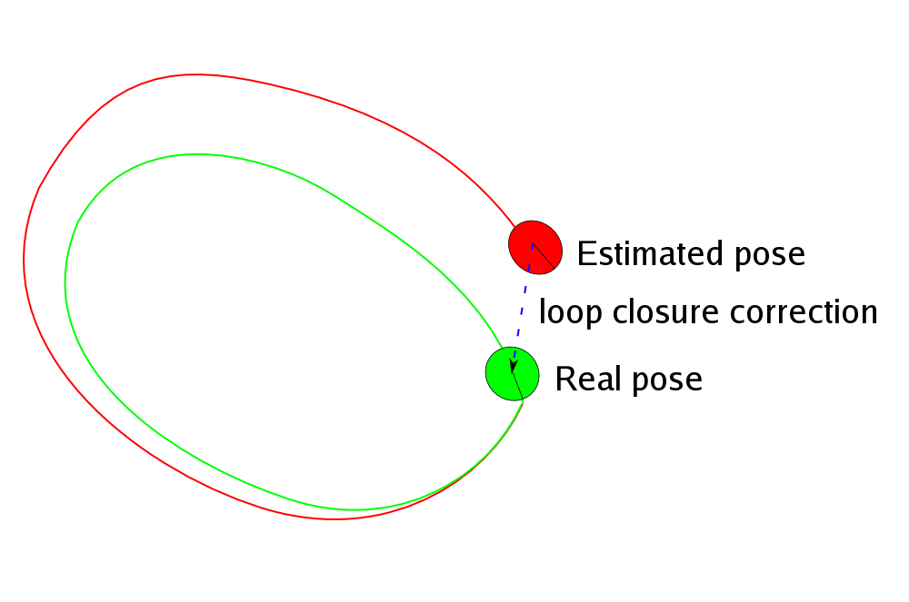
Loop Closing
With every new keyframe a comparison of bag of words with every other keyframe is made to decide of a loop closure had happened.
Closes a loop if 3 connected keyframes is a loop closure candidates and transformation matrix exists (using RANSAC).
The loop closes while the other threads continue to work.

Slide 14

Classification
We have 2 types of certifies cones: Blue and Yellow.
Decide if a set of pixels is Blue cone, Yellow cone or none.
We will use YOLO (You Only Look Once) which is a CNN (Convolutional Neural Network) that classify in real time.

Slide 15
CNN
Uses cross-correlation and not convolution.
Cross-correlates filters with image, the output is then inserted to neurons that apply some activation function (point wise). At every layer we make the output smaller (with pooling or bigger filter sizes) until the last layer has the size of the number of classes to classify, in our case 2, then classify the image as the max of the output of the last layers’ neurons.

Slide 16
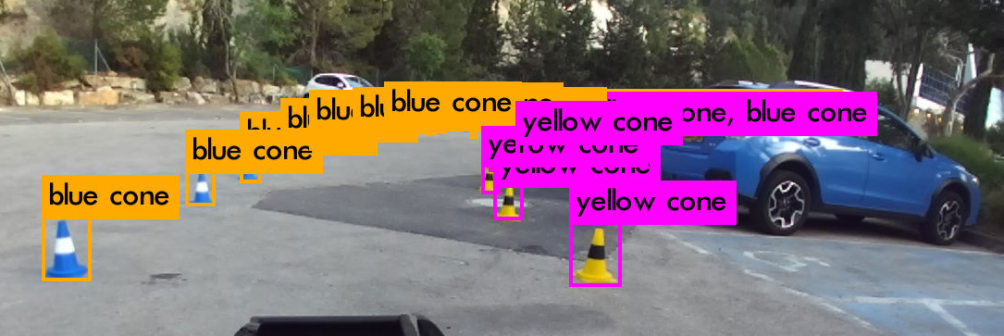
YOLO
Creates a grid from the image, unlike other classification networks which search for possible object regions first, then classify each cell.
Trained on 1300 images which was hand labeled by the formula team.

Slide 17
The Combination
For every image the ORB-SLAM gets, run YOLO to get tuples of <bounding box, class>.
For each tuple <bounding box, class> classify all ORB features in bounding box as class.
When Local Mapping creates new map point- if has class then classify map point as class.
Now we have a point cloud of unknown number cones.

Slide 18
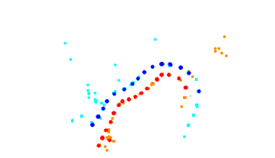
Step 3:
Clustering
Clustering solution: DBSCAN

Slide 19
Clustering
The cones will be 3 meters apart (competition rules).
Given set of 3d points (point cloud) find clusters that represent single cones.
We will use DBSCAN (Density-Based Spatial Clustering of Applications with Noise) which needs only 2 parameters and designed for spatial clustering- exactly our problem.

Slide 20
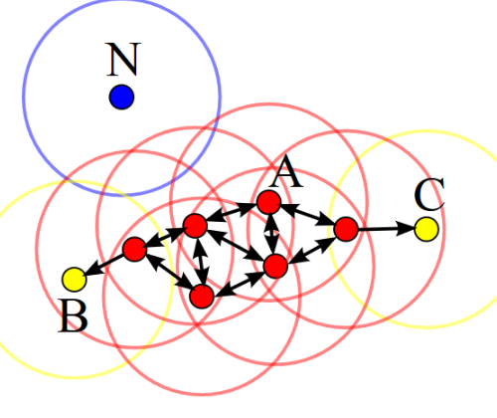
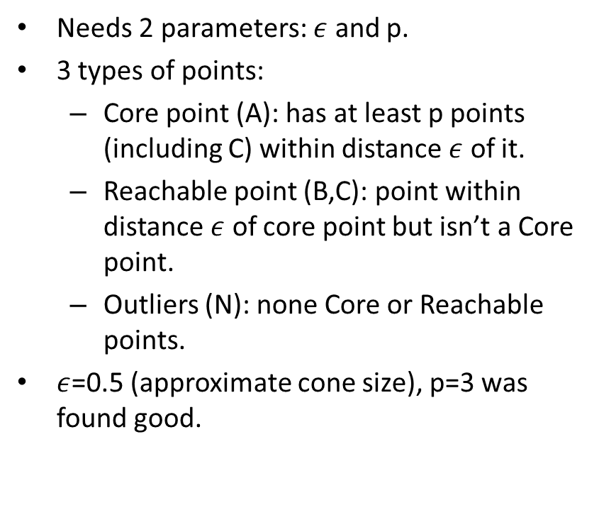
DBSCAN
Needs 2 parameters: $ε$ and p.
3 types of points:
  Core point (A): has at least p points (including C) within distance $ε$ of it.
  Reachable point (B,C): point within distance $ε$ of core point but isn’t a Core point.
  Outliers (N): none Core or Reachable points.
$ε$=0.5 (approximate cone size), p=3 was found good.

Slide 21
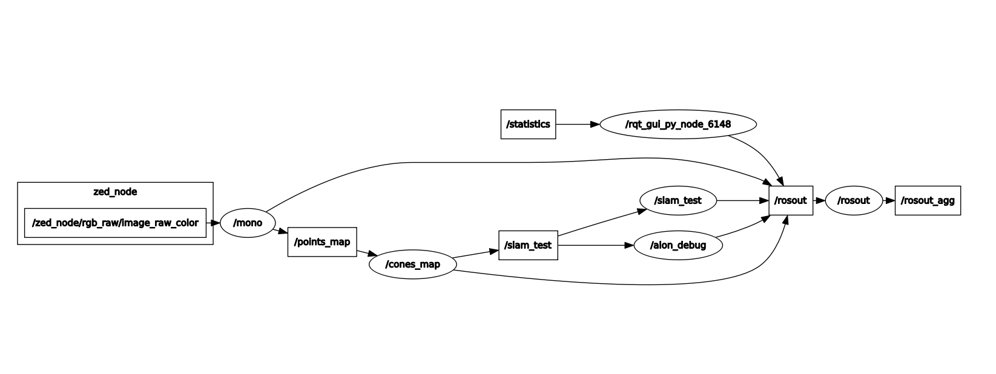
Communication
Communication solution: ROS

Slide 22
Communication
Every step of the system works independently, we need something to move data between them.
We also need a modular system for adding more advanced algorithms in the future.
We will use ROS (Robot Operating System).

Slide 23
ROS
Publisher-Subscriber: uses topics that one can publish or subscribe to.
In cone_slam the ZED camera publishes to /zed_node/…/ which the ORB-SLAM subscribed to. ORB-SLAM publishes to /points_map which cones_map subscribed to, etc.
Almost all cameras has ROS wrapper.
Has powerful debugging tools: rviz, rqt, community made tools.
Works with python and C++.

Slide 24
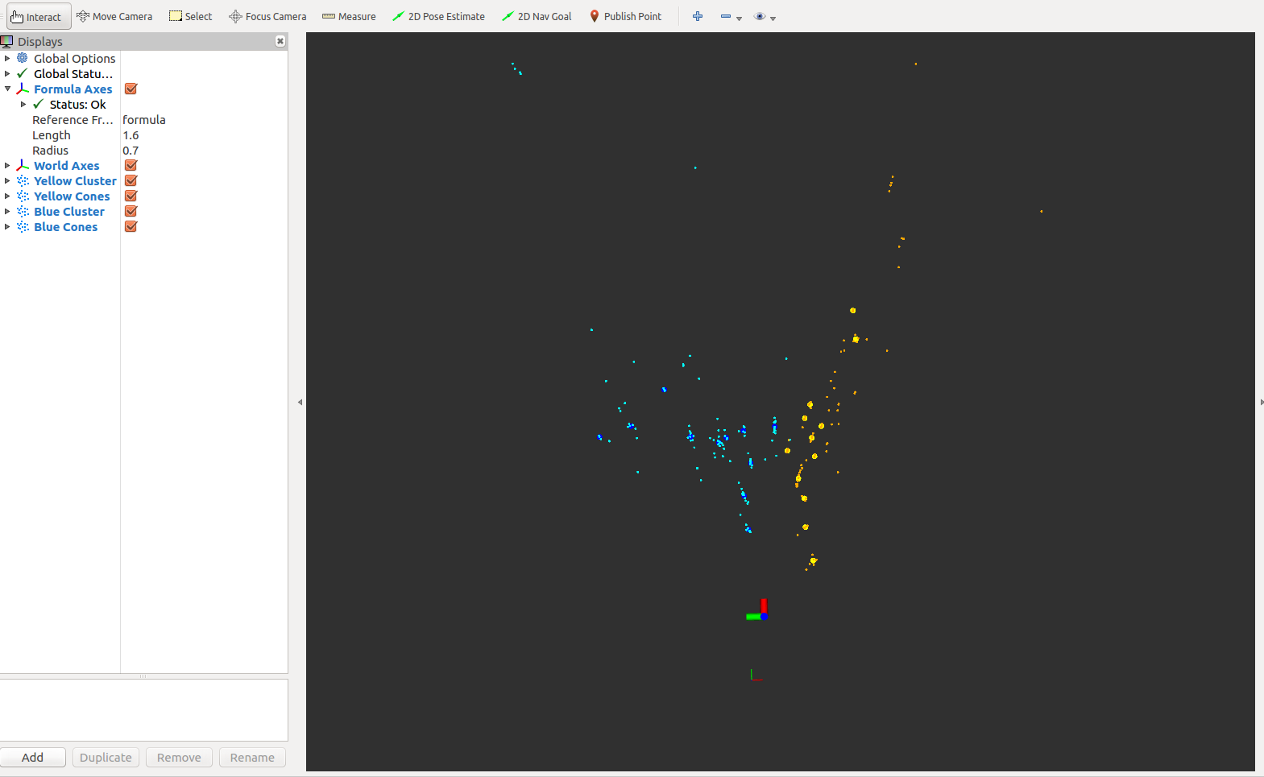
Debug unit
Visualization: RViz

Slide 25
Debug unit
Rviz is a powerful tool to visualize what is happening in the ros system – what each node publishes.
We created custom debug msg that contains:
  Blue and Yellow points cluster
  Blue and Yellow cones
  Formula’s yaw and position

Slide 26
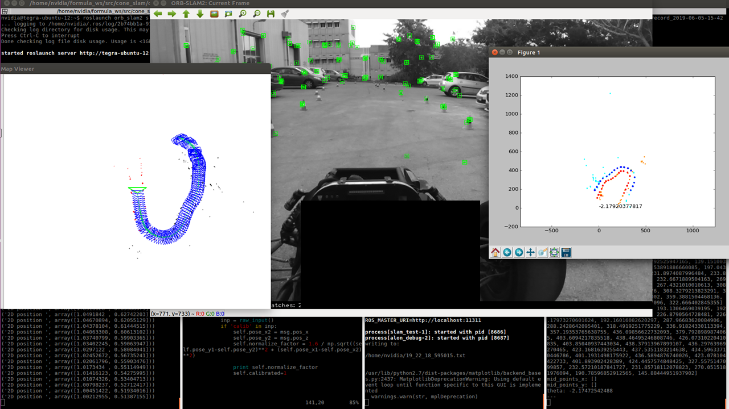
Results

Slide 27
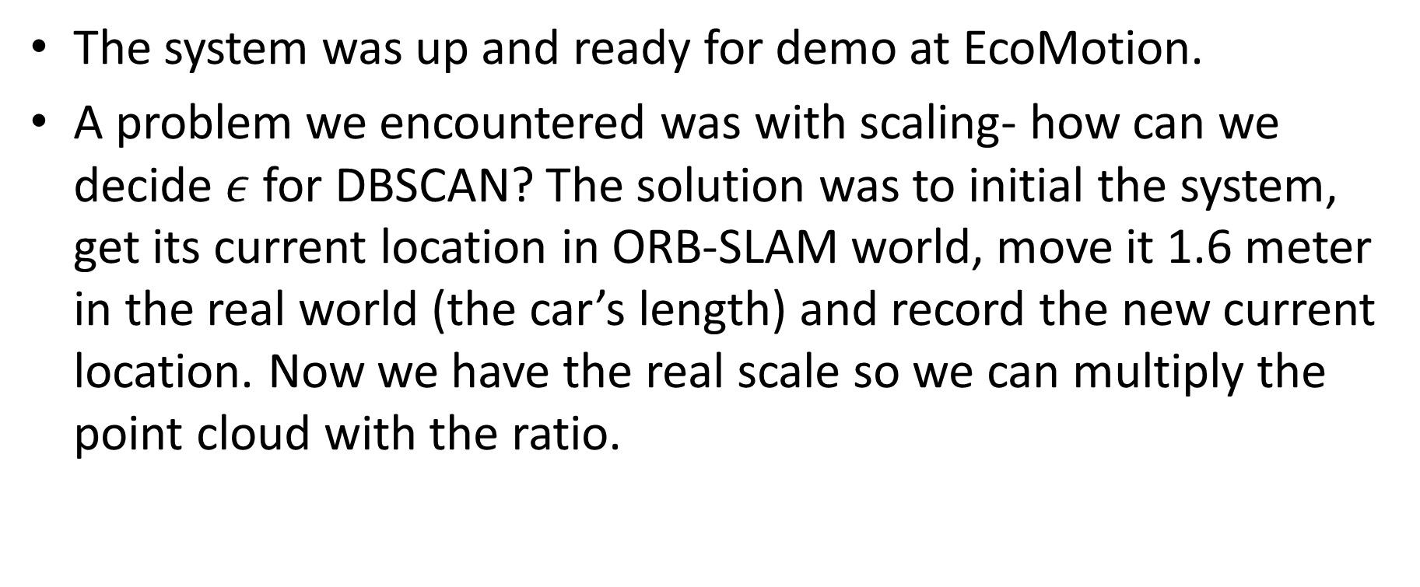
The system was up and ready for demo at EcoMotion.
A problem we encountered was with scaling- how can we decide $ε$ for DBSCAN? The solution was to initial the system, get its current location in ORB-SLAM world, move it 1.6 meter in the real world (the car’s length) and record the new current location. Now we have the real scale so we can multiply the point cloud with the ratio.

Slide 28
Problems
cone_slam isn’t giving location fast enough, so top speed is 4 km/h. Probably because of the computer we used (Jetson TX2).
Initialization of ORB-SLAM takes a lot of time; stereo will fix it.
Possible problem: there isn’t a guarantee to get ORB features on cones. For now we haven’t had a problem with it, but it is a possibility.

Slide 29
Future
SERVO – ORB-SLAM + ROVIO
Implemented but not tested, needs better computer than Jetson TX2.

Slide 30
Conclusions
The only way to understand someone else’s code is to dive in. Start from the input and hopefully you will get to the output.
Documentation is important.
Open-source is amazing.

Slide 31
References
https://github.com/raulmur/ORB_SLAM2
https://github.com/aslyansky-m/FSTD_SLAM
https://github.com/tomnorman/cone_slam

Slide 32
I would like to thank to GIP for the RealSense camera and VISL for the Jetson and ZED camera

