Slide 1



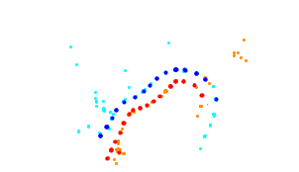
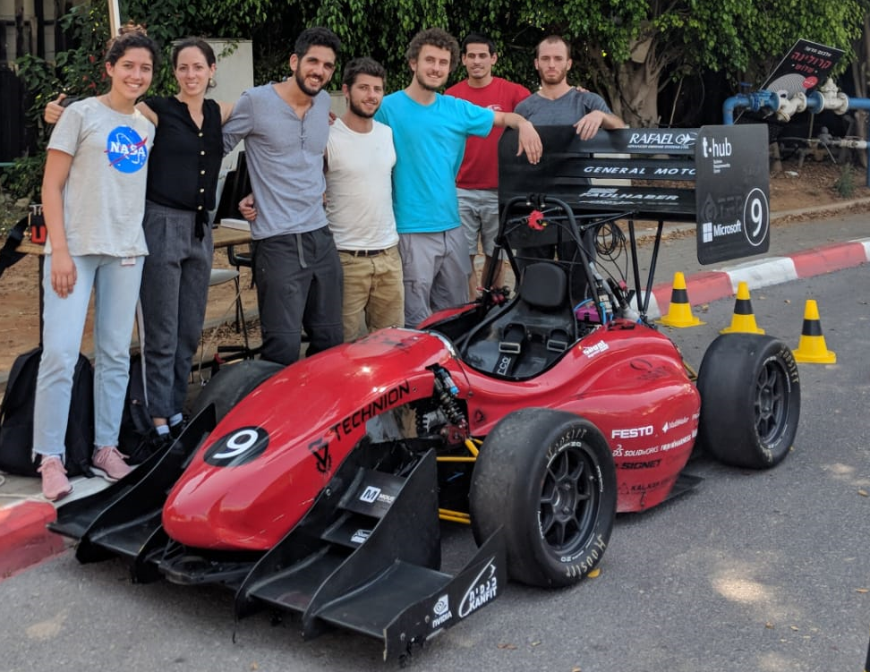
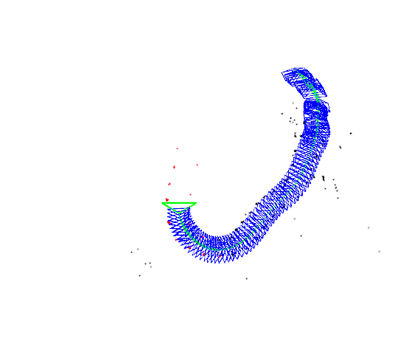
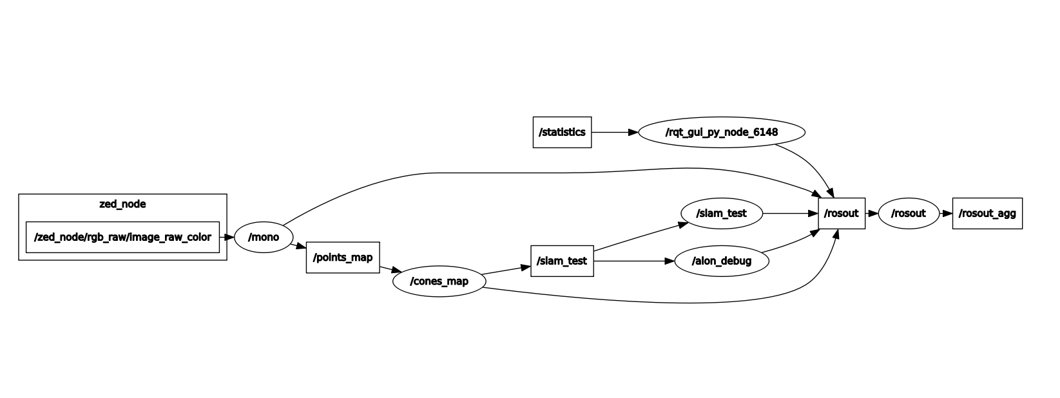
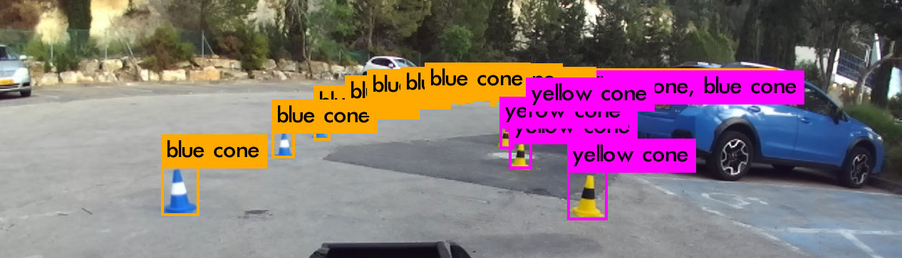
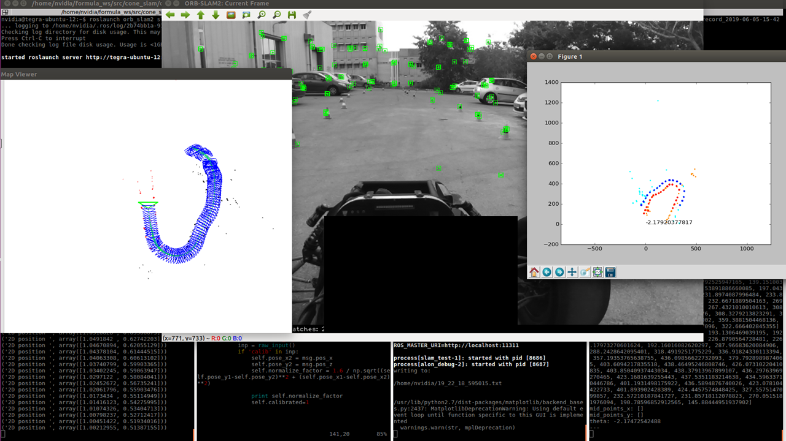
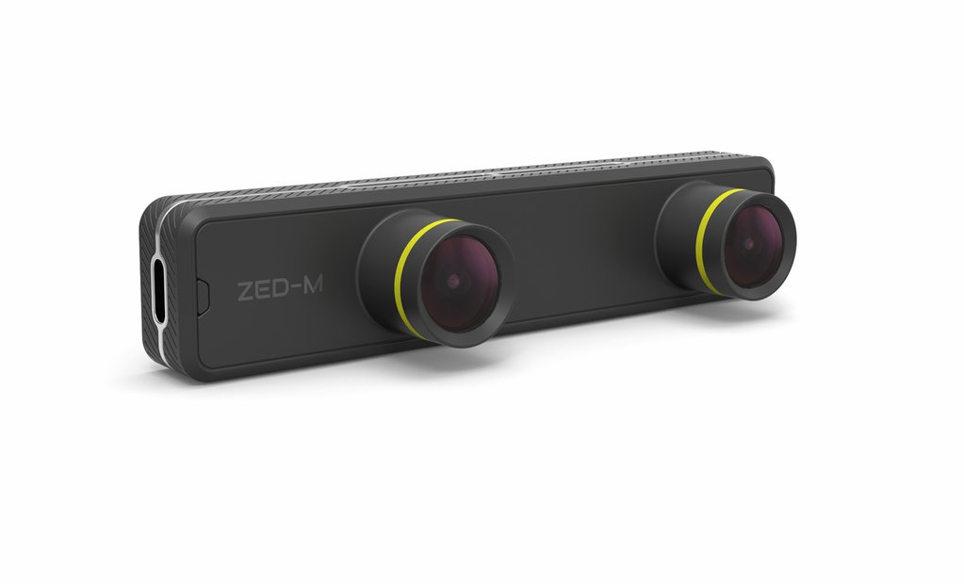
^{cone_slam}
SLAM for Driverless Formula
Tom Norman, Supervised by Vadim Indelman
Introduction
ORB-SLAM
DBSCAN
Formula Student Germany 2020 will accept only driverless cars
A simple modular autonomous system is needed
  Localization and mapping
  Route planning
  Control
Visual SLAM
Input- Image
Output- Location
Open source and well established
Works with monocular and stereo
Works well on big scenarios
Spatial clustering
Input- Point cloud
Output- Clusters
DBSCAN output on real scenario
ROS
    Modular system to transfer data between programs
    Has sophisticated visualization tools (good for debugging)
    Open source
Goals
ORB-SLAM output on real scenario
Localize the car in a track consisting of cones using camera only
Send location and map to route planning
Present a demo of a working system at EcoMotion 2019
YOLO
Real time classification CNN
Input- Image
Output- bounding boxes and classes
Training data- 1300 hand labeled images of cones
cone_slam nodes and topics
Challenges
Results
ORB-SLAM is a general system that can't track specific objects
Needs to train the CNN with labeled data
Time restriction (for EcoMotion demo)
The demo was a success- the car tracked the cones and planned a route between them
Stereo capabilities were added
Camera
YOLO output
Implementation
Mapping and Localization:
  When creating frame in ORB-SLAM:
    Get bounding boxes and corresponding classes (blue or yellow cone) from YOLO
    Classify all ORB features in bounding box as corresponding class
  When creating map point in ORB-SLAM:
    If made of blue or yellow ORB feature- classify as such
  Send the point cloud created for clustering
Clustering:
  Run DBSCAN on received point cloud to get a map of cones
  Send given map forward for route planning
cone_slam in action
Conclusions
ZED Mini
  Stereo and Monocular options
  Has ROS wrapper
  Cheap
Open source is amazing- cone_slam wouldn’t be possible in such a time scale without it
For the race in 2020 more advanced system is needed- several sensors fusion, maybe add lidar based slam as backup
September 2019

