Slide 1

Redshift to Databricks syntax translation
What does the translation script do?
What is the SQLGlot?
How does the SQLGlot work?
How to translate the SQL dialects.

Slide 2

What does the translation script do?
Script to translate the SQL dialects by the SQLGlot.
Implements the SQLGlot package.
Customize the outcome to assure the compatibility.

Slide 3

What is the SQLGlot?
SQLGlot is a no-dependency SQL parser, transpiler, optimizer, and engine.
It can be used to format SQL or translate between 20 different dialects like Redshift and Databricks.

Slide 4
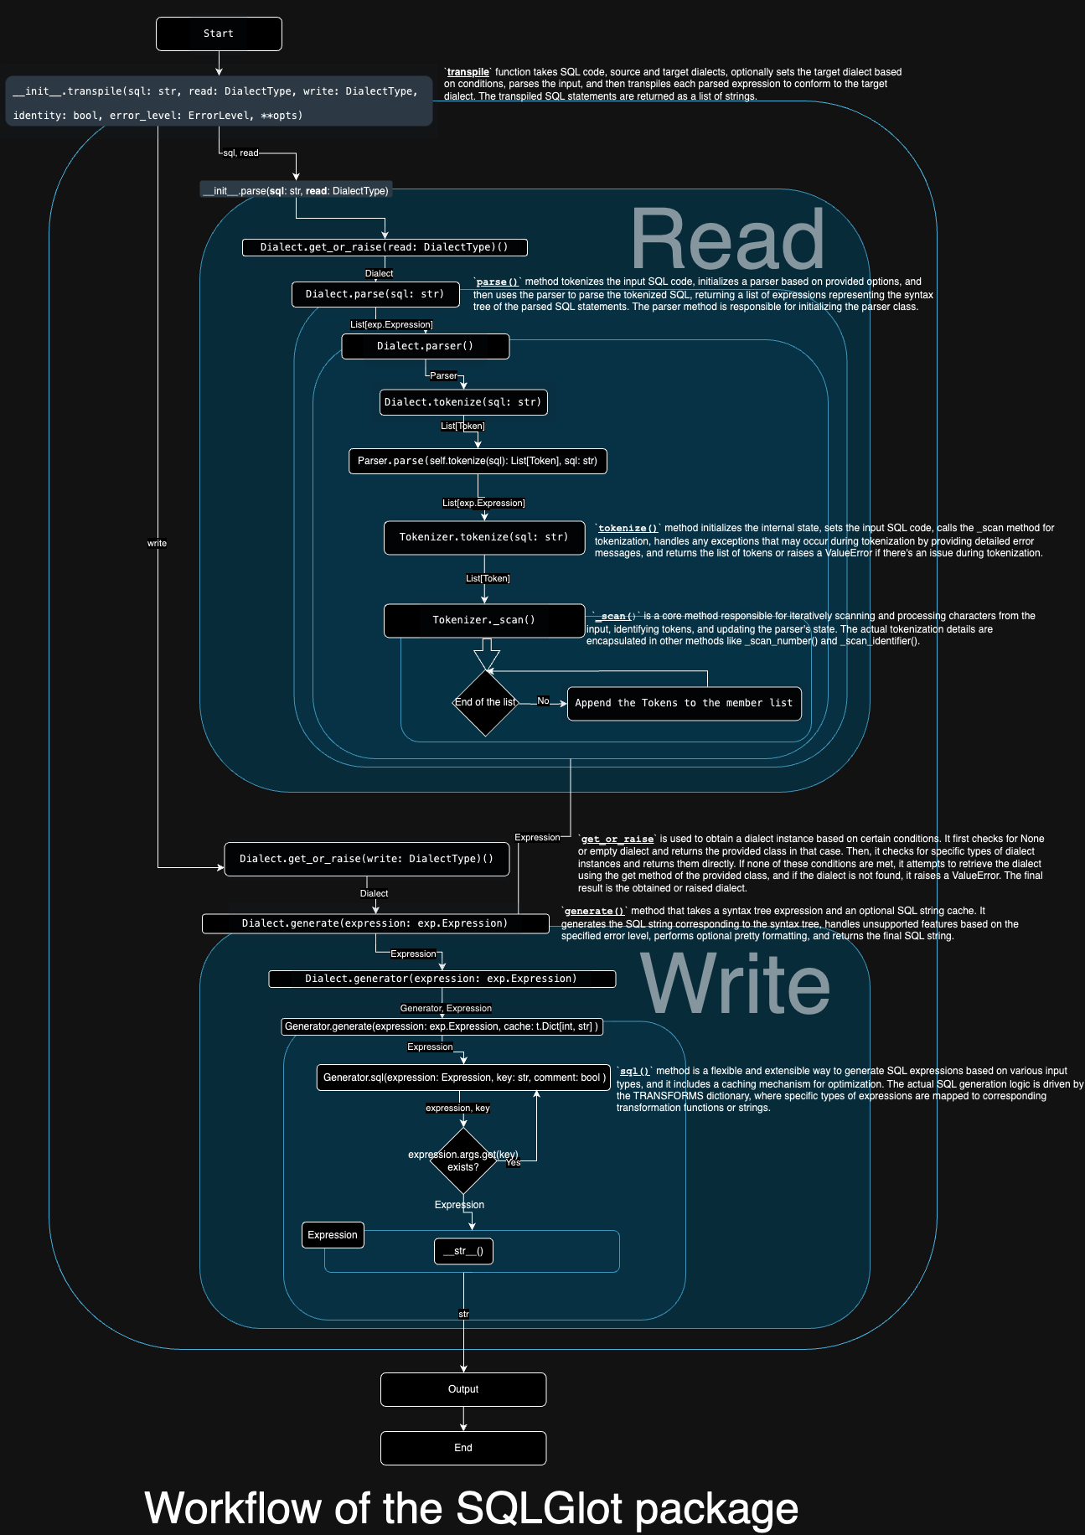
How does the SQLGlot work?
The `Read` and `Write` consist the broad outline of the architecture.
`Read` interprets the original input SQL syntax.
`Write` generates the translation results as an output.
There are no configuration file. Only some parameters for the `generator()` method.

Slide 5

How to translate the SQL dialects?
Simply specify the input SQL filename.
python translate.py Redshift_DDL_3_Tables.sql

