Slide 1
RGB Camera
Front
Pose Estimation
(MediaPipe Pose)
↓
3D Skeleton
Training Analysis
• Form evaluation
• Joint angle
• Back posture
• Bar trajectory
• Repetition counting
• Exercise speed
• Range of motion
• Fatigue estimation
MR Visualization
・Ideal skeleton
・Warning
・Exercise statistics
・Voice guidance
RGB Camera
Right
User
(MR Headset)
RGB Camera
Left
Input
Processing
Output
Ideal Form
Database
Real-time
feedback

Slide 2
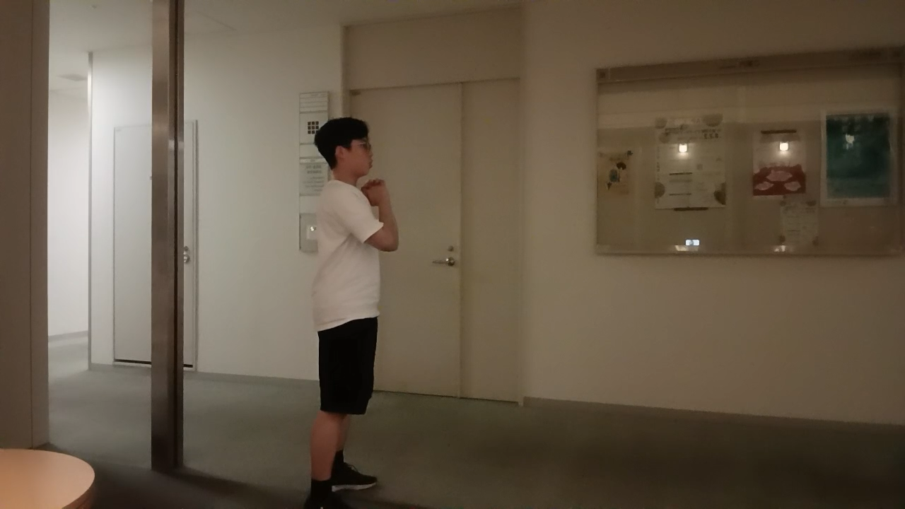
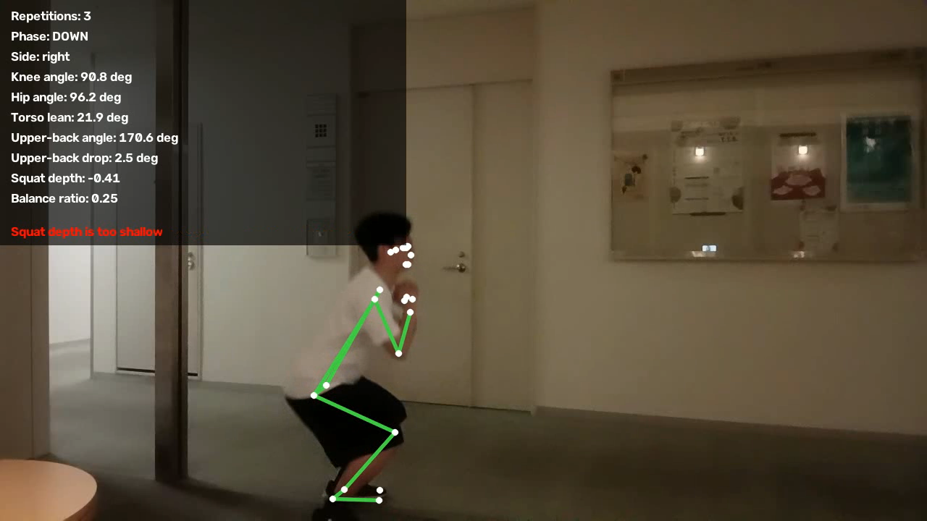
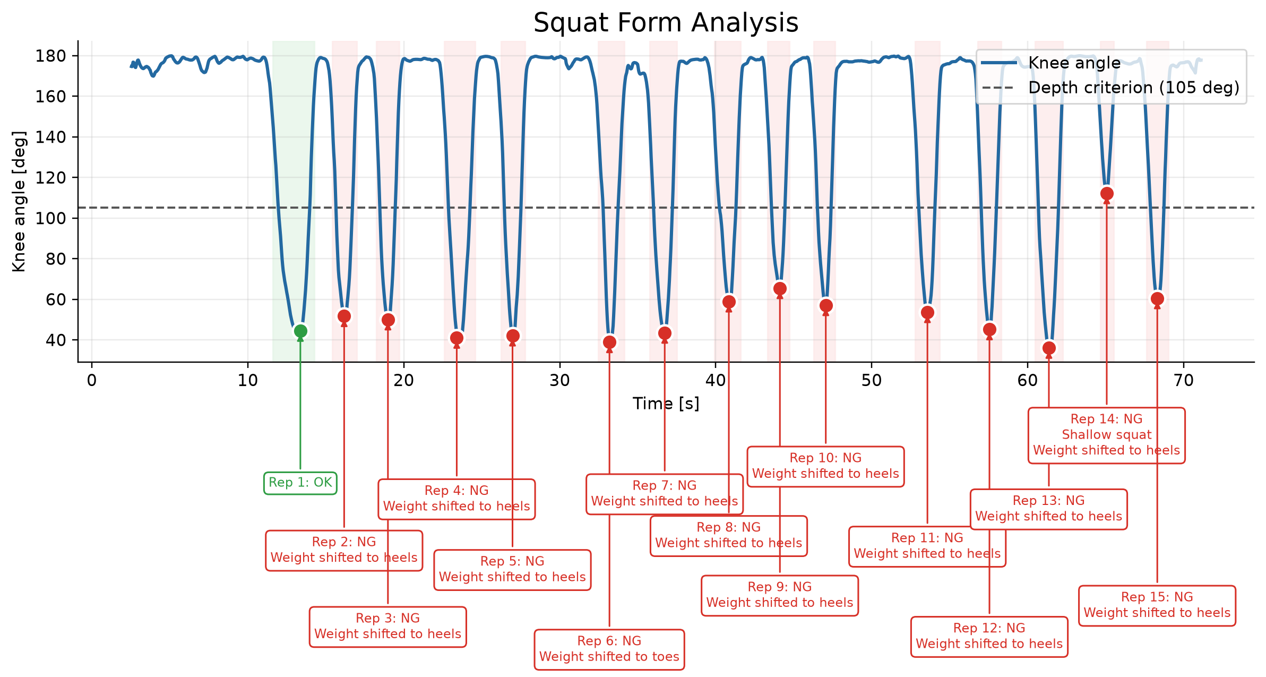
Input
Processing (Estimate & Evaluate)
Output

