Slide 1
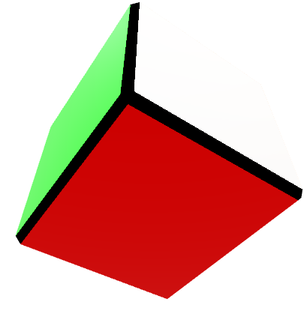
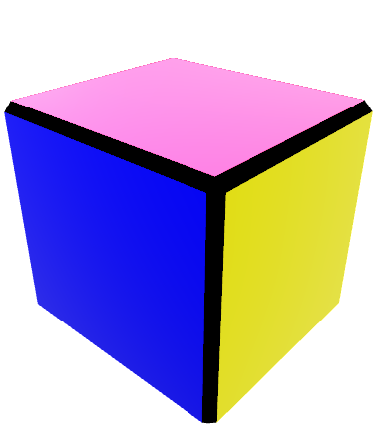
+Y
-Z
-Y
+X
+Z
-X
-Z
-X
+Y
+Y
+Y
+X
+Z
-X
-Z
+X
+Z
-X
-Z
+X
+Z
-Y
-Y
-Y

Slide 2
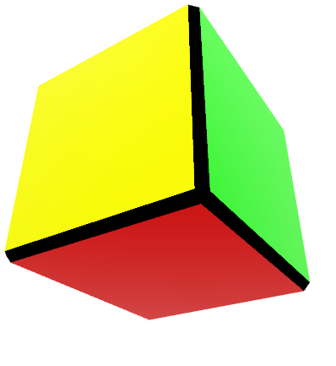
Rotate around X axis
+Y
+Y
X, -90
+X
+X
+Z
+Z
-Z
-Z
+Y
+Y
+X
+Z
-X
+X
+Z
-X
-Y
-Y

Slide 3
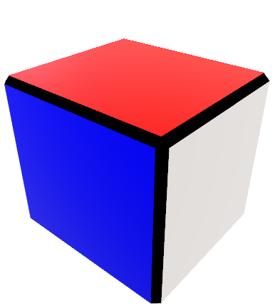
Rotate around Y axis
+Y
+Y
Y, +90
+X
+X
+Z
+Z
+Y
+Y
+X
+Z
-X
-Z
+X
+Z
-X
-Z
-Y
-Y

Slide 4
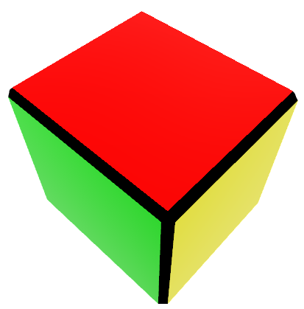
Rotate around Z axis
+Y
+Y
Z, +90
+X
+X
+Z
+Z
-X
-X
+Y
+Y
-Z
+X
+Z
-Z
+X
+Z
-Y
-Y

Slide 5
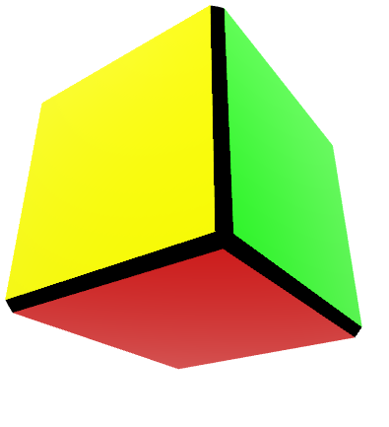
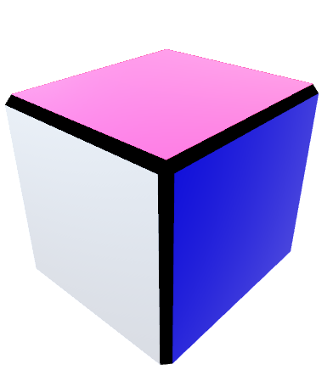
(ind1, ind2)=(0,1)
+Y
(ind1, ind2)=(1,2)
+Y
+X
+X
-X
+Z
-Z
-Y
+Z
(1,2)
[0,0]
+Y
[2,2]
+X
+Z
-X
-Z
[2,0]
[0,0]
-Y
[2,2]
Look 0
Look 3

