Slide 1




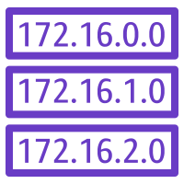


HTTP
Internet Gateway
VPC
(10.0.0.0/16)
Subnet (10.0.0.0/24)
Route Table
Destination | Target
10.0.0.0/16 | Local
0.0.0.0/0 | Igw-xxxxx
Web Server
Instane

