Slide 1




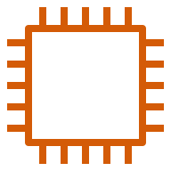

VPC1(10.0.0.0/16)
Firewall subnet
Public subnet
Private subnet
Network across VPCs only between private subnets

