Slide 1
EXCEED X/Y-axes cal
2017/1/18 Ver.0.0 F. Tsuchiya
2017/6/19 Ver.1.0 F. Tsuchiya

Slide 2
Download and install
Cal table (for x and y axes)
http://pparc.gp.tohoku.ac.jp/~tsuchiya/HISAKI/cal/cal_table.zip
Download cal_table.zip and extract it on your PC (ex. C:\HISAKI\).
execute a command below before using “cal tools”. IDL> defsysv, '!exc_cal_dir‘, ‘C:\HISAKI\cal_table\’
Cal table (for z axis)
https://www.darts.isas.jaxa.jp/pub/hisaki/euv/cal/
IDL Cal tool
http://pparc.gp.tohoku.ac.jp/~tsuchiya/HISAKI/cal/cal_tool.zip
Download cal_tool.zip and extract it somewhere on your PC
Set IDL path to “cal_tool”
SPICE (for Jupiter)
Install SPICE ICY (for IDL)
Download SPICE kernels for the Jovian system and Earth
From the NAIF web site or below (735MB !) http://pparc.gp.tohoku.ac.jp/~tsuchiya/HISAKI/spice_kernels.zip

Slide 3
How to use HISAKI CAL table (for Jupiter) (1/2)
Load spice kernels (!SPICE_DIR below is a SPICE kernel directory) IDL> cspice_furnsh, !SPICE_DIR+'lsk\naif0010.tls' IDL> cspice_furnsh, !SPICE_DIR+'spk\de421.bsp‘ IDL> cspice_furnsh, !SPICE_DIR+'spk\jup230l.bsp‘ IDL> cspice_furnsh, !SPICE_DIR+'spk\sat365.bsp‘ IDL> cspice_furnsh, !SPICE_DIR+'pck\pck00010.txt'
Initialize (read) CAL table for x(wavelength) and y(spatial) axes IDL> exc_cal_init
Read CAL table for z-axis (brightness) IDL> fits_read, ‘calib_20140101_v1.0.fits’, zcal, hd, exten_no=3
Read EXCEED image from L2 file IDL> file = ‘exeuv.jupiter.mod.03.20140101.lv.02.vr.00.fits’ IDL> fits_read, file, im, hd, exten_no=0 IDL> n=fxpar(hd ,'NEXTEND') IDL> fits_read, file, im_ucal, hd, exten_no=1

Slide 4
How to use HISAKI CAL table (for Jupiter) (2/2)
Use calibration table IDL> im_cal1 = im_ucal / float(n) * zcal ;[count]->[Rayleigh/A] IDL> jd_in = julday(1,1,2014) IDL> exc_cal_img, jd_in, im_cal1, im_cal2, xcal, ycal, /ipt, ycal_j=ycal_j
Im_cal2 : calibrated image
xcal : calibrated x-axis [A]
ycal : calibrated y-axis [arcsec]. y=0 is center of Jupiter
ycal_j : calibrated y-axis [RJ]. y=0 is center of Jupiter

Slide 5
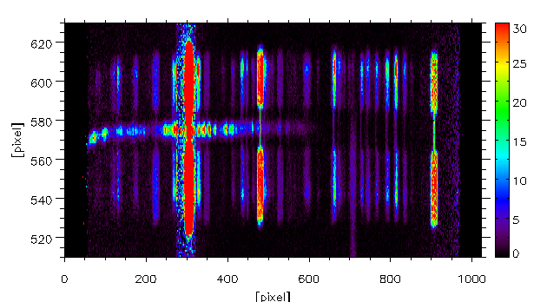
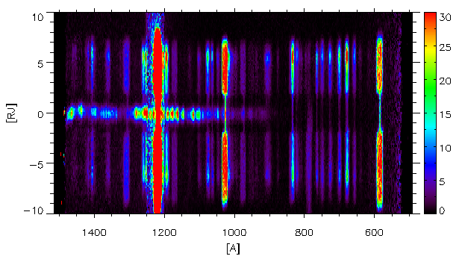
t3dplot,findgen(1024), finｄgen(1024), im_cal1, yr=[510,630], zr=[0,30]
Uncalibrated image
t3dplot,xcal, ycal_j, im_cal2,yr=[-10,10],zr=[0,30]
Calibrated image

Slide 6
MISC
How to install SPICE
http://pparc.gp.tohoku.ac.jp/~tsuchiya/HISAKI/HISAKI_L2_Basic_v1_2.pdf (Pages 6 and 7)
Report on Cal-table (Japanese)
https://www.dropbox.com/s/n0umn4va4swnr9y/20161115_%E5%9C%9F%E5%B1%8B_EXC-L2%E6%A0%A1%E6%AD%A3_V2.pdf?dl=0

Slide 7
MEMO
defsysv, '!SPICE_DIR', 'C:\Data\SPICE\kernel\'
dlm_register, 'C:\Data\SPICE\icy\lib\icy.dlm'
init_spice
defsysv, '!EXC_EUV_DIR', 'C:\data\hisaki\euv\'
defsysv, '!exc_cal_dir', 'C:\Doc\HISAKI\cal_table\’
exc_cal_init
read_exeuv_cal, xcalo, ycalo, zcalo
file = !EXC_EUV_DIR+‘l2\exeuv.jupiter.mod.03.20140101.lv.02.vr.00.fits'
fits_read, file, im, hd, exten_no=0
n=fxpar(hd ,'NEXTEND') fits_read, file, im_ucal, hd, exten_no=1
im_cal1 = im_ucal / float(n) * zcalo
jd_in = julday(1,1,2014)
exc_cal_img, jd_in, im_cal1, im_cal2, xcal, ycal, /ipt, ycal_j=ycal_j
t3dplot,xcal,ycal_j,im_cal2,yr=[-10,10],zr=[0,100]

