Slide 1
DAI
Tomas Ondrejka

Slide 2
Analysis

Slide 6
Visualizations

Slide 7
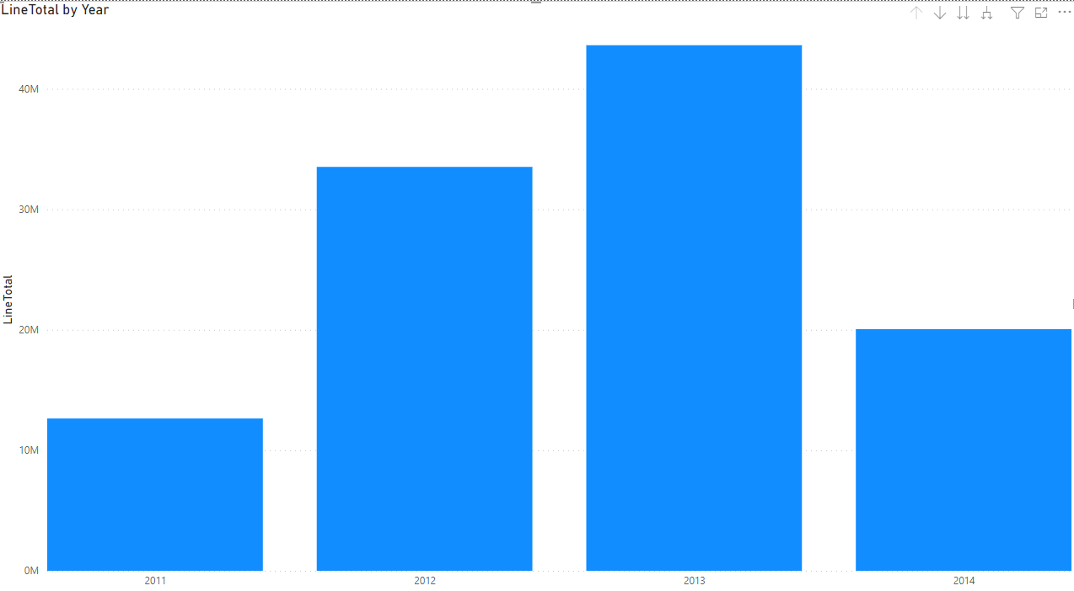
Profitability throughout the year with Seasons

Slide 8
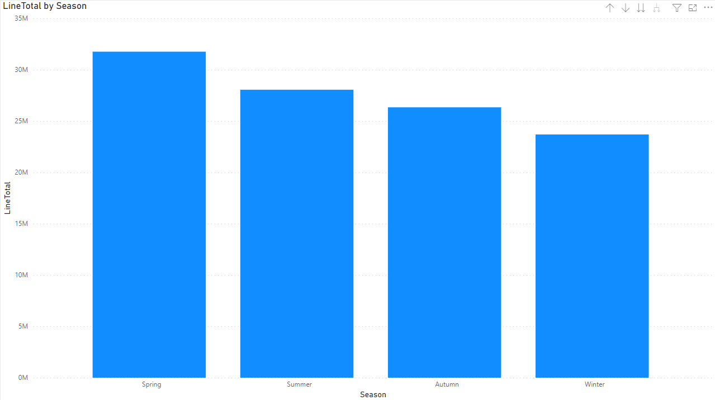
Profitability throughout the year with Seasons

Slide 9
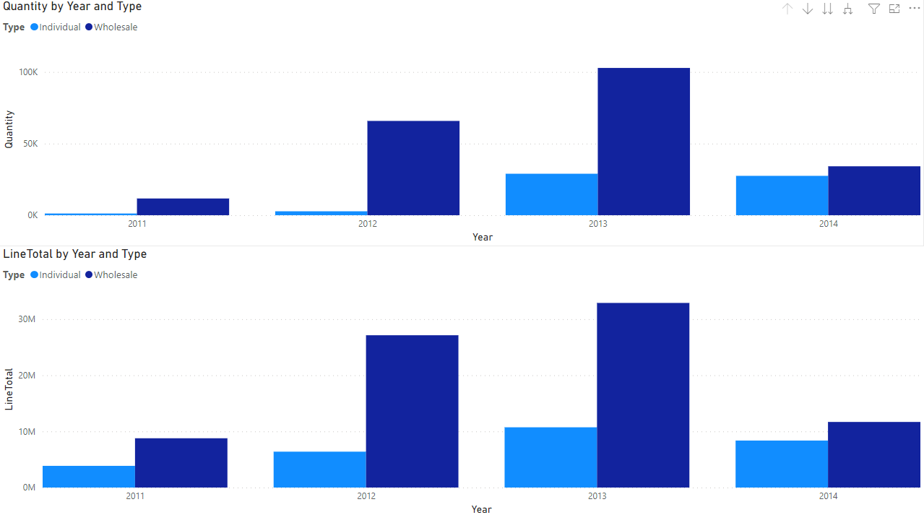
Difference between Individuals and Wholesale Customers

Slide 10
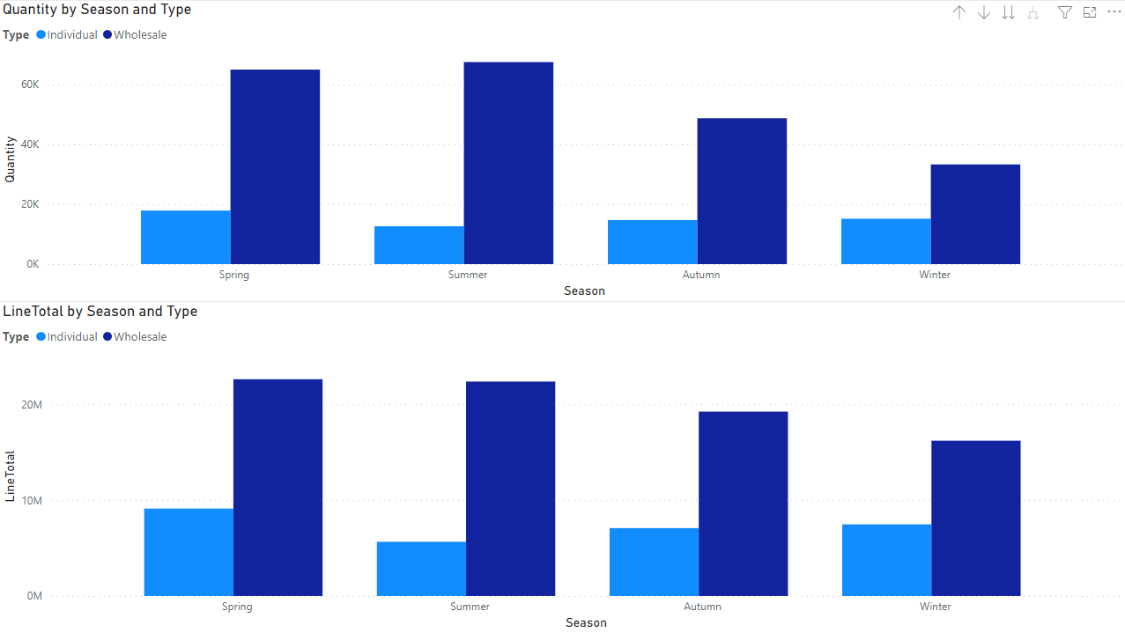
Difference between Individuals and Wholesale Customers

Slide 11
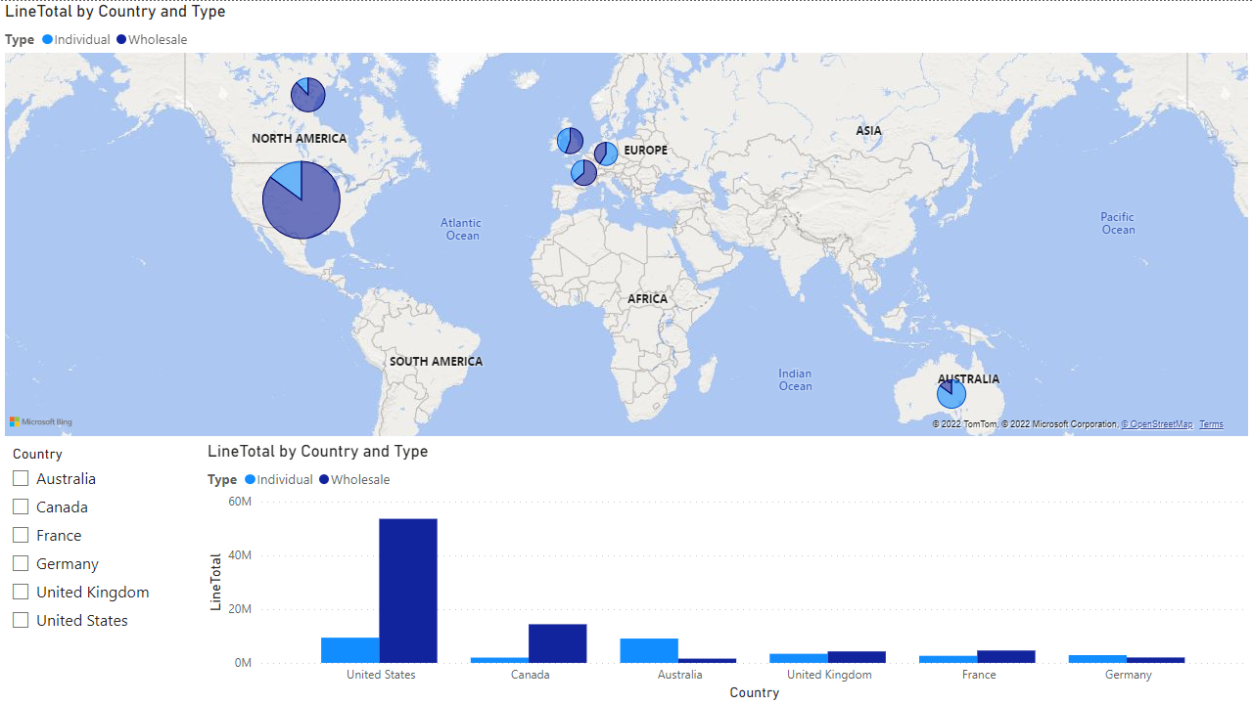
Comparision across geographical locations in terms of total sales

Slide 12
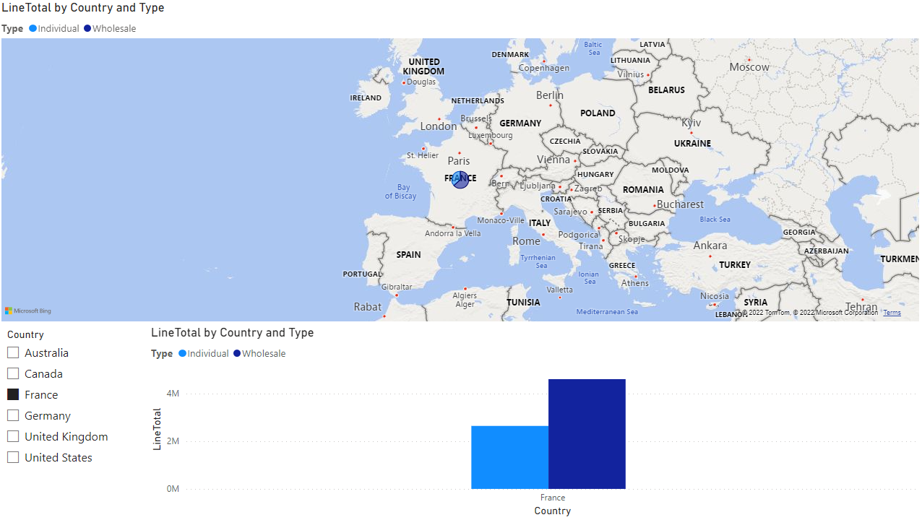
Comparision across geographical locations in terms of total sales

Slide 13
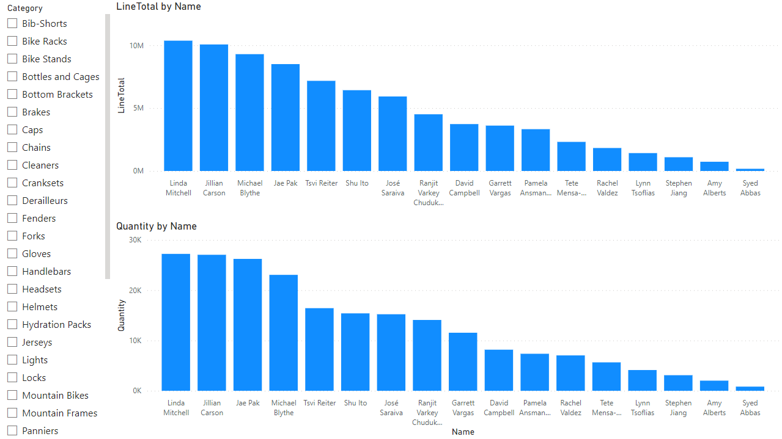
Store Sales Performance of Sales Personnel across Product Categories

Slide 14
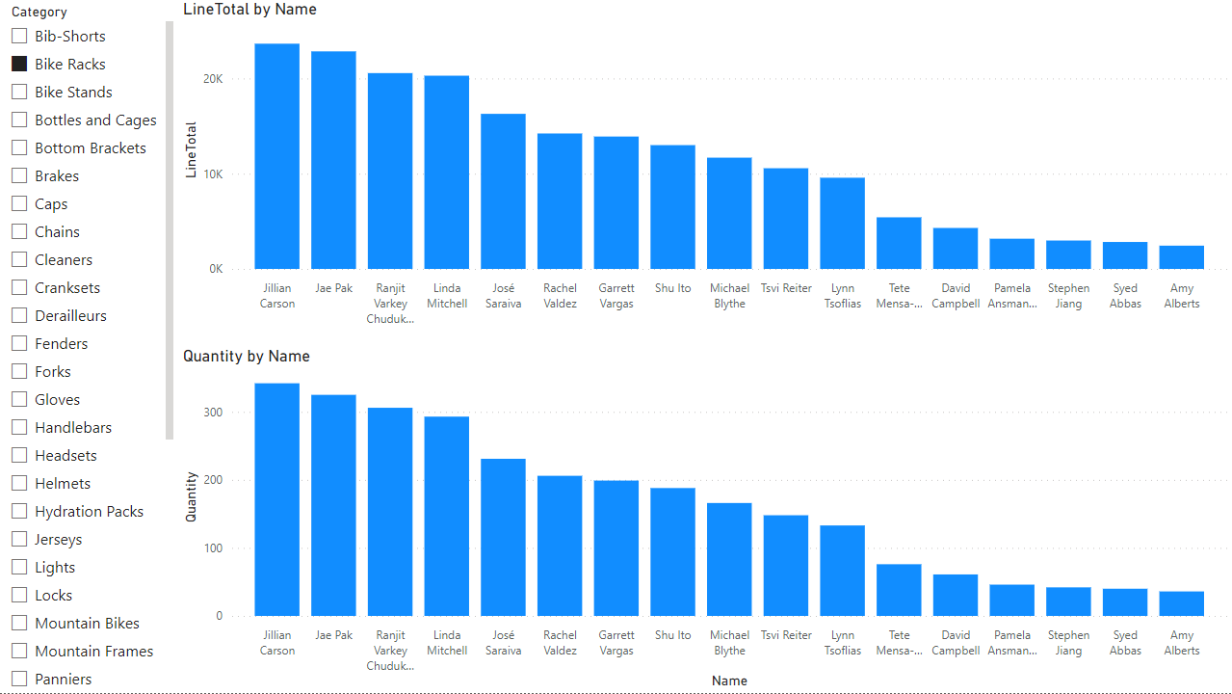
Store Sales Performance of Sales Personnel across Product Categories

