Slide 1
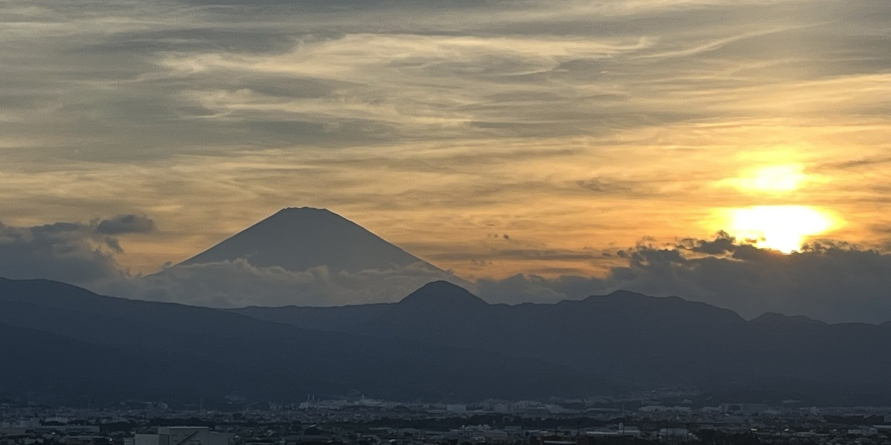
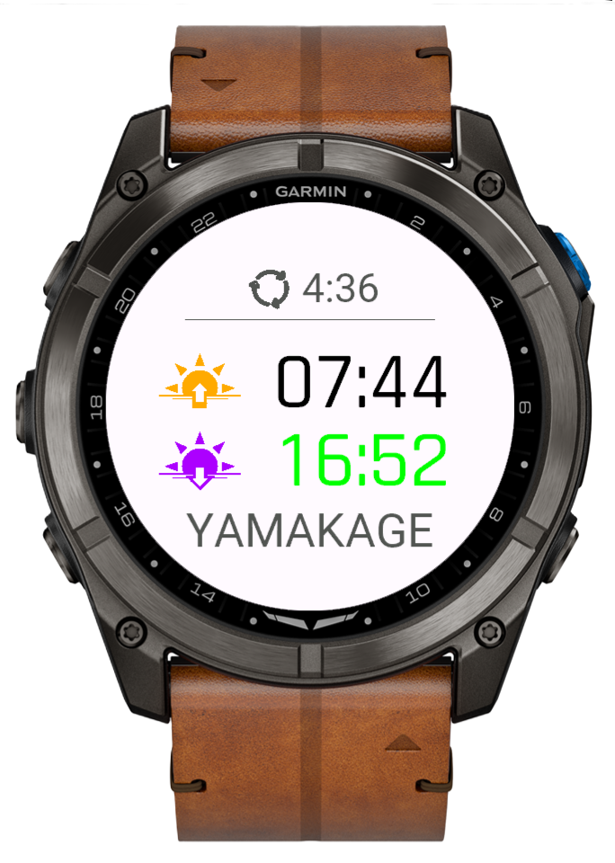
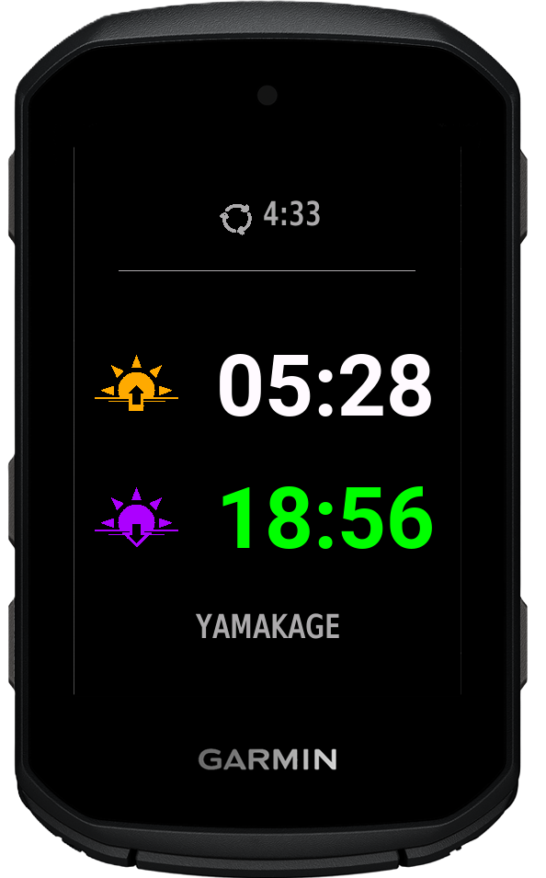
YAMAKAGE
Terrain-Aware Sunset & Sunrise.

Slide 2
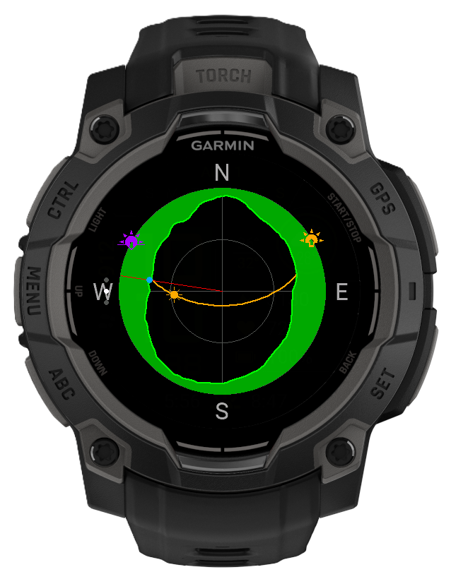
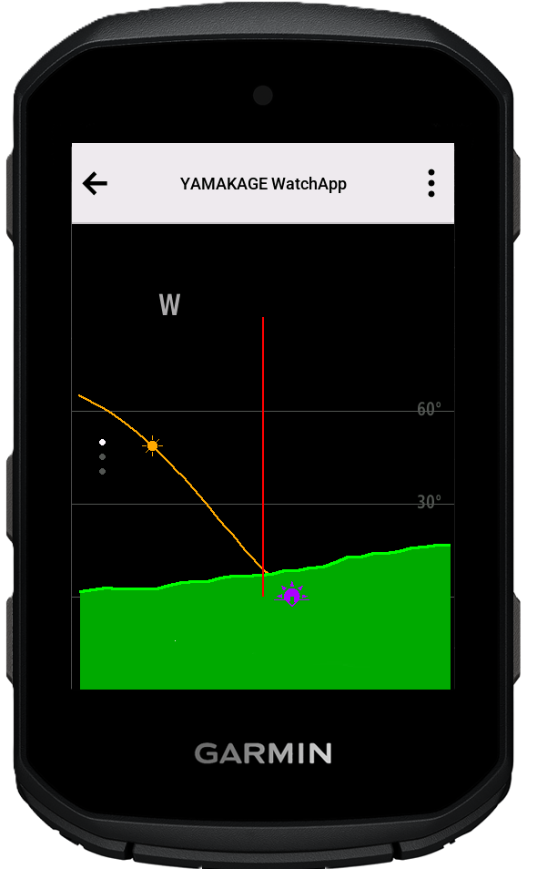
YAMAKAGE
-- Watch App --
Terrain-Aware Sunset & Sunrise.

