Slide 1
2013 Required Leader Development
Leader Series
Leader Development
Directors and above
Time: 8am – 12pm
Where: Hellenic Center
Purpose: To gain knowledge, skills and awareness to focus on Getting Results through high performance
Leader Series
Leader Development/Training
Directors and above
Time: 8am – 3pm
Where: Marriott Century Center
Purpose: To consolidate into one day required annual training needed
March 27
August 28
Q1
Q2
Q3
Q4
June 20
People Manager Meeting
Development & Annual Training
People Managers
Time: 8am – 1pm
Where: Hellenic Center
Purpose: To gain knowledge and skills on how to Be Clear and Compelling. To provide tools and training to aid in highly effective day-to-day operations
Take Out Training
Optional development for
Directors and above
Duration: 3 hours
Where: Learning Center, 1680 Tullie
Topic: Leading Change (June 17)
Topic: High Performing Teams (October 18)

Slide 2
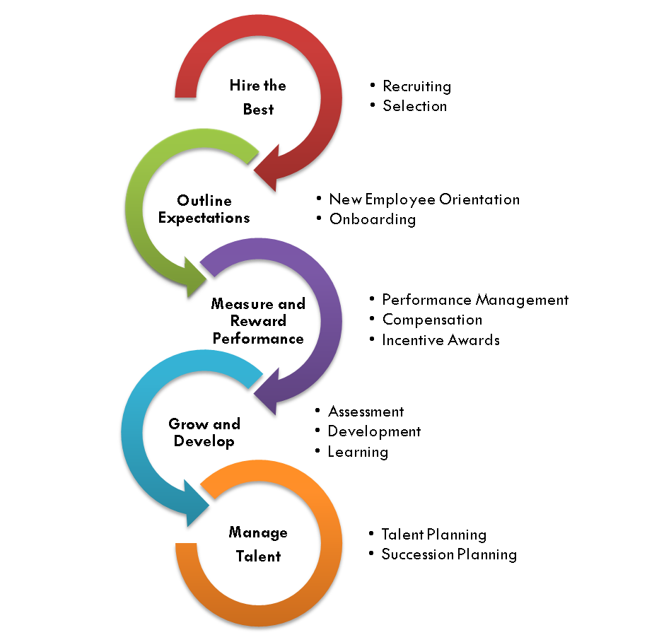

Children’s Leadership Competencies
Get Results
Understand issues
Connect the dots
Make decisions
Be efficient and consistent
Set expectations
Build a Strong Team
Hire and keep the best
Delegate authority
Trust your team
Celebrate success
Promote development
Leadership competencies outline the behaviors required for success as a leader.
They provide the foundation for everything we do to recruit, develop and retain the talent that makes Children’s Healthcare of Atlanta a best place to work.
Be Clear and Compelling
Know your audience
Set context
Manage the message
Make your point
Exercise clarity and brevity
Be a Leader
Work with energy
Be confident and decisive
Balance listening and responding
Continue to learn and grow
Be polished and poised
Grow Relationships
Know your customer
Work across boundaries
Value perspectives
Play well with others
Foster trust

Slide 3
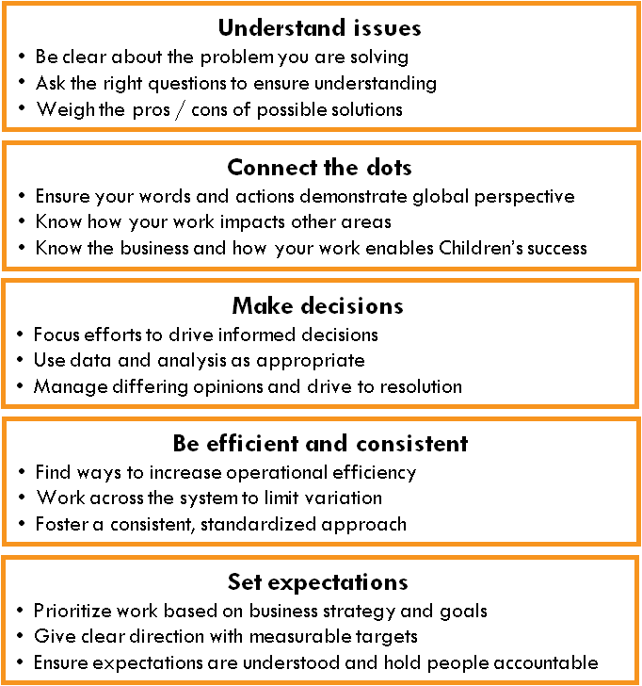
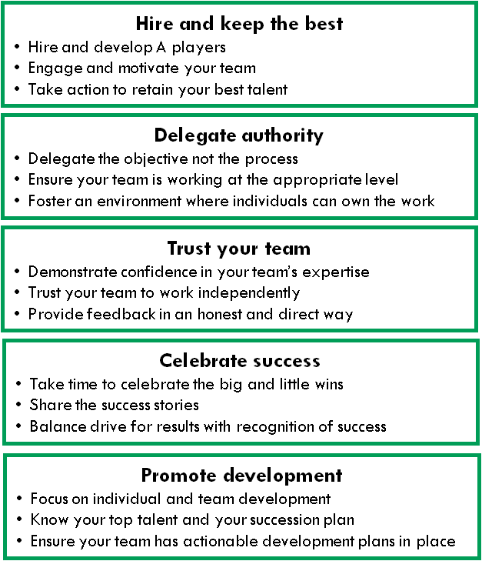
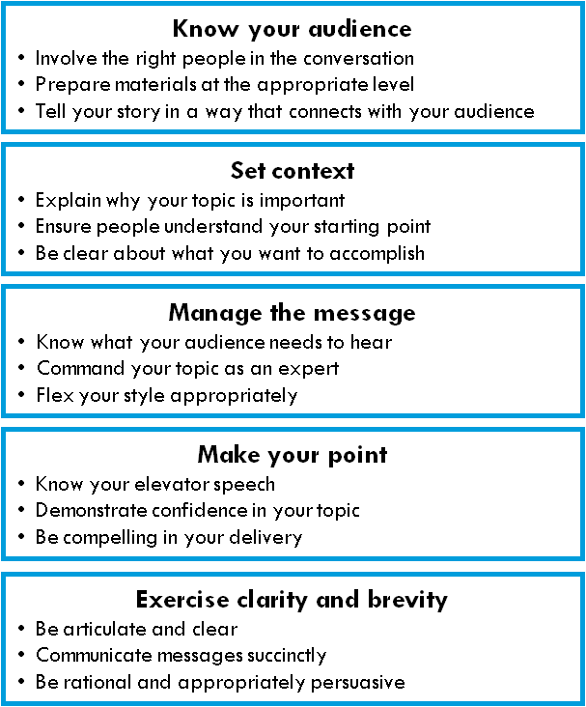
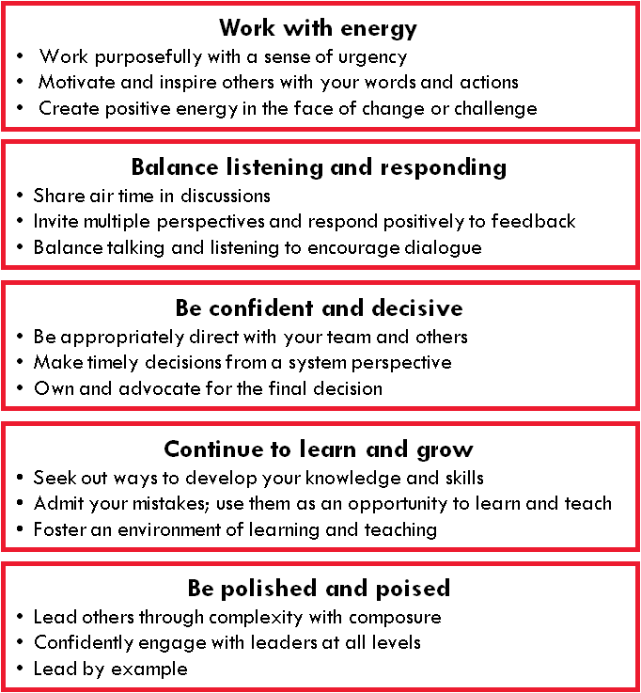
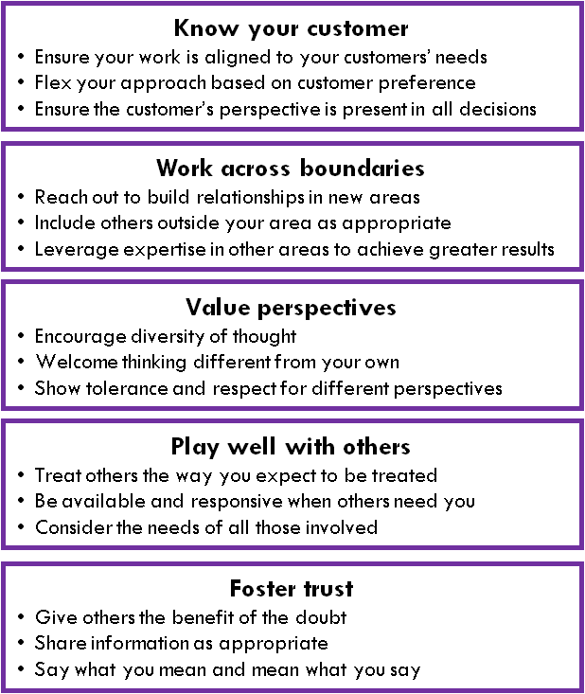
Get Results Build a Strong Team
Be Clear and Compelling Be a Leader Grow Relationships

