Slide 1
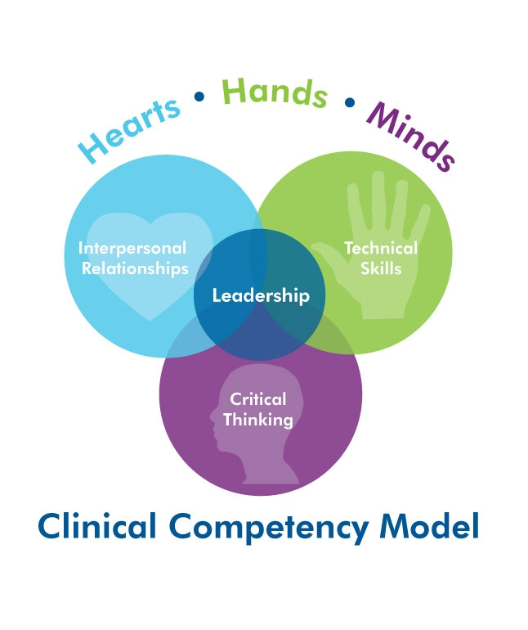
Staff Nurse Competency
What does it look like?
Self Awareness
Accountability
Personal Mastery
Empowerment
Manages Up
Confidence
Communication
Career Planning
Initiative
Authenticity
Action impact on Others
Emotional Intelligence
Notes:
Self Leadership: the process of influencing oneself to establish the self direction and self motivation needed to perform (Manz & Neck, 2008)
personal mastery, demonstrate confidence, able to trust and empower others, know how communication and actions impact others and sensitive to others’ cues, emotional intelligence, authenticity, personal accountability, career planning

Slide 2
CHOA Curriculum
Lesson Topic | Learning
Temperaments – Understanding your inborn temperaments so that you can become acutely aware of feelings and preferences that drive you to act and react to those around you. | Self -awareness and knowledge Personal development Self- modulation and regulation Understanding others
Self Leadership and Diagnosis – Understand diagnosis in the context of self-leadership. Identify self-motivators for doing your best work. Learn how to assess your stage of development on goals and tasks to get what you need. | Self- awareness Planning work Personal development Process management
Needs and Values - Learn why it is essential to understand your own needs and values---first by identifying them, and then by working to get your needs met effectively and successfully aligning them with your values. | Self -awareness and knowledge Personal development Self- modulation and regulation
Interpersonal Communication – Improve your ability to modify your communication habits and choices to better serve your purpose and achieve your goals. Learn the communication loop and keys to effective communication. | Listening Self awareness and knowledge Self -modulation and regulation
One on One Meetings – Discover how to ask for your one on one time with your leader. Learn how to prepare and create a powerful agenda and ask for what you need to be successful. | Planning Caring about others Motivating others
Temperaments and Others – Build on what you have already learned regarding temperaments by spending more time looking at the impact of your shadow temperament. | Approachability Understanding others Peer relationships
Partnering for Performance – Learn the definition of partnering for performance and the partnering process, including getting agreement on goals, tasks, development level, and leadership style | Motivating others Planning Fairness and compassion Caring about and developing others Listening

Slide 3
Program Flow – 5 Cohorts
7 Lessons = 42 weeks
Live Conference – Nursing Focused
4 weeks
2 weeks
Online Lesson
Live Debrief by Educators
400 Learners
1st Cohort – June 2013
Notes:
Deliver 7 online lessons and live debriefs over 42 weeks or 10 months (1 lesson / 6 weeks)
Educators conduct debriefing sessions
2000+clinical RNs (including staff / ANMs / mgrs)
ANMs/Mgrs/high performers part of first cohort
4 Cohorts over 2 years
400 RNs / cohort (approx 15 RNs per dept)
Develop live ½ or full day program for nurse-specific content at conclusion of each cohort
Aug 2012 - May 2013
January 2013 - Oct 2013
June 2013 - March 2014
Nov 2013 - Aug 2014

