Slide 1
Human Resources

Slide 2
Who is HR?
Recruitment
Benefits
Clinical Staff Development
Compensation
Total Rewards
Learning Services
Employee Wellness
HR
Continuing Education
Employee Health
Organizational Effectiveness
Technical Training
HR Technology
Internal Communications
HR Business Partners

Slide 3
HR Business Partners
Attract
Retention Strategies
Staffing Strategies
Employee Relations
Recognition Initiatives
Consult
HR
Engage & Retain
Policies
Engagement
Dispute Resolution
Manager-Employee Relationship
Develop
Coaching
Career Development

Slide 4
Campus HR Professionals
The Park
  David Patrick # 404.785.7784 - HR Manager
  Mamie Hodnett # 404.785.7168 - HR Director
Children’s Hughes Spalding
  Gaytria Thomas # 404.785.6800 - HR Generalist
  Pat Wagner # 404.785.6235 - HR Director
Children’s Marcus Autism Center
  Edwidge Ulysse # 404.785.0458 - HR Manager

Slide 5
Campus HR Professionals
Children’s Egleston
  Pat Wagner # 404.785.6235 - HR Director
  Edwidge Ulysse # 404.785.0458 - HR Manager
Children’s Scottish Rite, Rehab Neighborhood Locations and Ambulatory Surgical Services
  Michael Landis # 404.785.6975 - HR Manager
  Virginia Means # 404.785.2027 - HR Director
Physician Practices
  Michelle Reid # 404.785.7883 - HR Director
Notes:
<number>##

Slide 6




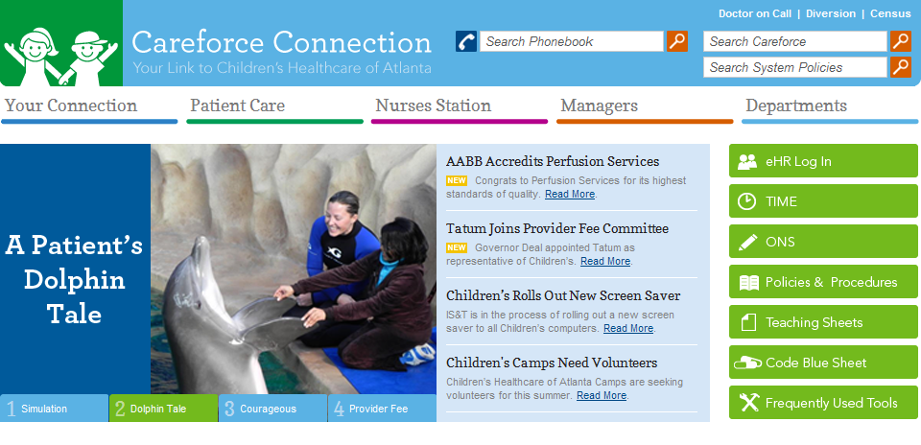
Policies on Careforce
    Click on Policies and Procedures
    HR policies typically start in the 4.00 series.
Systemwide Policy Search
Systemwide Policy Search
Copyright ©2007 Children's Healthcare of Atlanta. All Rights Reserved
For questions or comments, email Internal.Communications@choa.org
Copyright ©2007 Children's Healthcare of Atlanta. All Rights Reserved
For questions or comments, email Internal.Communications@choa.org
Frequent Asked Questions >
Instructions >
Contact Information >
Instruction for Standing Orders >
HIPAA >
Patient Accounting and Billing >
Point of Care Testing >
Laboratory Test Directory >
PILOT POLICY (ECH Only) - Trauma Massive Transfusion Protocol >
Policies and Procedures
This Web page includes system-wide Policies and Procedures for Children’s Healthcare of Atlanta. Please refer to the Instructions page for a complete explanation of the policy process, detailed definitions of Children’s policy categories and to obtain the appropriate forms for revising or creating policies. Departmental policies are available on the Departments Webpage or in hard copy in the respective departments.
Administrative and Operational
Environment of Care
Infection Control
Patient Care
Standing Orders
Policies for Children's at Hughes Spalding
Frequent Asked Questions >
Instructions >
Contact Information >
Instruction for Standing Orders >
HIPAA >
Patient Accounting and Billing >
Point of Care Testing >
Laboratory Test Directory >
PILOT POLICY (ECH Only) - Trauma Massive Transfusion Protocol >
Policies and Procedures
This Web page includes system-wide Policies and Procedures for Children’s Healthcare of Atlanta. Please refer to the Instructions page for a complete explanation of the policy process, detailed definitions of Children’s policy categories and to obtain the appropriate forms for revising or creating policies. Departmental policies are available on the Departments Webpage or in hard copy in the respective departments.
Administrative and Operational
Environment of Care
Infection Control
Patient Care
Standing Orders
Policies for Children's at Hughes Spalding
Notes:
<number>##

Slide 7
Introductory Period – 4.12
The Introductory Period lasts for six months.
Throughout the introductory period, the manager/designee should provide ongoing performance feedback.
Employees start a new introductory period whenever they start a new position at Children’s (promotion, demotion, lateral transfer).
Notes:
<number>##
Newly hired employees and employees beginning a new job as a result of a promotion, demotion or lateral transfer, enter into an introductory period, during which both the employee and the supervisor have an opportunity to evaluate the new job situation.

Slide 8
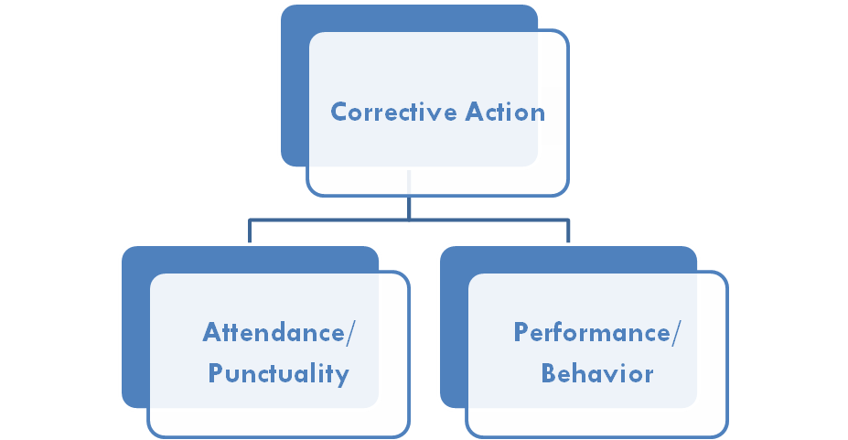
Corrective Action – 4.05
The purpose of the corrective action policy is to provide a fair and objective means of correcting and improving employee behavior while at work so that actions necessitating discipline are dealt with in a consistent manner.

Slide 9
Corrective Action: Performance/Behavior
Progressive Discipline Process
  Step 1: First Written Warning
  Step 2: Second Written Warning
  Step 3: Final Warning
  Step 4: Termination
*Some actions are considered to be of such a serious nature that they are grounds for immediate termination or partial bypass of the corrective action steps.
Notes:
<number>##

Slide 10
Review
How long is the Introductory Period?
  - 6 months

Slide 11
Attendance and Punctuality – 4.00
What is the corrective action process?
5 occurrences - First Memo Reminder
8 occurrences - Second Memo Reminder
10 occurrences - Final Written Warning
11 occurrences - Termination
*No-call and no-show results in Final Written Warning and the second instance will result in termination.
Notes:
<number>##

Slide 12
Corrective Action. Attendance and Punctuality
What is an “occurrence”?
An unscheduled absence = 1 occurrence
Unscheduled absence, 5 consecutive calendar days from date of first occurrence due to employee's own personal illness OR employees’ dependent’s illness = 1 occurrence
Tardy = 1/2 an occurrence
  Your department manager/director determines what constitutes a tardy.
Failure to work 3/4’s of your shift = 1 occurrence
* Employees are expected to personally call their manager/designee in the event they need to be out or tardy.
Notes:
<number>##
Who expects you to be at work on time?
At Children’s we track attendance/tardies by what we call occurrences.
How does Children’s define occurrences:
An unexcused absence;
Failure to work 3/4’s of your shift;
Two tardies.
It is the employees responsibility to be aware of their total number of occurrences.

Slide 13



Attendance and Punctuality – 4.00
Example 1:
 | Sun | Mon | Tue | Wed | Thu | Fri | Sat
Schedule | Off |  |  |  |  |  | Off
Actual | Off |  |  |  |  |  | Off
How many occurrences?
1 occurrence

Slide 14
Attendance and Punctuality – 4.00
Example 2:
 | Sun | Mon | Tue | Wed | Thu | Fri | Sat
Schedule |  |  |  | Off |  | Off
Actual | Work |  |  | Off |  | Off | Work
How many occurrences?
1 occurrence

Slide 15
Attendance and Punctuality – 4.00
Example 3:
 | Sun | Mon | Tue | Wed | Thu | Fri | Sat | Sun | Mon
Schedule | Off |  |  |  |  |  | Off | Off
Actual | Off |  |  |  |  |  | Off | Off
How many occurrences?
2 occurrences

Slide 16

TimeCall – 4.52
Clocking in/out is a standard workplace practice and required of all non-exempt (hourly) staff.
  Employees must access TimeCall in their designated work area.
  Employees must clock in/out on every shift; should there be a fourth (4th) occasion of a missed clocking, the employee will be issued formal disciplinary action.
  Any employee who clocks in and/or out for another employee, or transfers an incoming call from an employee to TimeCall subjects, both employees to corrective action.

Slide 17

Work Appearance – 4.11
All employees are expected to be neat, clean, well groomed and appropriately dressed while on duty or on company property. Work appearance includes dress, grooming, and personal hygiene.
Don’t
Denim, any type or color
Visible body piercing, other than ear lobes
Visible body art (must be covered)
Detectable fragrance of smoke odor
Distracting or unusual hair style or color
Non-surgical hats/caps
Shorts or capri pants
Open-toed shoes where patient care is provided
Shirts, blouses or dresses without sleeves
Notes:
<number>##

Slide 18
What Not to Wear?

Slide 19
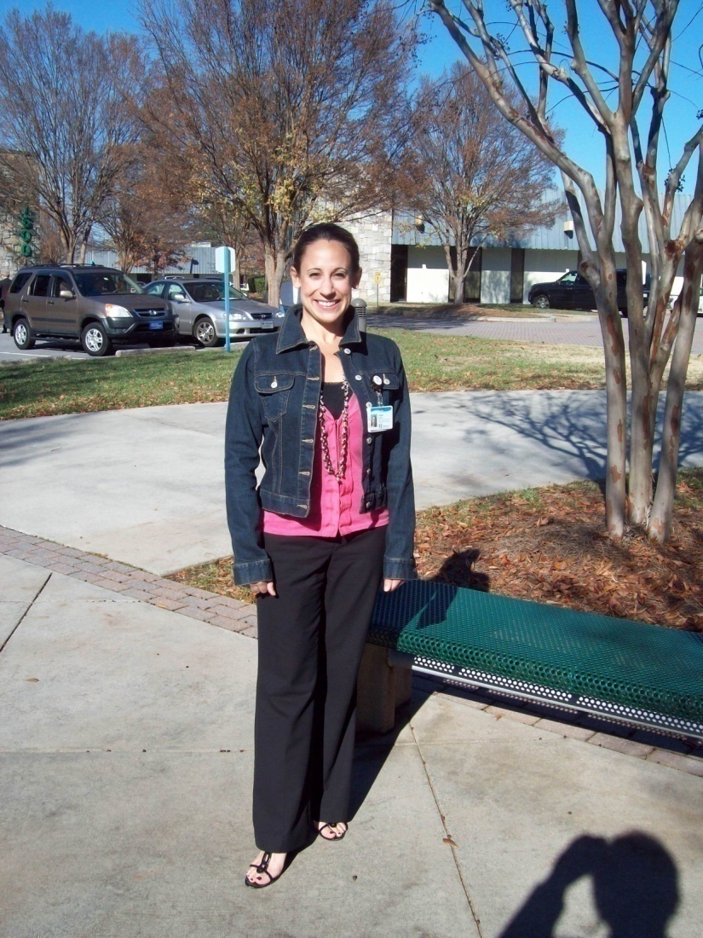

Can you find what not to wear?
Notes:
Denim

Slide 20
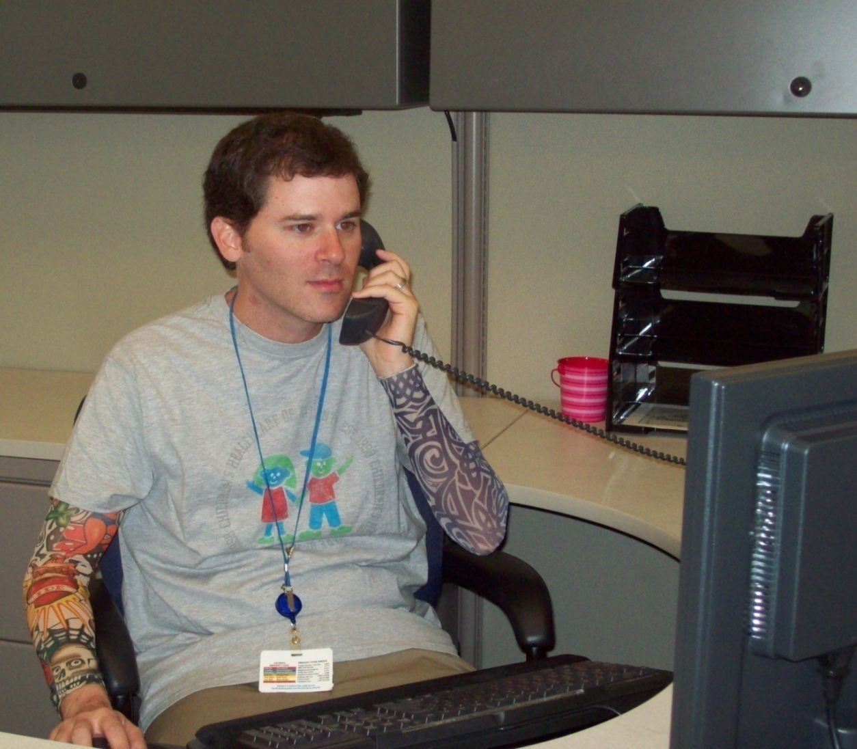
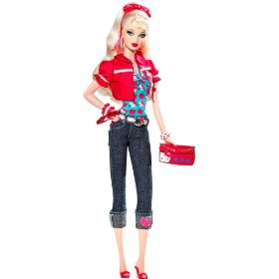
Can you find what not to wear?
Notes:
Tattoos

Slide 21
Review
What is the name of the system used to clock in/out?
  - TimeCall

Slide 22
Electronic Communications – 4.06
Employees may not use Children’s electronic systems for any of the following:
  Viewing, expressing or distributing inappropriate websites or email communications
  Distributing jokes
  Gambling or game-playing
Electronic Device – 4.49
Electronic devices should only be used during scheduled breaks or meal periods in non-working areas and turned off at all times when working in patient care related areas.
Cell phone photography is prohibited.
Notes:
<number>##

Slide 23
Social Media and Social Networking – 5.54
Employees may not access any social networking websites during working hours, whether from a personal device or Children’s computer.
Employees should be cautious about their communications and postings on social media and networking sites that are related in any way to Children’s.
Employees must comply with HIPAA at all times, including when using social media.

Slide 24
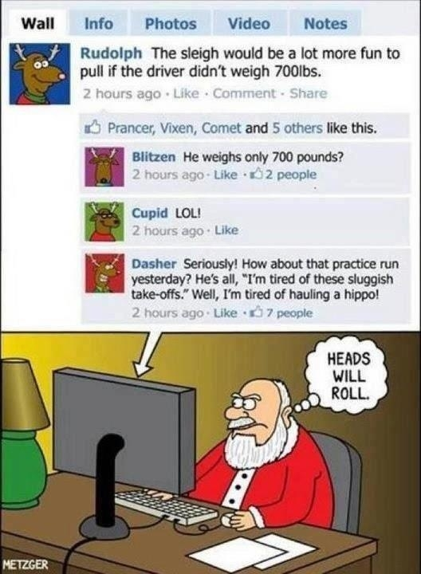

Slide 25
Review
True or False: I am allowed to wear denim to work as long as it is black or white.
  - False

Slide 26
Harassment/Discrimination
Harassment/Discrimination includes:
  Offensive remarks, comments, jokes, slurs, pictures, physical contact, sexual remarks/advances.
  Related to race, color, sex/gender, age, religion, disability, national origin, citizen status or other Intentional or unintentional
If you experience harassment:
  Ask person to stop the behavior; alert management.
  Management will partner with Human Resources to investigate, stop the harassment, and complete the investigation quickly.
  Managers/Supervisors must address all complaints.
We have a zero tolerance and no retaliation policy!

Slide 27
Review
If I am out of work due to a cold starting on Monday and return to work on Wednesday, how many occurrences will I receive?
  - 1 occurrence

Slide 28

Recognition Programs
Celebrations
Service Awards
Hospital Week
Catch Me At My Best
Daisy Award
Great Expectations
Employee Referral Bonus Program
Hope and Will Award

Slide 29
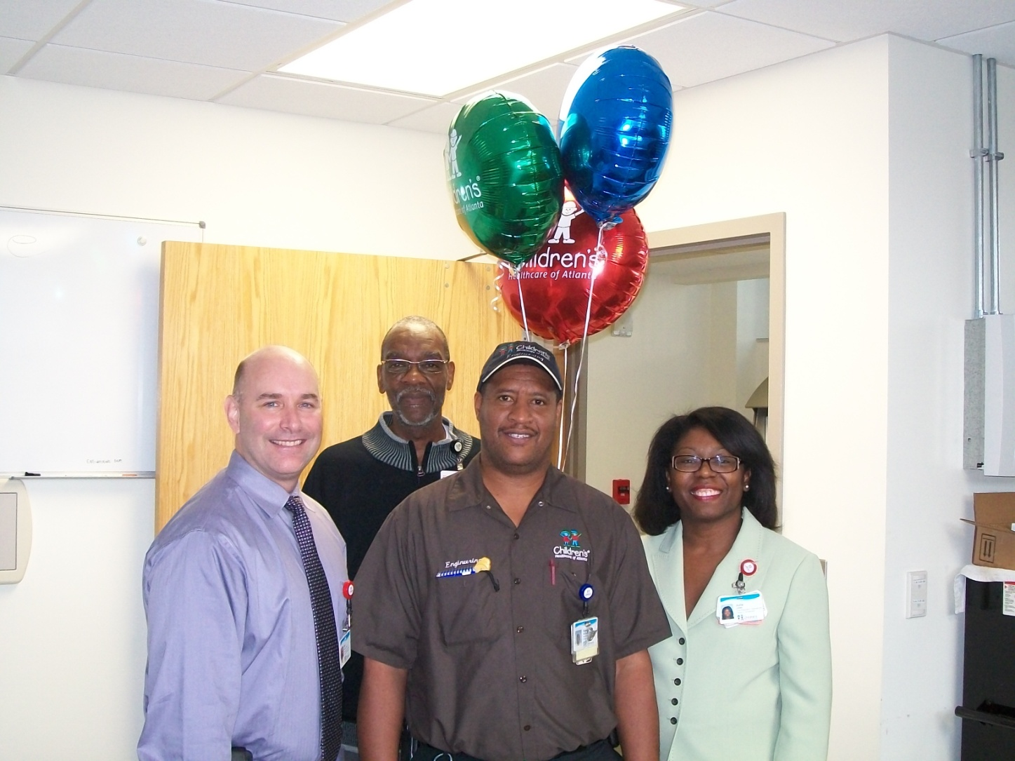
Hope and Will Award
Notes:
Hope & Will Award Winners are formally recognized by their fellow employees for going beyond the call of duty and for demonstrating behaviors such as outstanding customer service, exemplary attitude and spirit, exceptional skills and strong commitment to Children’s. Their outstanding contributions exemplify the Children’s Values:
Integrity
Respect
Nurturing
Excellence
Teamwork

Slide 30


Daisy Award
Notes:
To recognize and express appreciation for the great work that nurses do every day, and to raise the awareness of the importance of nursing to the treatment and care of those who are critically ill.
The DAISY Foundation
Foundation for the Elimination of Diseases Attacking the Immune System
In Memory of J. Patrick Barnes
"A nurse can make a difference!" This is what the DAISY Award exemplifies. The DAISY Award was established about four years ago by the DAISY Foundation, a foundation for the elimination of Diseases Attacking the Immune System in memory of J. Patrick Barnes. Mr. Barnes' parents established the foundation in Patrick's memory. They had first hand experience of the caring and compassion skills of the many nurses who had cared for their son. Mr. Barnes's parents felt compelled to find a personal way to say thank you to the nurses around the country for their compassionate care. This award was generated to provide that recognition. The Barnes' family currently gives the award to 24 hospitals around the country.

Slide 31
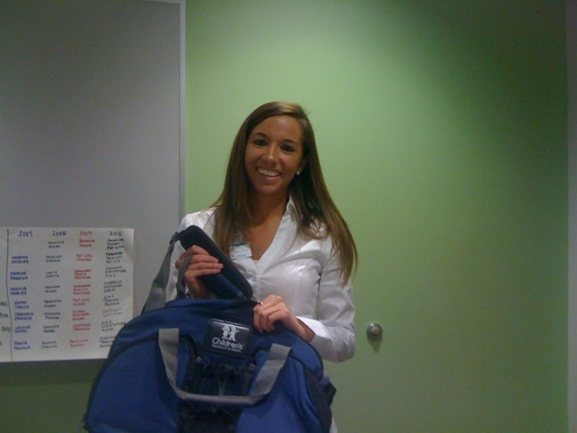
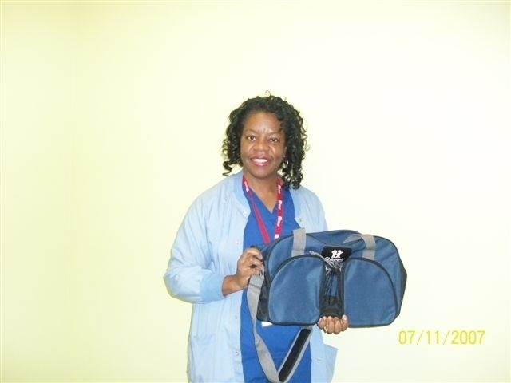
Catch Me At My Best
Notes:
Catch Me at My Best is a Systemwide initiative for patient families to recognize employees who go above and beyond in providing great care and service, enhancing the overall experience of those we serve. Throughout the year, patient families catch our staff at their best, and fill out Catch Me at My Best cards as a way to thank and recognize staff.
Each month, managers may submit one employee from their area for a Catch Me at My Best System drawing and recognition. On the 5th of each month, our Total Rewards department randomly draws three winners, who may work at Children’s at Egleston, Children’s at Scottish Rite, Children’s at Hughes Spalding, Marcus Autism Center or any of our neighborhood locations. Each month, the winners are announced on Careforce Connection and receive recognition and a Children’s sports bag from their director.

Slide 32
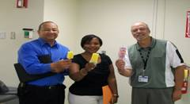
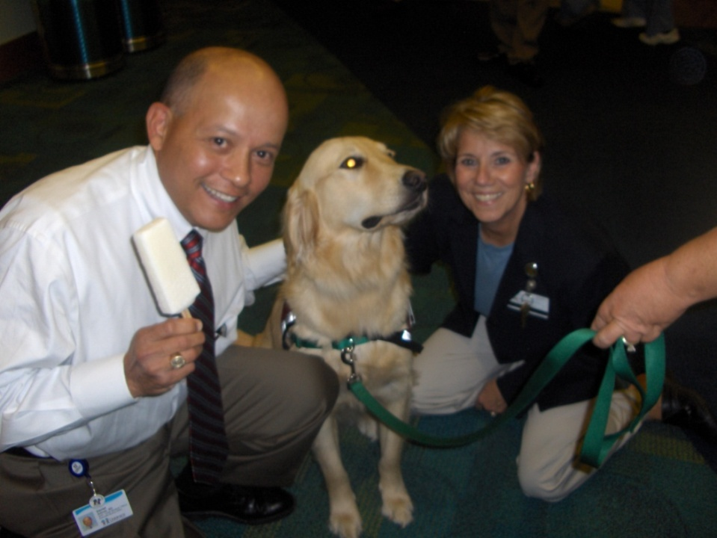
Hospital Week
Notes:
Hospital Week is special because it celebrates you—people who are strong and caring and have exactly what it takes to do the work we do.

Slide 33
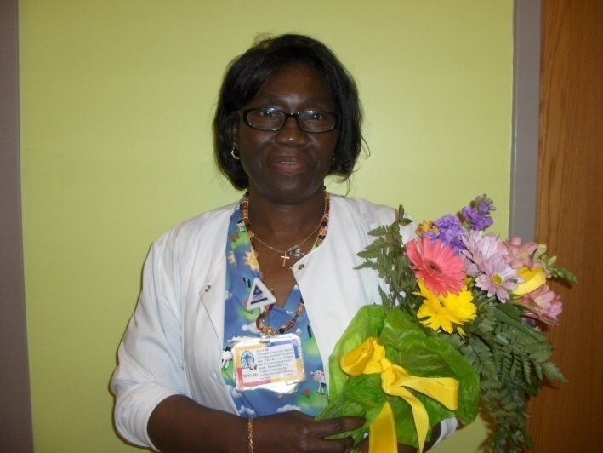
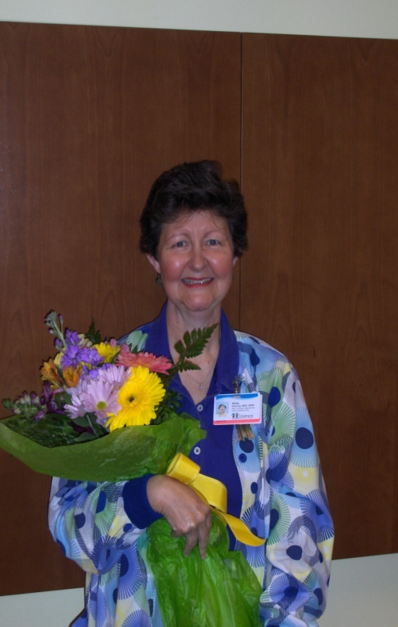
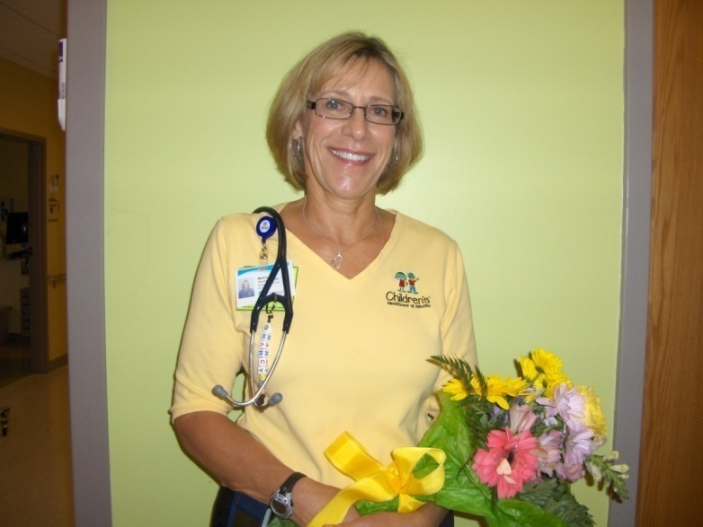
Service Awards
Notes:
Ten-year honorees are recognized with a luncheon, and 15-40 year honorees attend a banquet in their honor.

Slide 34
Review
Name 3 Recognition programs at Children’s.
  Hope & Will, Daisy Award, Great Expectations, Hospital Week, Service Awards

Slide 35
Review
What is the award at Children’s that is specifically for Nurses?
  Daisy Award

