Slide 1
Leader Next
Participant Welcome

Slide 2
Agenda
Children’s Leadership Competencies and the 2013 Development Plan
Overview of Leader Next
  Participants
  The Experience
  Expectations and Time Commitment
Next Steps
  The Assessment Process

Slide 3
Children’s Competencies lead the way
Children’s Leadership Competencies will be the foundation for all curriculum and content related to leader development.
Connecting the competencies to the strategy will help leaders understand and apply learning.
Competencies will ensure we develop the “total leader”.
Get Results
Understand issues
Connect the dots
Make decisions
Be efficient and consistent
Set expectations
Build a Strong Team
Hire and keep the best
Delegate authority
Trust your team
Celebrate success
Promote development
Be Clear and Compelling
Know your audience
Set context
Manage the message
Make your point
Exercise clarity and brevity
Be a Leader
Work with energy
Be confident and decisive
Balance listening and responding
Admit your mistakes
Be polished and poised
Grow Relationships
Know your customer
Work across boundaries
Value perspectives
Play well with others
Foster trust

Slide 4
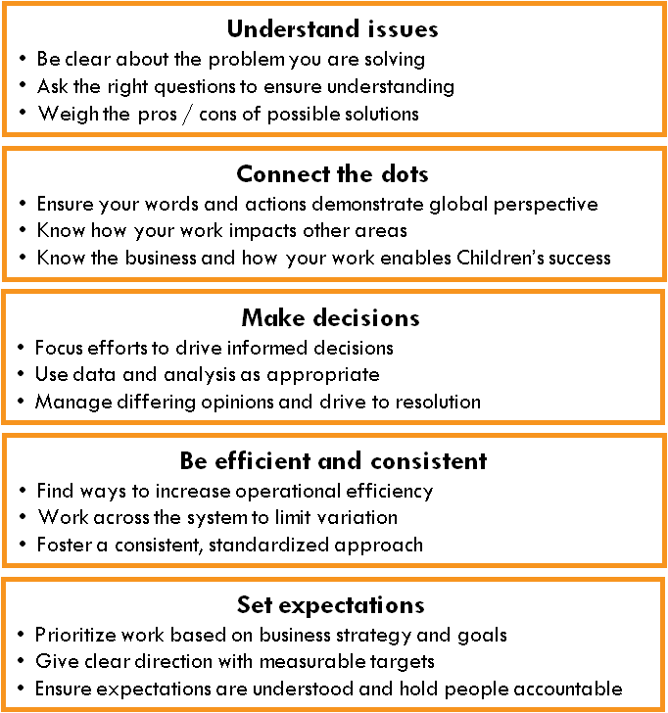
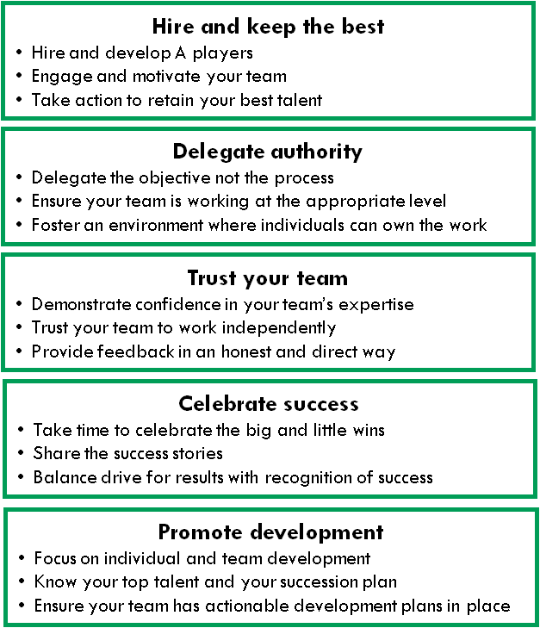
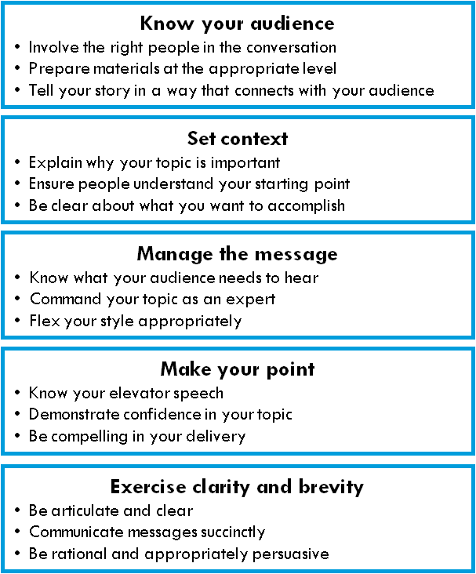
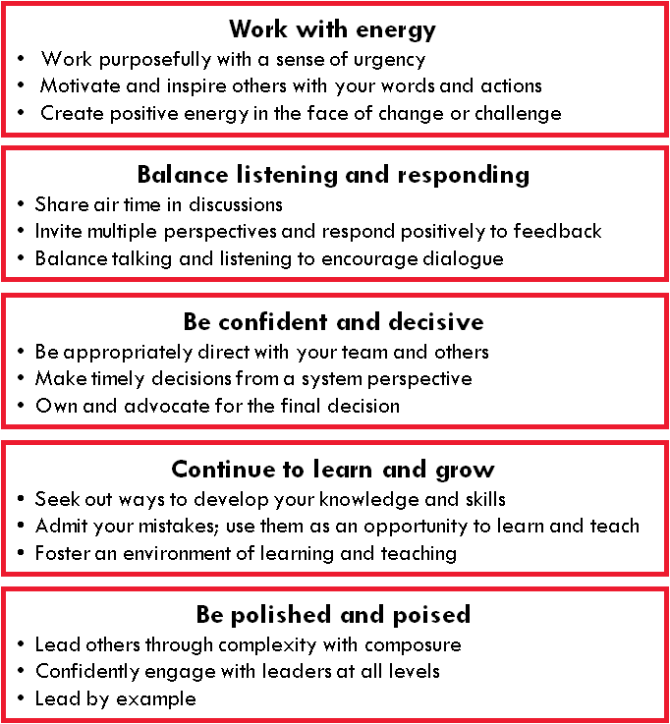
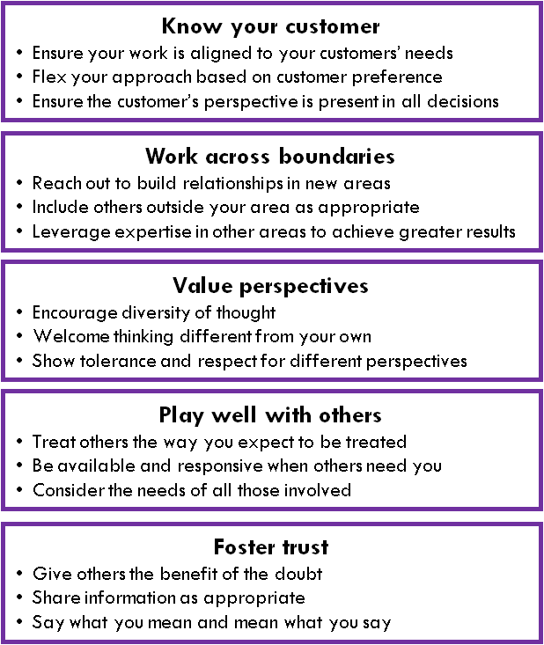
Get Results Build a Strong Team
Be Clear and Compelling Be a Leader Grow Relationships

Slide 5
2013 Leader Development Plan
Top Talent Development – Leadership Next
Q1
Q2
Q3
Q4
Leader Next
Workshop 1
Directors +
(Cohort 1)
Leader Next
Workshop 2
Directors +
(Cohort 1)
Leader Next
Workshop 3
Directors +
(Cohort 1)
Talent Sessions
Chiefs Workshop
(Class 5)
Generation Next
(Next Cohort)
Chiefs Workshop
(Class 6)
Performance Review Process
Budget Process
All Leader Development – Leadership Now
Q1
Q2
Q3
Q4
Leadership Series (Director +)
Take Out Training (Director +)
Leadership Series (Director +)
Take Out Training (Director +)
Management Essentials Program
(Next Cohort – New cohort launched every 3 months)
System Manager
Meeting (People Managers)
Physician Management
Essentials Program
(Next Cohort)
SLA/VP 360 Feedback (those in Leader Next will complete at time of program)

Slide 6
Agenda
Children’s Leadership Competencies and the 2013 Development Plan
Overview of Leader Next
  Participants
  The Experience
  Expectations and Time Commitment
Next Steps
  The Assessment Process

Slide 7
2013 Leader Next Participants
Heather Balberde – Director, Physician Practice Operations
Rick Bonner, MD – Executive Director, Physician Practice Council
Mary Beth Bova – SVP Operations, Egleston
Farah Chapes – Government Affairs Director
Linda Cole – SVP Operations, Scottish Rite
Florence Davis – Director, Patient Access/UR
Jim Fortenberry, MD – Pediatrician in Chief
Julia Jones – VP, Operations, Hughes Spalding
Ellen Light – Director, Clinical Risk Management & Patient Grievances
Bill Mahle, MD – Cardiologist, Sibley
John McMillen – Senior Director, Supply Chain
Don Mueller – VP Operations, Marcus Autism Center
Tim Stacy – Director, Pharmacy
Kay Stewart-Huey – Service Line Administrator
Beth Strickland – VP, Total Rewards
Diane Waldner – Service Line Administrator
Mark Wulkan, MD – Surgeon in Chief
Participant Demographics
VP, SVP – 5
Director, Sr. Director, SLA – 8
Physicians - 5

Slide 8
What will I gain from Leader Next?
Leaders who attend Leader Next will better:
Understand the external environment and how to pull relevant megatrends into business decisions
Know how to ask the right questions to drive better business outcomes
Understand how to tell the right story to drive results
Be able to set expectations for high performance and identify ways to delegate and empower their teams
Demonstrate increased leadership impact

Slide 9
Leader Next Program At a Glance
April 8 – May 31 June 5-7 August 14-16 November 14-15
Assessment
& Feedback
Workshop 1:
Know the Business
(2.5 days)
Workshop 2:
Lead Your Business
(3 days)
Workshop 3:
Lead Your Team
(2 days)
Key Steps:
Live 360 interviews
Complete online assessment
Receive feedback from 3rd party assessor
Draft development plan
Key Topics:
Connect the Dots
Ask the Right Questions
Understand Issues
Make Decisions
Manage Uncertainty
Get Sustainable Results
Key Topics:
Transform the Business
Understand System Dynamics
Increase System Perspective
Understand Process Improvement
Work Across Boundaries
Manage Conflict
Know your Audience
Manage the Message
Make Your Point
Key Topics:
Hire & Keep the Best
Delegate Authority
Expect High Performance
Increase your Leadership Impact
Live the Values
9

Slide 10
Expectations and Time Commitment
Expectations of Participant:
That you are able to attend all workshops without conflict or interruption
That you complete any pre-read materials required for workshops (minimal)
That you have a discussion with your leader before and after the workshops to align your objective and create an environment of support
That you focus on your development by actively seeking input, feedback and resources to support you
Time Commitment over the Year:
Assessment: 4-5 hours
Workshops: 7.5 days

Slide 11
Agenda
Children’s Leadership Competencies and the 2013 Development Plan
Overview of Leader Next
  Participants
  The Experience
  Expectations and Time Commitment
Next Steps
  The Assessment Process

Slide 12
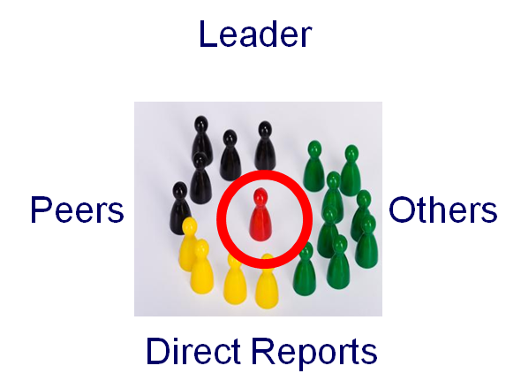
Two Types of Assessment
Inside Out
Outside In
How you see yourself
In-depth interview
3 Hogan Assessments:
  Your leadership style
  Potential leadership challenges
  What motivates you
How others see you
Live 360 format
7-9 raters
Based on new leader competencies
12
Notes:
The Hogan series aims to measure an individuals’ personality, strengths, shortcomings and aspirations. It is a highly comprehensive tool that focuses on the day to day performance, how individuals perform when under stress (the ‘dark side’) and the values of individuals that may impact their behavior and performance.
The Hogan Series has been validated with more than 40,000 executives from around the globe, and it is the leading executive assessment tool on the market.
Each of the 3 assessments will take 20 minutes or 60 minutes in total.

Slide 13
Who Will Assess Me?
Aon Hewitt Consulting
World leader in executive assessment
PhD and Master’s level consultants with deep expertise in executive assessment and coaching
Your assigned consultant will:
  Interview you
  Interview the raters you select
  Write the report
  Conduct a face to face feedback session with you
13
Notes:
Keep in mind this is strictly people’s perceptions of your leadership skills. The only people that will be able to view the results of this assessment are you and your direct leader.
It is not punitive, it is only for development purposes. We do this at the end of the program so that you can choose one thing that you want to continue to develop after graduation.
13

Slide 14
The Assessment Process
360 interviews
Online assessment
Feedback session
Development plan
April 5 – 22 April 23 – May 3 May 20 – June 4 June 10 – 28
April 5-12:
Select your raters and discuss with your manager
April 12:
Submit your approved rater list to Jennifer Ferrara in Learning
April 15:
Send pre-written email to invite your raters to provide feedback
April 22:
Your one hour interview with Aon Hewitt will be scheduled
April 23:
You will receive an email with your unique login information from Aon Hewitt
May 3:
Deadline to complete three Hogan Assessments online (60 minutes)
May 20 – June 4:
Your two-hour feedback session will be scheduled with Aon Hewitt
Begin development conversation with Aon Hewitt assessor
June 10-14:
Finalize development plan
June 17-21:
Your HR partner will schedule a meeting to review & discuss your development plan
June 21-28:
Share updated development plan with manager
14

Slide 15
Rater Selection Guidelines
Rater Category | Rater Name
Direct Manager
Peers / Business Partners (select 3-4)
Direct Reports (select 3-4)
How many raters?
At least 7 but no more than 9
Who do I choose?
People that know your work and style well
People who will be objective and honest in their appraisal, not just friends
People who are not afraid to give constructive feedback to leaders
People who will exercise discretion around confidentiality
15
Notes:
guiding the leaders in selecting raters:
Select raters that know your work and style well
Raters should be objective and honest in their appraisal
Select raters that are not afraid to give constructive criticism to leaders
Select raters that have discretion around confidentiality

Slide 16
Congratulations and Thank You!

