Slide 1
Nursing Strategic Plan
2013 - 2015

Slide 2
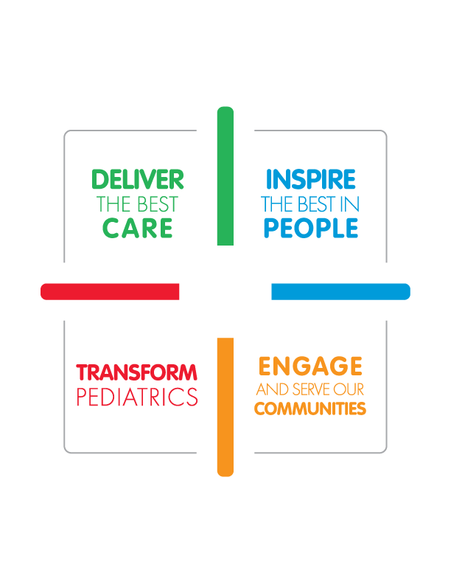






Strategies
Improve nursing and patient care though evidence based practice and care coordination
Enhance philosophy and framework for decision-making that empowers nurses and maximizes evidence based resources
Contribute new knowledge through nursing research
Balance organizational financial viability with effective and efficient nursing care
Use nurses to the full extent of their education and training

Slide 3
DELIVER THE BEST CARE
Right Nurse
Right Place
BEST Patient Care
Doing the
Right Thing
Right Time
What does this mean for you?
  Find efficiency in the workplace and eliminate unnecessary work
  Enhance collaboration with our physicians
  Use our quality data, information & technology to help us make better decisions

Slide 4
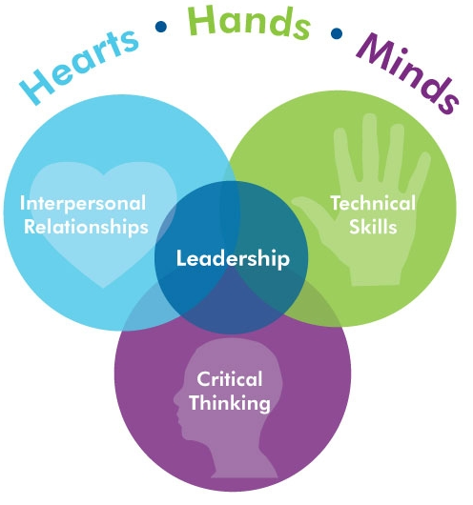
INSPIRE THE BEST IN PEOPLE
What does this mean for you?
  Leverage current skills, education and training
  Analyze & plan for future nursing positions
  Ensure that your involvement in decision making works for you and others
  Use professional development to enhance nursing at Children’s

Slide 5
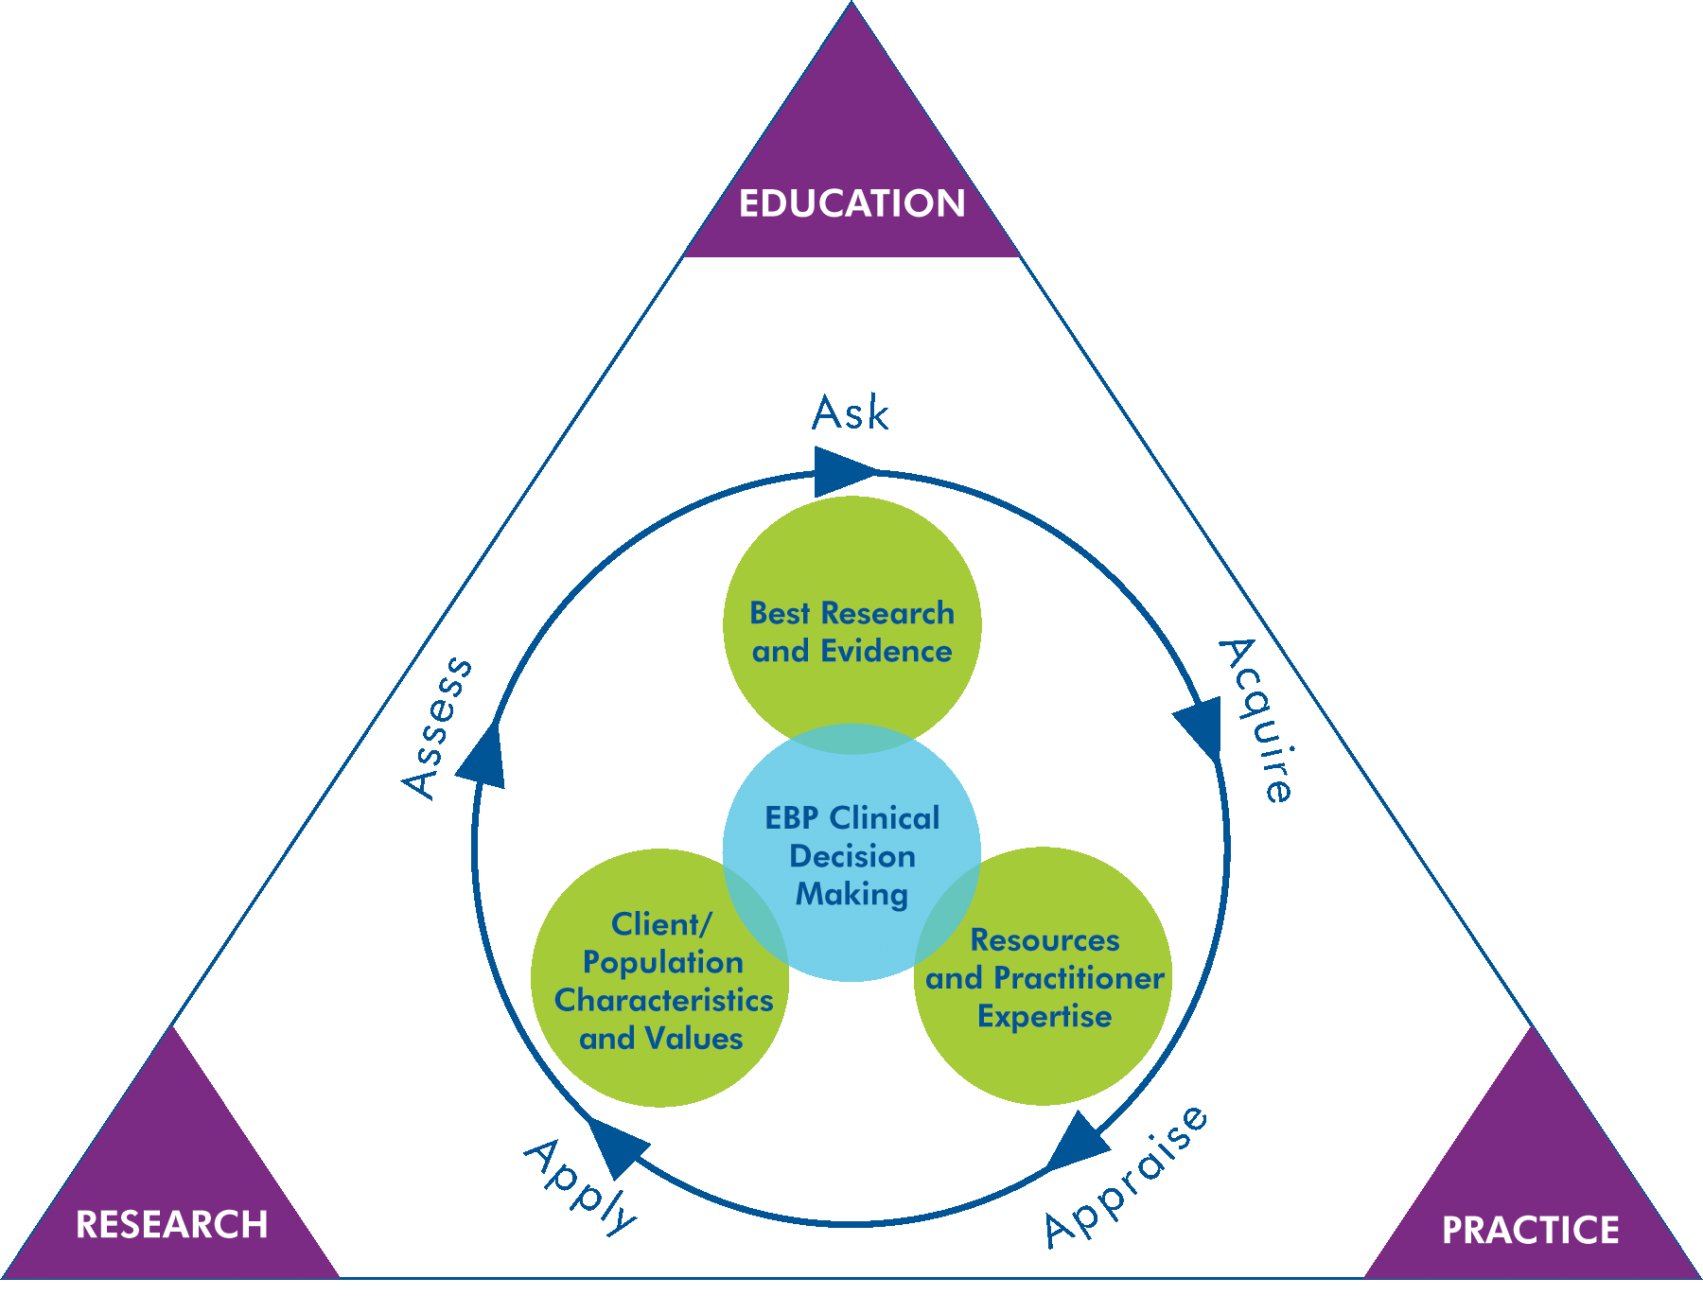
TRANSFORM PEDIATRICS
What does this mean for you?
Continue:
  To do nursing research
  Use the best evidence for clinical decision-making
  Publish nursing research and best practice findings

Slide 6
Nursing Priority Scorecard
Nursing Sensitive Indicators | Target | Baseline | Month | YTD
Effective & Efficient Care
Outperform national Quality benchmarks for 7 nursing sensitive indicators (BSI, VAP, UTI, PU, falls, restraints, IV infiltrates) | 5 of 8 qtrs
Outperform national benchmark for pt satisfaction overall and in 5 areas of nursing care | 5 of 8 qtrs
Balance organizational financial viability with effective and efficient nursing care | Budgeted RNH/UOS
Reduce readmissions | TBD
Professional Practice
Outperform national benchmark for nurse satisfaction | 2 survey rotations
Decrease in discharge delays as a result of improved RN-MD communication (Pt Flow) | 39.5%
Increase funding sources and number of publications | TBD
Eligible for Magnet Recognition | 2015
Develop & Deploy
Increase direct care BSN rate | 80% by 2015
Increase professional nursing certification rate by 5% annually | 63% by 2015
RN Retention & vacancy | Budgeted rate
Staff RN & APN Manpower plans | Complete plans

Slide 7
Today’s Question
If you were "running this hospital", how would you handle the recent high census and staffing challenges?

