Slide 1
Suffix Arrays:
A new method for on-line string searches
Udi Manber
Gene Myers

Slide 2

Introduction
Suffix Array: Lexicographically sorted list of all suffixes of text A
Pattern matching problem: Find all instances of string W in large text A
  N – length of text A
  P – length of string W
  Over an alphabet

Slide 3
Suffix Trees vs. Suffix Arrays
2nd advantage is important because |E| can be very large for certain applications
Query: “Is W a substring of A?”
Suffix Tree:
  O(Plog| |) with O(N) space, or:
  O(P) with O(Nlog| |) space (impractical)
Suffix Array:
  Competitive/better O(P+logN) search
  Main advantage: Space: 2N integers
  (In practice, problem is space overhead of query data structure)
  Another advantage: Independent of | |

Slide 4
Drawback:
  For small | |: O(NlogN) construction time vs. O(N) for trees
  Solution: Present an algorithm for building in O(N) expected time (requires additional space)
Suffix arrays are preferable for large alphabet or large texts

Slide 5
Suffix Arrays - Overview
Present search algorithm
  Assuming data structures (sorted array and lcp info) are known
Construction of suffix array
Computation of longest common prefix (lcp) info
Expected-time improvement

Slide 6
Search Algorithm - Overview
Sorted suffix array given text A
Define search interval on array for a given string W
Solution assuming interval is known
Find search interval
Improved find of search interval

Slide 7
Sorted Suffix Array
A = a₀a₁…a_{N-1}
A_{i} = suffix beginning at index i
Pos: lexicographically sorted array:
Pos[k] is the start position of kth smallest suffix

Slide 8
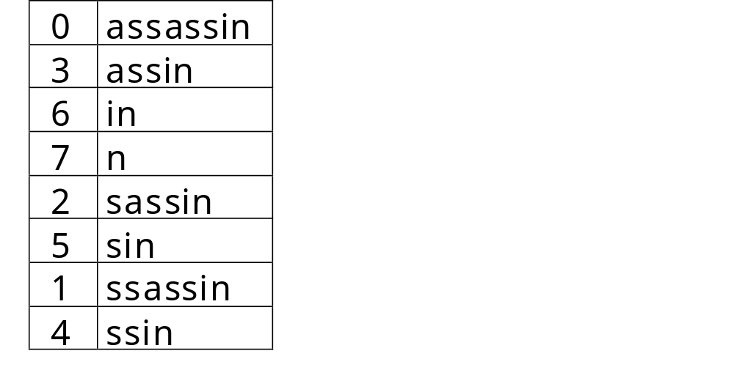
Example:
A = assassin
0 | 1 | 2 | 3 | 4 | 5 | 6 | 7
Pos[2] = 6 (A₆ = in)
Pos

Slide 9

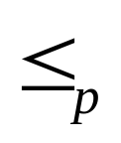

Define: For a string u, u^{p} = first p symbols (or u if len(u) p)
Define: u v iff u^{p} v^{p}
The Pos array is ordered according to for any p
For now: assume Pos is known

Slide 10



Define Search Interval
W = w₀w₁…w_{P-1}
Define:
L_{W} = min (k : W A_{Pos[k]} or k = N )
R_{W} = max(k : W A_{Pos[k]} or k = -1)
W matches a_{i} a_{i+1} ...a_{i+P-1} iff i=Pos[k] for some k [L_{W}, R_{W}]

Slide 11
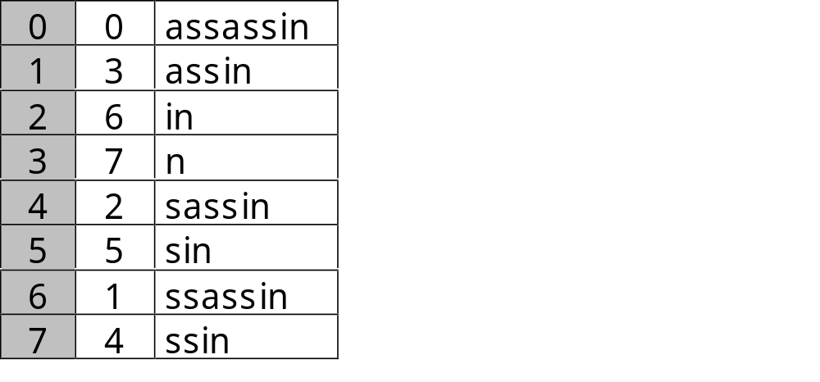
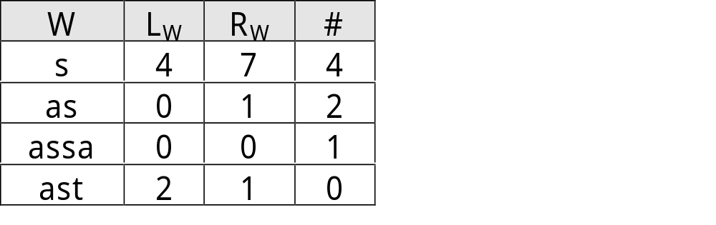
Example:
A = assassin
0 | 1 | 2 | 3 | 4 | 5 | 6 | 7
Pos

Slide 12
Solution
If W appears once, it will be at a certain i and W>(i-1) and W<(i+1) --> L=R=I
If W is larger than all -> L=N and R=N-1 --> # = 0
If W is smaller than all -> L=0 and R=-1 --> # = 0
If W isn’t there it should be between i and j=i+1 -> L=j and R=i --> # = 0
Solution is immediate with L_{W},R_{W}:
  Num of matches is (R_{W}-L_{W}+1)
  Matches are A_{Pos[LW]},…, A_{Pos[RW]}
Explanation:
  A_{Pos[RW]} W A_{Pos[LW]}
  But A_{Pos[LW]} A_{Pos[RW]}
  All k [L_{W},R_{W}] are =_{p} W
  If W is not a substring: L_{W} >R_{W}
Pos
W>A_{Pos[k]}
W<A_{Pos[k]}
L_{W}
R_{W}

Slide 13
Find Search Interval
Pos is in -order
Use simple binary search to find L_{W} and R_{W}
  O(logN) comparisons of O(P)
Find all instances of string W in text A in O(PlogN)

Slide 14

Improved Find of Search Interval
l = 0 = h and assuming N >> P, the search will constantly move to the left half,
h will remain 0 and no comparisons will be saved
Basic binary search for L_{W} / R_{W}:
  L,R are interval edges in cur iteration
  if (W A_{Pos[M]}) R = M // go left
  else (i.e. W > A_{Pos[M]}) L = M // go right
  at end: L_{W} = R
In each iteration: (L,M,R)
N-2 such triplets
Use lcps to improve binary search:

Slide 15
Define:
  l = lcp(A_{Pos[L]}, W), r=lcp(W, A_{Pos[R]})
  Update l,r in each iteration
  Llcp[M] = lcp(A_{Pos[LM]}, A_{Pos[M]})
  Rlcp[M] = lcp(A_{Pos[M]}, A_{Pos[RM]})
  Size N-2
  Constructed with Pos
  For now: assume Llcp, Rlcp are known

Slide 16
Example:
W = abc
l = 3
r = 2
abcde... |  |  | abcdf... |  |  | abd...
Pos
Llcp[M]=4
Rlcp[M]=2
L
M
R
Use Llcps to find L_{W} (Rlcp for R_{w})
Assume: r l: compare l and Llcp:

Slide 17
Example: W=abcx
Llcp[M]>l: Llcp[M]=4
Llcp[M]<l: Llcp[M]=2
l=3
r=2
abcde... | abc... | abc... | abcdf… |  |  | abd…
W>A_{Pos[L]}
W>A_{Pos[M]}
Go right
l is unchanged = 3
l=3
r=2
abcde... |  |  | abdf… |  |  | abd…
W<A_{Pos[M]}
Go left
r = Llcp[M] = 2

Slide 18


W=abcx
Llcp[M]=l: Llcp[M]=3
Similar cases for l r
Same comparisons using Rlcp for R_{W}
l=3
r=2
abcde... | abc... | abc... | abcp… |  |  | abd…
Compare W_{l} and A_{Pos[M]l} until W_{l+j} A_{Pos[M]l+j}:
Go right / left according to W_{l+j}, A_{Pos[M]l+j}
new l / r = (l+j)
Num of comparisons = j+1

Slide 19

Complexity
Max (j+1) comparisons in each iteration
j P
Total comparisons (P + #Iterations)
O(P+logN) running time
Requires only 3 N-sized arrays

Slide 20
Sorting – Building of Suffix Array
So far:
  Query in O(P+logN) given a sorted suffix array
Now:
  Sort suffixes to build the array
  Present efficient sorting algorithm

Slide 21


General Structure of Alg
O(logN) iterations:
  1st step: Sort in buckets by 1st char
  Assume correct sort according to first k symbols and inductively sort according to first 2k symbols
  Stages are numbered according to k:
  After H-th step buckets are sorted according to -order (buckets Pos)
  Referred to as “H-buckets”

Slide 22
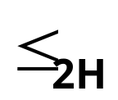
Intuition
Sort H-buckets to produce -order:
  A_{i}, A_{j} are in the same H-bucket
  Sort them by next H symbols
  Their next H symbols =
  first H symbols according to which
  A_{i+H} and A_{j+H} are currently sorted
H=2:
abef… | abcd… | ab… | bb... | bb… | cd… | cd… | ef…
A_{i}
A_{j}
A_{j+H}
A_{i+H}

Slide 23
Use this!
Let A_{i} be in 1st H-bucket after stage H
A_{i} starts with smallest H-symbol string
A_{i-H} should be 1st in its H-bucket
abef… | abcd… | ab… | bb... | bb… | cdef… | cdab… | ef…
A_{i}
A_{i-H}

Slide 24
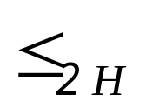
Algorithm
Scan the suffixes in -order
For each A_{i}: Move A_{i-H} to next available place in its H-bucket
In the resulting array: Every suffix with a diff 2H-prefix “opens” a new 2H-bucket
The suffixes are now sorted according to -order

Slide 25
Example:
After stage 1:
Pos
assin
assassin
in
n
sin
ssin
sassin
ssassin
After stage 2:
Pos
assin
assassin
in
n
sassin
sin
ssin
ssassin
After stage 3:
Pos
assassin
assin
in
n
sassin
sin
ssassin
ssin

Slide 26
Complexity
Stage 1:
  Radix sort on 1st symbol
  O(N)
Stage H > 1:
  Scan Pos array
  Const num of ops per element
  O(N) per stage
O(logN) stages
  H is multiplied in every stage

Slide 27
Sort in O(NlogN)
Space efficient implementation with only two N-sized integer arrays

Slide 28
Finding Longest Common Prefixes
Search algorithm requires sorted suffix array and lcp info
So far:
  Find solution given a sorted suffix array
  Constructing sorted suffix array
Now:
  Construct Llcp and Rlcp arrays
  Reminder:
    Llcp[M]= lcp(A_{LM}, A_{M})
    Rlcp[M]=lcp(A_{M}, A_{RM})

Slide 29
Overview
Present algorithm for lcp of adjacent buckets:
  Present algorithm
  Updating of lcps – operations required
Data structures
  Present new data structure
  Define operations on ds
Usage of data structure for lcp
  Find all Llcp, Rlcp efficiently

Slide 30
Algorithm – lcp for adjacent buckets
After stage 1 lcp of adjacent buckets is 0
Assume lcp for adjacent buckets is known after stage H
Use lcp_{H} to find lcp for newly adjacent 2H-buckets at stage 2H:

Slide 31

For A_{p}, A_{q} in the same H-bucket but different 2H-buckets:
  H lcp(A_{p}, A_{q}) < 2H
  lcp(A_{p}, A_{q}) = H + lcp(A_{p+H,} A_{q+H})
  lcp(A_{p+H,} A_{q+H}) < H
If A_{p+H} and A_{q+H} were in adjacent H-buckets - lcp is known
If not: Consider A_{p+H} , A_{q+H} in Pos:

Slide 32


Conclusion about lcp can be shown by induction
At stage H: A_{Pos[i]}, A_{Pos[j]} are not in adjacent buckets:
  Assume: i < j (i.e. A_{Pos[i]} < A_{Pos[j]})
  Known: lcp(A_{Pos[i]}, A_{Pos[j]}) < H
  Pos is in -order
lcp(A_{Pos[i]}, A_{Pos[j]}) =
min{ lcp(A_{Pos[k]},A_{Pos[k+1]}):k [i,j-1] }
H=4:
abcd… | abcd… | abce… | abde... | acdf… | aceg… | cd… | cd…
i
j
A_{p+H}
A_{q+H}

Slide 33
Updating of lcp - Implementation
Hgt(i)=lcp(A_{Pos[i-1]}, A_{Pos[i]}), 1 i N-1
Hgt is computed inductively with sort:
  Hgt is inited to N+1
  Step 1: Hgt(i)=0 for A_{Pos[i]} that are first in their buckets
  Step 2H: Hgt(i) is updated at stage 2H iff H lcp(A_{Pos[i-1]}, A_{Pos[i]}) < 2H
  Correctness: All lcps < H will have been updated by step H

Slide 34
Example: A = assassin
H=1
assin
assassin
in
n
sin
ssin
sassin
ssassin
9
0
0
0
9
9
9
H=2
assin
assassin
in
n
sassin
sin
ssin
ssassin
9
0
0
0
1
1
9
lcp(ssin,sin)=1+lcp(sin,in)=1+min{lcp(in,n),lcp(sin, n)}=1
H=4
assassin
assin
in
n
sassin
sin
ssassin
ssin
3
0
0
0
1
1
2

Slide 35
Data Structures + Operations
Interval Tree:
  O(N)-space height balanced binary tree
  leaf i corresponds to Hgt (i)
  Invariant for interior node v:
  Hgt[v] = min(Hgt[left(v)], Hgt[right(v)])
Set(i,h)
  Set Hgt[i] = lcp(A_{Pos[i-1]}, A_{Pos[i]}) to h
  Maintains invariant from i up to root
  O(logN)

Slide 36
Min_Hgt(i,j) = min{Hgt[k]:k [i,j]}
  a = nearest common ancestor (i,j)
  P={ nodes from i to a (excluding a) }
  Q={ nodes from j to a (excluding a) }
  Return:
  min{Hgt[i], Hgt[j],
  Hgt[w]:w=right(v), v P, w not in P,
  Hgt[w]:w=left(v), v Q, w not in Q}
  O(logN)

Slide 37
Example: Min_Hgt
4
d
3
c
2
b
1
a

Slide 38
Example: Interval Tree
0
1
0
9
0
0
1
9
(0,1)
(1,2)
(2,3)
(3,4)
(4,5)
(5,6)
(6,7)
3
1
1
2
9
0
0
0
9
9
9

Slide 39
Complexity
If m leaves are updated in stage H:
  O(N) - find the m leaves that just “opened” new buckets
  O(mlogN) - m updates
  O(N+mlogN) per stage
m = N
Total O(NlogN) to compute Hgt

Slide 40
Usage for Llcp+Rlcp
There are, as stated, N-2 possible M points and N-2 interior nodes
Shape tree so that:
  Each M has interior node (L_{M},R_{M})
    Exactly N-2 interior nodes in tree
  For each interior node:
    left(L_{M},R_{M}) = (L_{M}, M)
    right(L_{M},R_{M}) = (M, R_{M})
  Leaf(i-1,i) = Hgt[i]
Then Llcp and Rlcp are directly available from tree at end of sort

Slide 41
Expected-case Improvement
Probability for all k-length words is 1/|E|^{k} and the 2 repetitions can be at any 2 indices i,j
(minus the k at the end) -> #options for indices < (N*N)/2 --> Pr for rep of length k = O((N*N)/(2*|E|^{k})).
If k=logN, base |E|, then Pr=N/2 > 1. If k=2logN, base |E|, then Pr=1/2.
If k=3logN, base |E|, then Pr=1/(2*N). I.e. between logN and 2logN, Pr goes under 1. Since we need O(),
we’ll take all k<=2logN with Pr=1.
Exp = Sigma 0<=k<=2logN : k*1 + Sigma 2logN<=k<=N/2 : K*(N*N)/(2*|E|^{k}).
Calc both with integrals under the assumption that N is very big.
Intuition: The small nums < 2logN have a big prob of being repeated, the big nums > 2logN have a small
chance of being repeated -> 2logN is logical as the mean.
Improved expected-case algs for:
  Search
  Sorting – building of suffix array
  lcp calculations
  Drawback: space
Assumption:
  All N-symbol strings are equally likely
  Under this assumption: Expected len of longest repeated substr = O(log| |N)

Slide 42
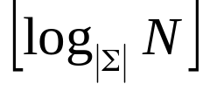



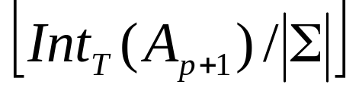
Basic Method Used
Isomorphism: had-had-erki and al. It won’t necessarily cover [0,N-1] because we took floor of log.
Let T =
Int_{T}(u) = integer encoding in base | | of the T-symbol prefix of u
Map each A_{P} to Int_{T}(A_{P}):
  Isomorphism onto [0,| |^{T}-1] [0,N-1]
  -order on ints -order on strings
Compute Int_{T}(A_{P}) for all p in O(N):
  Int_{T}(A_{P}) = a_{p}| |^{T-1} +

Slide 43
Expected-case Search
Intuition:
  Complexity is in finding L_{W}, R_{W}
  Narrow search interval to suffixes that are =_{T} W
Define:
Buck[k] = min{ i : Int_{T}(A_{Pos[i]}) = k }
  | |^{T} non-decreasing entries
  Computed from Pos in O(N)

Slide 44

|E|^{M} options for words in N places ->
average of N/|E|^{M} times per word = the avg diff between i’s in adjacent buckets
Given a substring W:
  k = Int_{T}(W)
  O(T) to compute
  L_{W}, R_{W} [Buck[k], Buck[k+1]-1]
  Contains all suffixes that are =_{T} W
  Limit the search interval to avg N/| |^{T}
  O(1) expected-size interval
Search in expected O(P)

Slide 45
Expected-case Sorting
Step 1 of alg:
  Radix sort on Int_{T}(A_{P})
  Int_{T}(A_{P}) [0,N-1] – still O(N)
  Extend base from 1 to T at no added cost
Num of steps is a small const:
  Stop once longest repeated substr is sorted
  Exp len of longest repeated substr = O(T)
O(N) expected-case sorting

Slide 46
Expected-case Calculation of lcp
The leaves are in an array, so each suffix can be reached by its index
Build tree to model bucket refinement during sort:
  Node for each H-bucket (that is diff from its H/2-bucket)
  Leaves = suffixes
  Each node has at least 2 children
  O(N) nodes
  Each node holds its split stage
  Built in O(N) during the sort

Slide 47
Compute lcp(A_{p},A_{q}) recursively:
  Find a=nca(A_{p},A_{q}) in O(1)
  Stage of a = H
  lcp(A_{p},A_{q}) = H + lcp(A_{p+H},A_{q+H})
  Find lcp(A_{p+H},A_{q+H}) recursively
  Stop when nca = root
  Each stage takes O(1)

Slide 48
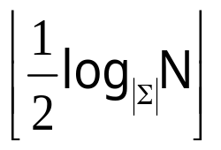
  H is at least halved in each iteration
  Exp lcp < exp len of longest repeated substring = O(log| |N)
  Stop recursion once H < T’ =
  O(1) steps on average
Left to find: an lcp known to be<T’:

Slide 49
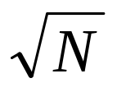
Build | |^{T’}-by-| |^{T’} array:
  Lookup[Int_{T’}(x), Int_{T’}(y)] = lcp(x,y) for all T’-symbol strings x,y
  Max N entries (| |^{T’} = )
  Compute incrementally in O(N)
  Final level of recursion is O(1) lookup
Compute lcp in exp O(1)
Produce lcp arrays in exp O(N)

