Slide 1

GIT
A short presentation
Tom Van de Steene

Slide 2

VCS?
Version Control System
System that records changes of files
Advantages:
BACK TO THE PAST!

Slide 3
History
3 generations
1st: Local
2nd: Centralized
3rd: Distributed

Slide 4
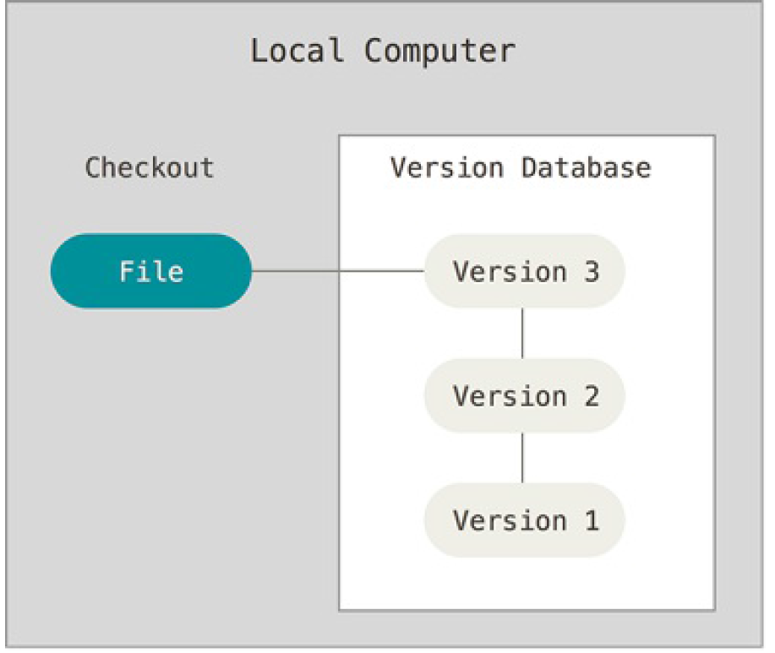
Local Version Control
One machine
Difficult to share work
High risk of losing work
Bvb : RCS

Slide 5
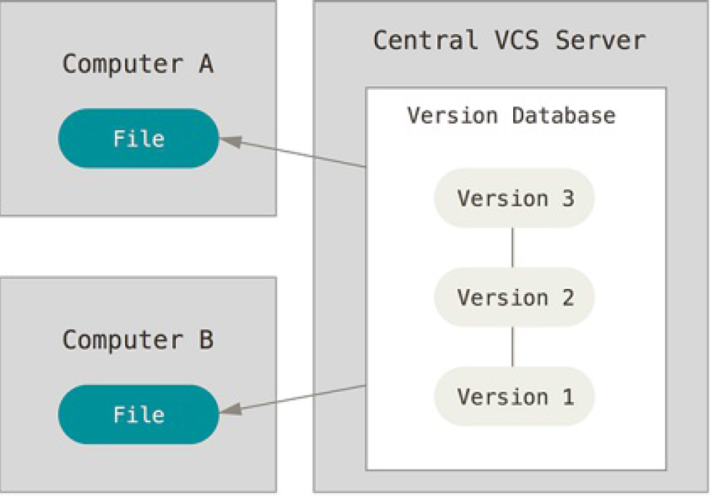
Centralized Version Control
Keeps changes in a central database
The local computer has the last snapshot
Easy to share work
Still dangerous to break a version
Bvb: CVS, SVN

Slide 6
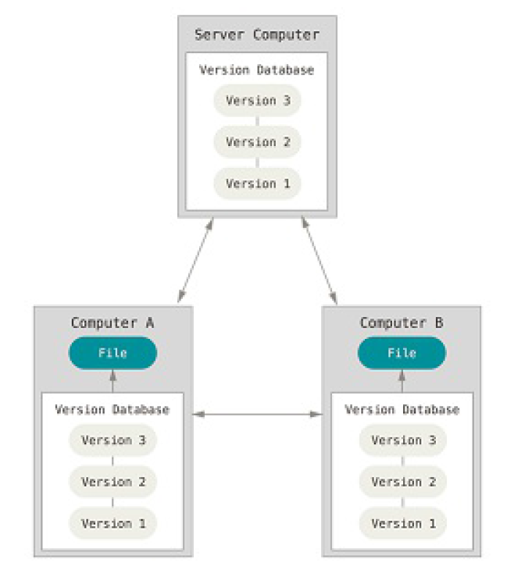
Distributed Version Control
Complete history of complete project on each computer
More local memory necessary
Very low risk to lose work
Infrastructure to synchronize with others
Mostly combined with central repository(ex: GitHub)
Bvb : Git, Mercurial

Slide 7
GIT
Modern 3th generation VCS
Open Source
Linus Torvalds (LINUX)
For little and huge projects
Complex with steep learning curve
Using it alot will teach you GIT
Git : a stupid or worthless person (especially a man)

Slide 8
Online Git Services
GitHub
BitBucket
GitLab
…

Slide 9
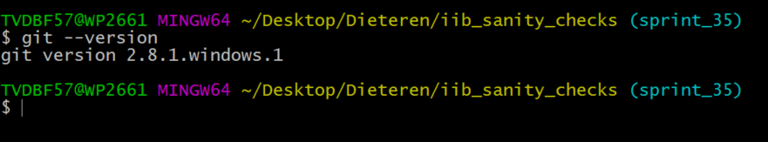
Install Git
https://git-scm.com/download

Slide 10
CLI vs GUI
GUI ex.: Gitkraken, SourceTree, …
https://git-scm.com/downloads/guis
GUI tools use GIT commands behind the screens
Use CLI!
GitBash

Slide 11
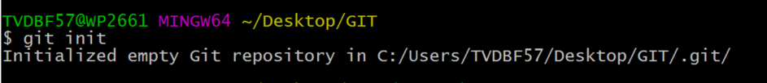
MyFirstGitProject
1. Create new repository on GitHub
2. Open GitBash
3. Change working directory to local project
4. Initialize local directory to local Git repository

Slide 12
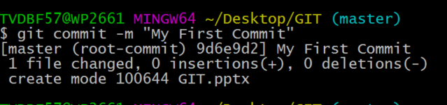
MyFirstGitProject
5. Add files to local repository
µ
6. Commit the files

Slide 13
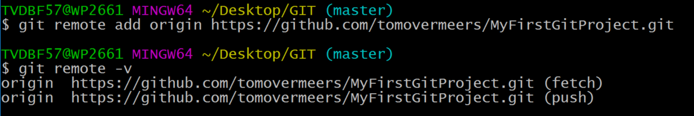
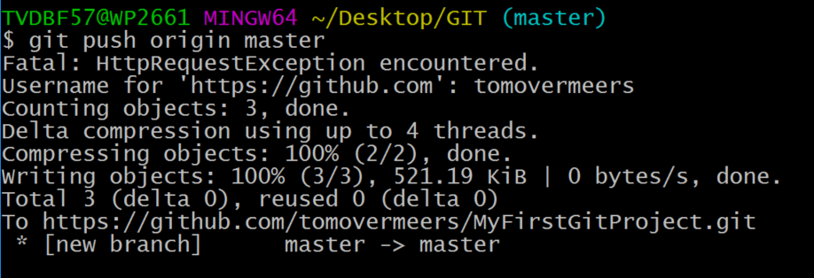
MyFirstGitProject
7. Link project to the remote repository
8. Push

Slide 14
Working Tree States
4 states
Untracked: newly added files (red)
Unstaged: changed files already known by git; not included in next commit (red)
Staged: changed files included in next commit (green)
Commited: Saved files into git and has no changes since. Considered clean.

Slide 15
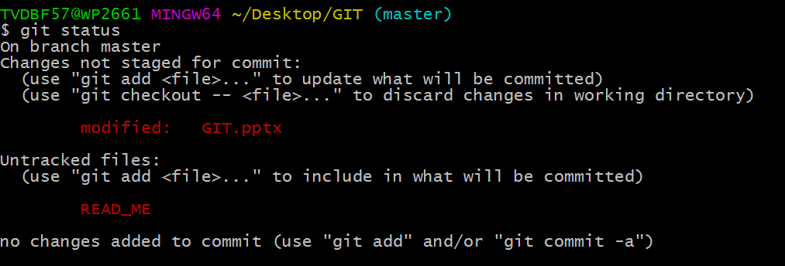
Unstaged / Untracked

Slide 16
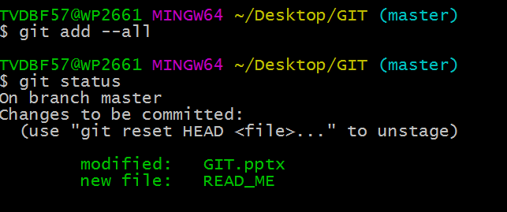
Staged

Slide 17

Commited

