Slide 1
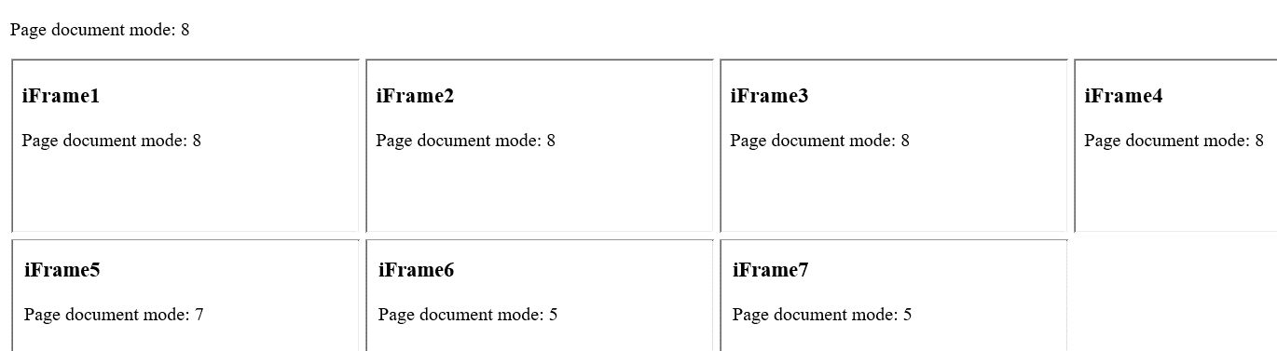
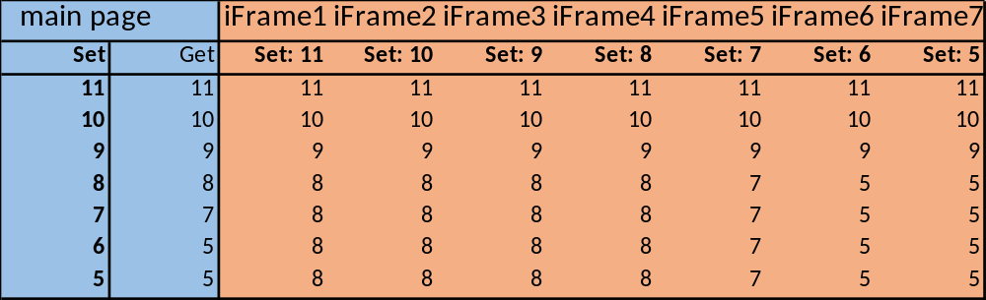
IE11 Document Mode Test for Main Page And 7 iFrames Set Using "X-UA-Compatible“ Tag
Screen Image
IE11 Document modes for main page and 7 iframes on this page as observed at set and get (read) operations

