Slide 1
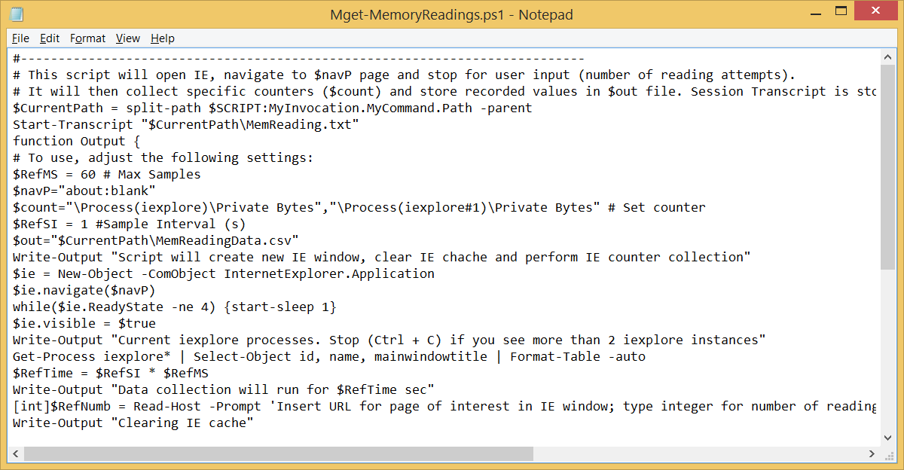

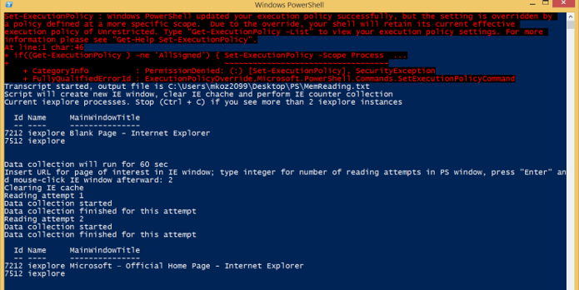
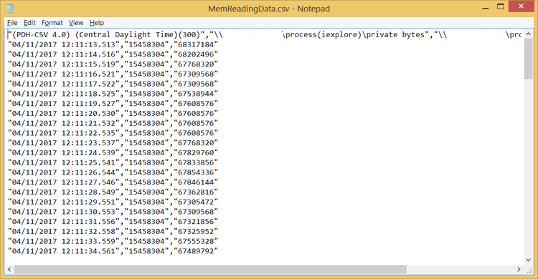
IE Memory Leak/Allocation Logging
Code
Page
Output
Data File

Slide 2
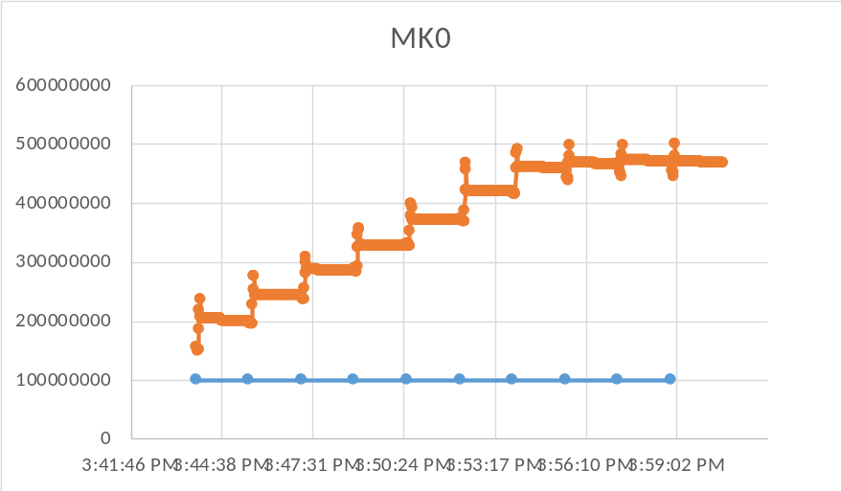
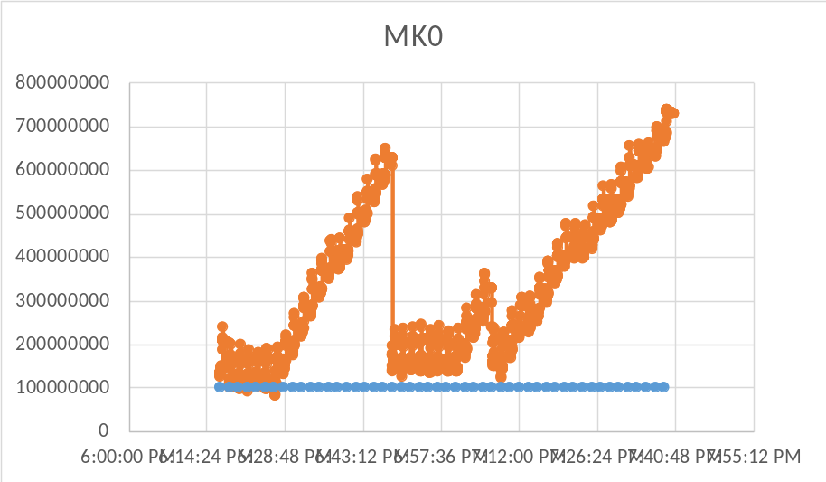
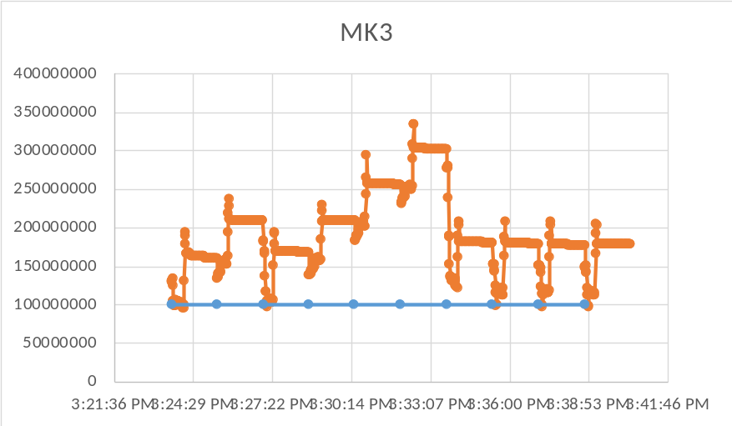
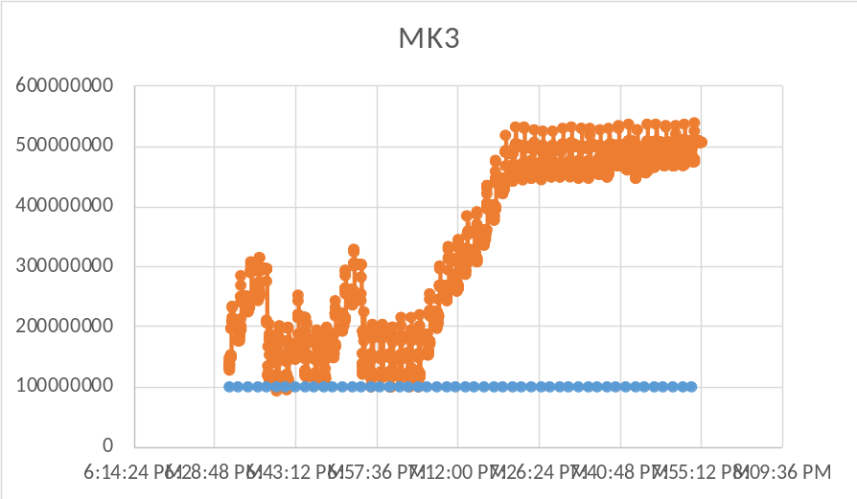
IE Memory Leak/Allocation Logging: 1
Memory Readings
Action Trace
Collected over short period of time: High Resolution
Collected over long period of time: Reproducibility

Slide 3
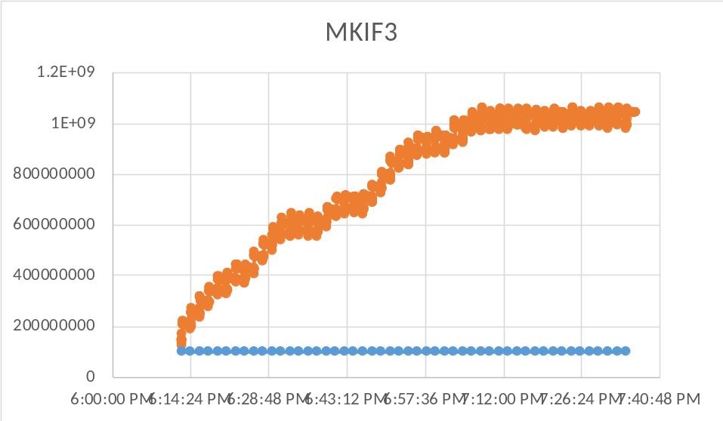

IE Memory Leak/Allocation Logging: 2
Page loaded in IFRAME: Memory is high
Page loaded with NetSh Trace On: Memory is high
Numerous Conditions can be set up and tested automatically

Slide 4
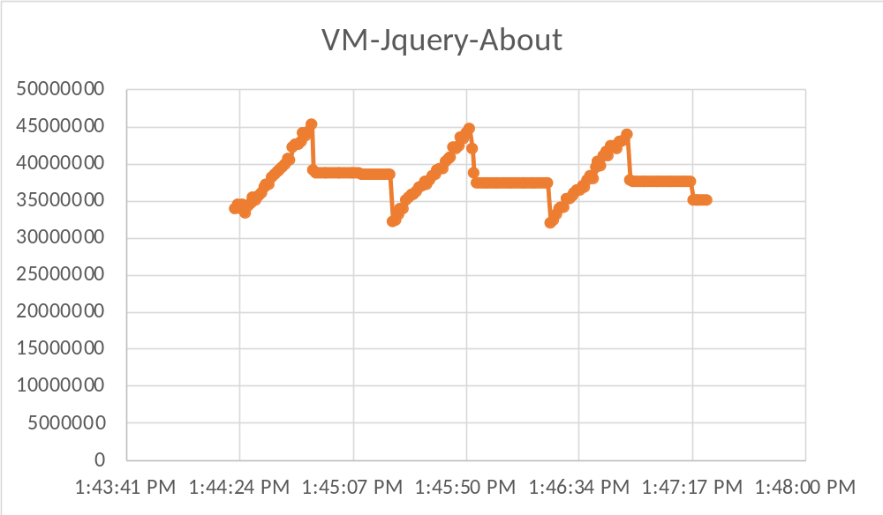
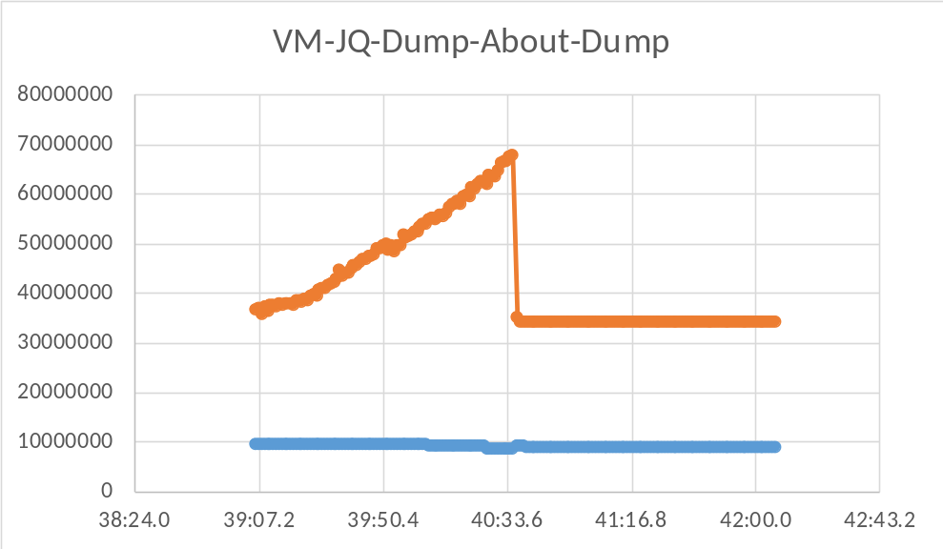
IE Memory Leak/Allocation Logging: 3
Memory Trace for app (MT) & abaut:blank link (AB)
AB
AB
AB
MT
MT
MT
Memory Trace for app (MT) & abaut:blank link (AB)
followed by Memory Dumps (MD)
MD
MD
MT
AB

