Slide 1
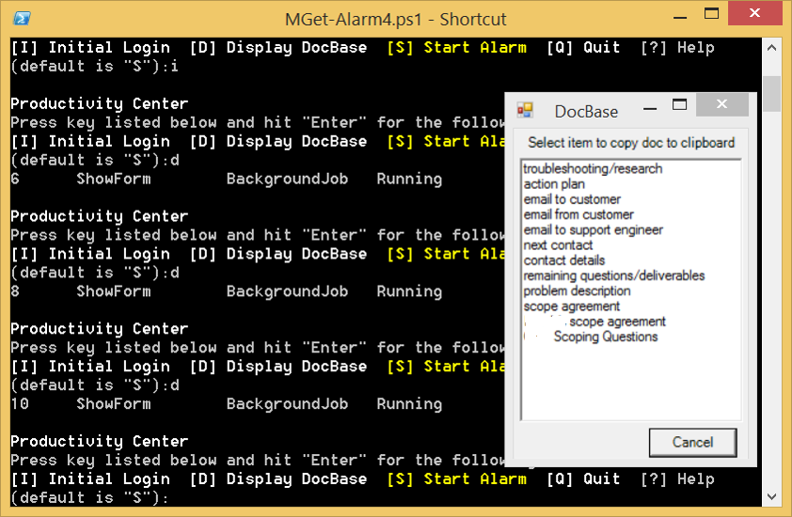
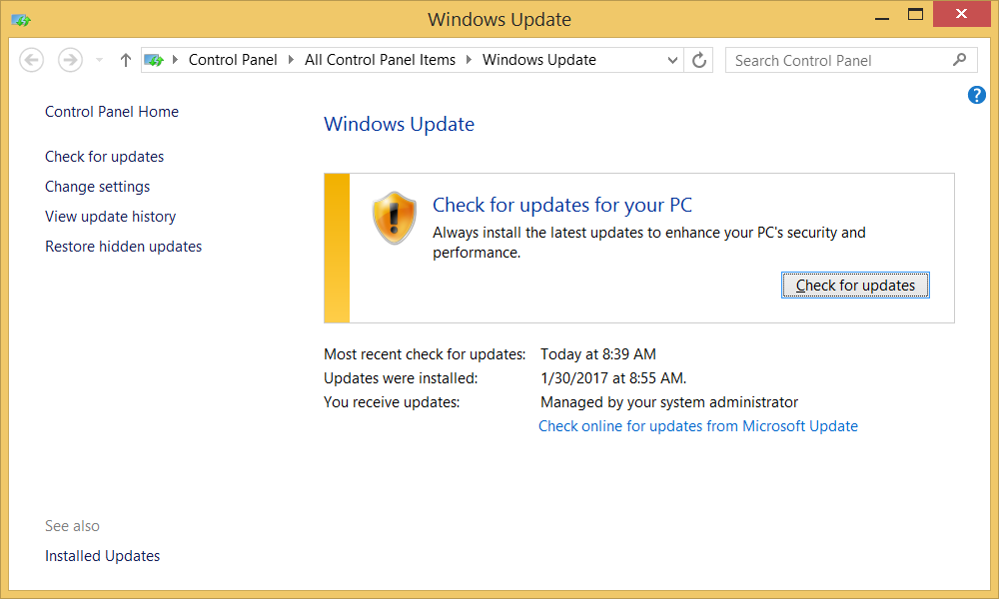
PowerShell Workday Productivity Tool
Provides the Following Features
Creates Workday Environment
  starts Software
  checks for updates
  opens Web pages
Shows Document Base entrees for quick information access
Starts Workday timer/voice reminder
…
Runs Automatically at Computer Login
Can be used company-wide

