Slide 1
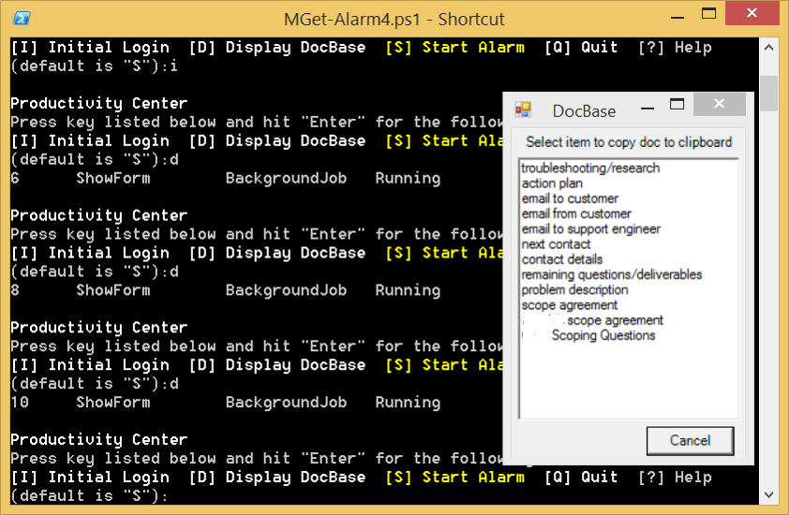
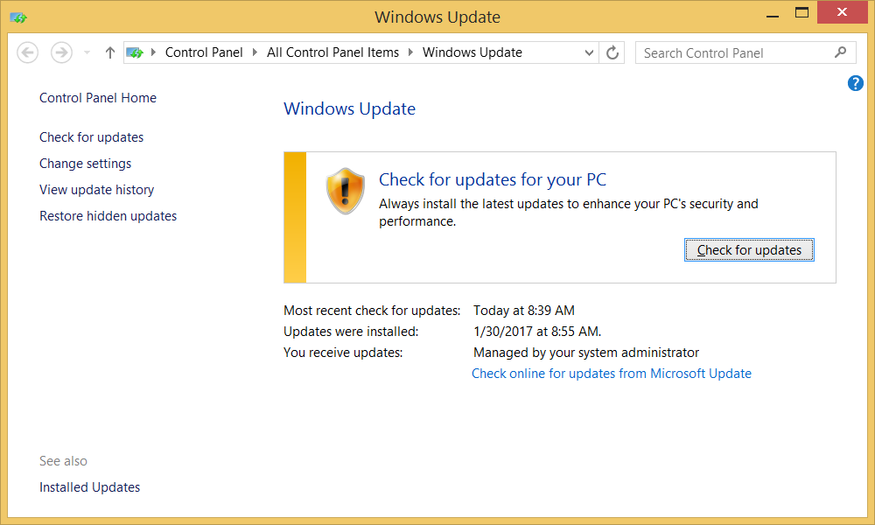
PowerShell Workday Productivity Tool
Provides the Following Features
Creates Workday Environment
starts Software
checks for updates
opens Web pages
Shows Document Base entrees for quick information access
Starts Workday timer/voice reminder
…
Runs Automatically at Computer Login
Can be used company-wide

