Slide 1
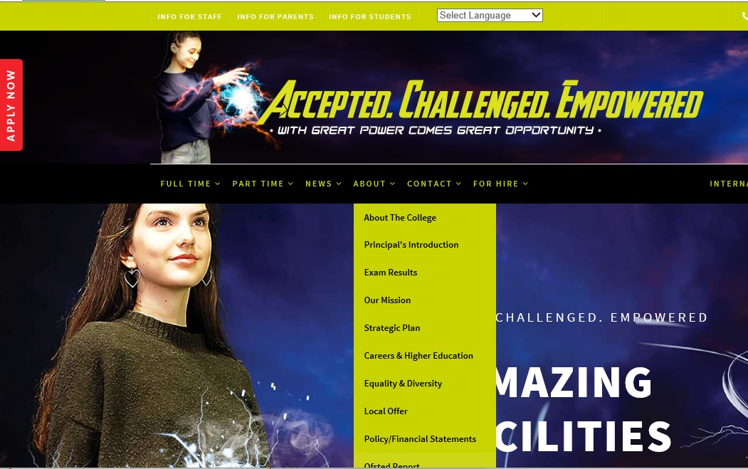
Usability Presentation
Accepted. Challenged. Empowered.
A New UX for Bexhill College
bexhillcollege.ac.uk
Thomas Owens BA (hons), [Student ID: 271057] for Digital Business.
Notes:
Read all lectures, social media, email marketing reqs. Accessib reqs,,,, h walkthru w/ notes. Pay attn to errors, accessibility, ofsted reqs. 11 minutes

Slide 2
Contents
Accepted. Challenged. Empowered.
UX Principles
Why it matters
UX Process, The Walkthrough
Accessibility Review
Conclusion
Social Media Strategy
Email Marketing Strategy
Open Day Solution
Recommendations
References
Notes:
Customer dont just buy they are patrons of the website. The User. types of USer, students and parents, job seekers, affiliates and partners. Suppliers, the media.
What make UX Important.
Need to research the types of users for that industry not current users as we may consider that but this is about improvement not maintaining things the way they are and improving the current UX.
So new users / Existing Users.

Slide 3
UX Principles.
Minimalist
Consistencies
Match ... Real World
COLOUR
MOOD BOARD
Flexibility
...recover from errors
BRAND
Nielsen 1995
GOALS
...Control and Freedom
You
Recognition Not Recall
UX
Help & Documentation
3 Click Rule
Knows What They want
UI
Visibility of ...Status
CALL OUTS
Error Prevention
(Usability.gov, 2018)
≠
Affordance
The Fold
UX
Decoration
Visibility
Stickiness
Norman (Mantz 2012)
Conflict
REDIRECTS
User
Feedback
HCI
The Changing User
Constraints
SEO
Color Blindness [...] do not…
overwhelm color cues (Tognazzini, 2014)
Notes:
Customer dont just buy they are patrons of the website. The User. types of USer, students and parents, job seekers, affiliates and partners. Suppliers, the media.
What make UX Important.

Slide 4
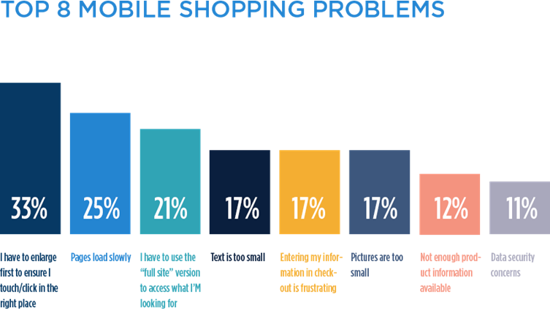
Why it matters
UX ROI
Why It Matters
CRO
UX / Usability
Conversion
(Ratcliffe, 2018)

Slide 5
UX Process: The Walkthrough
Recommendations.
Perhaps SEO Factors Considered
Expert, Heuristics
Notes / Evaluation
Walkthrough
Cognitive
Designs
Pluralistic
Wireframes
Find Patterns Analytics

Slide 6
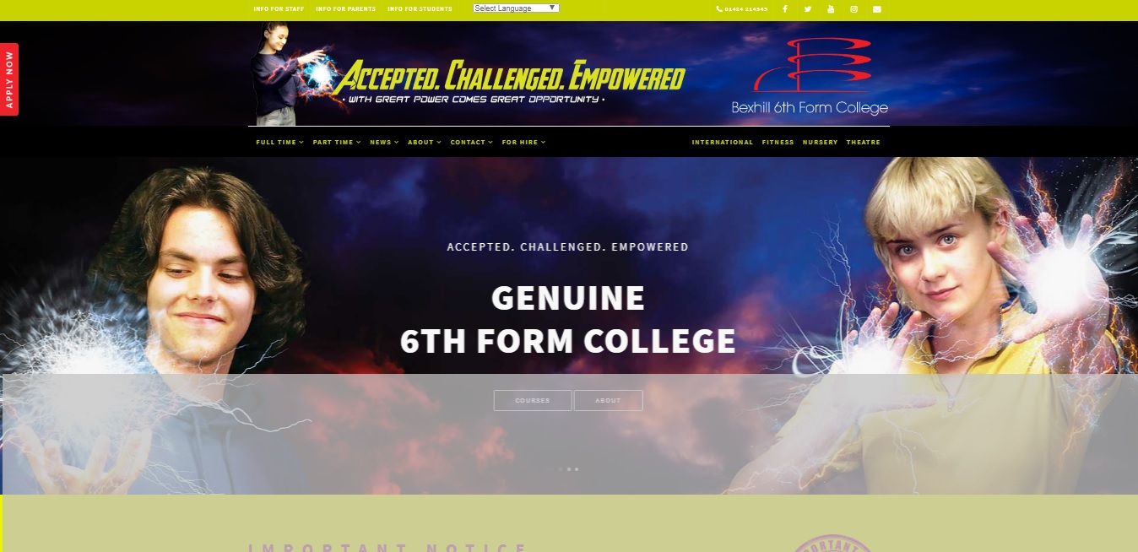
The Fold on a (1366x768) Display.

Slide 7
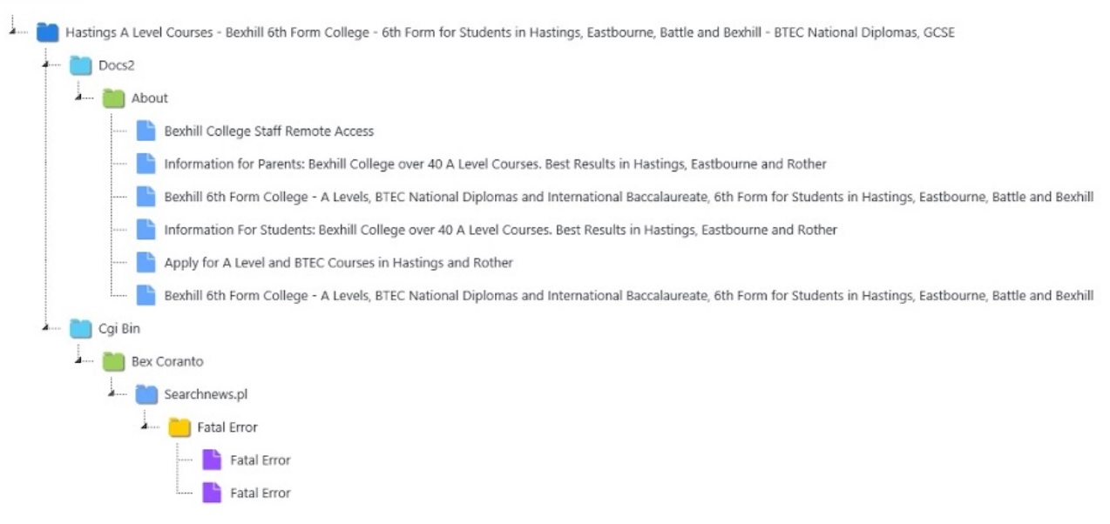
Visual Site Map
Pages Crawled
Derive a Sitemap
Scale of task.
Courtesy of Dyno Mapper. Accessed: 2018 https://dynomapper.com/features/visual-sitemap-generator

Slide 8
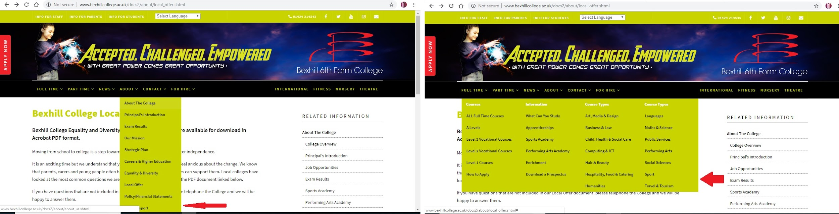
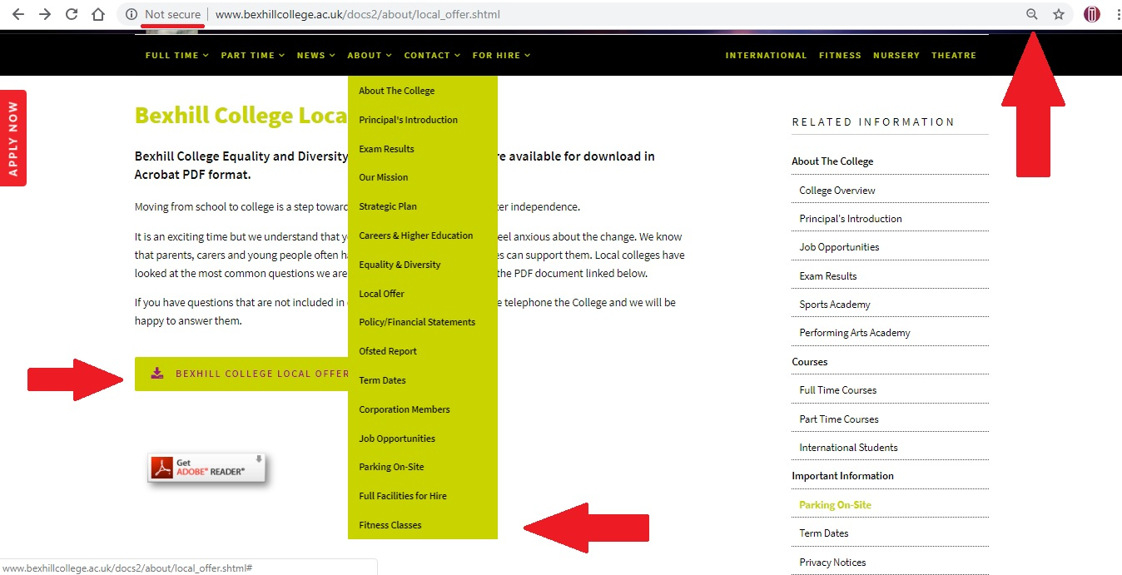
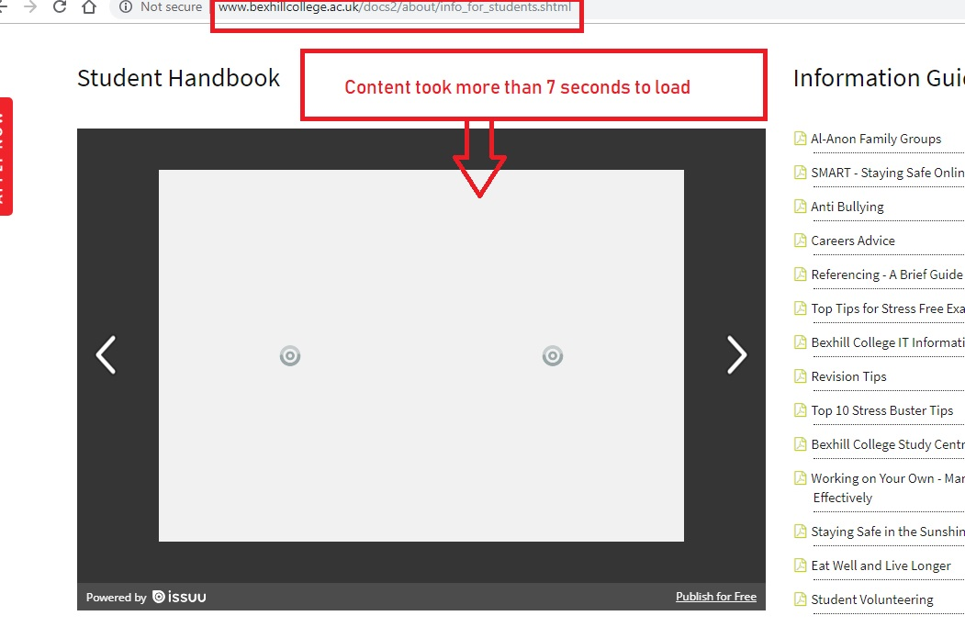
1
2
(Work, S. 2014)
4
3
Info for Students page

Slide 9
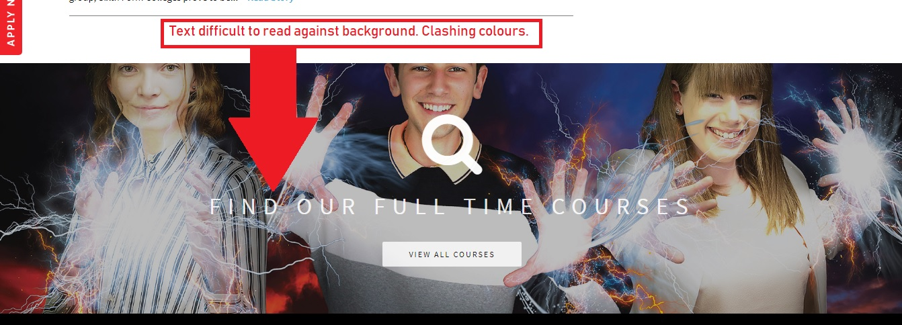
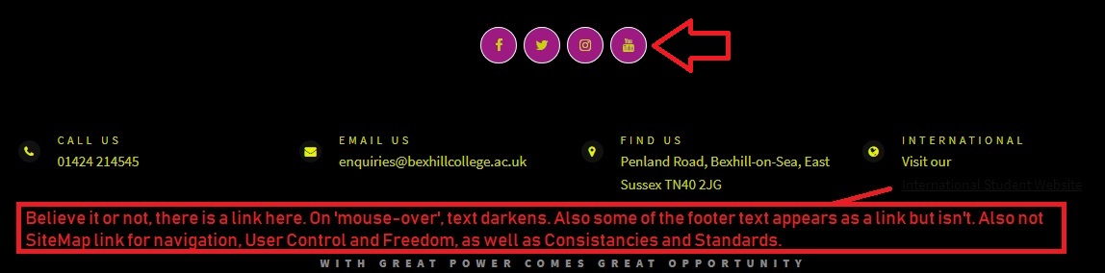
Key Points
Visibility
Affordance
(Mantz 2012)

Slide 10
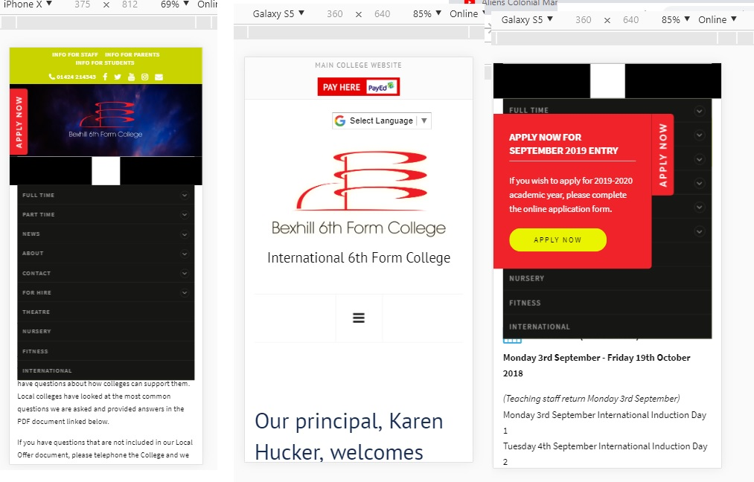
2
3
X
1

Slide 11
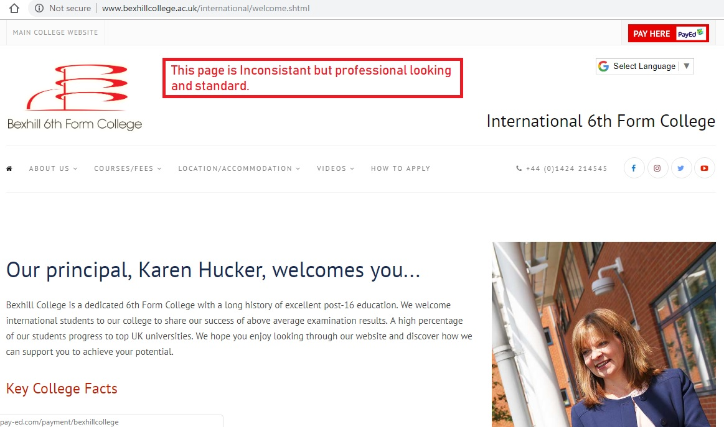

Slide 12
Accessibility Review
CAPTIONS
INTUITIVE, DON’T MAKE ME THINK.
(Krug 2000) STANDARDS
Screen readers
Bexhill is OfSted Compliant
OFSted
(Ofsted, 2018)
UK LAW
Equalities Act
2010
LAWS AND REGS in FOREIGN TERRITORIES such as the US
SCREEN READERS
ACCESSIBILITY LAW
INFO, NO NEED TO CALL
WEB STANDARDS
w3c
EU LAW
(Mueller, 2018)

Slide 13
Conclusion
What is currently done well
Parallax Scrolling
OfSted Content Compliant
Format of Text
Call Outs
What can be improved
Responsiveness
Resolve Confusing Structure
Branding and Consistency
Moodboarding
Notes:
Half way through

Slide 14
Social Media Strategy - Advice
Article 13 (EU, 2016)
Well Being, Social (ONS, 2016)
Appropriate channels
Twitter is News, Instagram events, You Tube Media, facebook is a business page.
Legalities around imagery and children (Dept. Culture, 2016)
Student engagement, how long a student spends on social media.
F
In
t
What Works For Schools/ Colleges
Social Media Strategy
Apply to Bexhill
Yt
Numbers
Expects CR
Engagement.
Students Online Time Spend
Competition Analysis
insta
Legalities
Imagery
Worth Knowing
Notes:
Permissions of parents, Running a social media campaign, appropriate channels.

Slide 15
Email Marketing Strategy - Advice
Legal issues
Building an email list
I refer you to my handout.
Email Marketing Strategy
GDPR
(IOC 2018)
Goals
UX of Sign Up
Stickiness
Optimise Page for Sign Up’s
Mailing List
Competitions
Sign Up’s
Market Research, Understand User
Other Legalities,
Can not be Purchased
UX Conversion
Existing Users
Content Design
Mail Chimp ™

Slide 16
Bexhill Open Day
Prototyping
Optimise page
ENGAGING IMAGERY
Social Media
Keywords
Website Booking
CALL OUT
Open Day Solutions
Targeting GCSE Parents.
BODY OF TEXT
REVERSE FORMAT
Event
Email
SOCIAL ICONS
FOOTER
Notes:
WHO TO TARGET, PARENTS GCSE STUDENTS, HOW TO TARGET THEM.
Optimise page to ensure sign up
Best practice in email campaign design

Slide 17
Recommendations
STICKINESS
(WFI, 2018)
Pluralistic & cognitive walkthrough, 10-15 Evaluators (Wong, 2018)
Importance of demographic targeting, Analytics
Virtual Worlds (Barneche & Hernández, 2014)
Visual and HTML Sitemap
Greater responsiveness.
Search Feature
Prototyping (Usability.gov, 2018)
Persona Development
Social Channels: Twitter: News, Instagram: Events, You Tube: Instructional.
WATCH THIS VIDEO
FREE TRIAL
CLICK HERE TO
TAKE A LOOK AROUND

Slide 18
Thank you
Any Questions?

Slide 19
References
Barneche Naya, V. Hernández Ibáñez, Luis Antonio. (2014). Evaluating user experience in joint activities between schools and museums in virtual worlds. [Online]. Available: https://link.springer.com/article/10.1007/s10209-014-0367-y [Accessed: 08 December 2018]
Digital, Culture, Media & Sport, Dept. for (2016). Child Safety Online: A Practical Guide for Providers of Social Media and Interactive Services. [Online] Available: https://www.gov.uk/government/publications/child-safety-online-a-practical-guide-for-providers-of-social-media-and-interactive-services/child-safety-online-a-practical-guide-for-providers-of-social-media-and-interactive-services [Accessed: 7 December 2018]
Education, Dept. for (2018). What maintained schools must publish online. [Online] Available:gov.uk/guidance/what-maintained-schools-must-publish-online [Accessed: 7 Dec 2018]
European Parliament and Council, For The. (2016). DIRECTIVE OF THE EUROPEAN PARLIAMENT AND OF THE COUNCIL on copyright in the Digital Single Market. Ch 2, Article 13. [Online]. Available: https://eur-lex.europa.eu/legal-content/EN/TXT/HTML/?uri=CELEX:52016PC0593&from=EN [Accessed: 07 December 2018]
Hazaël-Massieux, Dominique 2018. MOBILE WEB. [Online] Available: https://www.w3.org/standards/webdesign/mobilweb [Accessed: 7 Dec 2018]
HSS 2018. 1:1 Provide Useful Content. [Online] Available: https://webstandards.hhs.gov/guidelines/1 [Accessed 7 Dec 2018]
IOC (2016). Guide to the General Data Protection Regulation (GDPR) [Online] Availability: ico.org.uk/for-organisations/guide-to-the-general-data-protection-regulation-gdpr/ [Accessed: 7 Dec 2018]
Krug, S. 2000, Don't Make Me Think, Revisited: A Common Sense Approach to Web Usability. 2nd edn, New Riders Press.
Nielsen, J. (1995). 10 Usability Heuristics for User Interface Design. [Online]. Available: https://www.nngroup.com/articles/ten-usability-heuristics/ [Accessed: 7 Dec 2018]
Matz, K. (2012). Donald Norman’s design principles for usability. [Online]. Available: architectingusability.com/2012/06/28/donald-normans-design-principles-for-usability/ [Accessed: 7 December 2018]
Mueller, Mary Jo. Jolly, R. Eggert, (2018). Equality Act 2010. [Online] Available: https://www.w3.org/WAI/policies/united-kingdom/#equality-act-2010 [Accessed: 7 Dec 18]
Mueller, Mary Jo. Jolly, R. Eggert, E. (2018). Web Accessibility Laws & Policies. https://www.w3.org/WAI/policies/ [Accessed: 7 Dec 18]
ONS(2016). Selected measures of children's well-being by time spent on social networking websites: UK, 2013 to 2014.[Online]Available: ons.gov.uk/peoplepopulationandcommunity/wellbeing/adhocs/006049selectedmeasuresofchildrenswellbeingbytimespentonsocialnetworkingwebsitesuk2013to2014. [Accessed 7 Dec 18]
Ratcliff, C, 19 June 2018. 12 fascinating stats about UX and usability testing to help your business case. [Online] Available: https://www.userzoom.com/blog/fascinating-stats-about-ux-and-usability-testing-to-help-your-business-case/ [Accessed: 7 December 2018]
Tognazzini, Bruce.(2014). First Principles of Interaction Design. [Online]. Available: https://asktog.com/atc/principles-of-interaction-design/ [Accessed: 9 December 2018]
Usability.gov, 2018. 3-click rule. [Online] Available:https://www.usability.gov/what-and-why/glossary/3-click-rule.html [Accessed: 7 Dec 18]
Usability.gov (2018). Prototyping. [Online]. Available:usability.gov/how-to-and-tools/methods/prototyping.html [Accessed: 8 Dec 2018]
Web Finance Inc 2018. sticky site [Online]. Available: http://www.businessdictionary.com/definition/sticky-site.html [Accessed: 7 Dec 2018]
WONG, E.(2018). Heuristic Evaluation: How to Conduct a Heuristic Evaluation. [Online]. Available: interaction-design.org/literature/article/heuristic-evaluation-how-to-conduct-a-heuristic-evaluation [Accessed: 8 December 2018]
Work, S (2014). How Loading Affects Your Bottom Line. [Online]. Available: https://blog.kissmetrics.com/wp-content/uploads/2011/04/loading-time.pdf [Accessed: 7 December 2018]
Notes:
All the books that influenced content /

