Slide 1
ADVANCED SYSTEMS ENGINEERING 25.6.2026
Can AI Develop a Slicer?
RQ1 · Feasibility
RQ2 · Performance
Can an experienced FDM 3D-printer user with no slicer or geometric-computing expertise develop a working slicer using only AI?
How does the AI-built slicer compare to professional software (Ultimaker Cura) in terms of dimensional accuracy and print time?
Thomas Martin Pfister
University of Salzburg
1 / 5

Slide 2
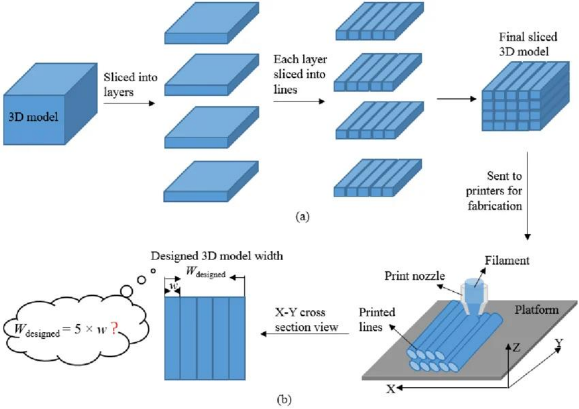
What is a slicer?
A slicer is the compiler. It turns a 3D model into machine instructions (G-code) — the way gcc turns C into assembly.
Input — the STL file: just a soup of triangles with no idea which form a wall or a hole. Rebuilding that structure is the hard part.
Example entry triangle in an STL file:
Model → layers → printer toolpaths. (Jin et al., 2020, CC BY 4.0)
facet normal 0 0 -1
outer loop
vertex 0 0 0 / vertex 10 0 0 / vertex 10 10 0
endloop
endfacet
University of Salzburg
2 / 5

Slide 3
Building the slicer with AI
STL
triangle soup
→
JSON
ordered contours
→
G-code
printer commands
~2,700 lines of Go — every line written by AI from natural-language prompts.
AI models used
44
GPT-5.3 Codex
early development phase
prompts kept — out of 150+ issued
GPT-5.4-mini
later phase
30 remain in the live code
University of Salzburg
3 / 5

Slide 4
Results: the numbers
Mean deviation from nominal (in mm, rounded) with per-axis breakdown, and mean print time, vs. Ultimaker Cura.
Object · Dev. / Time / per-axis | Cura matched | Vibe Slicer | Cura opt. (ref.)
cube outer | +0.06 / 09:04 X +0.02 Y +0.13 Z +0.02 | +0.06 / 07:47 X +0.03 Y +0.15 Z +0.01 | −0.01 / 11:32 X −0.03 Y −0.01 Z +0.01
Hole outer | +0.08 / 28:33 X −0.02 Y +0.30 Z −0.05 | +0.07 / 46:12 X −0.08 Y +0.30 Z −0.01 | +0.03 / 31:47 X −0.03 Y +0.16 Z −0.03
10 mm hole | −0.05 X −0.07 Y −0.03 | −0.10 X −0.17 Y −0.02 | −0.01 X −0.01 Y 0.00
20 mm hole | −0.07 X −0.18 Y +0.04 | −0.08 X −0.16 Y +0.01 | −0.04 X −0.09 Y +0.02
Summary Vibe Slicer: matched accuracy under matched parameters; 14% faster on the cube, 62% slower on the holed plate.
University of Salzburg
4 / 5

Slide 5
Conclusion
RQ1 · Feasibility
Yes* — a working slicer can be built entirely by prompting.
* Very challenging without G-Code experience
* Implementing complex shapes purely AI-based proved very difficult with the AI models used.
RQ2 · Performance
Comparable accuracy on simple geometry; significantly longer print time on complex parts.
Same parameters → matched accuracy and a faster cube; 62% slower print time on the holed plate.
Open question: would a different AI model — or handing the AI a geometric library (Clipper2) — handle complex shapes better?
Next — live demo.
University of Salzburg
5 / 5

