Slide 1
Datenschutzfreundliche Speicherung unternehmensinterner Überwachungsdaten mittels Pseudonymisierung und kryptographischer Schwellwertschemata
20. März 2018
Tom Petersen
Universität Hamburg
Fachbereich Informatik
Notes:
Langsam sprechen
Einen Schluck Wasser nehmen, wenn nötig
Körperhaltung: aufrecht
Zu Vortragsbeginn: Schultern gerade, entspannen

Slide 2
Privacy-preserving storage of enterprise logdata using pseudonymisation and threshold cryptosystems
20. März 2018
Tom Petersen
Universität Hamburg
Fachbereich Informatik
Notes:
Langsam sprechen
Einen Schluck Wasser nehmen, wenn nötig
Körperhaltung: aufrecht
Zu Vortragsbeginn: Schultern gerade, entspannen

Slide 3
Agenda
Motivation
Approach
Conceptual design
Pseudonymisation
Threshold cryptosystem
Identifying created pseudonyms
Evaluation
Conclusion

Slide 4
Insider attacks
Serious threat for companies (examples)
IBM, Bitkom TODO
regular access control, intrusion detection systems, ... not usable, because users are allowed too perform actions
-> anomaly-based detection = comparing current user behaviour with common user behaviour (statistical approach/machine learning)
requires a lot of data
But storing and processing this data can collide with the privacy of employees
Bundesdatenschutzgesetz,§32, 1: Personenbeziehbare Daten für Straftataufdeckung nur mit konkretem Anfangsverdacht
Data related to employees may just be used for detecting crimes when there is concrete evidence
Notes:
Serious threat for companies (examples)
IBM, Bitkom TODO
regular access control, intrusion detection systems, ... not usable, because users are allowed too perform actions
-> anomaly-based detection = comparing current user behaviour with common user behaviour (statistical approach/machine learning)
requires a lot of data
But storing and processing this data can collide with the privacy of employees
Bundesdatenschutzgesetz,§32, 1: Data related to employees can be used for detecting crimes just with concrete evidence

Slide 5
Insider attacks
Insider attack:
IBM Cyber Security Intelligence Report (2015): 55% of attacks carried out by actors with insider access (including actions caused by human error)
Bitkom Spezialstudie Wirtschaftsschutz (2016): about 60% of incidents in the area of data theft, industrial spying or sabotage have a connection to current or former employees

Slide 6
Insider attacks
Firewall, IDS, …
Anomaly-based detection
§32 BDSG
Icons from: https://www.shareicon.net (Flaticon basic license)

Slide 7
Approach (I)
Pseudonymisation
Using an identifier different from the real identifier of a subject
Alice : 0x2003
Assignment e.g. by using functions like hash algorithms or mapping tables
+
Threshold cryptosystems
(t,n) secret sharing scheme
Threshold decryption
Key generation (pk, shares)
Message encryption (pk)
Computing partial decryptions
Decrypting message
-> Secret key is NOT restored
Distributed trust
No „blocking“ participants
Notes:
(t,n) secret sharing scheme
- n: # parts (shares)
- t: shares required for restoring the secret
Threshold decryption
Public key scheme
Decryption requires at least t participants (share owners)
Message is decrypted but secret key is NOT restored
Advantages: distributed trust, prevents „blocking“ participants

Slide 8
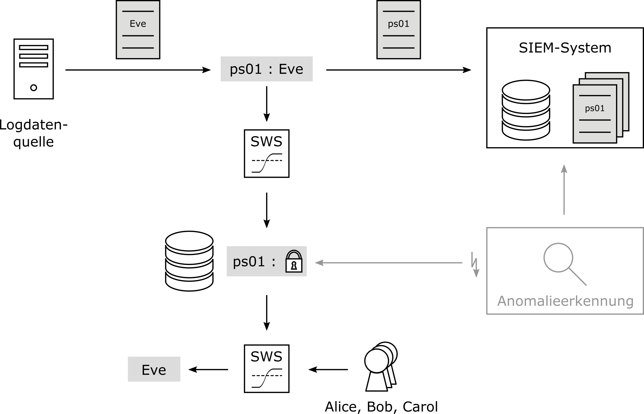
Approach (II)

Slide 9
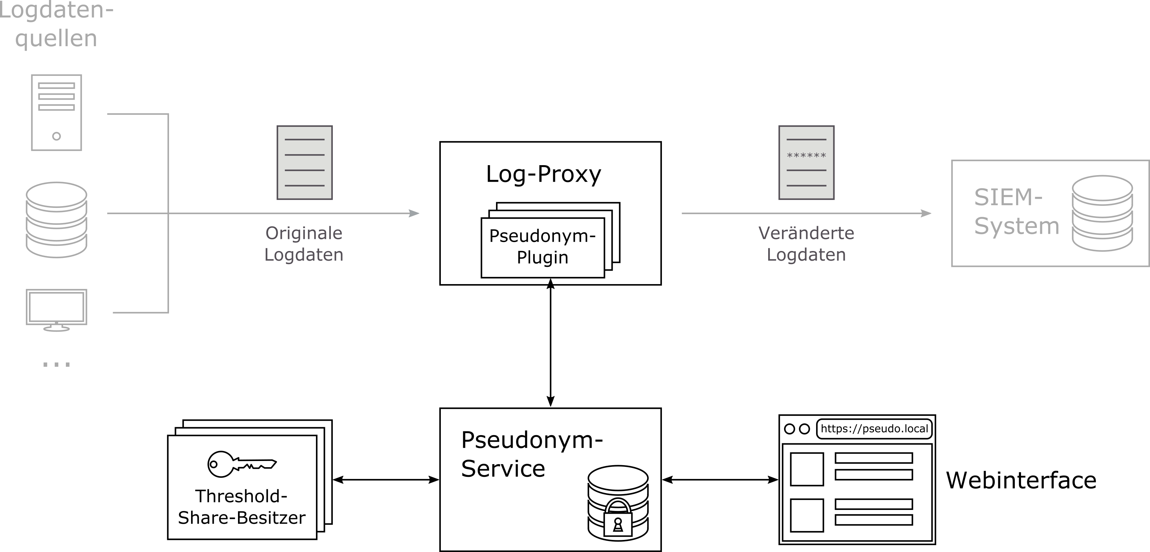
Conceptual design

Slide 10
Pseudonymisation
Changing pseudonyms regularly
Linkability: balancing privacy and anomaly detection requirements
Time and usage dependent
Parameter choice depends on
Data source properties
Anomaly detection requirements
Implementation: straightforward

Slide 11
Threshold cryptosystem
Threshold public key decryption combining ElGamal and Shamir‘s secret sharing
Centralized key generation
Implementation:
No usable open source implementation
Own implementation as hybrid scheme

Slide 12
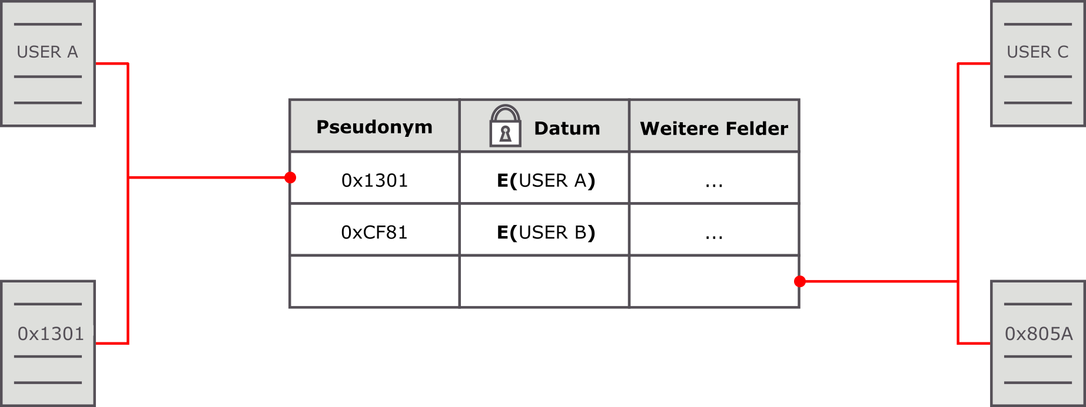
Identifying created pseudonyms
Local storage
Decryption
Deterministic encryption
Hashing
MACs
Searchable encryption

Slide 13
Evaluation (I) - possible attacks
Background knowledge
Centralized key generation
Ciphertexts leak message length
Review of cryptographic functions required

Slide 14
Evaluation (II) - performance

Slide 15
Conclusion and future work
Well-suited approach for the stated problem
Parameter-dependent linkability for log data => privacy-preserving anomaly detection
Disclosure of pseudonym owner secured by four-eye principle
Implementation issues
Distributed key generation
Review of cryptographic library
ECC-ElGamal
Open questions
Effect of different parameter choices
Further (context-dependent) parameters

Slide 16
Thank you!

