Slide 1
Datenschutzfreundliche Speicherung unternehmensinterner Überwachungsdaten mittels Pseudonymisierung und kryptographischer Schwellwertschemata
20. März 2018
Tom Petersen
Universität Hamburg
Fachbereich Informatik
Notes:
Langsam sprechen
Einen Schluck Wasser nehmen, wenn nötig
Körperhaltung: aufrecht
Zu Vortragsbeginn: Schultern gerade, entspannen

Slide 2
Privacy-preserving storage of enterprise logdata using pseudonymisation and threshold cryptosystems
20. März 2018
Tom Petersen
Universität Hamburg
Fachbereich Informatik
Notes:
Langsam sprechen
Einen Schluck Wasser nehmen, wenn nötig
Körperhaltung: aufrecht
Zu Vortragsbeginn: Schultern gerade, entspannen

Slide 3
Agenda
Motivation
Approach
Conceptual design
Pseudonymisation
Threshold cryptosystem
Identifying created pseudonyms
Evaluation
Conclusion

Slide 4
Insider attacks (I)
Corporate
network
IBM Cyber Security Intelligence Report (2015): 55% of attacks carried out by actors with insider access (including actions caused by human error)
Bitkom Spezialstudie Wirtschaftsschutz (2016): about 60% of incidents in the area of data theft, industrial spying or sabotage have a connection to current or former employees

Slide 5
Insider attacks (II)
Firewall, IDS, …
Anomaly-based detection
§32 BDSG
BAG Erfurt
Icons from: https://www.shareicon.net (Flaticon basic license)
Notes:
regular access control, intrusion detection systems, ... not usable, because users are allowed too perform actions
-> anomaly-based detection = comparing current user behaviour with common user behaviour (statistical approach/machine learning)
requires a lot of data
But storing and processing this data can collide with the privacy of employees
Bundesdatenschutzgesetz,§32, 1: Data related to employees may just be used for detecting crimes when there is concrete evidence
BAG Erfurt: Using keyloggers to test user behaviour is not allowed

Slide 6
Approach (I)
Pseudonymisation
Using an identifier different from the real identifier of a subject
Alice : 0x2003
Assignment e.g. by using functions like hash algorithms or mapping tables
+
Threshold cryptosystems
(t,n) secret sharing scheme
Threshold decryption
Key generation (pk, shares)
Message encryption (pk)
Computing partial decryptions
Decrypting message
-> Secret key is NOT restored
Distributed trust
No „blocking“ participants
Notes:
(t,n) secret sharing scheme
- n: # parts (shares)
- t: shares required for restoring the secret
Threshold decryption
Public key scheme
Decryption requires at least t participants (share owners)
Message is decrypted but secret key is NOT restored
Advantages: distributed trust, prevents „blocking“ participants

Slide 7
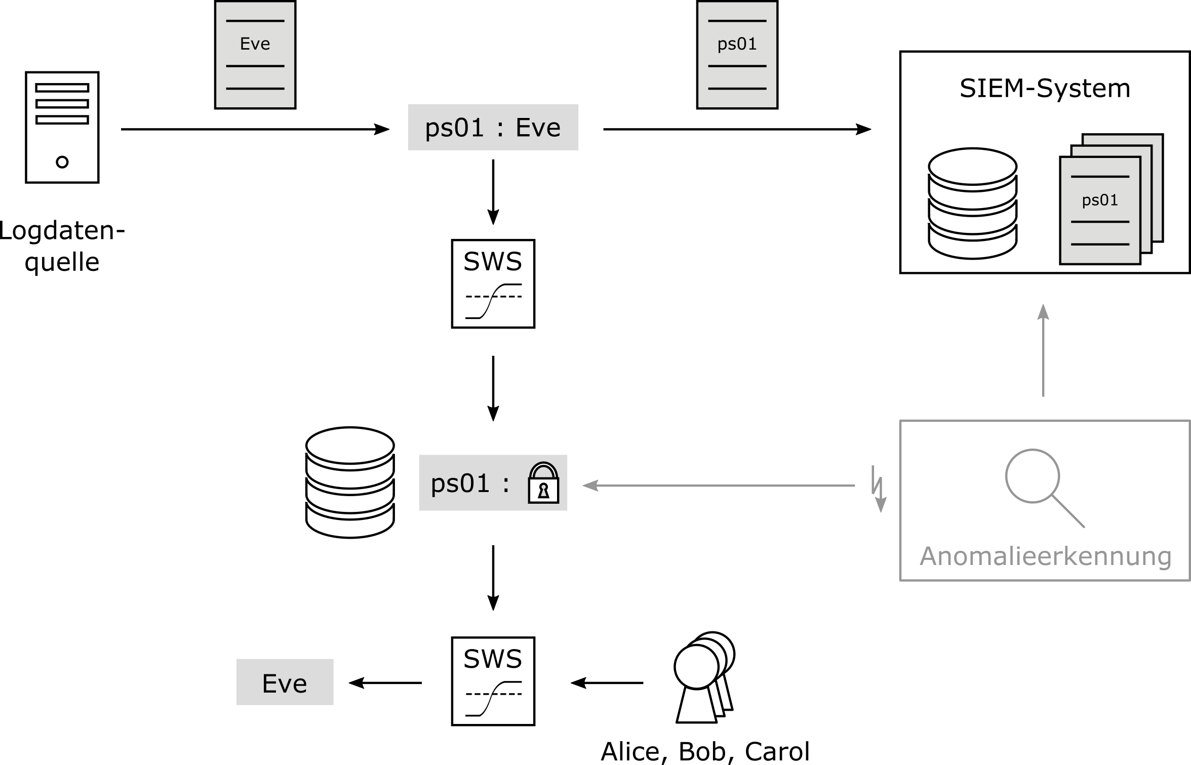
Approach (II)

Slide 8
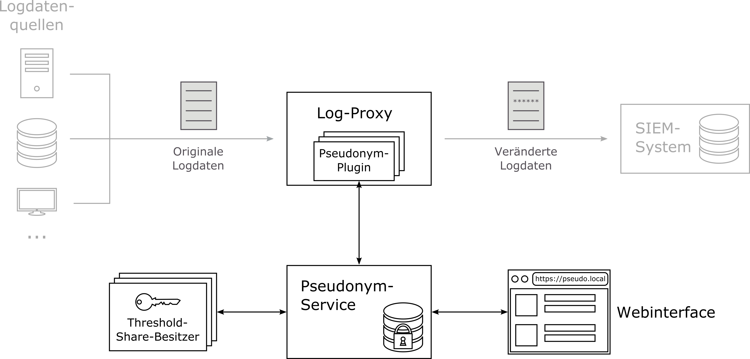
Conceptual design

Slide 9
This way?
Pseudonymisation
Changing pseudonyms regularly
Linkability: balancing privacy and anomaly detection requirements
Time and usage dependent
Parameter choice depends on
Data source properties
Anomaly detection requirements
Implementation: straightforward
Threshold cryptosystems
Threshold public key decryption combining ElGamal and Shamir‘s secret sharing
Centralized key generation
Implementation:
No usable open source implementation
Own implementation as hybrid scheme

Slide 10
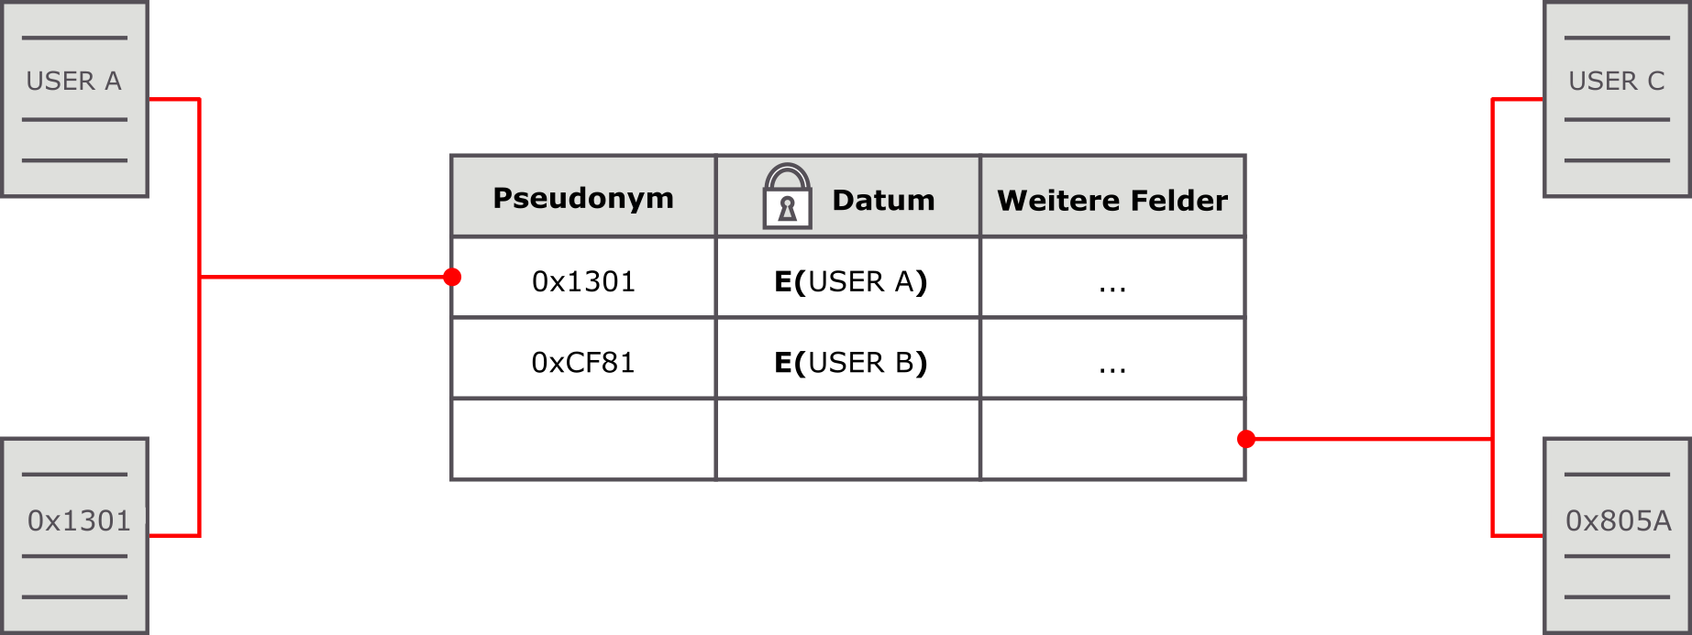
Identifying created pseudonyms
Local storage
Decryption
Deterministic encryption
Hashing
MACs
Searchable encryption

Slide 11
Evaluation (I) - possible attacks
Background knowledge
Centralized key generation
Ciphertexts leak message length
Review of cryptographic functions required

Slide 12
Evaluation (II) - performance

Slide 13
Conclusion and future work
Well-suited approach for the stated problem
Parameter-dependent linkability for log data => privacy-preserving anomaly detection
Disclosure of pseudonym owner secured by four-eye principle
Implementation issues
Distributed key generation
Review of cryptographic library
ECC-ElGamal
Open questions
Effect of different parameter choices
Further (context-dependent) parameters

Slide 14
Thank you!

Slide 15
Insider attacks
Serious threat for companies (examples)
IBM, Bitkom TODO
regular access control, intrusion detection systems, ... not usable, because users are allowed too perform actions
-> anomaly-based detection = comparing current user behaviour with common user behaviour (statistical approach/machine learning)
requires a lot of data
But storing and processing this data can collide with the privacy of employees
Bundesdatenschutzgesetz,§32, 1: Personenbeziehbare Daten für Straftataufdeckung nur mit konkretem Anfangsverdacht
Data related to employees may just be used for detecting crimes when there is concrete evidence
Notes:
Serious threat for companies (examples)
IBM, Bitkom TODO
regular access control, intrusion detection systems, ... not usable, because users are allowed too perform actions
-> anomaly-based detection = comparing current user behaviour with common user behaviour (statistical approach/machine learning)
requires a lot of data
But storing and processing this data can collide with the privacy of employees
Bundesdatenschutzgesetz,§32, 1: Data related to employees can be used for detecting crimes just with concrete evidence

Slide 16
Pseudonymisation
Changing pseudonyms regularly decreases linkability
privacy <=> anomaly detection requirements
Parameters:
Time
Maximum number of uses
Choice depends on
Data source properties
Anomaly detection requirements
Implementation: straightforward

Slide 17
Threshold cryptosystem
Threshold public key decryption combining ElGamal and Shamir‘s secret sharing
Centralized key generation
Implementation:
No usable open source implementation
Own implementation as hybrid scheme

