Slide 1
Tor: The Second-Generation Onion Router SKI - Integrated seminar
18 January 2017
Thomas Maier, Tom Petersen
Department of Informatics
University of Hamburg
Notes:
Langsam sprechen
Einen Schluck Wasser nehmen, wenn nötig
Körperhaltung: aufrecht
Zu Vortragsbeginn: Schultern gerade, entspannen

Slide 2
Agenda
Previous work
Working principle
Improvements to onion routing
Status quo
Conclusion
Notes:
ich

Slide 3
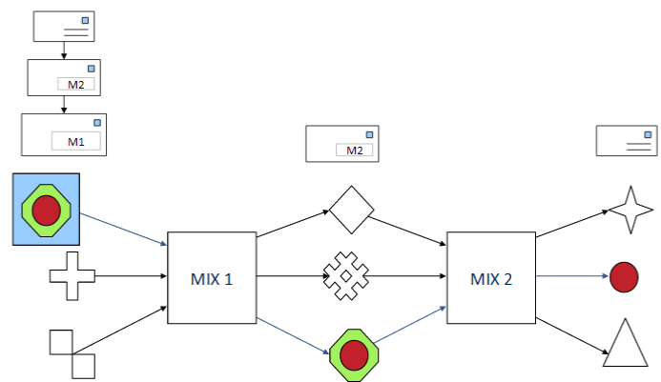
Previous work
Mix-Nets by David Chaum
[Federrath, Hannes: Lecture slides SKI – Datenschutzfreundliche Techniken]
Notes:
Using chain of proxy server which are called mixes
Mixes get messages from multiple senders
Send them to the next user
Mix just know the predecessor and successor of a chain
Each message is encrypted to each proxy using public key cryptography
Resulting encryption is layered like an onion
All messages has same length
Have to use more than one mix

Slide 4

Previous work
Onion Routing
Developed since 1995
Based on Chaums Mix-Nets
Offers anonymous connections
Protects against traffic analysis and network surveillance
Connection through onion routers (OR)
Other implementations
JAP: Used fixed mix cascades instead of variable circuits
MorphMix: peer to peer based anonymity network.
Tor
Paper was published 2004
Notes:
ich

Slide 5
Working principle of Tor
HTTP
HTTP
HTTP
HTTP
webserver
exit node
Client
Onion Proxy
OR
TLS
OR
OR
directory
server
OR
OR
Notes:
Tom

Slide 6
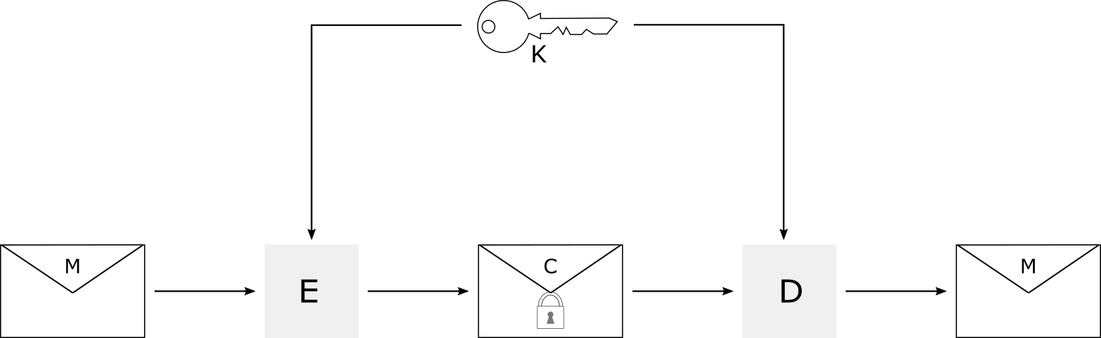
(Used cryptographic principles)
Symmetric encryption
Asymmetric encryption
Diffie-Hellman key exchange
Notes:
Tom

Slide 7
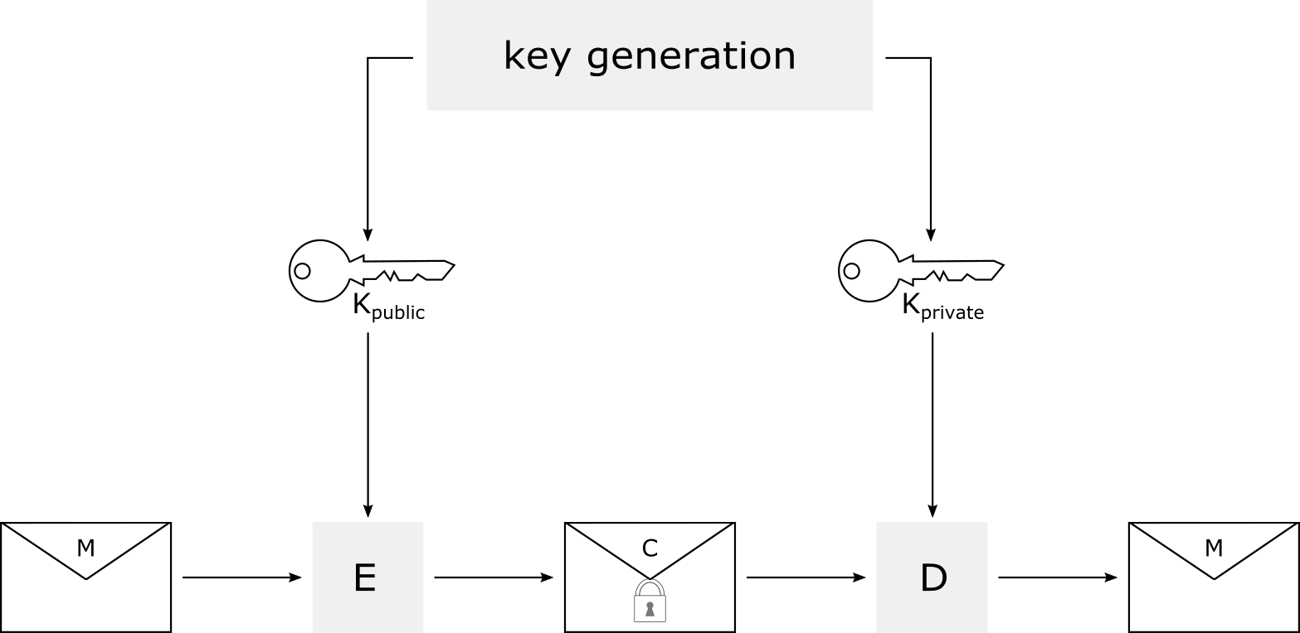
(Used cryptographic principles)
Symmetric encryption
Asymmetric encryption
Diffie-Hellman key exchange
Notes:
Tom

Slide 8




(Used cryptographic principles)
Symmetric encryption
Asymmetric encryption
Diffie-Hellman key exchange
A
$$g^{x} mod p$$
B
$$g^{y} mod p$$
$$K={{(g}^{y})}^{x} mod p$$
$$K={{(g}^{x})}^{y} mod p$$
Notes:
Tom

Slide 9



Working principle of Tor
$$K_{B}^{priv}$$
A
create $\left[cID, K_{B}^{pub}\left(g^{x}\right) \right]$
B
$$K=g^{xy}$$
created $\left[cID, g^{y},H(K)\right]$
$$K=g^{xy}$$
relay$\left[cID, Data, K(HTTP_GET)\right]$
GET
RESP
relay $\left[cID, Data, K(RESP)\right]$
Notes:
Tom

Slide 10
Improvements to onion routing
Directory servers instead of routing information flooding
Hidden services
Perfect forward secrecy
Usage of a standard proxy interface
Exit policies
…
Notes:
Tom

Slide 11
Status quo
Upsides:
Protect your privacy, fight mass surveillance, circumvent censorship
Used by businesses, human rights activists or whistleblowers, journalists, …
Downsides:
Non-legal marketplaces like SilkRoad
Command & control server for botnets
Influence of the paper
Cited more than 3000 times
Tor is currently used by round about 2 million users
Notes:
Positive aspects
Protects your privacy
Circumnvent censorship in China (able to read the new York times)
Human rights activists or wistleblowers to exposes illegal activities
Journalists to report from war zones
Negative aspects:
Host illegal marketplaces like SilkRoad
Or you are able to command and control server for botnets.

Slide 12
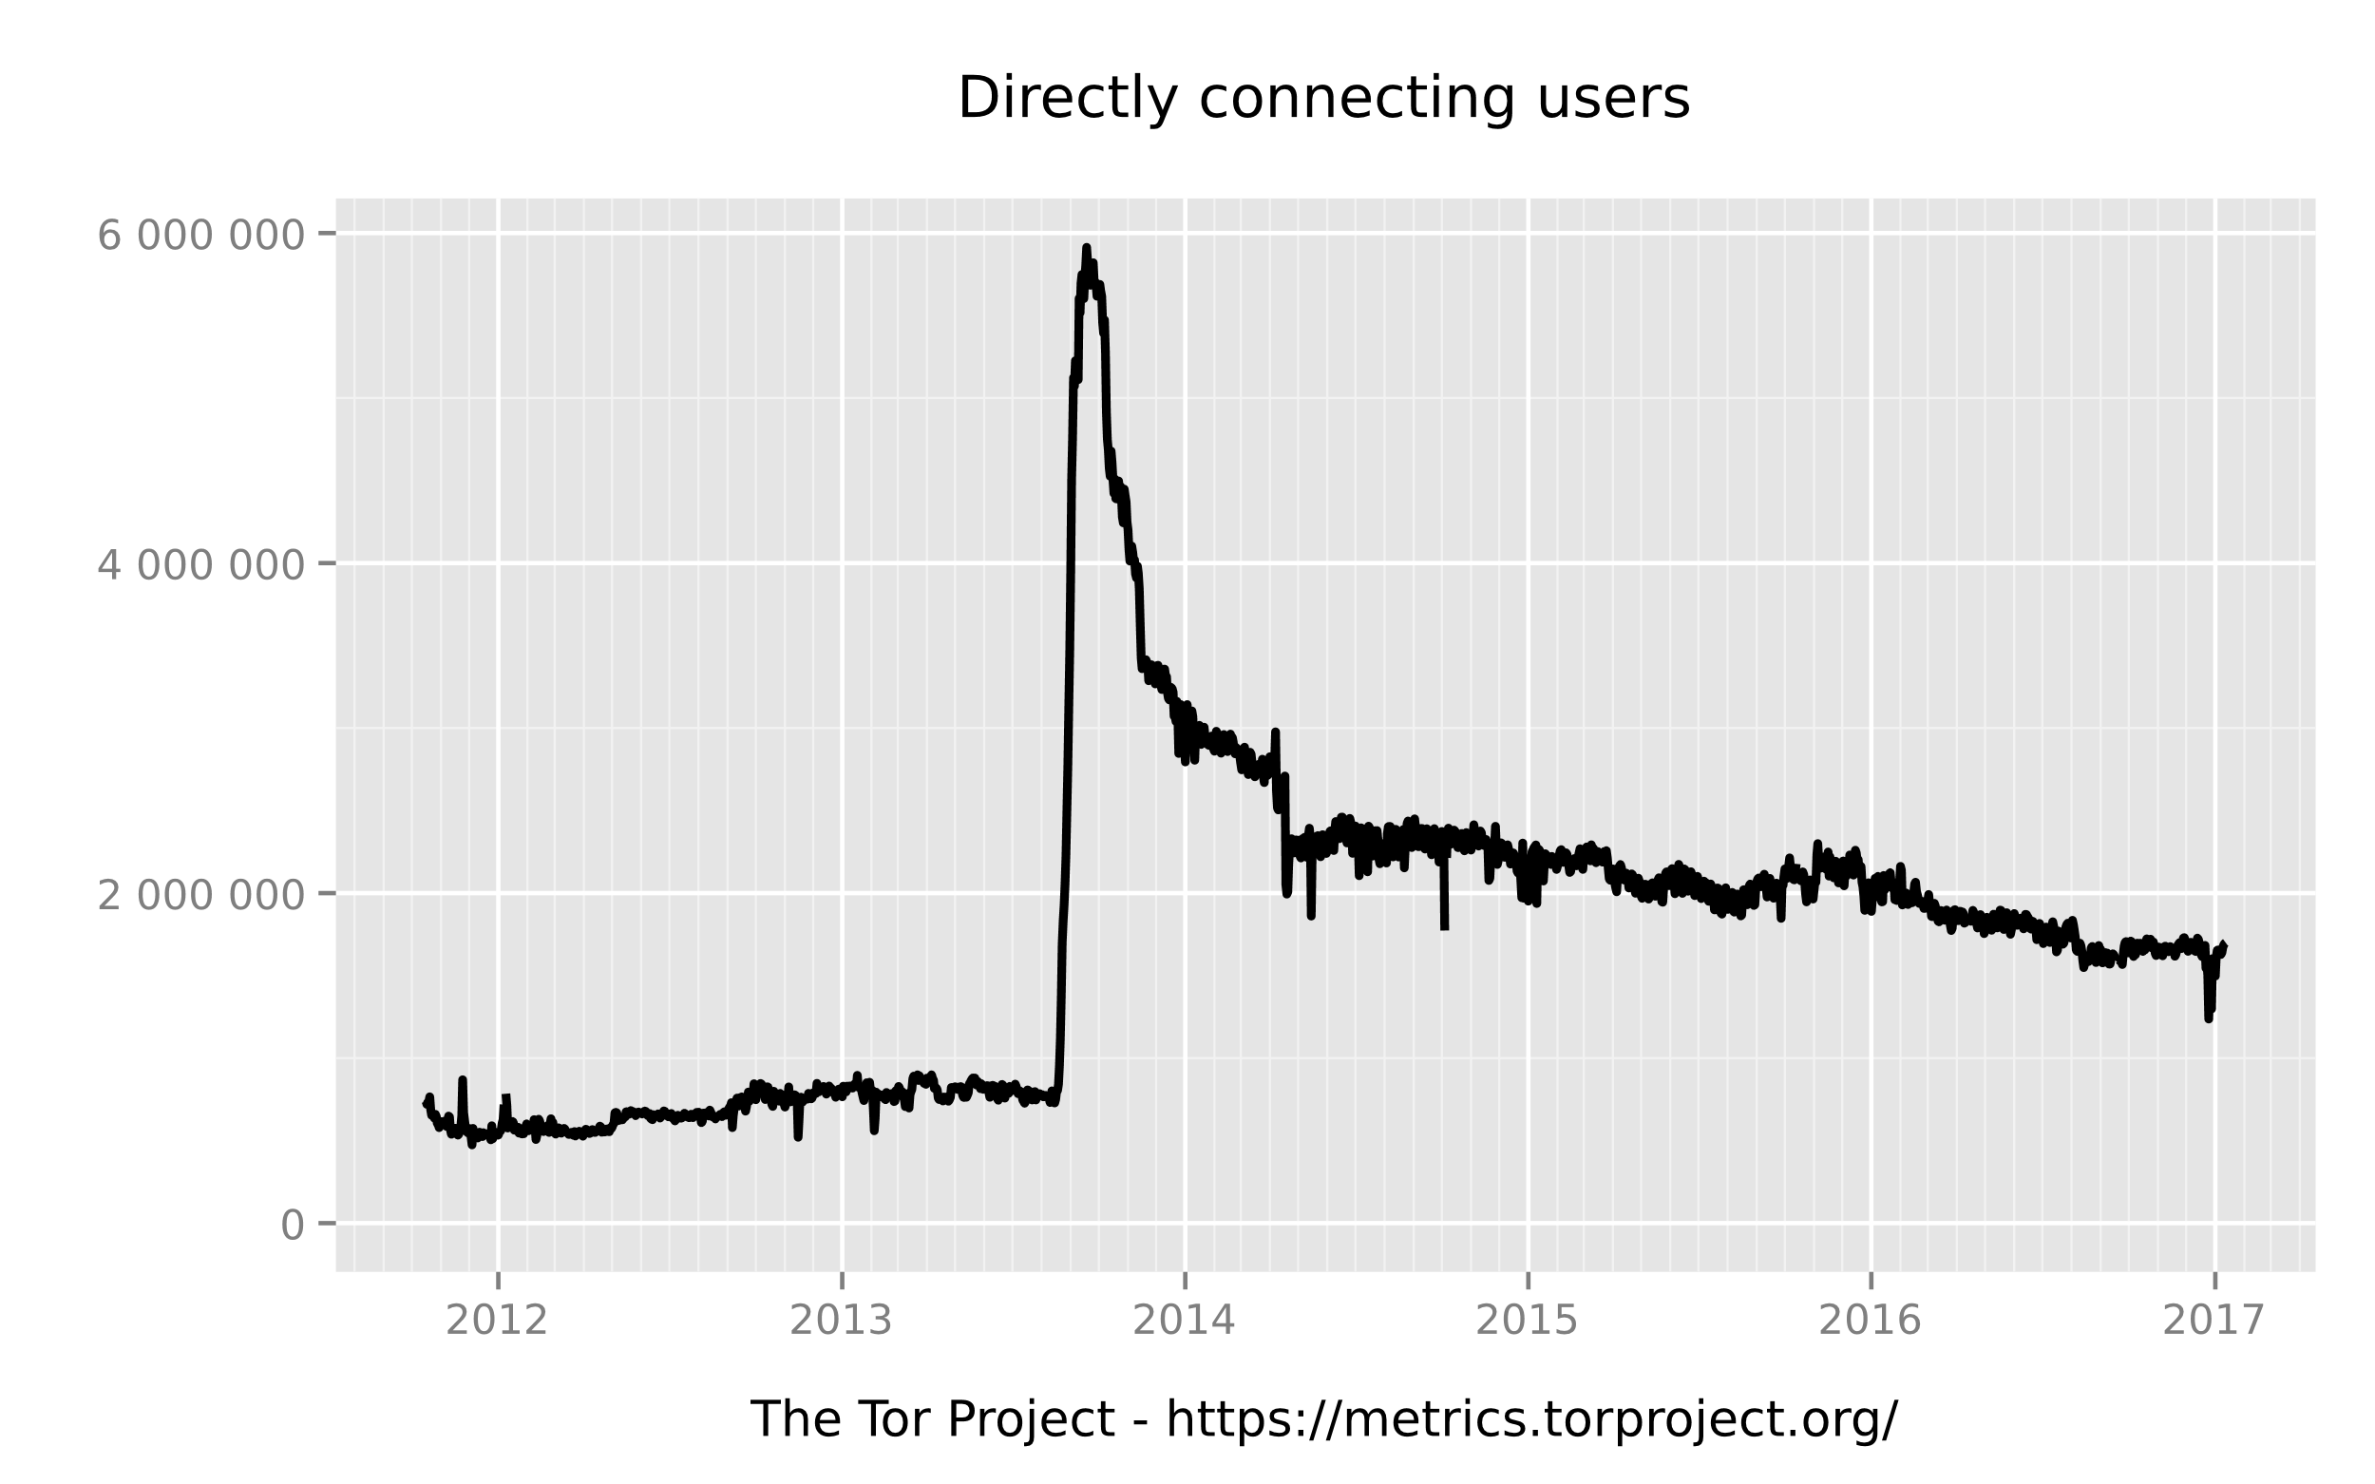
Status quo
Notes:
ich
NICHT SAGEN !!!On this peak they suppose a command and control of botnet servers

Slide 13
Conclusion
Based on Mixed-Nets and onion routing
Uses layered encryption to hide the message destination and origin
Protects against traffic analysis and network surveillance
Major improvements to the original onion routing
Highly adapted in the world wide web
Currently round about 2 million users
Support of privacy for everyone vs. Potential criminal usage
Notes:
Mix-net and onion routing
Layered encryption to hide message dest and origin
Traffic analysis and network surveillance
Major imrpovements to
-uses standard proxy protocol
-users are able to host hidden services

Slide 14
Tor: The Second-Generation Onion Router
Thank you!
Notes:
ich

