Slide 1
MLOps for Football
World Cup Prediction
Multi-Model Comparison with Structured Model Promotion

Slide 2
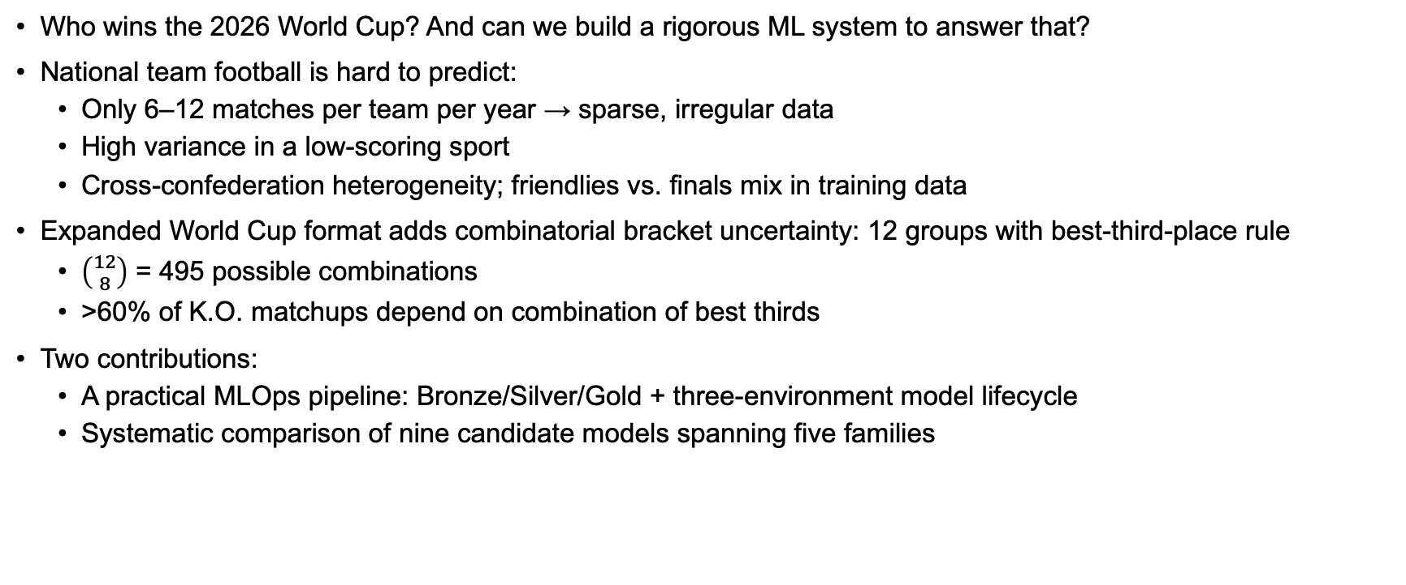
Motivation
Who wins the 2026 World Cup? And can we build a rigorous ML system to answer that?
National team football is hard to predict:
Only 6–12 matches per team per year → sparse, irregular data
High variance in a low-scoring sport
Cross-confederation heterogeneity; friendlies vs. finals mix in training data
Expanded World Cup format adds combinatorial bracket uncertainty: 12 groups with best-third-place rule
$\left({12 \atop 8}\right)$ = 495 possible combinations
>60% of K.O. matchups depend on combination of best thirds
Two contributions:
A practical MLOps pipeline: Bronze/Silver/Gold + three-environment model lifecycle
Systematic comparison of nine candidate models spanning five families

Slide 3
Data Pipeline & Feature Engineering
Bronze: raw immutable snapshots — API-Football (fixtures + per-match stats) and Elo ratings (eloratings.net)
Silver: cleaned Parquet — schema validation, team name mapping, competition tier (1–4), Elo join (date-proximate)
Gold: one row per match, strictly time-aware features (no future information)
Feature families:
Elo: elo_diff (favourite signal) + elo_sum (match quality, added in Gold v2)
Rolling form (last 10 matches): goals for/against, shot volume/precision, fouls, corners, possession %
Context: competition_tier, is_knockout, is_neutral, is_cross_confederation
Squad cohesion: days_since_last_match, rest_diff (Gold v2)
Clustering experiment: silhouette < 0.40 across all k/variants → no discrete tactical archetypes → raw rolling columns used directly
~51% stats coverage → fine-grained features (e.g. shots-inside-box: ~1.6% non-null) excluded from core feature set

Slide 4
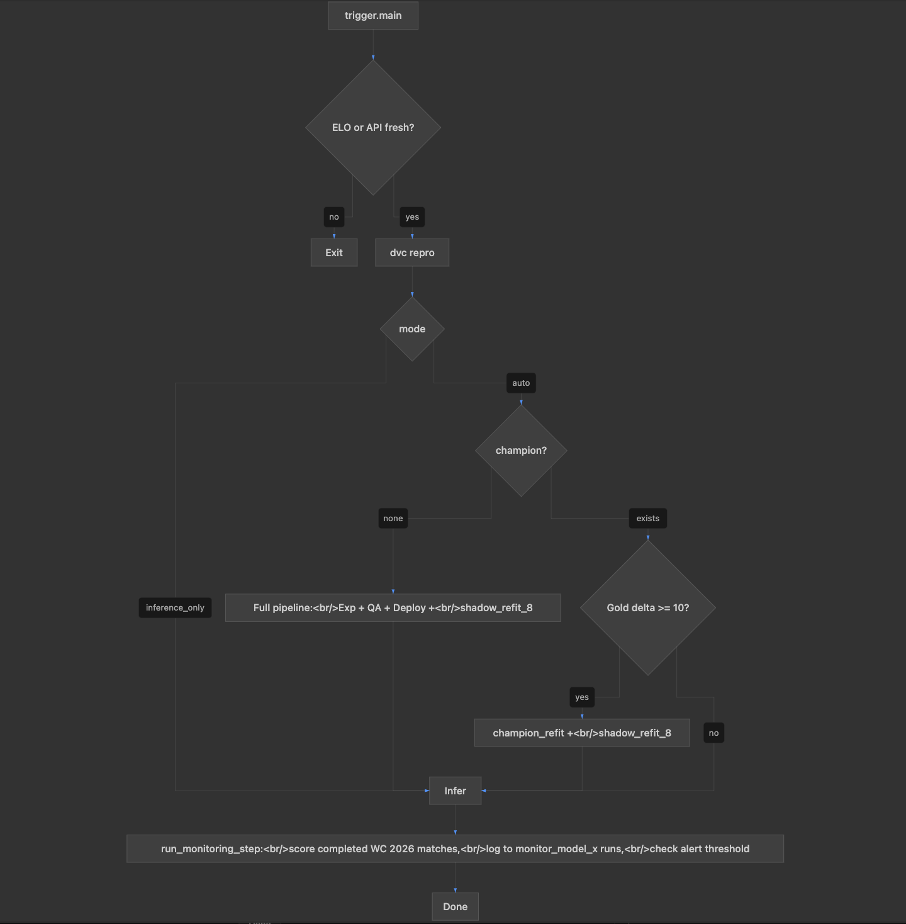
End-to-End MLOps Pipeline

Slide 5
Nine Candidate Models
Rank | Model | Family | CV NLL
1 | NegBin GLM | Statistical | 2.758
2 | Bayesian Poisson | Bayesian | 2.759
3 | Bivariate Poisson | Statistical | 2.763
4 | XGBoost | ML (Tree-Based) | 2.767
5 | Random Forest | ML (Tree-Based) | 2.768
6 | LSTM | Deep Learning | 2.821
7 | Ridge | ML | 2.847
8 | SARIMAX | Time-Series | 3.016
9 | 1D CNN | Deep Learning | 3.039

Slide 6
Experimental Setup
Modeling objective: predict goal-rate distributions P(home, away) → W/D/L derived downstream via score marginalization + Monte Carlo simulation: P(W) = P(home > away)
Nine candidates across five families:
Statistical: Poisson GLM (bivariate Karlis-Ntzoufras), NegBin GLM
Bayesian: Bayesian Poisson (ADVI)
Time-series: SARIMAX (integer match-index time axis)
ML: Ridge, Random Forest, XGBoost
Deep learning: LSTM, 1D CNN (Keras / JAX)
Data split: pre-WC 2022 training (3,903 rows) | WC 2022 holdout (64 matches, never seen during training)
Tuning: Optuna TPE, 50 trials, walk-forward expanding CV; objective = Poisson NLL (goal-count space)
QA metric: Ranked Probability Score (RPS) on WC 2022 holdout — lower is better
All nine advance to QA (no top-K gate — empirically motivated; see next slide)

Slide 7
Finding 1: CV–Holdout Ranking Reversal
Rank | Model | Family | CV NLL
1 | NegBin GLM | Statistical | 2.758
2 | Bayesian Poisson | Bayesian | 2.759
3 | Bivariate Poisson | Statistical | 2.763
4 ★ | XGBoost | ML (Tree-Based) | 2.767
5 | Random Forest | ML (Tree-Based) | 2.768
6 | LSTM | Deep Learning | 2.821
7 | Ridge | ML | 2.847
8 | SARIMAX | Time-Series | 3.016
9 | 1D CNN | Deep Learning | 3.039
Rank | Model | Family | Holdout RPS
1 ★ | XGBoost | ML (Tree-Based) | 0.2109
2 | Random Forest | ML (Tree-Based) | 0.2121
3 | Ridge | ML | 0.2141
4 | Bivariate Poisson | Statistical | 0.2159
5 | Bayesian Poisson | Bayesian | 0.2166
6 | NegBin GLM | Statistical | 0.2170
7 | SARIMAX | Time-Series | 0.2183
8 | LSTM | Deep Learning | 0.2207
9 | 1D CNN | Deep Learning | 0.2248
Two explanations:
(1) metric mismatch — NLL rewards scoreline accuracy; RPS evaluates W/D/L probabilities.
(2) distribution shift — WC holdout is tournament-only (neutral venues, strong teams); training set contains many tier-3/4 matches.
→ Design decision: removed top-4 promotion gate; all nine models advance to QA.
Notes:
Original idea: promote only the 4 best-performing models (Cross-Validation Negative Log Likelihood) to the QA phase
Finding: Holdout Ranked Probability Score turned the experimental ranking on its head
Design choice changed: Promote all 9 models instead
Patterns:
Fine-Tuning most successful for statistical > ML
RPS performance best for ML > statistical
Narrow holdout RPS band: 0.010 across 8 of 9 models → shared feature ceiling limits gains from more complex architectures.
Deep Learning and SARIMAX not competitive on either metric

Slide 8
Finding 2: Elo Differential Dominates
Model | #1 Feature (RPS Δ) | #2 Feature (RPS Δ) | #3 Feature (RPS Δ)
Random Forest | elo_diff (+.121) | elo_sum (+.002) | roll_goals_ag_h (+.002)
SARIMAX | elo_diff (+.110) | roll_goals_ag_h (+.002) | elo_sum (+.000)
NegBin GLM | elo_diff (+.104) | roll_goals_ag_h (+.001) | comp_tier (+.001)
Bayesian Poisson | elo_diff (+.103) | rest_diff (+.001) | roll_goals_ag_h (+.001)
Poisson GLM | elo_diff (+.102) | roll_goals_ag_h (+.001) | comp_tier (+.001)
XGBoost | elo_diff (+.098) | roll_tac_poss_a (+.002) | roll_goals_ag_h (+.002)
LSTM | elo_diff (+.095) | is_neutral (+.005) | comp_tier (+.002)
Ridge | elo_diff (+.062) | roll_goals_ag_h (+.004) | roll_goals_ag_a (+.002)
1D CNN | elo_diff (+.055) | is_neutral (+.005) | comp_tier (+.004)
elo_diff ranks #1 across ALL nine model families — importance 1–2 orders of magnitude above any other feature.
Narrow holdout RPS band: 0.010 across 8 of 9 models → shared feature ceiling limits gains from more complex architectures.
Gold v2 auto-promotion: XGBoost ΔRPS = −0.0009 over v1 → registered as wc_production version 4.
Deep learning penalty confirmed (H4): LSTM degraded +0.0074 after adding 5 features to an already data-sparse corpus.
Notes:
elo_diff ranks #1 across ALL nine model families (importance 1–2 orders of magnitude above any other feature)
Deep learning penalty confirmed (H4): LSTM degraded +0.0074 after adding 5 features to an already data-sparse corpus.

Slide 9
Live Demo
MLflow UI
Experiment runs and Optuna trial audit trail
wc_production champion alias | wc_staging WC 2022 audit trail | wc_shadow monitoring candidates
Tournament simulation output
Per-team group-stage advancement and knockout probabilities
10,000 Monte Carlo paths; 60%+ of knockout matchups non-deterministic under best-third-place rule
Inference cycle walk-through
Trigger → freshness check (ELO SHA-256 + API-Football 48h window)
→ dvc repro (Silver / Gold rebuild with updated rolling features)
→ champion predict → simulation artifacts logged to MLflow

Slide 10
Summary
XGBoost selected as production champion: holdout RPS 0.2109 on 64 WC 2022 matches
CV–holdout ranking reversal motivated removing the top-K gate → all nine advance to QA
Elo differential is the dominant signal; the shared feature ceiling limits gains from more complex architectures
MLOps iteration loop works: Gold v2 auto-promoted XGBoost (ΔRPS −0.0009) without manual intervention
Next: WC 2026 live monitoring — per-match scoring of all nine models against actual results every 30 minutes
Limitations:
Single holdout (89 matches) — limited statistical power to separate closely ranked models
WC 2022 holdout is 4 years from prediction target; tactical/generational drift unmodeled

