Slide 1
MLOps for Football
World Cup Prediction
Multi-Model Comparison with Structured Model Promotion
Tom Farnschläder, Tampere University

Slide 2
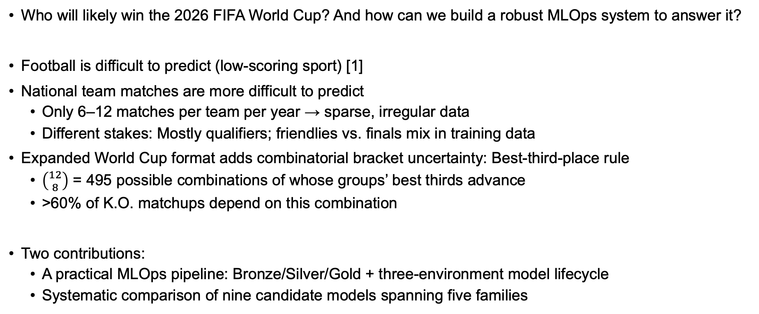
Motivation
Who will likely win the 2026 FIFA World Cup? And how can we build a robust MLOps system to answer it?
Football is difficult to predict (low-scoring sport) [1]
National team matches are more difficult to predict
Only 6–12 matches per team per year → sparse, irregular data
Different stakes: Mostly qualifiers; friendlies vs. finals mix in training data
Expanded World Cup format adds combinatorial bracket uncertainty: Best-third-place rule
$\left({12 \atop 8}\right)$ = 495 possible combinations of whose groups’ best thirds advance
>60% of K.O. matchups depend on this combination
Two contributions:
A practical MLOps pipeline: Bronze/Silver/Gold + three-environment model lifecycle
Systematic comparison of nine candidate models spanning five families

Slide 3
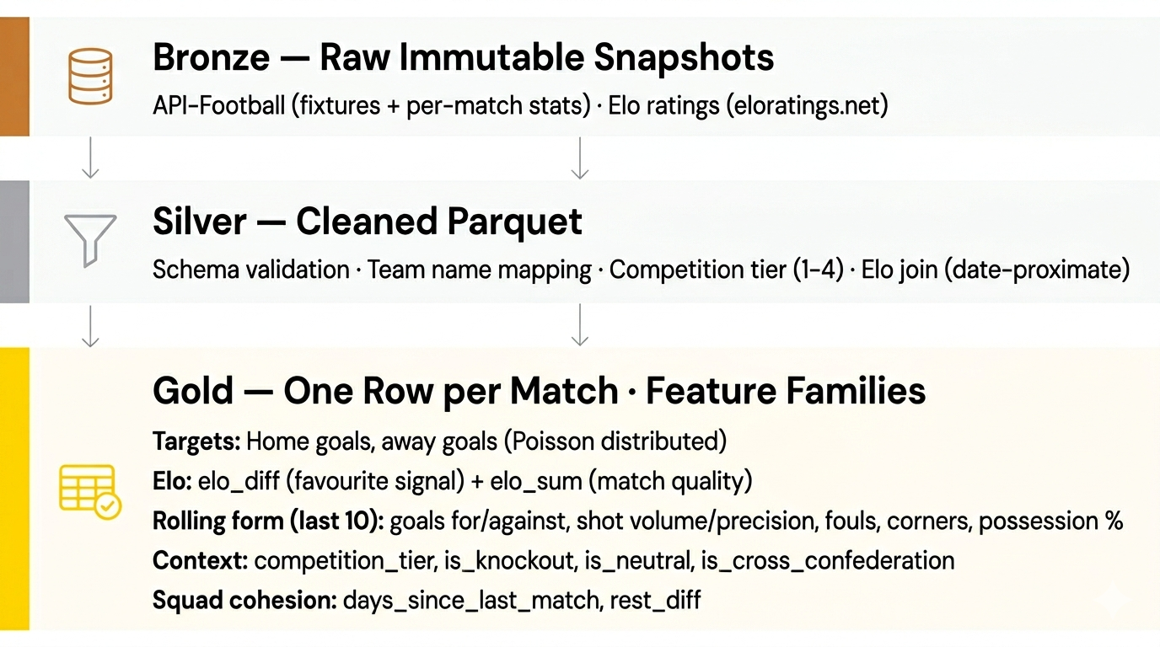
Data Pipeline & Feature Engineering
[2]
[3]
Notes:
Technical debt, but justifiable
Tactical clustering was considered, but:
Silhouette < 0.40 across all variants
→ no discrete tactical archetypes
→ raw rolling columns used directly

Slide 4
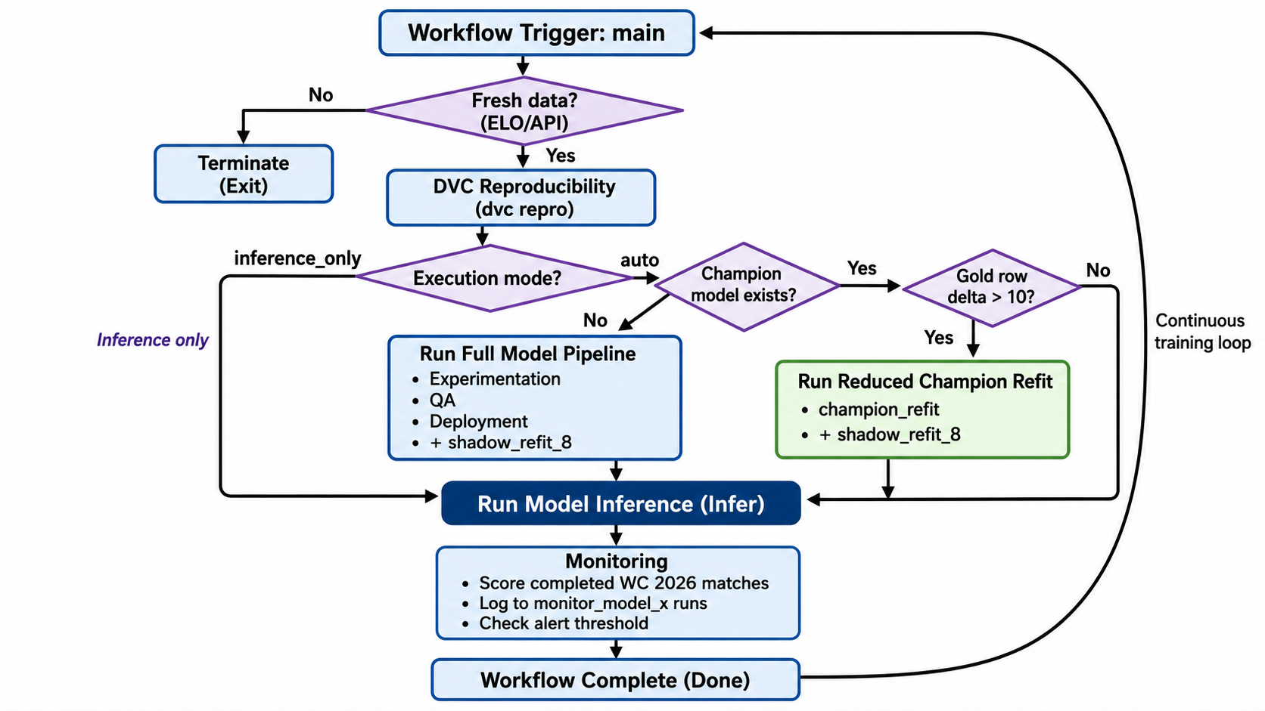
MLOps Pipeline: Google Automation Lvl 1
Google Perspective: Automation Level 1 [4]
Databricks Perspective: [3][5]
Dagshub → DevOps
DVC → DataOps
MLflow → ModelOps
Notes:
Google MLOps Level 1: automated retraining
Databricks perspective: Dagshub for DevOps, DVC for DataOps and Mlflow for ModelOps
Trigger: Every day at night (4:30 UTC) until the tournament starts; then, every 30 minutes; Cloud Run Jobs
Inference: Predict home and away goal distributions for all 1176 potential matchups of the 48 qualified teams
Monte Carlo Simulation: 10.000 tournament simulations
Monitoring = Alert-only: if champion model degrades in RPS (ranked probability score)
Active only after at least 24 matches in the tournament are played (1 matchday)

Slide 5
Modeling: Nine Candidate Models
Objectives:
Predict goal-rate distribution for home goals and away
Monte Carlo simulation samples integer scorelines from distributions → derives outcome (H/D/A)
Model Family | Candidate Models
Statistical | Bivariate Poisson GLM [6], Negative Binomial GLM
Bayesian | Bayesian Poisson (NUTS)
Time-series | SARIMAX
ML | Ridge, Random Forest, XGBoost
Deep Learning | LSTM, 1D CNN
Notes:
Bivariate Poisson GLM (one parameter each for home and away goals, and one shared parameter)
Bayesian Poisson: No-U-Turn Sampler (NUTS) was used; very inefficient (and not worth it for the purpose of this project, see later)
Deep Learning: Long-Short-Term-Memory, 1-dimensional Convolutional Neural Network (Keras, JAX backend)

Slide 6
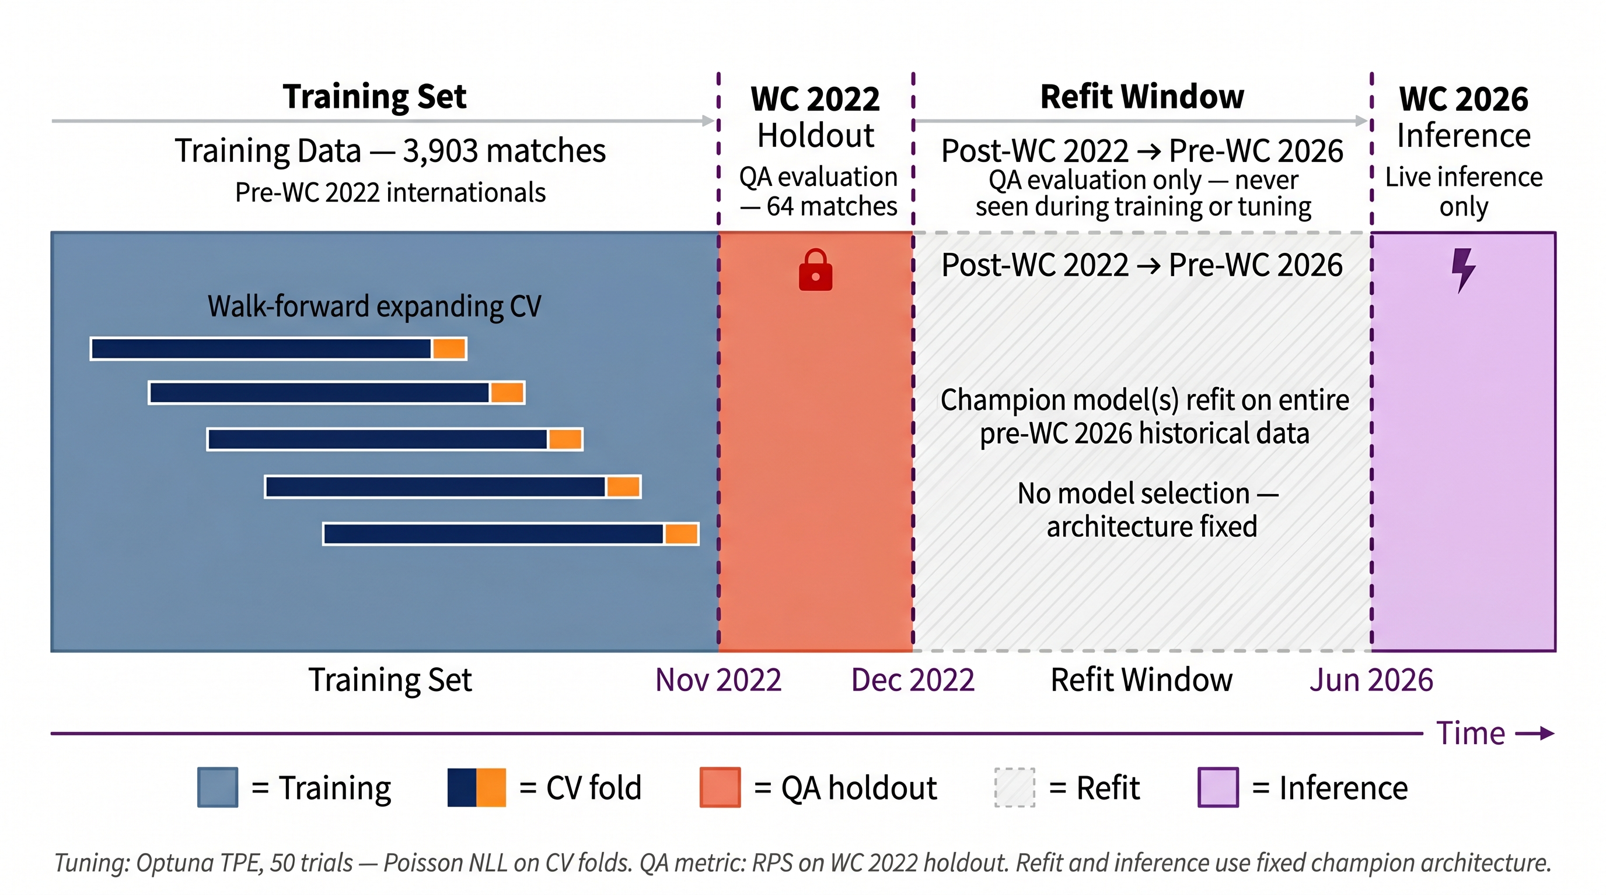
Modeling: Experimental Setup
QA metric (holdout): Ranked Probability Score (RPS) to evaluate calibration of W/D/L outcome probabilities
Training objective (CV): Poisson NLL, which rewards scoreline accuracy in goal-count space
Experimental
QA
Production
Notes:
Experimental environment: Training and fine-tuning on all national team matches between 2018 and 2022; optimizing for low Poisson NLL to reward scoreline accuracy
QA: Validation of best configurations against WC 2022 holdout; selecting challenger model by lowest RPS
Gate: Challenger is then compared to existing champion (one with the lower RPS is champion)
Production: Champion is refit on the whole pre-WC 2026 data; then used for inference
Other models are refitted as well as “shadow” models to enable comparison
WHY WE HAVE TWO DIFFERENT METRICS
What I want to predict: Winning probabilities, Group stage ranking probabilities, Probabilities of teams advancing to stage X
Therefore, we select by RPS (because its Ordinal nature -> rewards predicting the outcome into the “right direction”)
But: I want to avoid fine-tuning a model on RPS
Draw predictions never get the maximum penalty, so the models would likely hedge towards draws
Historically, only about 25% of WC matches are draws
Therefore, we optimize for Poisson Negative Log Likelihood (which rewards scoreline accuracy and is agnostic to outcome)
We tune for accurate scorelines and select for the right outcome direction

Slide 7
Finding 1: Narrow Result Spread and CV–Holdout Ranking Reversal
Model | Family | CV NLL | CV Rank | QA RPS | QA Rank | QA Acc
Ridge | ML | 2.847 | 7 | 0.2250 | 1 | 50.0%
Random Forest | ML | 2.768 | 5 | 0.2255 | 2 | 53.1%
XGBoost | ML | 2.767 | 4 | 0.2263 | 3 | 51.6%
Poisson GLM | Statistical | 2.763 | 3 | 0.2284 | 4 | 53.1%
LSTM | DL | 2.821 | 6 | 0.2289 | 5 | 54.7%
Bayesian Poisson | Bayesian | 2.759 | 2 | 0.2289 | 6 | 51.6%
NegBin GLM | Statistical | 2.758 | 1 | 0.2294 | 7 | 53.1%
SARIMAX | Time-Series | 3.016 | 8 | 0.2336 | 8 | 50.0%
1D CNN | DL | 3.039 | 9 | 0.2479 | 9 | 42.2%
Notes:
Original idea: promote only the 4 best-performing models (Cross-Validation Negative Log Likelihood) to the QA phase
Finding: Holdout Ranked Probability Score turned the experimental ranking on its head (as here too between 1 and 7)
Explanations:
Metric mismatch (NLL vs RPS)
Distribution shift (WC holdout is tournament only, neutral venues, strong teams)
Design choice changed: Promote all 9 models instead (not much overhead but adds to analysis)
Very narrow range for each metric for models 1-7
Given that the holdout was just 64 matches, the model differences might be due to statistical noise
CNN and SARIMAX perform worst on both metrics
Accuracy: much better than random guessing, but still difficult

Slide 8
Finding 2: Elo Differential Dominates
Elo difference
ranks #1 in all 9 models
15–110× larger than the next feature
Other observations:
Rolling goals against (home team) appears in the top 3 of 7/9 models, the most robust secondary feature
Models exploit different features for the rest of the signal, for example:
Ridge: rolling goals features
Deep learning: venue neutrality
Bayesian Poisson: days since last match

Slide 9
Live Demo: Streamlit App
Streamlit app connects to DagsHub MLflow via tracking URI + token
Queries for the most recent run tagged stage = "inference"
Downloads that run's CSV artifacts (tournament probabilities, group positions, predictions, k.o. pairings)
Renders four Plotly views from those DataFrames
Accessible via Streamlit Cloud: https://wc2026-predictions.streamlit.app/

Slide 10
Summary
Pipeline:
Three-environment lifecycle (Experimental → QA → Production) implements Google Level 1
Dagshub / DVC / MLflow covers DevOps / DataOps / ModelOps domains.
Findings:
Football World Cup matches are hard to predict
Elo difference dominates all other signals and provides a feature ceiling
Which model performs best depends on training/gating metrics
Future work: WC 2026 live monitoring; 30-min inference cycle tracks per-team advancement probabilities after each completed match
Trace per-team probability trajectories across matchdays
Identify factors of probability swings (e.g. proximity to 3rd-place boundary, no. of groups completed)
Quantify the gradual resolution of tournament uncertainty in the new format
Notes:
Shannon entropy

Slide 11
References
[1] Maher, M. J. (1982). Modelling Association Football Scores. Statistica Neerlandica, 36(3), 109–118.
[2] eloratings.net (2026). World Football Elo Ratings. https://www.eloratings.net/about
[3] Databricks (2023). The Big Book of MLOps, 2nd Edition.
[4] Google Cloud (2023). MLOps: Continuous Delivery and Automation Pipelines in Machine Learning.
[5] Moreschini, S., Hästbacka, D. & Taibi, D. (2023). MLOps Pipeline Development: The OSSARA Use Case. ACM RACS '23.
[6] Karlis, D. & Ntzoufras, I. (2003). Analysis of Sports Data by Using Bivariate Poisson Models. JRSS-D, 52(3), 381–393.

Slide 13
MLFlow Tracking
Experiment: wc_prediction (single experiment for everything)
Registered models: wc_production (champion), wc_staging (QA candidates), wc_shadow (8 non-champion refits)
Aliases: champion on wc_production, challenger on wc_staging
Run tags: every run gets stage (one of: experimental, qa, production-refit, champion-refit, shadow-refit, inference, monitoring) and model_name
Params logged: all hyperparameters + gold_row_count + evaluation_run_id (on deploy runs)
Metrics logged: cv_nll, holdout_rps, holdout_nll, holdout_rmse_home, holdout_rmse_away, wall-clock time, and per-step rps/nll/rmse_h/rmse_a/cum_rps in monitoring runs
Artifacts: importance CSVs (experimental), model pyfunc artifacts (QA/deploy/shadow), predictions_all_models.csv (inference), wc2026_monitoring.csv (monitoring)

Slide 14
Threats to Validity and Future Work
Elo source reliability: Elo ratings come from a third-party site with no SLA. On fetch failure, the pipeline reuses the last snapshot. Tolerable short-term, can introduce feature drift if undetected over longer periods.
Dual-source desynchronization: API-Football and eloratings.net use different naming conventions and update cadences can be slightly out of sync. Mapping might need to be adjusted in very rare cases.
Future work: Build own Elo database from scratch using the public formula.
Single-tournament holdout: QA rests on 64 WC 2022 matches, 4 years from the prediction target. Model spread (0.0046 RPS range among top 7 models) approaches statistical noise at this sample size.
Future work: Increase the holdout to the last iteration of each continental tournament.
Sparse statistics coverage: ~51% of matches have per-match statistics; lower for AFC/CAF/OFC. Only XGBoost uses shot and tactical features (handles NaN natively).
Future work: Ignore tactical playstyle and match statistics; rely on rolling goals for offense/defense form
Notes:
Elo changes slowly between matches, so short-term staleness is tolerable, but an undetected prolonged outage could introduce feature drift.
Dual-source desynchronization: API-Football and eloratings.net use different team names, country codes, and update cadences.
merge_asof always joins the most recent Elo observation before match date, so an early Elo update does not leak post-match information.
Team name mapping relies on a manually curated csv. Changes have to be added manually, but are rare (last ones Macedonia to North Macedonia and Swaziland to Eswatini in 2018)

Slide 15
Hypotheses
 | Hypothesis | Verdict
H1 | Elo differential is the dominant feature across all model families | ✓ Confirmed
H2 | Statistical models are a competitive baseline despite their simplicity | ✓ Confirmed
H3 | Deep learning underperforms relative to complexity (data-sparsity penalty) | (✓) Partly Confirmed
H4 | Bayesian Poisson produces best-calibrated predictions | ✗ Not (yet?) confirmed
Notes:
H1: Elo difference 10x – 100x more important than the next feature
H2: Bivariate Poisson GLM and Negative Binomial GLM among lowest CCV NLL, competetive for RPS
H3:
1D CNN by far worst-performing model in every metric
LSTM competetive for RPS and with highest accuracy (but could be noise)
H4: Not confirmed, priobably because of the pipeline design.
The implementation collapses the Bayesian posterior to point-estimate λ means before building the Poisson grid, so the theoretical calibration advantage cannot really manifest.
Future Work: Full posterior predictive integration is something worth testing
(sampling scorelines directly from posterior)

