Slide 1
ParentalControl
Saara Männikkö, Heikki Niemelä, Anniina Lukkarila

Slide 2
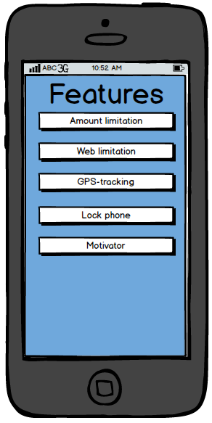
ParentalControl
ParentalControl is an application that helps parents to control child’s phone using

Slide 3
What you can do with ParentalControl?

Slide 4
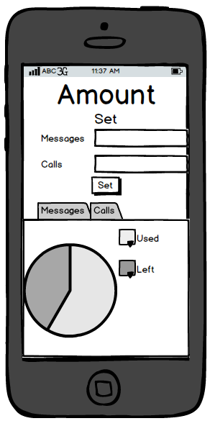
Parents
Can control the amount of messages, calls and internet using
Locate and lock the phone (GPS) if it is stolen or just missing
Send notification to child, for example:
”It’s time to come home”, ”Dinner is ready”
Use Parental Network (Social network for parents’)
Create tasks in motivator (calculations, etc…)

Slide 5
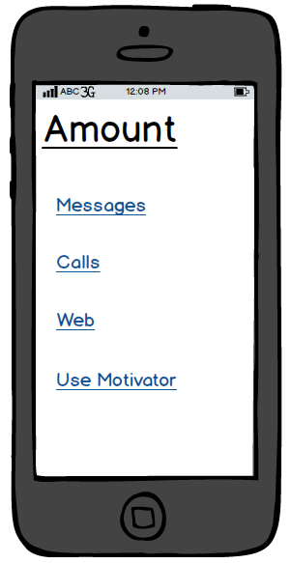
Child
Check your limitations
Use motivator to earn more calls, messages and internet time
Can always call parents, even when there is no calls left

