Slide 1
RunGame
The main point is to motivate runners and make a challenge to training. As well the app is a game, it’s also a way to
challenge yourself!

Slide 2
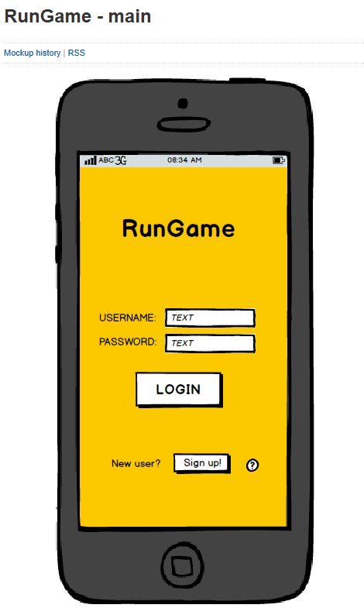
What’s the idea?
This app is a game where you compete against other people by running.
It uses GPS to map and track running/jogging trail and tell how fast the runner is and what kind is the ground (hills etc.).

Slide 3
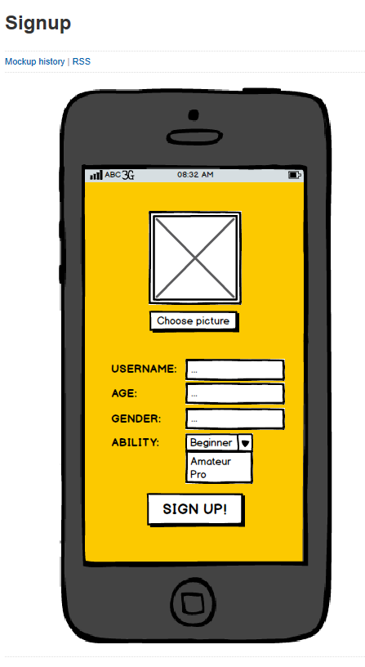
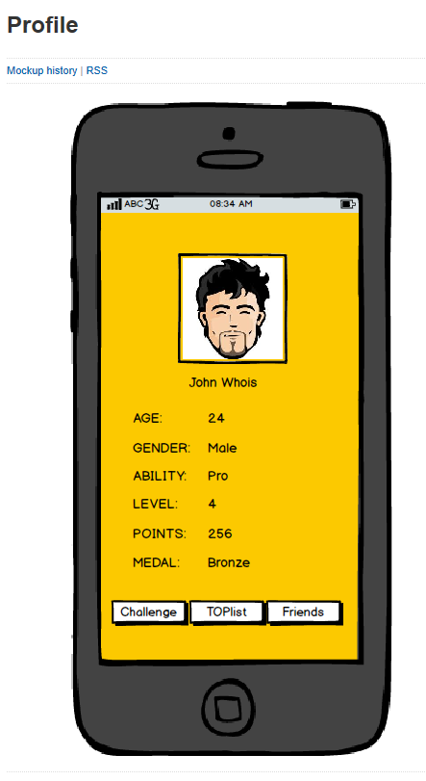
How do I get started?
Gamer makes a profile and logs into the app.
Gamer has to create a nickname and a password.
Next step is to add gamer’s own area, ability group and information about himself (age and gender) to the profile.

Slide 4
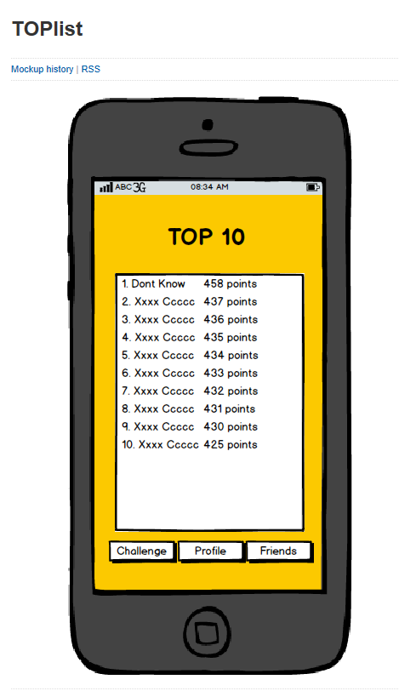
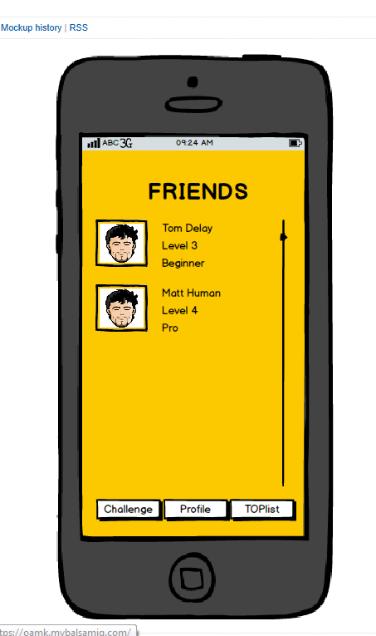
Some features..
After logging in, the player can explore top lists and friend lists.
Potential scams are designed to prevent with acceleration sensor (in the phone)

Slide 5
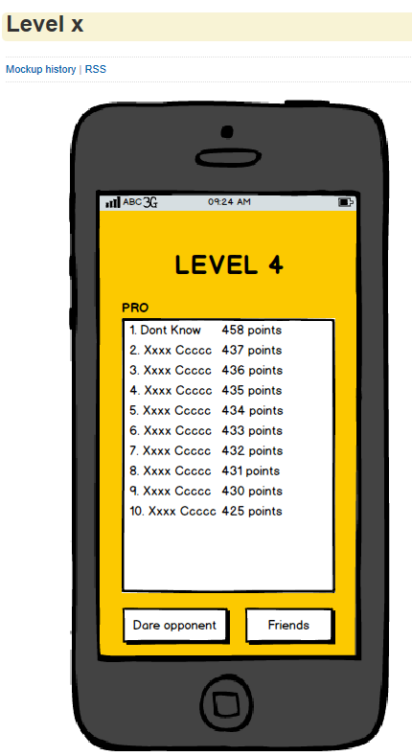
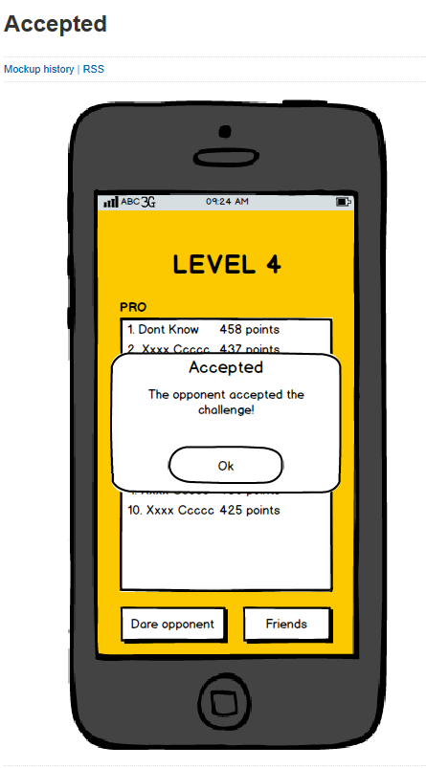
How to make or accept a challenge?
Gamer can move to the menu where he can choose the ability group he would fit in, and the opponent from the same level.

Slide 6
Levels
Ability Group
Time and ground are determinant factors when getting points from
accomplishment but the distance must be completed for passage of the level.
Beginner (8min/km) |  | 8
Level | At least time (min) | Distance (km)
1 | 10 | 1,25
2 | 15 | 1,88
3 | 20 | 2,50
4 | 25 | 3,13
5 | 30 | 3,75
Aficionado (6min/km) |  | 6
Level | At least time (min) | Distance (km)
1 | 20 | 3,33
2 | 30 | 5,00
3 | 40 | 6,67
4 | 50 | 8,33
5 | 60 | 10,00
Pro (5min/km) |  | 5
Level | At least time (min) | Distance (km)
1 | 20 | 4
2 | 30 | 6
3 | 40 | 8
4 | 50 | 10
5 | 60 | 12

Slide 7
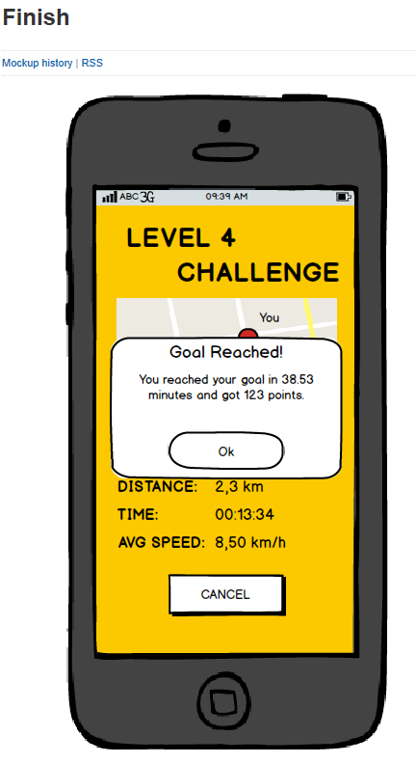
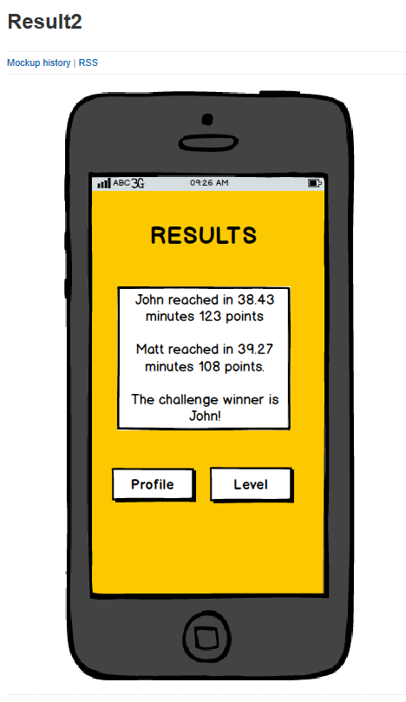
How you know who won?
The app gives a signal, a voice, to tell that the challenge goal has been completed.
After that the runner will see info about the performance and points he has achieved.
After the opponent has completed the challenge, the app tells which one were the winner and gets to the next level.

Slide 8

Motivation!
In certain levels, runner can achieve medals (bronze, silver, gold).
-> The runner gets more
motivation for running
again and gets
challenge
to his training.

