Slide 1
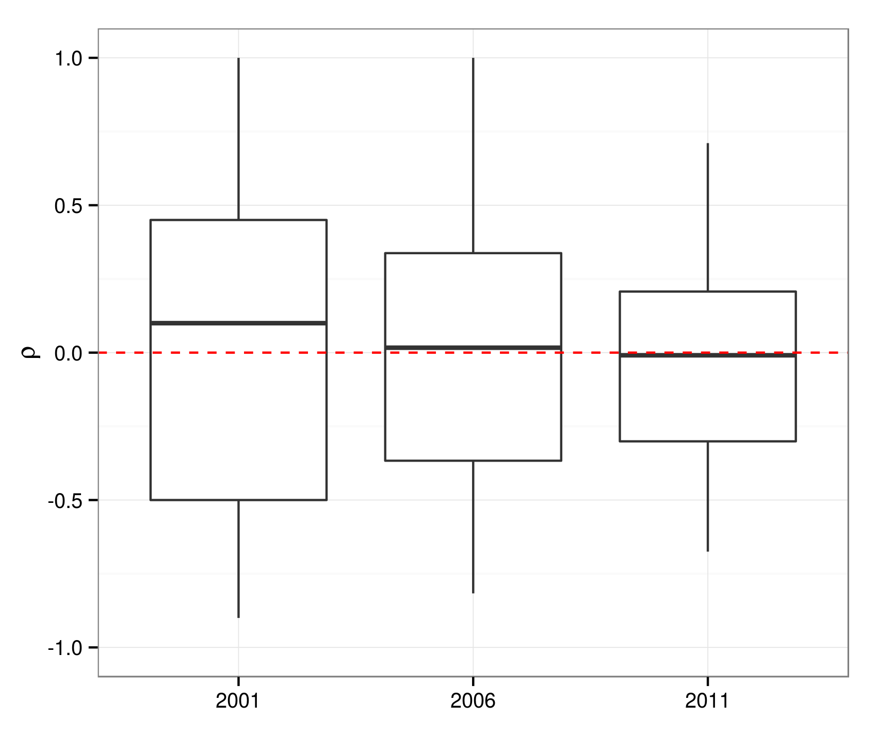
1.0
0.5
ρ
0.0
−0.5
−1.0
2001
2006
2011

