Slide 1
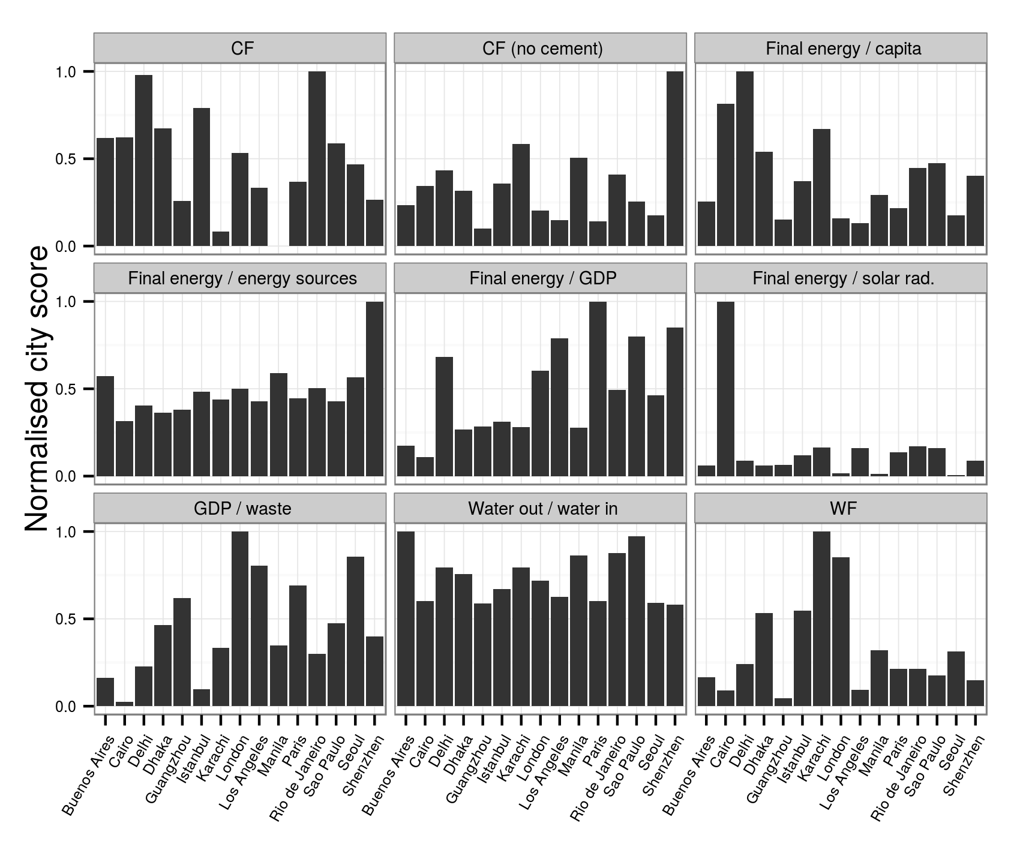
1.0
CF
CF (no cement)
Final energy / capita
0.5
0.0
1.0
Final energy / energy sources
Final energy / GDP
Final energy / solar rad.
Normalised city score
0.5
0.0
1.0
GDP / waste
Water out / water in
WF
0.5
0.0
Cairo
Paris
Cairo
Paris
Cairo
Paris
Delhi
Seoul
Delhi
Seoul
Delhi
Seoul
Dhaka
Karachi
Manila
Dhaka
Karachi
Manila
Dhaka
Karachi
Manila
London
London
London
Istanbul
Shenzhen
Istanbul
Shenzhen
Istanbul
Shenzhen
Buenos Aires
Guangzhou
Los Angeles
Sao Paulo
Buenos Aires
Guangzhou
Los Angeles
Sao Paulo
Buenos Aires
Guangzhou
Los Angeles
Sao Paulo
Rio de Janeiro
Rio de Janeiro
Rio de Janeiro

