Slide 1
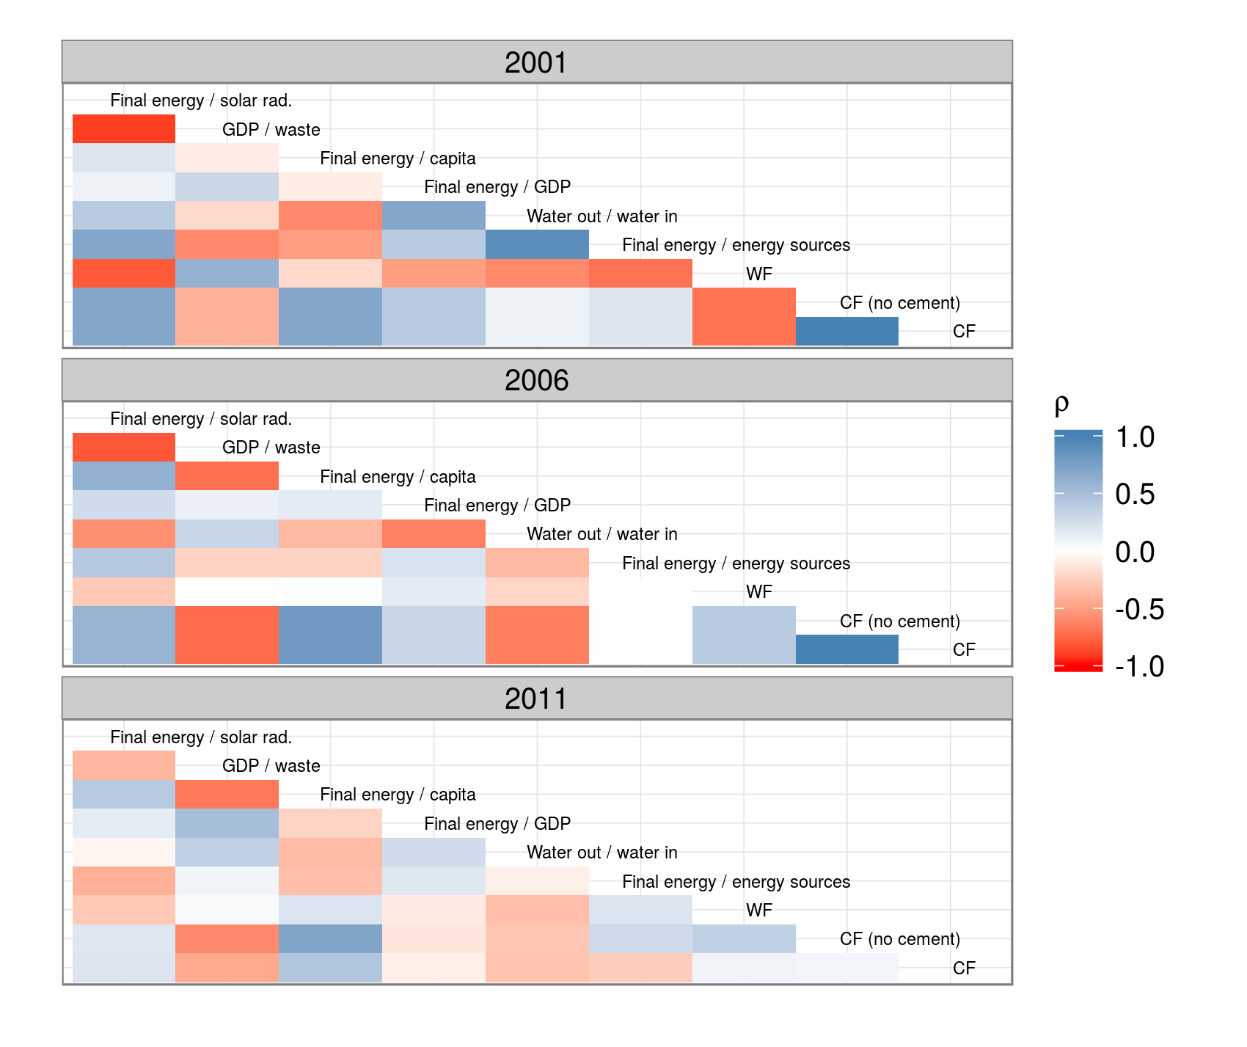
2001
Final energy / solar rad.
GDP / waste
Final energy / capita
Final energy / GDP
Water out / water in
Final energy / energy sources
WF
CF (no cement)
CF
2006
ρ
Final energy / solar rad.
1.0
GDP / waste
Final energy / capita
Final energy / GDP
0.5
Water out / water in
0.0
Final energy / energy sources
WF
CF (no cement)
-0.5
CF
-1.0
2011
Final energy / solar rad.
GDP / waste
Final energy / capita
Final energy / GDP
Water out / water in
Final energy / energy sources
WF
CF (no cement)
CF

