Slide 1
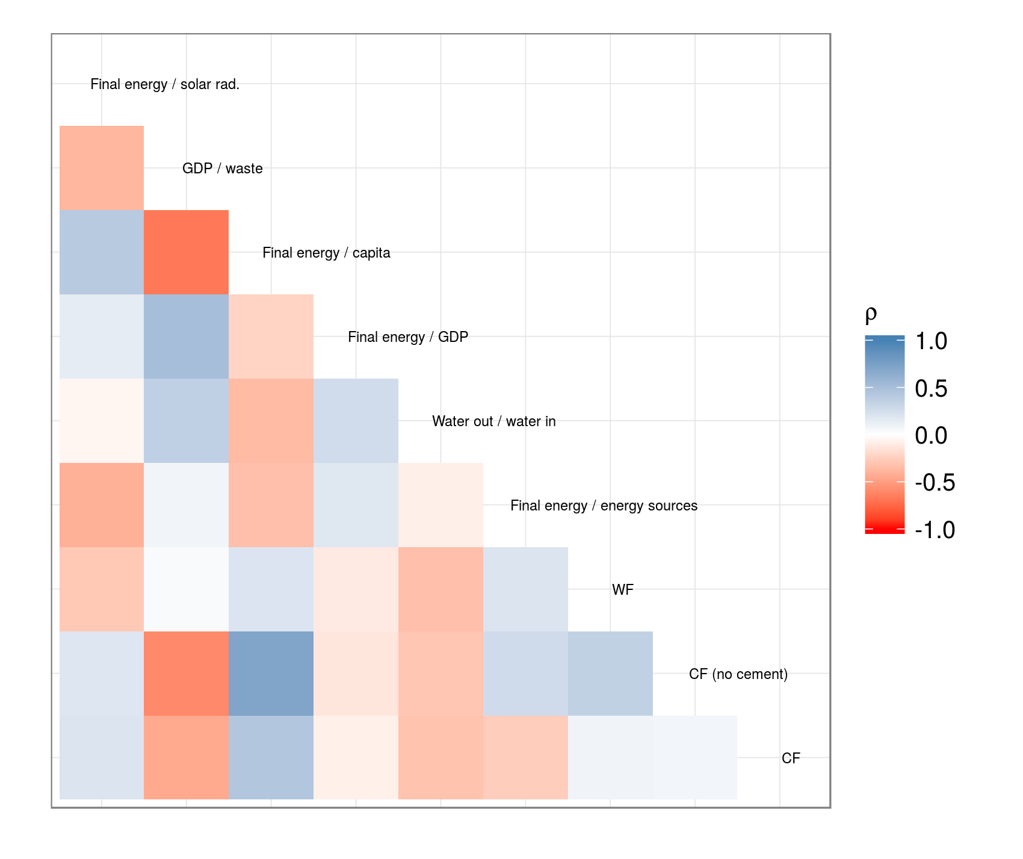
Final energy / solar rad.
GDP / waste
Final energy / capita
ρ
Final energy / GDP
1.0
0.5
Water out / water in
0.0
Final energy / energy sources
-0.5
-1.0
WF
CF (no cement)
CF

