Slide 1
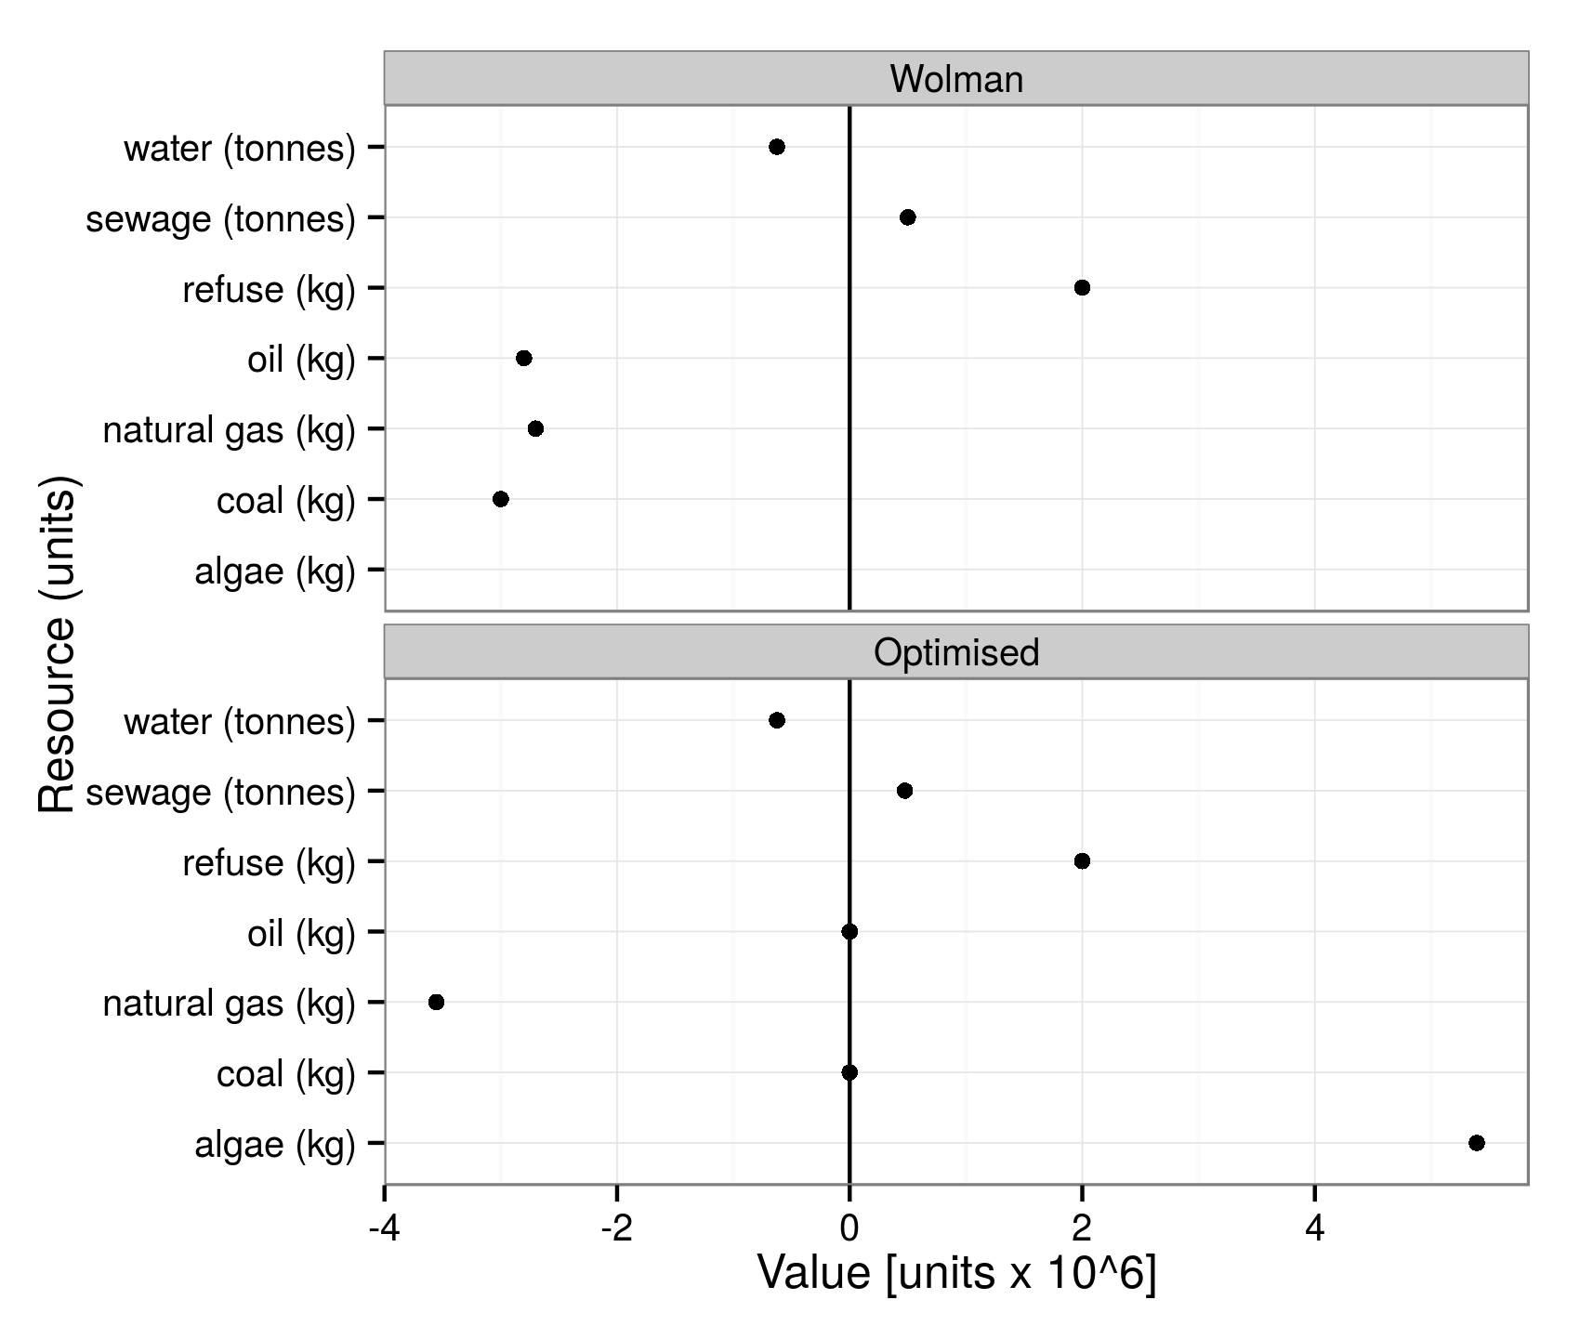
Wolman
water (tonnes)
sewage (tonnes)
refuse (kg)
oil (kg)
natural gas (kg)
coal (kg)
algae (kg)
Resource (units)
Optimised
water (tonnes)
sewage (tonnes)
refuse (kg)
oil (kg)
natural gas (kg)
coal (kg)
algae (kg)
-4
-2
0
2
4
Value [units x 10^6]

