Slide 1
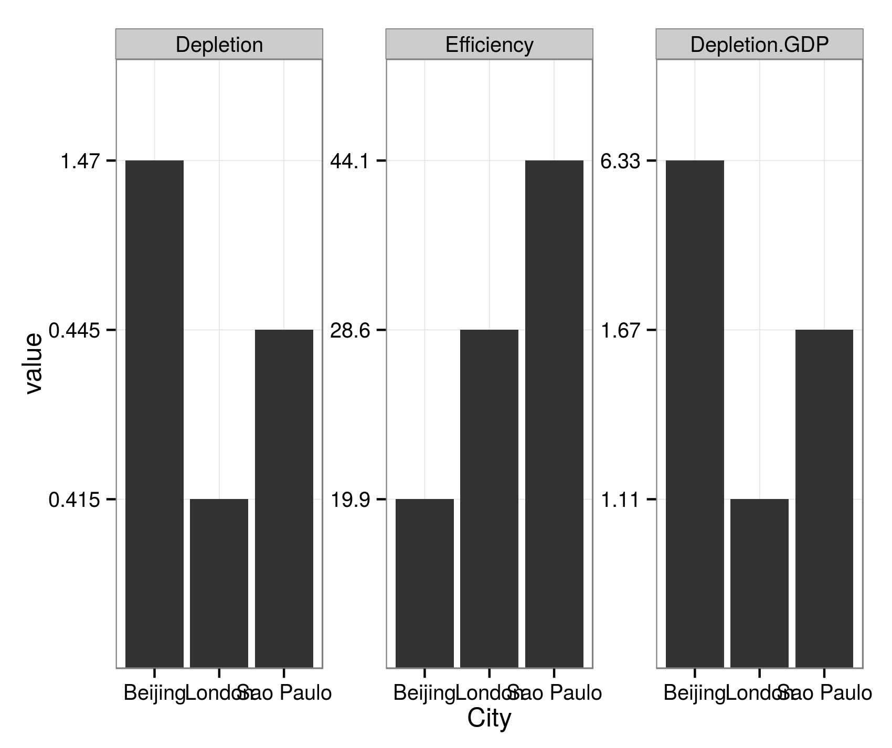
Depletion
Efficiency
Depletion.GDP
1.47
44.1
6.33
0.445
28.6
1.67
value
0.415
19.9
1.11
Beijing
London
Sao Paulo
Beijing
London
Sao Paulo
Beijing
London
Sao Paulo
City

