Slide 1
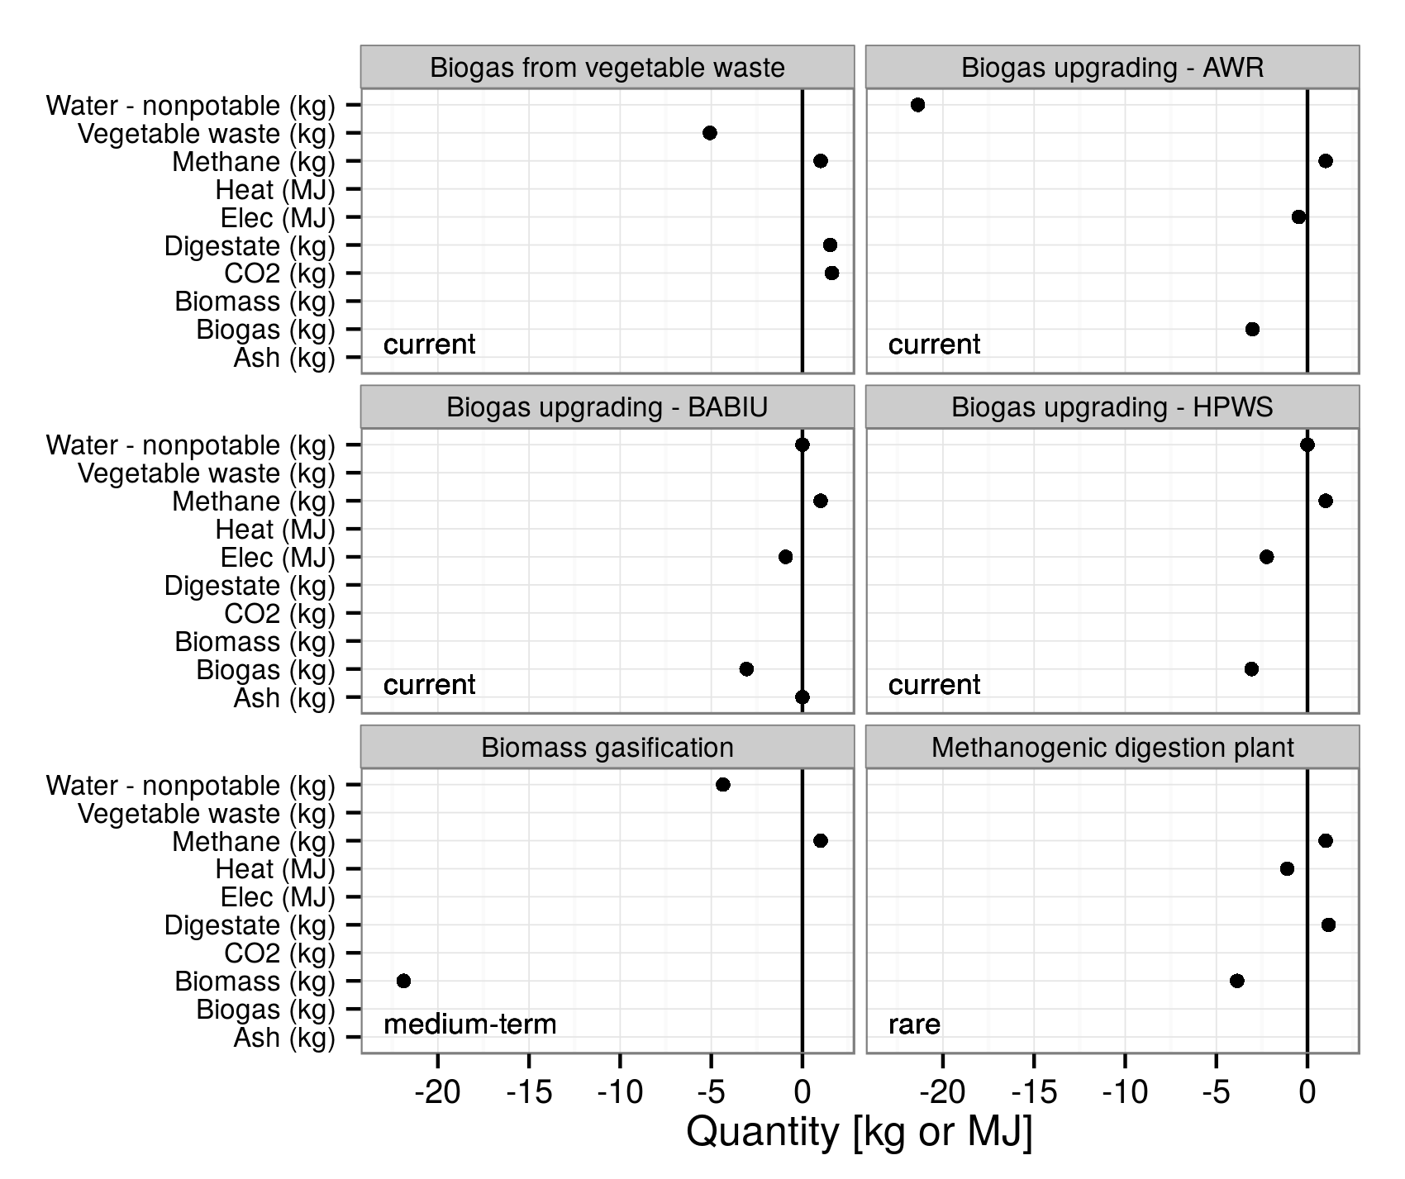
Biogas from vegetable waste
Biogas upgrading - AWR
Water - nonpotable (kg)
Vegetable waste (kg)
Methane (kg)
Heat (MJ)
Elec (MJ)
Digestate (kg)
CO2 (kg)
Biomass (kg)
Biogas (kg)
current
current
current
current
current
current
current
Ash (kg)
current
Biogas upgrading - BABIU
Biogas upgrading - HPWS
Water - nonpotable (kg)
Vegetable waste (kg)
Methane (kg)
Heat (MJ)
Elec (MJ)
Digestate (kg)
CO2 (kg)
Biomass (kg)
Biogas (kg)
current
current
current
current
current
current
current
current
Ash (kg)
current
Biomass gasification
Methanogenic digestion plant
Water - nonpotable (kg)
Vegetable waste (kg)
Methane (kg)
Heat (MJ)
Elec (MJ)
Digestate (kg)
CO2 (kg)
Biomass (kg)
Biogas (kg)
medium-term
medium-term
medium-term
rare
rare
rare
Ash (kg)
rare
-20
-15
-10
-5
0
-20
-15
-10
-5
0
Quantity [kg or MJ]

