Slide 1
Block duration
Block duration
Block duration
Inter-block Interval
Inter-block Interval
Event duration
Inter-stimulus Interval

Slide 2
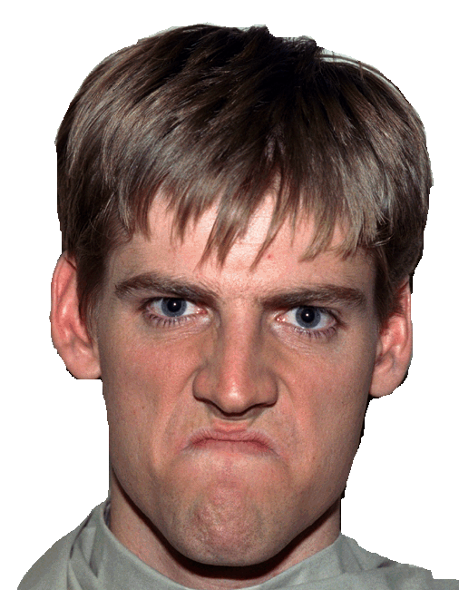

Condition 1:
Emotional Content Not Necessary
Match Emotion
Notes:
Emotion - Angry

Slide 3

Condition 2:
Emotional Content Necessary
Match Emotion
Notes:
Emotion - Angry + Happy

Slide 4
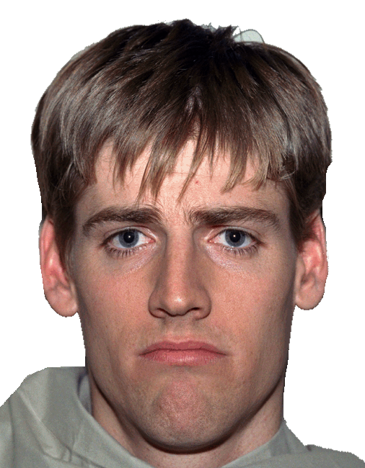
Condition 3:
Emotional Content Necessary and Conflicting
Match Emotion
Notes:
Emotion - Angry + Happy

Slide 5


Neutral Condition:
Match Blurred Faces
Match
Notes:
Emotion - Angry + Happy

