Slide 1
Block Length (Block_Leng)
Block Length
Block Length
Inter-Block Length
(Block_Leng)
Inter-Block Length
Block Length and Inter-Block Length are equal
Sequence Length
(Seq_Leng)
Event duration (Event_Dur)
Inter-trial Interval (ITI)
Total Duration (total_Dur)

Slide 2
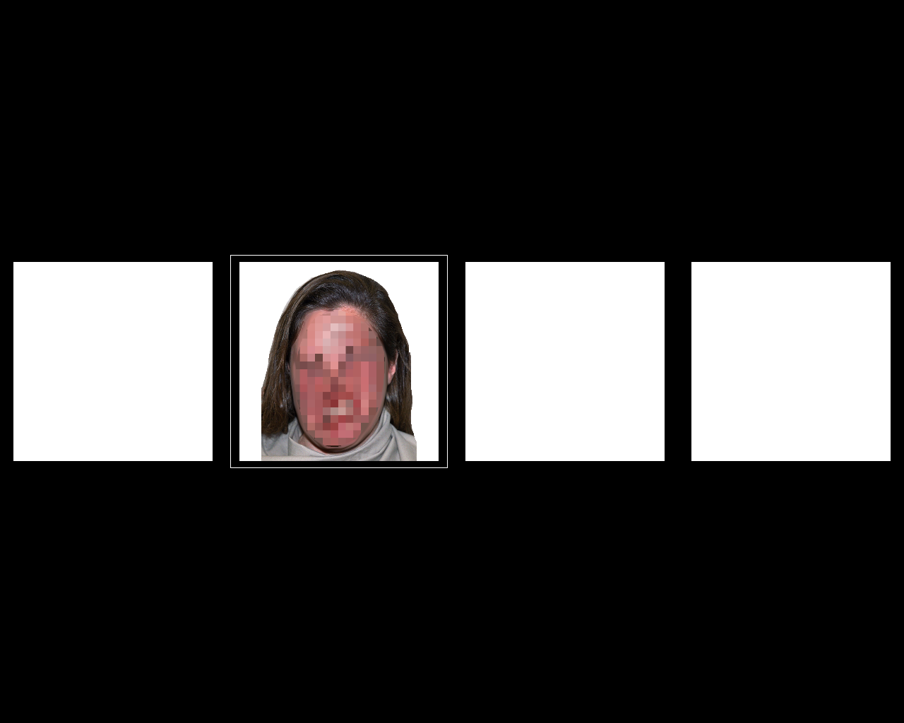
Control Block

Slide 3

Experimental Block

