Slide 1
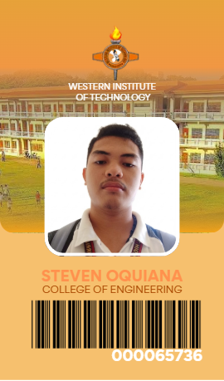
TECHNICAL SYSTEM PRESENTATION · 2026
WIT Barcode
Student Information
System
Computer-vision student identification, subject enrollment, assessment and documentation — implemented as a local desktop application.
Western Institute of Technology · Computer Engineering
Built from repository commit 521e66c · 20 October 2026
PySide6 6.12
MySQL 8.4
YOLOv8n
CODE39
Notes:
Opening frame: the deck is a technical account of the system in this repository, not a product brochure. The ID cards on the right are 300 DPI renders produced by the application's own IdCardService from a real student record. The four version chips are the runtimes that were actually verified on this machine.

Slide 2
NAVIGATION
What this deck covers
Five sections, 35 slides. Numbers are traced to the repository, the live database, training artefacts or captured UI.
01
Context & objectives
3–6
Problem, goals, scope and what is deliberately not delivered.
02
System design
7–10
Context boundary, stack, layered architecture and module map.
03
Product walkthrough
11–25
Every working page, the scan pipeline and the documents it produces.
04
Data & model
26–33
Schema, ERD, data flow, 2,551-image dataset, training and inference.
05
Verification & roadmap
34–35
Test results, documented defects, limitations and next steps.
Evidence policy: no placeholder screenshots, no invented metrics, no claim that a module works when it is unrouted or crashing.
WIT Barcode Student Information System · Technical Presentation · October 2026
02 / 35
Notes:
The deck moves from why the system exists, through how it is built and what it does, to the data and model evidence, and ends with an unvarnished test and limitations slide. The page ranges are the actual slide numbers in this file.

Slide 3
01 · EXECUTIVE SUMMARY
A working desktop SIS with a real vision pipeline
Eight operational modules, 19 database tables and a fine-tuned detector — plus a short, documented list of gaps.
45,978
19
2,551
531
PYTHON LOC
DATABASE TABLES
DATASET IMAGES
TESTS PASSING
122 first-party files, measured with wc -l
230 columns, 33 foreign keys, InnoDB
2,515 barcode boxes across 8 variants
of 553 collected; 22 post-scan failures
WHAT IS PROVEN
WHAT IS NOT
• Identity path: YOLO locates a card barcode, pyzbar decodes it and an exact SQL match resolves the student.
• Records: students, enrollment, subjects, assessment items, schedules and scan history persist in MySQL.
• Documents: Certificate of Matriculation, assessment reports, barcode reports and CSV scan logs.
• Honesty: unknown, duplicate and multi-card reads are distinct states, not false successes.
• No authentication: logout is a stub and the app opens straight into the dashboard.
• Generator not routed: BarcodeGeneratorPage exists but no sidebar route reaches it.
• Two UI defects: dashboard student table and ID-card preview dialog both raise exceptions.
• Core dataset has no test split: the active model was selected on validation only.
Bottom line: the core identification and records workflow is real and demonstrable; the hardening work is identifiable and finite.
WIT Barcode Student Information System · Technical Presentation · October 2026
03 / 35
Notes:
This is the claim the rest of the deck supports: a real, working local system, not a mock-up. The four KPIs are measured. The red panel is deliberately on the summary slide so the audience does not have to wait until the end to hear the limitations.

Slide 4
01 · PROBLEM
Why a barcode-first student system
Three operational frictions the project targets: slow identity checks, fragmented records and document assembly by hand.
01
02
03
Identity checks are manual
Records live in separate places
Documents are assembled repeatedly
A registrar compares a printed name and reference against a card. It is slow at a counter and easy to misread when cards look alike.
Student details, subject lines, fees, schedules and scan history are usually kept in spreadsheets or paper forms, so one fact has several versions.
Certificates, assessment statements and scan logs are retyped for each request, which repeats work and introduces transcription errors.
Target: locate the symbol, decode the payload, resolve a database row.
Target: 19 related tables with foreign keys and uniqueness constraints.
Target: generate from the same records the UI reads.
The demonstration database holds 3 students, 21 subject lines, 3 assessments and 65 scan records — enough to exercise every workflow end to end.
WIT Barcode Student Information System · Technical Presentation · October 2026
04 / 35
Notes:
The problem statement is operational rather than theoretical. Each block ends with the concrete design response that appears later in the deck. The row counts at the bottom come from the live database after the screenshot scan was removed.

Slide 5
01 · OBJECTIVES
Success criteria and where they stand
Each objective is paired with the implementation that serves it and the evidence that can be inspected.
Objective | Implementation | Evidence | Status
Identify a student from a physical card | YOLOv8n → ROI gate → pyzbar → exact SQL match | 3/3 real cards decoded; audit report | Met
Never present a decode as a student | VERIFIED requires a matching students row | scan_pipeline.py state machine | Met
One source of truth for records | 19 tables, 34 FKs, UNIQUE constraints | SHOW CREATE TABLE; ERD | Met
Produce documents from live data | ReportLab COM, assessment, barcode and CSV | reports/ artefacts; Reports page | Met
Run without a server or network | PySide6 + local MySQL + local files | Context and deployment diagrams | Met
Make the pipeline testable offline | No Qt/threads in ScanPipeline; injectable services | 553 tests collected | Partial
Protect access with authentication | users table exists; no login flow | Logout stub in main_window.py | Not met
Route every built screen | Barcode generator page built but unrouted | No route in PAGE_CLASSES | Not met
“Met” means observed in the running application or measured from the live database — not inferred from a README.
WIT Barcode Student Information System · Technical Presentation · October 2026
05 / 35
Notes:
The status column is intentionally blunt. The two 'Not met' rows and the 'Partial' row are developed on slides 34 and 35. Everything marked Met has a screenshot, a database query or a source file behind it.

Slide 6
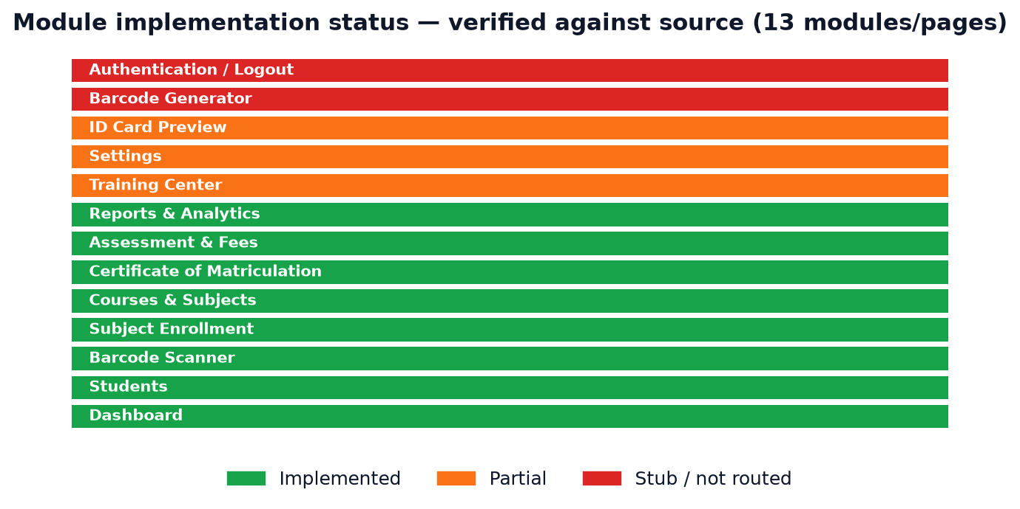
01 · SCOPE
Delivered versus partial — at a glance
Module status was checked against source imports and routes, then confirmed in the running application.
DELIVERED
• Dashboard, Students, Scanner
• Enrollment, Courses & Subjects
• Assessment & Fees, Reports
• Certificate of Matriculation
• YOLO scan pipeline and 19-table schema
PARTIAL OR ABSENT
• Training Center: reads empty DB tables, ignores 2,551 files on disk
• Settings: general tab works; several controls are inert
• Barcode Generator: complete page, no route
• Authentication: users table but no login
• ID-card preview: service renders; dialog raises QImage error
WIT Barcode Student Information System · Technical Presentation · October 2026
06 / 35
Notes:
The module-status chart counts 13 modules: 8 implemented, 3 partial, 2 stubs or unrouted. The partial column names the specific defect rather than saying 'needs work'.

Slide 7
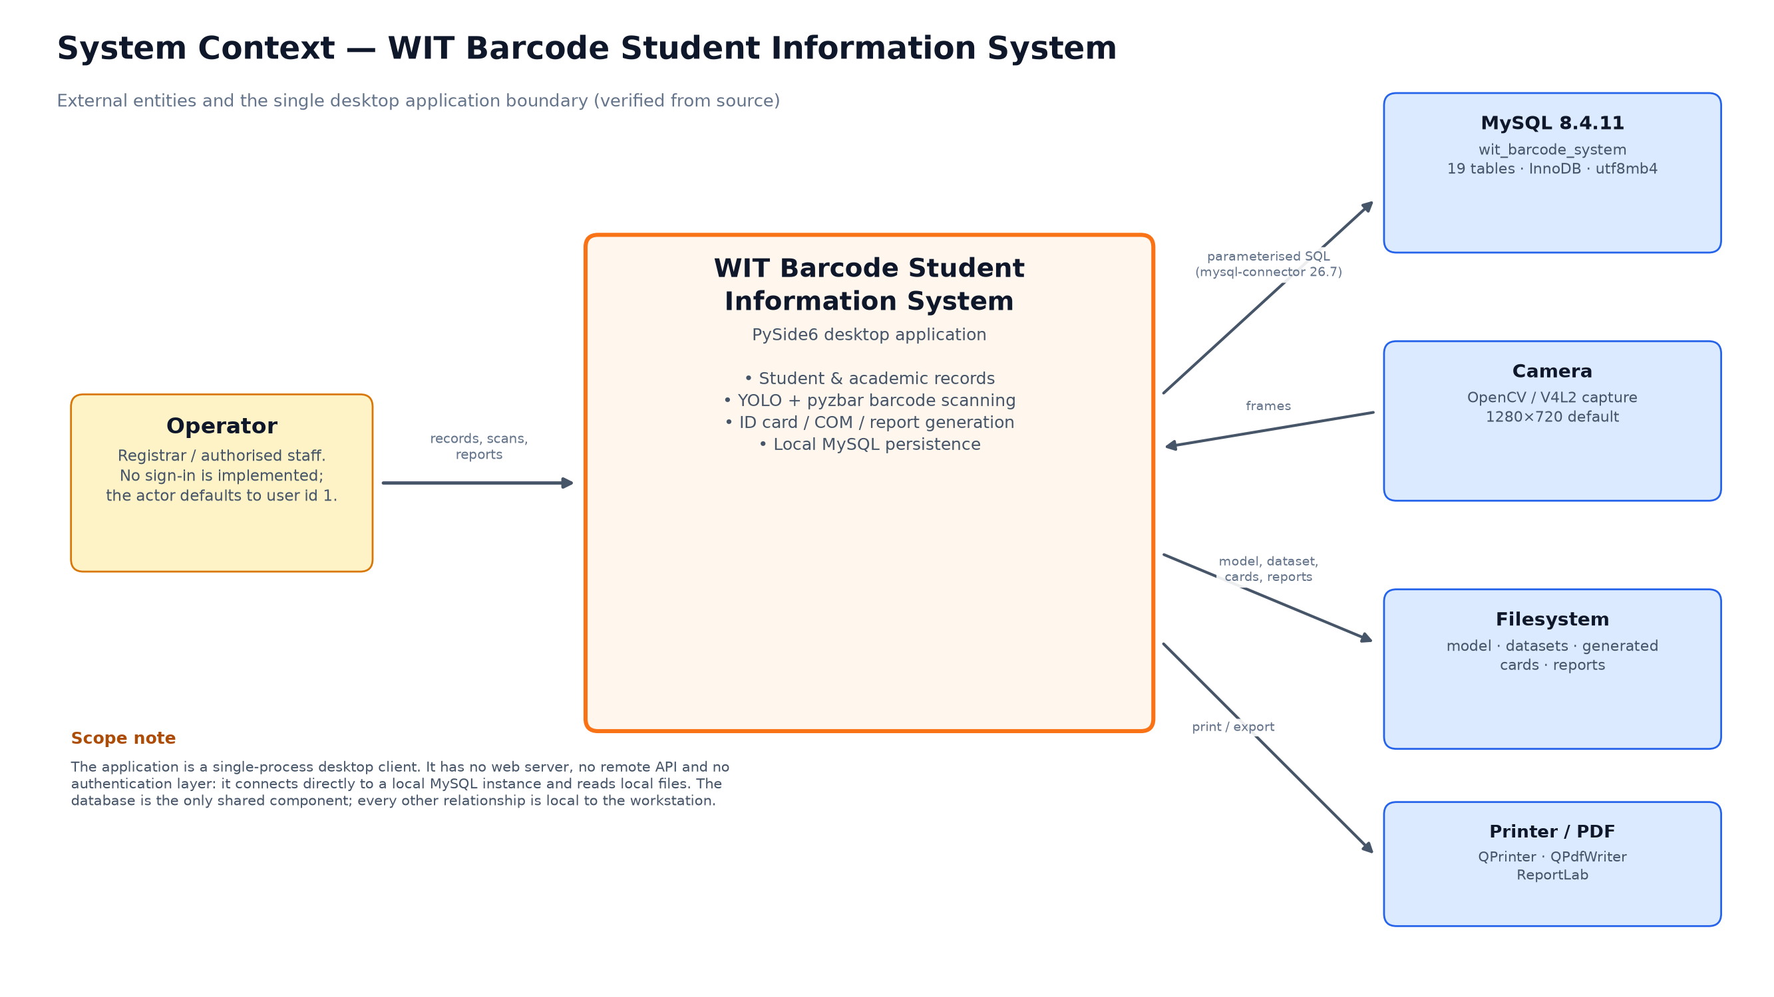
02 · SYSTEM DESIGN
System context — one workstation, no network tier
The application is a monolithic PySide6 desktop client that owns the camera, the model, the database connection and the filesystem.
Boundaries that matter
• Operator is the only human actor.
• Camera is a local V4L2 device; an uploaded image is the fallback.
• MySQL runs on the same workstation. There is no API server.
• Model and datasets are files on disk, not services.
• Outputs land in reports/ and generated_id_cards/.
WIT Barcode Student Information System · Technical Presentation · October 2026
07 / 35
Notes:
This boundary explains several later limitations: there is no session, no role check and no remote audit surface because there is no server. It also explains the deployment story: copy the repository, a Python environment and a MySQL instance onto one machine.

Slide 8
02 · TECHNOLOGY
Verified runtime and libraries
Versions were read from the project virtual environment and from live imports, not from a requirements wish-list.
Application & UI
Data & storage
Vision & identity
Python
3.14.4
MySQL
8.4.11
Ultralytics
8.4.177
PySide6
6.12.0
mysql-connector-python
26.7.0
PyTorch
2.14.1
Qt
6.12.0
InnoDB
utf8mb4
OpenCV
5.0.0
python-dotenv
configured
connection pool
size 10
pyzbar
0.1.9
pytest
9.1.1
ReportLab
5.0.1
python-barcode
0.16.1
CUDA · RTX 2050
CPU fallback
Linux workstation
No web framework, no HTTP client, no cloud SDK in the dependency set.
WIT Barcode Student Information System · Technical Presentation · October 2026
08 / 35
Notes:
The unusual item is Python 3.14.4, which is newer than most Qt tutorials assume; the environment still imports and runs cleanly. MySQL 8.4.11 is the live server. The vision stack is the heaviest dependency and is the reason the deck reports measured latency rather than a guess.

Slide 9
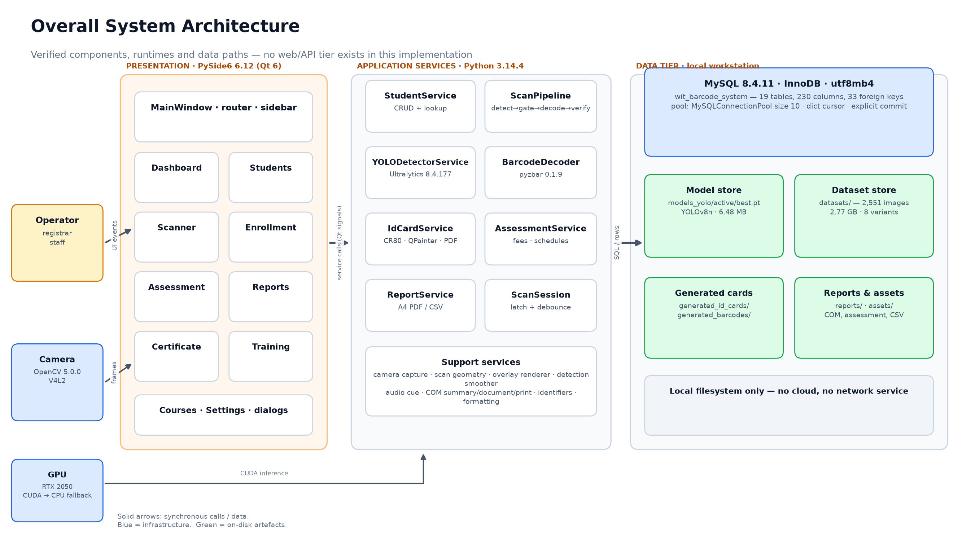
02 · ARCHITECTURE
Three tiers inside one process
Presentation, application services and the local data tier. Arrows are synchronous calls or data, not network messages.
WIT Barcode Student Information System · Technical Presentation · October 2026
09 / 35
Notes:
The important architectural claim is that there is no hidden service layer. The UI calls services directly; services use repositories and the connection pool. That makes the system easy to run but means the UI thread discipline and error handling live in the page code, which is where two of the three known defects are found.

Slide 10
02 · CODEBASE
Module map and implementation state
Thirteen user-facing modules, checked against the router, the page classes and the running window.
Module | State | What is actually there
Dashboard | Working | KPI cards and DB status; student table raises TypeError
Students | Working | Search, filters, pagination, create/edit/delete dialog
Barcode Scanner | Working | Live camera, YOLO, decode, student panel, history, result modal
Subject Enrollment | Working | Student selector, enrollment tabs, subject add/edit
Courses & Subjects | Working | Read-only catalogue from courses/subjects
Assessment & Fees | Working | Assessment lines, schedule, balances, payment dialog
Certificate of Matriculation | Working | Live preview, Save PDF, Print
Reports & Analytics | Working | Five report cards, background generation
Training Center | Partial | Config/registry UI; dataset counts read empty DB tables
Settings | Partial | General tab persists; several controls are placeholders
ID Card Preview | Partial | Service renders CR80; preview dialog raises QImage error
Barcode Generator | Unrouted | Full page class, no entry in PAGE_CLASSES
Authentication / Logout | Stub | users table exists; no login, logout says “to be implemented”
Counts: 122 first-party Python files and 45,978 lines in config/, database/, models/, scripts/, services/, styles/, tests/, ui/ and main.py (wc -l; venv/, .git/ and presentation/ excluded).
WIT Barcode Student Information System · Technical Presentation · October 2026
10 / 35
Notes:
This table is the ground truth for module claims. 'Working' means the primary workflow was exercised for the screenshots. 'Partial' means part of the screen functions and part does not. 'Unrouted' is not the same as missing: the generator page is 1,402 lines of implemented UI that a user cannot reach.

Slide 11
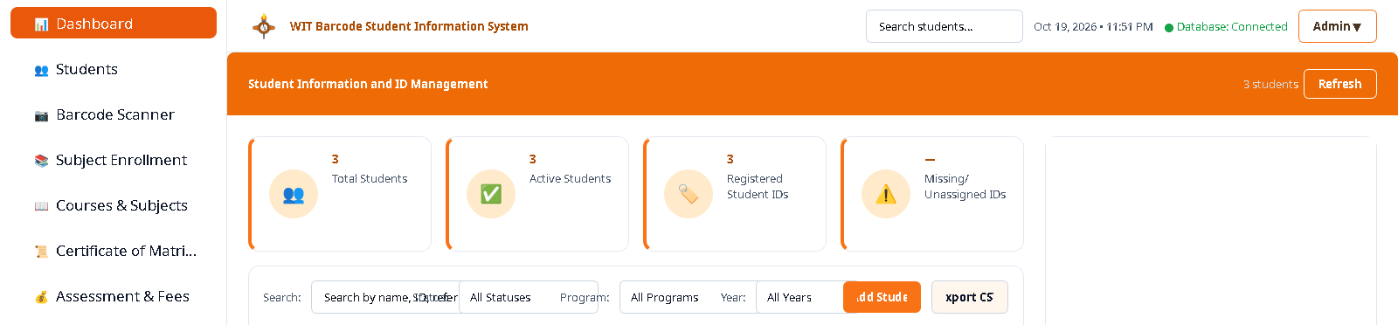
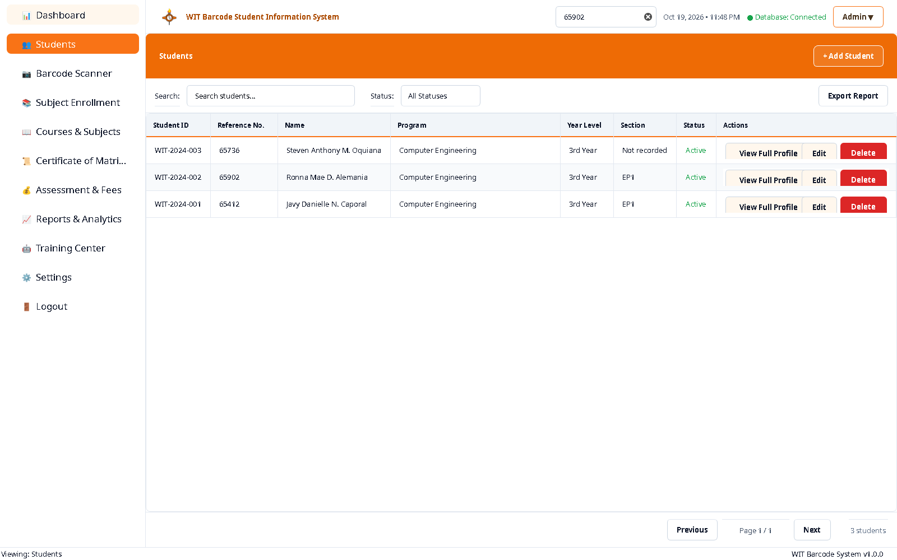
03 · WALKTHROUGH
Dashboard and global navigation
The landing page shows four KPI cards, a database health indicator and a global quick-search available from every page.
OBSERVED
• Live counts: 3 total, 3 active, 3 registered, 0 missing barcodes.
• Health probe: the top bar reports “Database: Connected” after a real query.
• Quick search: Ctrl+K searches name, student ID or reference from any page.
• Navigation: nine sidebar routes, including the stub logout.
The student table below this KPI strip raises TypeError: set_cell() got an unexpected keyword argument 'family'. The screenshot is cropped above the fault; slide 34 shows the real error.
Captured at 1600×1000 from the offscreen Qt platform against the live MySQL database.
WIT Barcode Student Information System · Technical Presentation · October 2026
11 / 35
Notes:
The dashboard is the first thing a user sees, and it is also one of the two visible defects. The KPI strip itself is correct and reads the same student rows the Students page uses. The crop is honest: the deck does not hide the failure, it isolates the working part and shows the failure later.

Slide 12
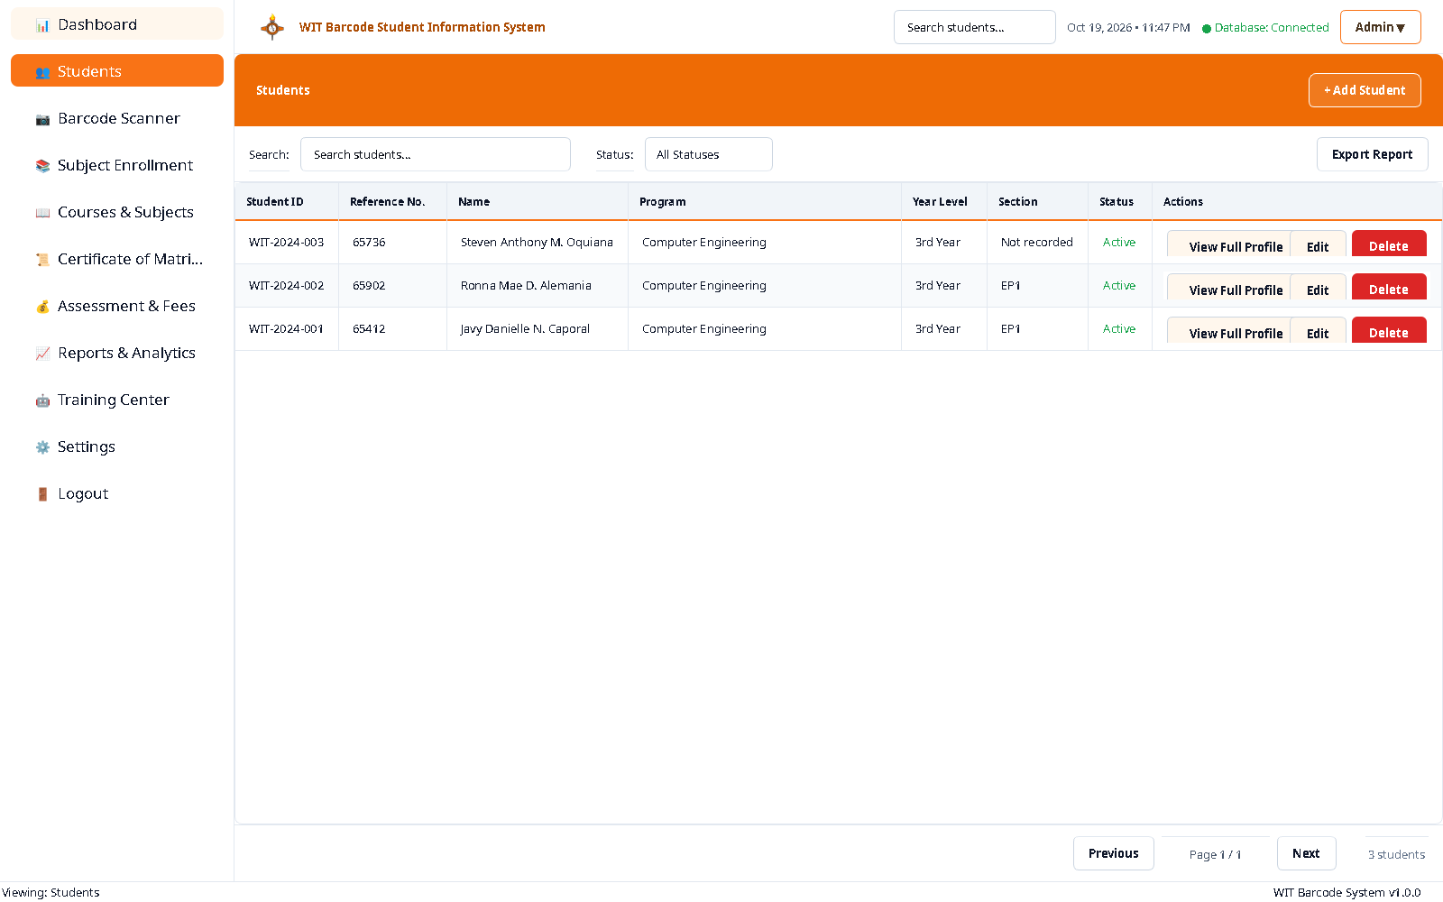
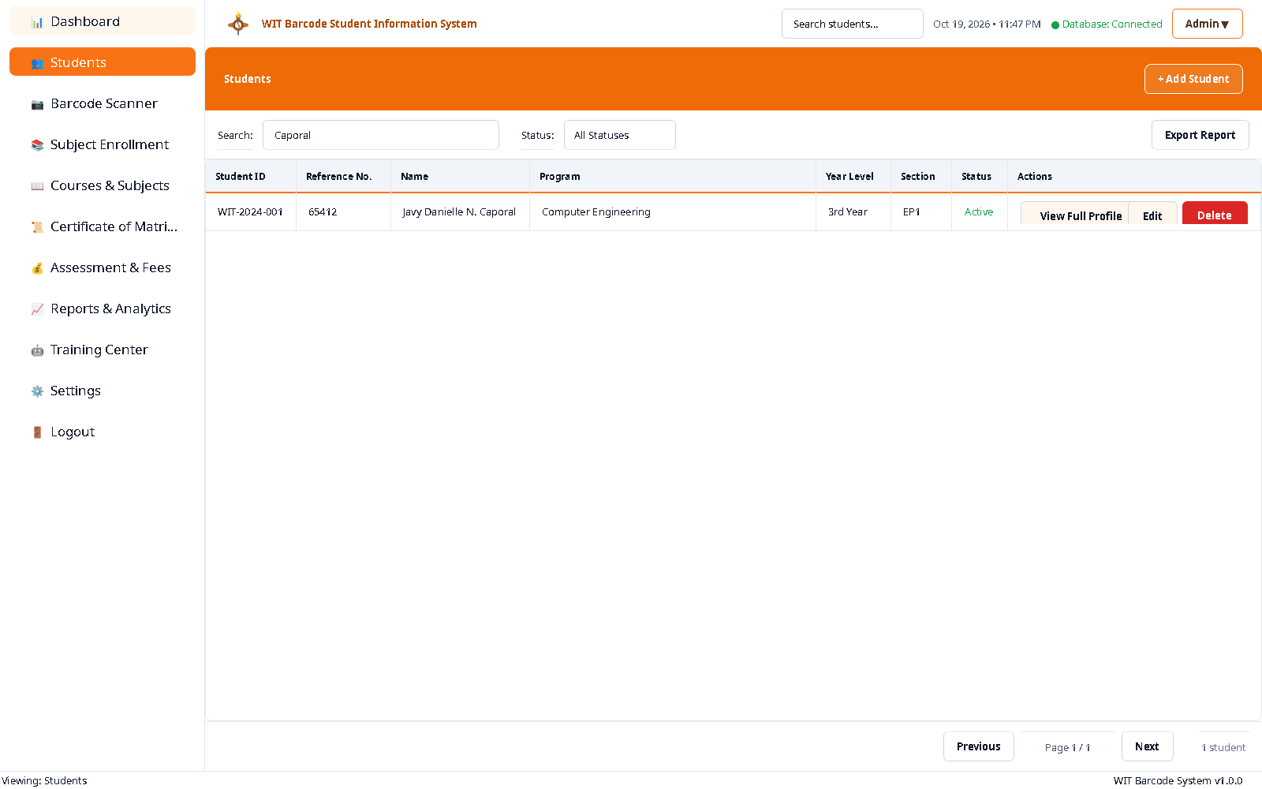
03 · WALKTHROUGH
Student directory and record management
The directory is the administrative backbone: search, filter, page and edit the same rows the scanner resolves.
CAPABILITIES
• Search by name, ID or reference
• Status / program / year filters
• 25-row pagination
• Create, edit and delete dialog
• Portrait resolved from assets/profile/
Three real records, all Computer Engineering, 3rd Year. The filter example is the query “Caporal”.
WIT Barcode Student Information System · Technical Presentation · October 2026
12 / 35
Notes:
Student records are the join point for every other module: enrollment, assessment, barcode and ID card all reference students.id. The directory search is also used by the scan result dialog, so a failure here would propagate widely.

Slide 13



03 · WALKTHROUGH
Identity design: CODE39 payloads on the physical cards
The implementation uses CODE39 with a zero-padded nine-digit reference, matching the cards in assets/images/.
Javy Danielle N. Caporal
Why CODE39, not CODE128
WIT-2024-001 · reference 65412
payload 000065412
• Physical cards already use CODE39; the decoder must match them.
• Nine digits at module width 2 still fit a CR80 card with a 2 mm quiet zone.
• The payload is the key: students.barcode_payload is UNIQUE and is what the scanner queries.
• README mismatch: the README still advertises CODE128 and a WIT:STUDENT: prefix; the code and database use CODE39.
Ronna Mae D. Alemania
WIT-2024-002 · reference 65902
payload 000065902
Steven Anthony M. Oquiana
WIT-2024-003 · reference 65736
payload 000065736
BarcodeGeneratorPage is implemented (1,402 lines) but has no sidebar route, so this identity path is used only by pre-existing cards and the ID-card service.
WIT Barcode Student Information System · Technical Presentation · October 2026
13 / 35
Notes:
The barcode images shown are the project's own generated assets. The filename mismatch is a trap: barcode_1.png belongs to student 2 and barcode_2.png to student 1. Nothing in the application keys on filename; it keys on the decoded payload. The README/code mismatch is a documentation defect, not a runtime one.

Slide 14
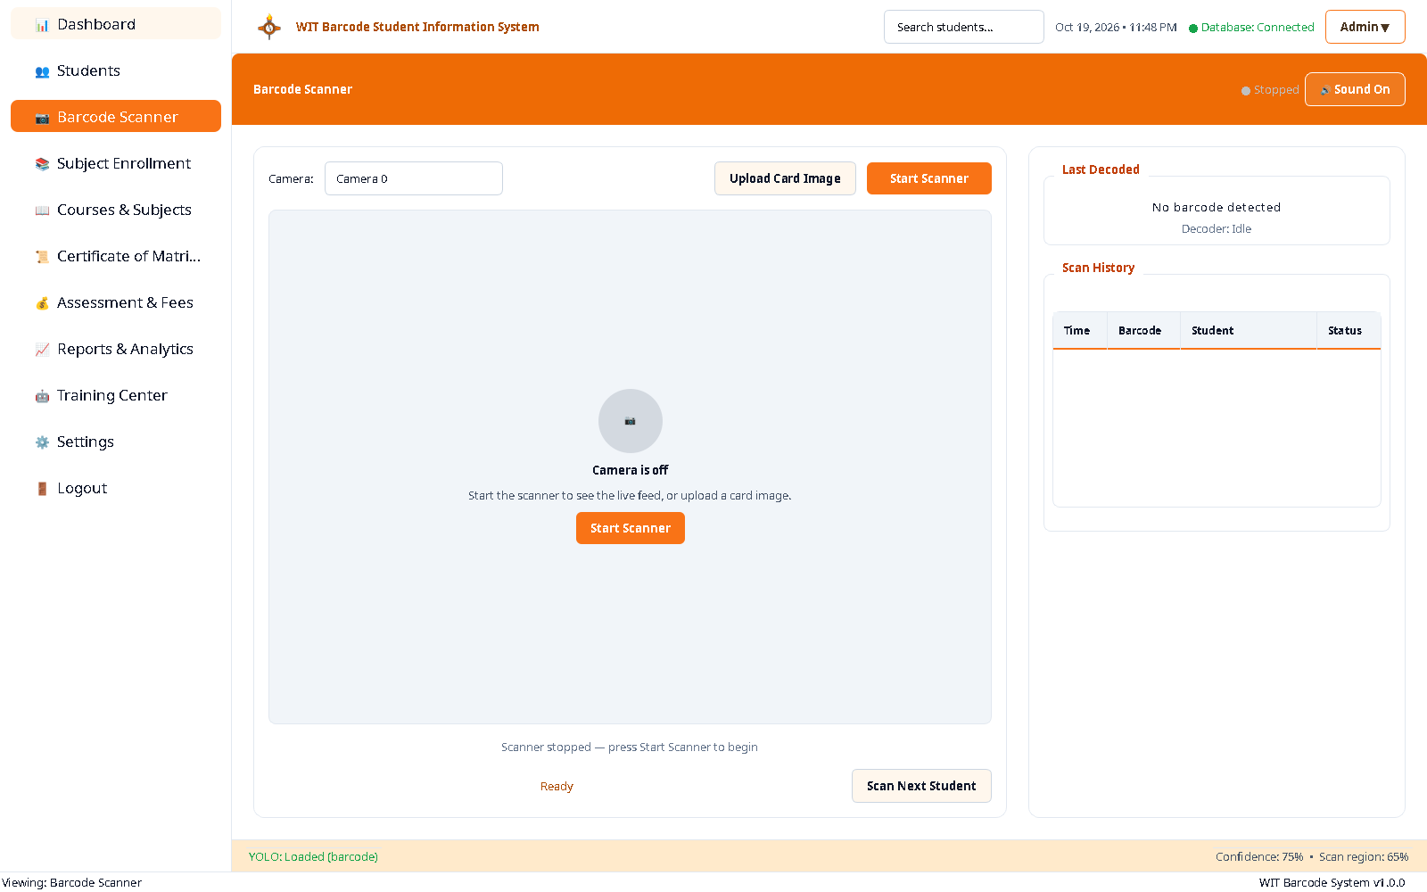
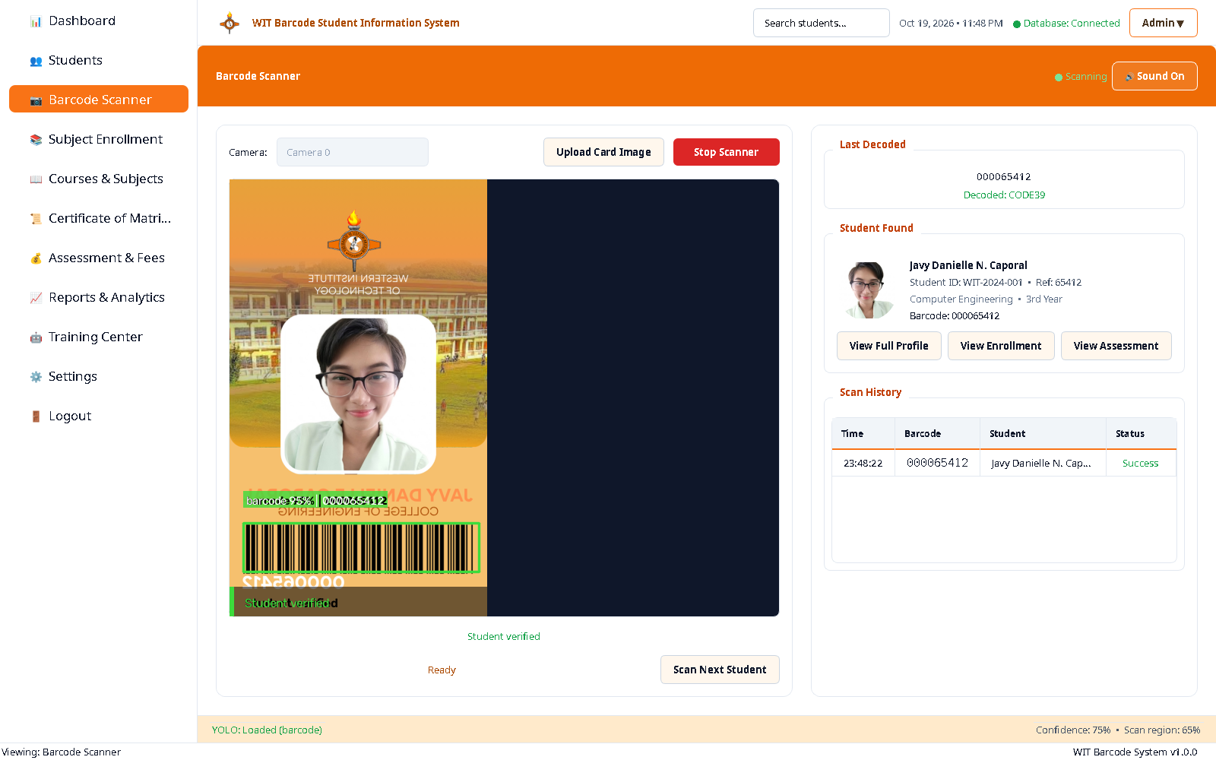
03 · WALKTHROUGH
The scanner experience
Live camera and image-upload paths share one pipeline. A verified read fills the student panel and appends a history row.
IDLE
VERIFIED
• Camera list, YOLO status, live history
• Upload Card Image as a fallback
• Scan Next Student resets the latch
• Decoded 000065412 and matched Javy Danielle N. Caporal
• History row persisted; success tone and result modal fire once
• Yellow guide is a hint; the gate is a separate 0.88×0.88 region
Both frames captured from the running app. The verified frame came from feeding the real Id_1.png through ScanPipeline; the resulting DB row was removed afterwards.
WIT Barcode Student Information System · Technical Presentation · October 2026
14 / 35
Notes:
The scanner is the centre of the project. The idle frame shows the operator affordances: camera selection, model status, and a history table. The verified frame is the proof that detection, decoding and database lookup agree on the same person. The database was restored after capture, so the deck's scan counts are the pre-capture counts.

Slide 15
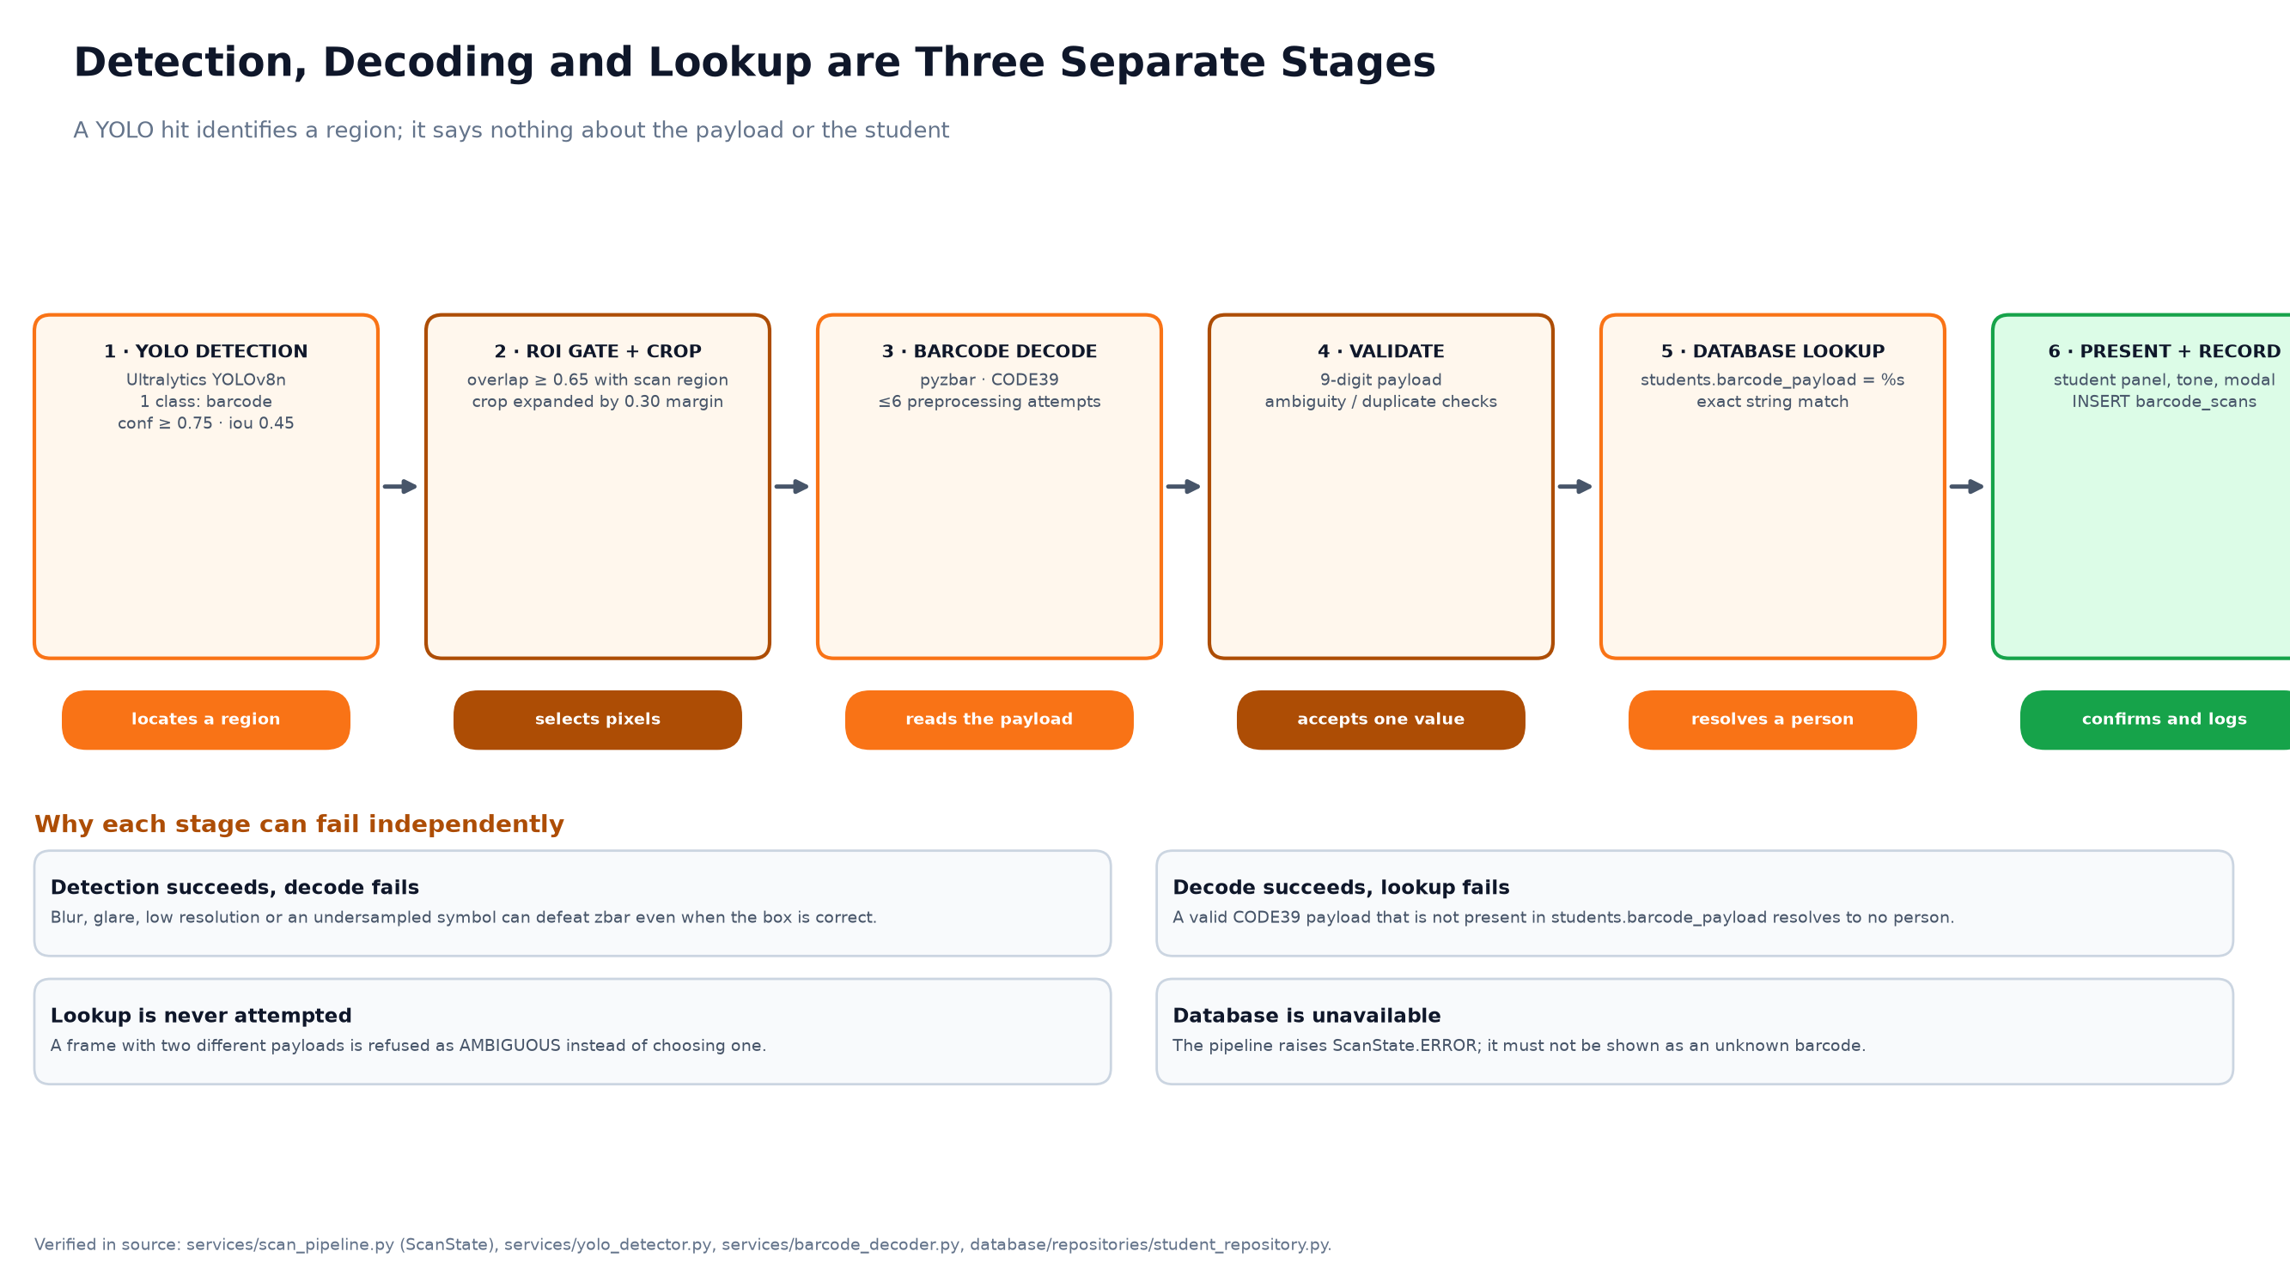
03 · SCANNER INTERNALS
Detection, decoding and lookup are separate stages
A YOLO hit identifies a region; it says nothing about the payload or the student. Each stage can fail without faking the next.
Verified in source: services/scan_pipeline.py, services/yolo_detector.py, services/barcode_decoder.py, database/repositories/student_repository.py. Thresholds are the runtime values in .env.
WIT Barcode Student Information System · Technical Presentation · October 2026
15 / 35
Notes:
The separation is the most important design decision in the scanner. It is what allows the UI to say 'barcode found but not decodable' instead of 'unknown student', and what makes the pipeline testable without a camera.

Slide 16
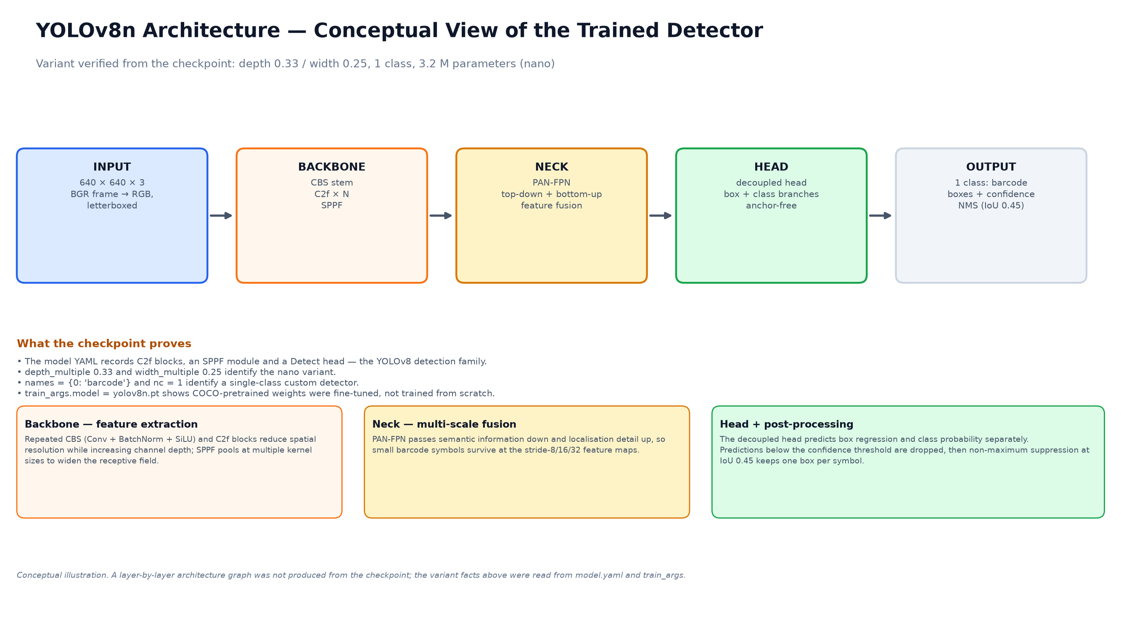
03 · DETECTION MODEL
YOLOv8n fine-tuned for one class: barcode
A nano detector keeps the model at 6.48 MB and fast enough for a 12 FPS preview on the available GPU.
Property | Value
Checkpoint | models_yolo/active/best.pt
Size / parameters | 6,484,970 B · 3.2 M
Classes | 1 — barcode
Input | 640 × 640 letterboxed
Confidence | 0.75 (runtime .env)
NMS IoU | 0.45
Device | CUDA:0 → CPU fallback
Architecture diagram is conceptual: CBS/C2f/SPPF backbone, PAN-FPN neck, decoupled anchor-free head. Variants confirmed from the checkpoint metadata.
WIT Barcode Student Information System · Technical Presentation · October 2026
16 / 35
Notes:
YOLOv8n was chosen for latency and size, not because it is the most accurate option. The one-class problem is easy enough that a nano model reaches a high validation mAP. The 0.75 confidence threshold is a runtime choice recorded in .env after measurement; the code default is 0.5.

Slide 17

03 · DETECTION EVIDENCE
The detector finds all three real cards
Inference on the checked-in card images, using the active checkpoint and the runtime threshold.
Card | Frame | Box (x, y, w, h) | Confidence
Id_1.png | 590 × 1004 | 19, 789, 540, 111 | 0.9545
Id_2.png | 590 × 1004 | 46, 784, 501, 130 | 0.9480
Id_3.png | 270 × 459 | 13, 359, 239, 64 | 0.9213
Model identity
• Trained 2026-10-15 22:23
• Run: v7-distance
• Ultralytics 8.4.177
• Best epoch 34 of 64
• mAP50 0.995
• mAP50-95 0.8075
WHAT THE NUMBERS SAY
• Every card clears 0.92 confidence — a wide margin over 0.75.
• Id_3 is the smallest card and still detects cleanly.
• A detection is only a region: decode and SQL lookup are still required.
• The annotated crop on the left is the real model output, scaled 2× for legibility.
WIT Barcode Student Information System · Technical Presentation · October 2026
17 / 35
Notes:
This is not a synthetic demo: the three coordinates and confidences were printed by the active model on the three card assets. The tall image on the left is the model's own annotated output. Notice that detection succeeds even on the smallest card, which is the case that used to fail before the decoder was given upscaling attempts.

Slide 18
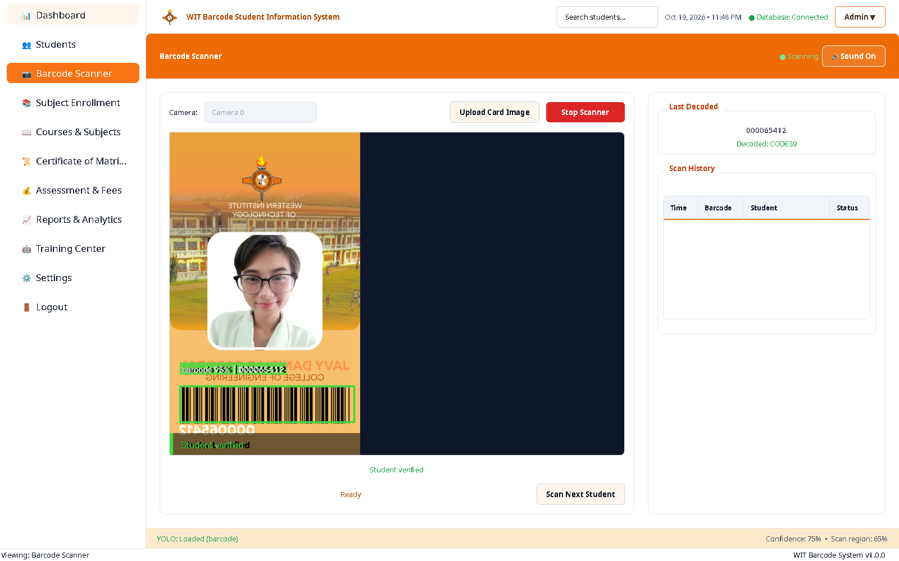
03 · DECODING
From pixels to a payload, with a bounded attempt budget
The ROI gate decides which detections reach pyzbar; the decoder tries a small ordered set of preparations and records which one worked.
GATE
• Overlap ≥ 0.65 with the scan region, measured as intersection over the detection box.
• Crop margin 0.20, minimum 80 × 24 px; unusable crops are skipped rather than decoded.
• Candidate de-duplication at IoU 0.70, so one symbol is not decoded repeatedly.
DECODE
• Ordered attempts, ≤ 6: original colour, greyscale, CLAHE, Otsu, 2× and 3× upscale variants.
• Every payload is kept, not just the first: two distinct values make the read AMBIGUOUS.
• Method and attempt count travel with the result, so the UI can be honest about a difficult read.
Why upscaling exists: Id_3.png supplies only ~1.85 px per narrow CODE39 element at native size.
Screenshot: live detection with the bounding box, guide overlay and decoded value 000065412.
WIT Barcode Student Information System · Technical Presentation · October 2026
18 / 35
Notes:
The decoder is deliberately bounded: six attempts per crop, not an unbounded search over every filter combination. That keeps a frame from stalling on a hopeless crop. The ambiguity rule is a safety property: if two different payloads are read from the same crop, the system refuses to choose.

Slide 19
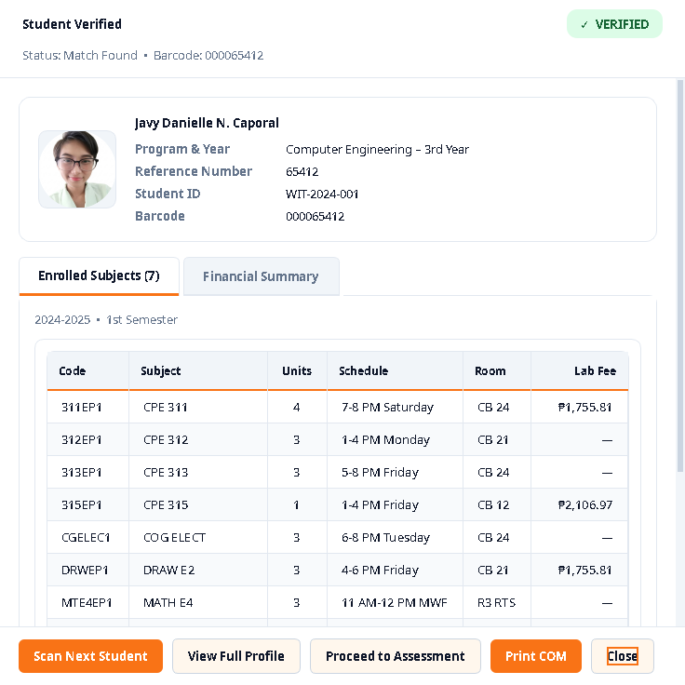

03 · OUTCOMES
Verified, unknown and ambiguous are different states
The UI never collapses a failed lookup into a success. The demonstration data records both outcomes.
VERIFIED — student resolved
UNKNOWN — decoded, no DB row
RESULT MODAL
• Student panel, portrait and reference
• Success tone + one history insert
• COM and financial tabs open
• Decoded value is shown
• not_found row is written
• No student panel, no success tone
• Database failure is a separate ERROR state
65 scans on file
41 success · 24 not found
The not-found rows are test reads against unknown payloads, not silent failures.
Scan counts are the live barcode_scans table after removing the one capture scan. Success rate is 63.1%.
WIT Barcode Student Information System · Technical Presentation · October 2026
19 / 35
Notes:
The unknown state is important because it proves the system does not treat a decode as identity. The 42/24 split in the original evidence became 41/24 after the screenshot row was removed. The modal on the right is the structured result view; it is a separate dialog from the student panel.

Slide 20
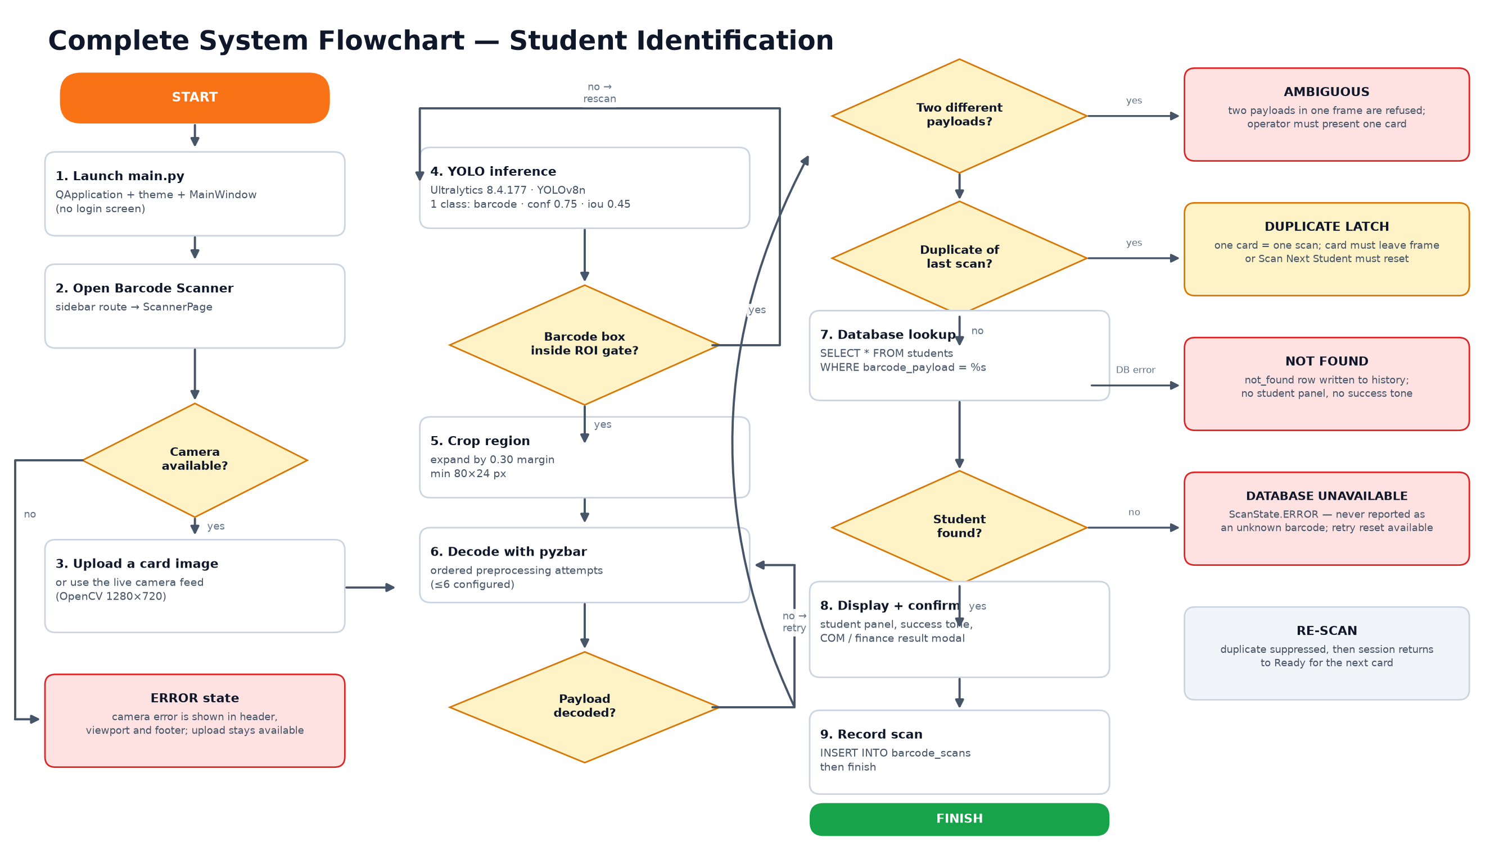
03 · END-TO-END FLOW
Complete scan workflow, including failure branches
Green is the verified path; red branches are implemented failure handling, not hypothetical edge cases.
WIT Barcode Student Information System · Technical Presentation · October 2026
20 / 35
Notes:
The flowchart is the best single answer to 'what happens when it goes wrong'. Camera missing, box outside the gate, decode failure, unknown payload, two cards in frame, duplicate frame and database outage each have a distinct path and message.

Slide 21
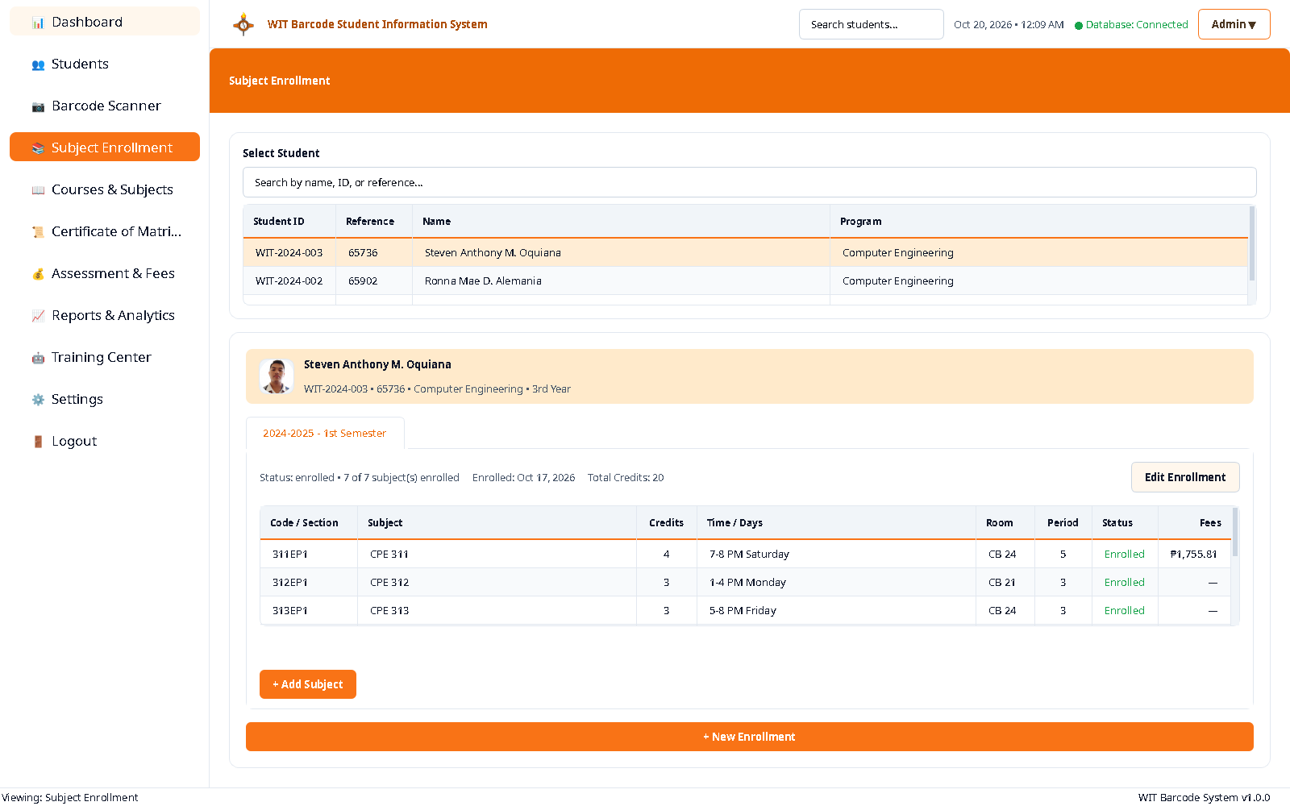
03 · WALKTHROUGH
Subject enrollment
A student is selected once, then every enrollment for that student is shown as a tab with subject lines and fees.
LIVE RECORD
3
21
ENROLLMENTS
SUBJECT LINES
• Steven Anthony M. Oquiana is enrolled in 2024–2025, 1st Semester.
• 7 subjects, 20 credits, with section, room, days, time and period.
• Status and per-subject fees are persisted, not computed in the widget.
• New Enrollment and Add Subject open modal dialogs backed by the same service.
The screenshot is populated by selecting the first row of the real student list; the earlier capture showed the unselected empty state.
WIT Barcode Student Information System · Technical Presentation · October 2026
21 / 35
Notes:
Enrollment is where the barcode identity becomes an academic record. The page reads enrollments by student and renders one tab per enrollment. The counts on the right come from the live tables: three enrollments, twenty-one subject lines.

Slide 22
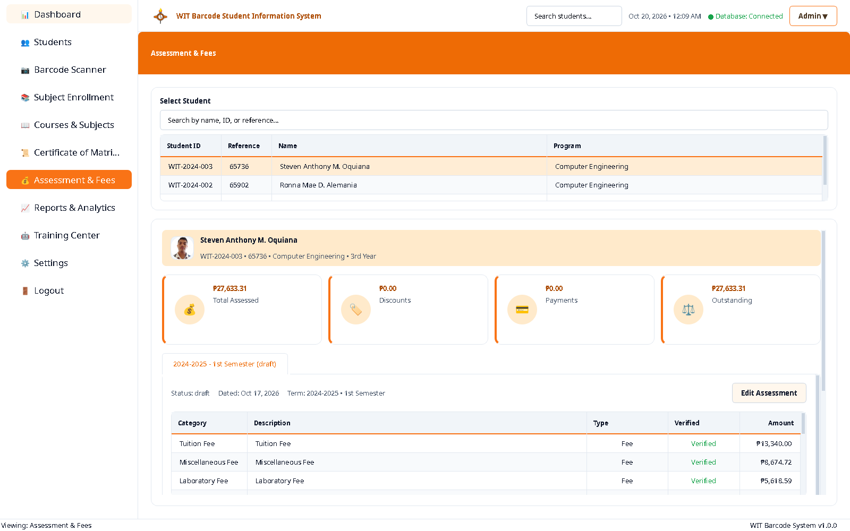
03 · WALKTHROUGH
Assessment, fees and balances
Charges, discounts, payments and installment schedules are separate tables joined to one assessment per term.
PHP 82,899.93
ASSESSED ACROSS 3 STUDENTS
33 assessment items
PHP 0.00
PAYMENTS RECORDED
12 schedules, all pending
• Tuition, miscellaneous and lab fees are verified line items
• Outstanding balance is persisted on assessments
• Schedule table drives due dates and status
• Payment dialog exists; demo data has no payments
The visible student is Steven Anthony M. Oquiana; his assessment totals PHP 27,633.31. Database totals cover all three students.
WIT Barcode Student Information System · Technical Presentation · October 2026
22 / 35
Notes:
The financial module is complete enough to create an assessment, show line items and schedules, and record a payment. What the demo data does not contain is an actual payment, so the paid and balance columns are honest zeros on the outstanding side. That is a data limitation, not a code claim.

Slide 23
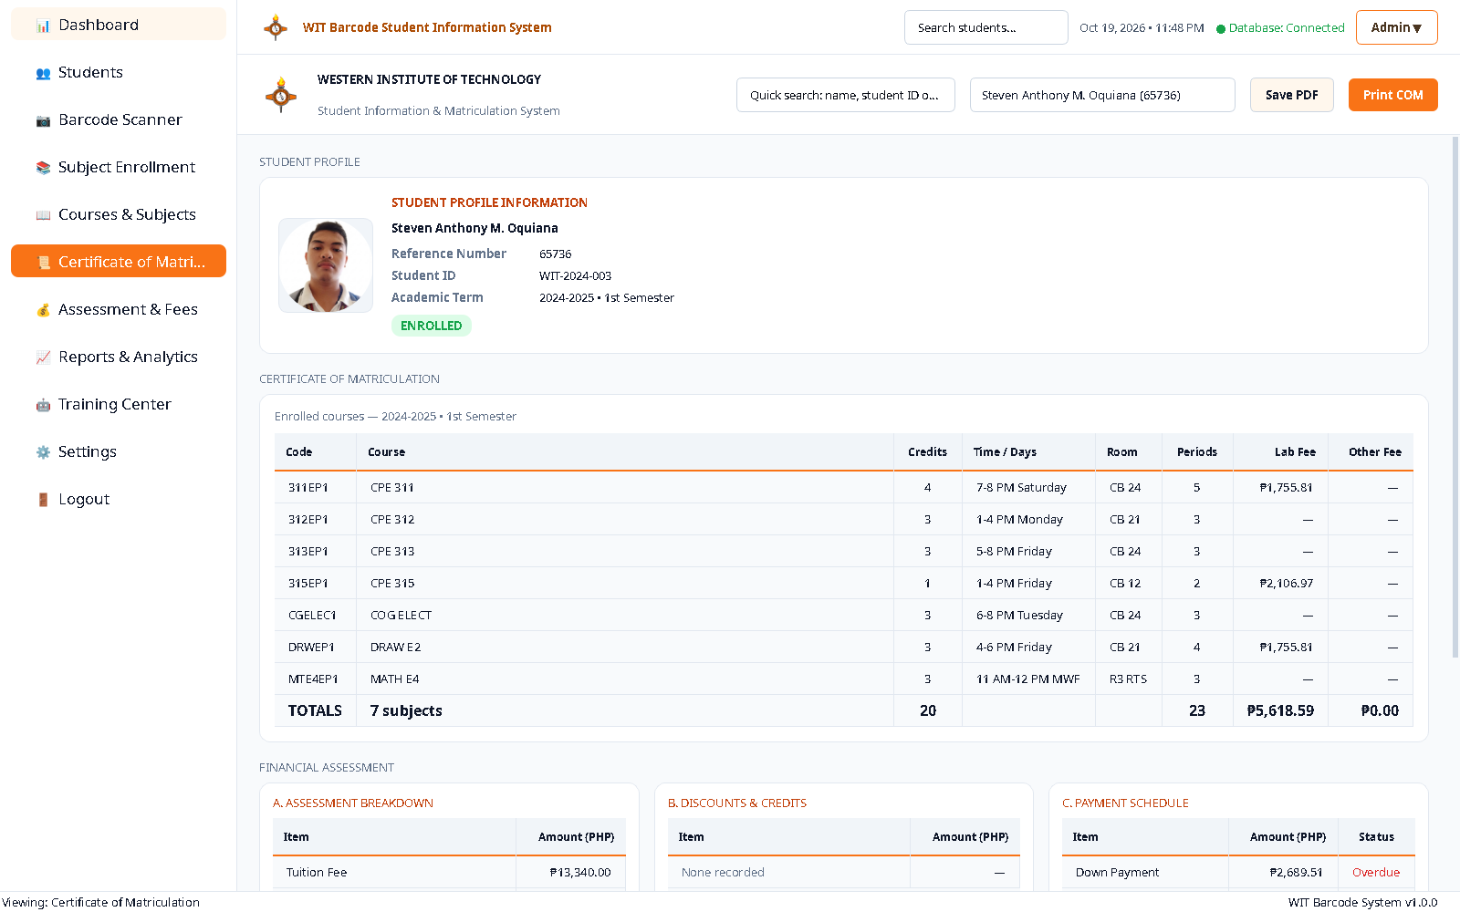
03 · WALKTHROUGH
Certificate of Matriculation
The certificate is rendered from the same enrollment and subject rows the page displays, then saved as A4 PDF or printed.
DOCUMENT FACTS
• Live student: Steven Anthony M. Oquiana, reference 65736.
• 7 subjects, 20 credits, with code, schedule, room, periods and fees.
• Actions: Save PDF, Print COM, and a student-profile jump.
• Artifact: reports/certificate_65412_20261017_112221.pdf was produced by the same service.
• Threading: report builds run off the GUI thread and surface write failures.
The certificate is not a separate data entry form. It reads enrollment and assessment records by student ID.
Screenshot shows the live preview, not a PDF opened in a viewer.
WIT Barcode Student Information System · Technical Presentation · October 2026
23 / 35
Notes:
The COM is a good example of the project's 'one source of truth' goal: the page and the PDF share the same service calls. The saved artifact in reports/ proves the PDF path runs. The on-screen preview is the clearest evidence that the layout is generated, not pasted from a template.

Slide 24
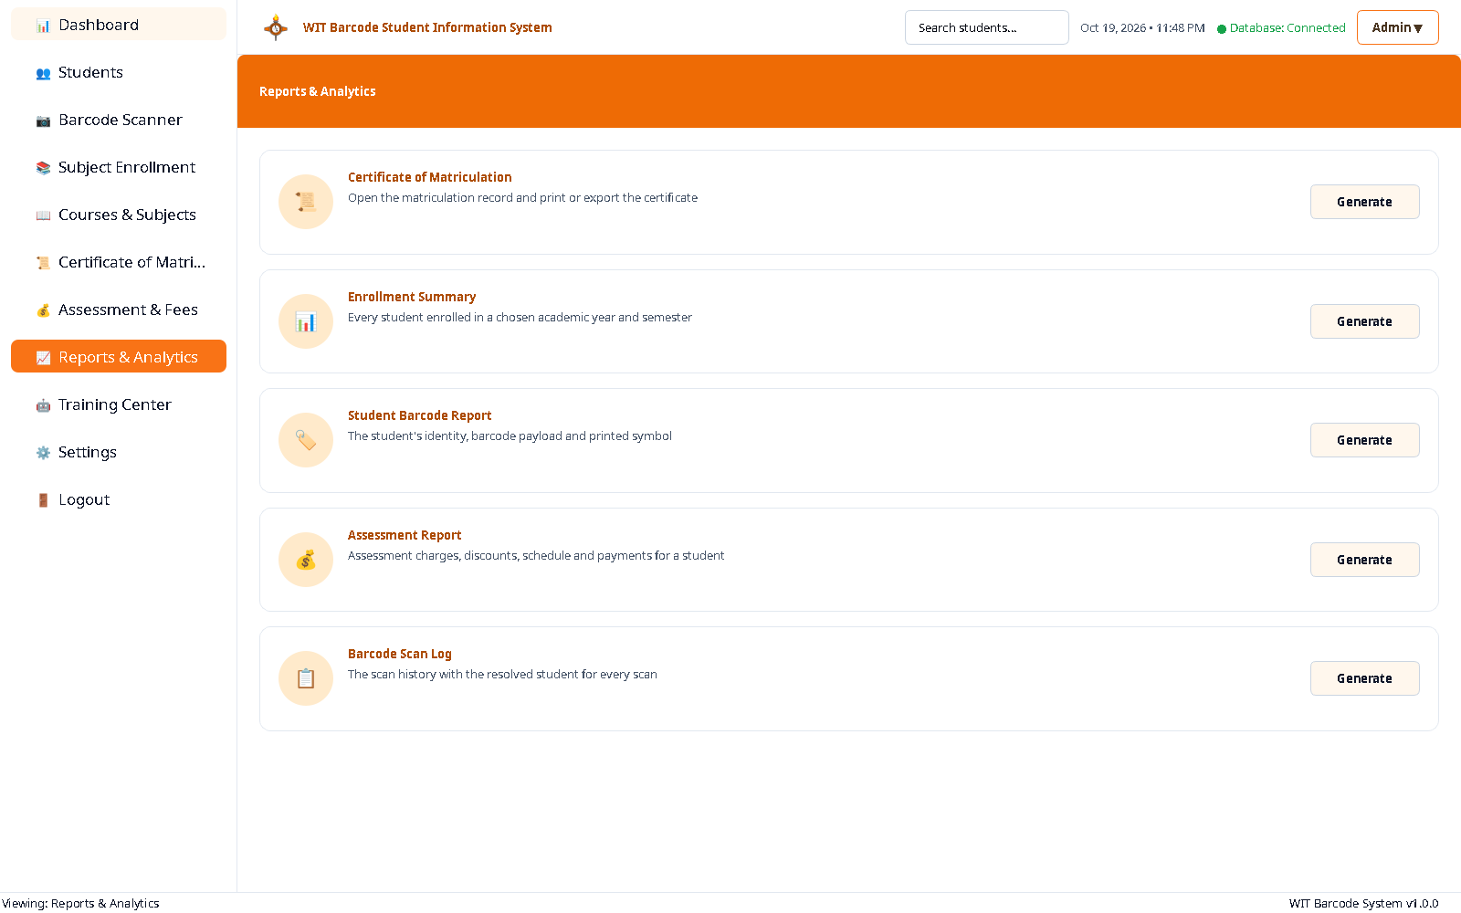
03 · WALKTHROUGH
Reports and analytics
Five report cards, each backed by a generator that writes a file and reports failure instead of silently doing nothing.
CATALOGUE
• Certificate of Matriculation → A4 PDF / print.
• Enrollment Summary → students for a chosen term.
• Student Barcode Report → identity, payload, symbol.
• Assessment Report → charges, schedule, payments.
• Barcode Scan Log → CSV of history with resolved student.
Generation runs in a worker thread. A missing file or a write failure is shown as an error, not a success toast.
Screenshots of the report cards; generated PDFs and CSV are in reports/ and were produced by ReportService.
WIT Barcode Student Information System · Technical Presentation · October 2026
25 / 35
Notes:
The reports page is a thin UI over ReportService. The important engineering detail is that a build runs off the GUI thread and that a failure is reported plainly. The catalogue is also the best evidence that the document layer is not a mock-up.

Slide 25
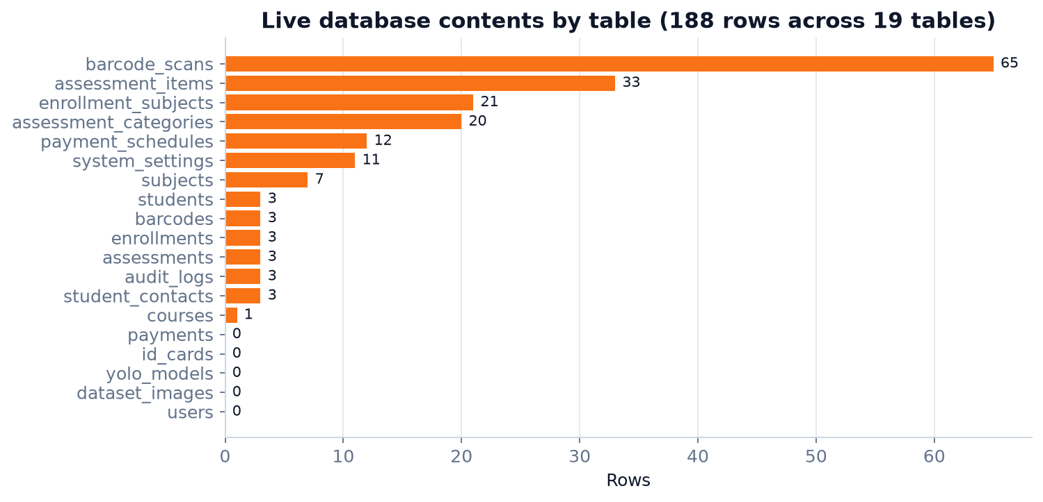
04 · DATA
The live database at a glance
MySQL 8.4.11, InnoDB, utf8mb4_unicode_ci. Nineteen tables, 230 columns and 33 foreign keys.
Measure | Value
Tables | 19
Columns | 230
Foreign keys | 33
Rows (all 19 tables) | 188
Students | 3
Enrollments / subject lines | 3 / 21
Assessments / items | 3 / 33
Scan records | 65
Users / ID cards / models | 0 / 0 / 0
Empty tables are real: no login users, no saved ID cards, no model registry rows, no dataset rows.
Row counts are live after removing the screenshot-inserted scan. Chart label is generated from the same query; the 188-row total includes reference data (assessment categories, courses, subjects, settings).
WIT Barcode Student Information System · Technical Presentation · October 2026
26 / 35
Notes:
The schema is substantial for a desktop project, but the live data is a demonstration set. Reporting both is important: 19 tables and 33 FKs describe capability; 3 students and 65 scans describe the actual evidence base. The 188-row total counts all 19 tables, including 42 reference/settings rows that are not student records. Empty registry tables are why the Training Center shows zeros.

Slide 26
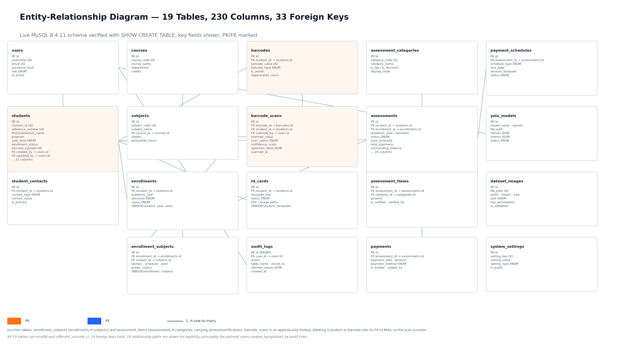
04 · DATA MODEL
Entity-relationship diagram
Key fields shown for all 19 tables. PK/FK roles and the 1..N relationships are marked; 18 paths are drawn for legibility.
Verified with SHOW CREATE TABLE against the live schema. Every table uses InnoDB and utf8mb4_unicode_ci; barcode_scans is append-only and its student/barcode FKs are nullable so a deleted student does not erase history.
WIT Barcode Student Information System · Technical Presentation · October 2026
27 / 35
Notes:
The ERD is dense on purpose: it is the reference diagram, not a teaching slide. The two junction tables are enrollment_subjects and assessment_items. The users table is the intended audit anchor, but there are no user rows yet, which is why created_by / updated_by are unused in the demo data.

Slide 27
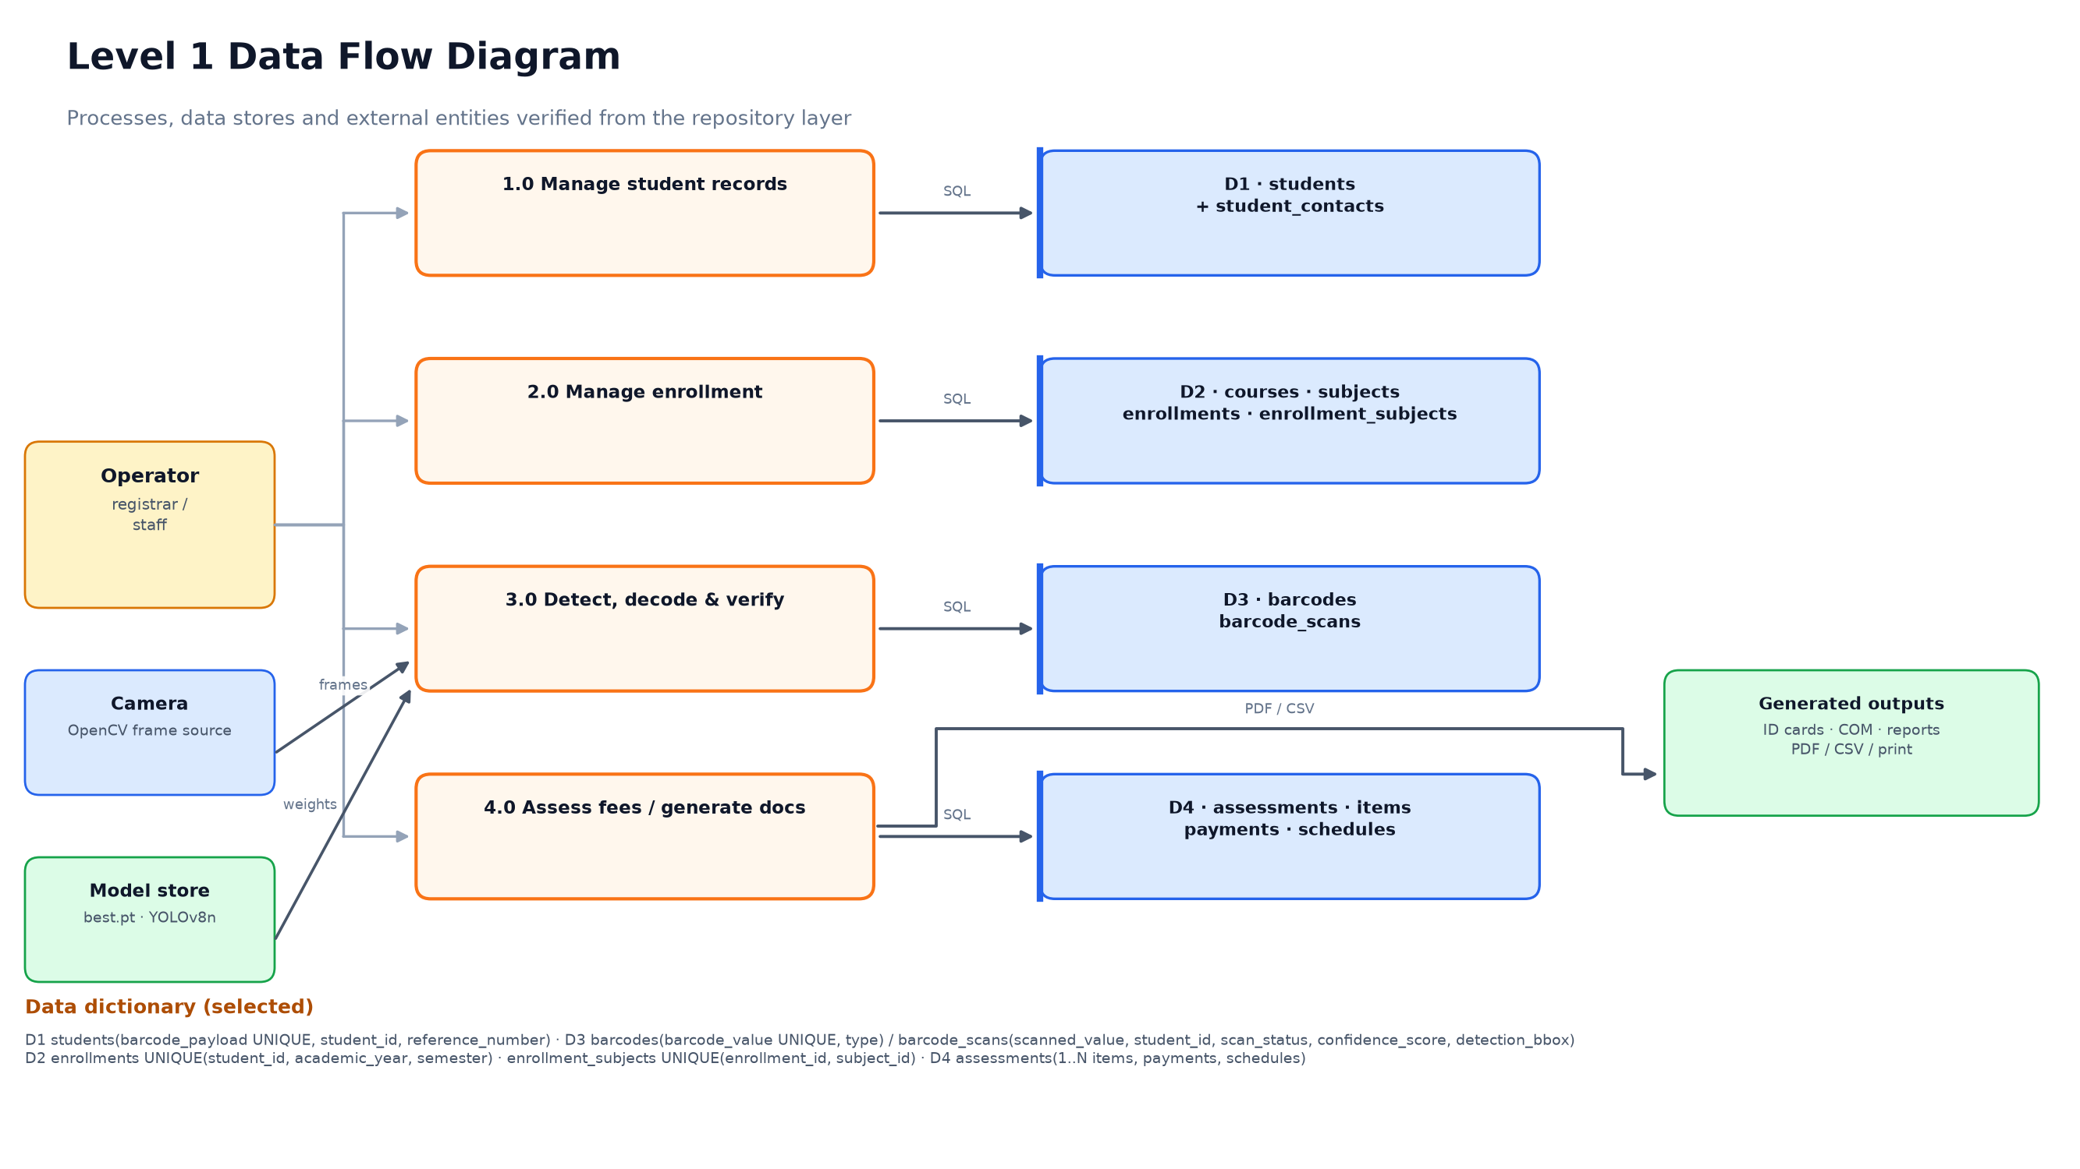
04 · DATA FLOW
Level 1 data flow diagram
Four processes, four data stores and the external inputs/outputs that feed them.
Process numbers are explanatory, not a formal DFD leveling. The data dictionary strip names the key columns and the uniqueness rules that make the scan lookup deterministic.
WIT Barcode Student Information System · Technical Presentation · October 2026
28 / 35
Notes:
This diagram connects the UI screens to the tables: student management to D1, enrollment to D2, scanning to D3, and assessment/documents to D4. The camera and model store are inputs to the scan process, and the generated outputs are files, not database rows.

Slide 28
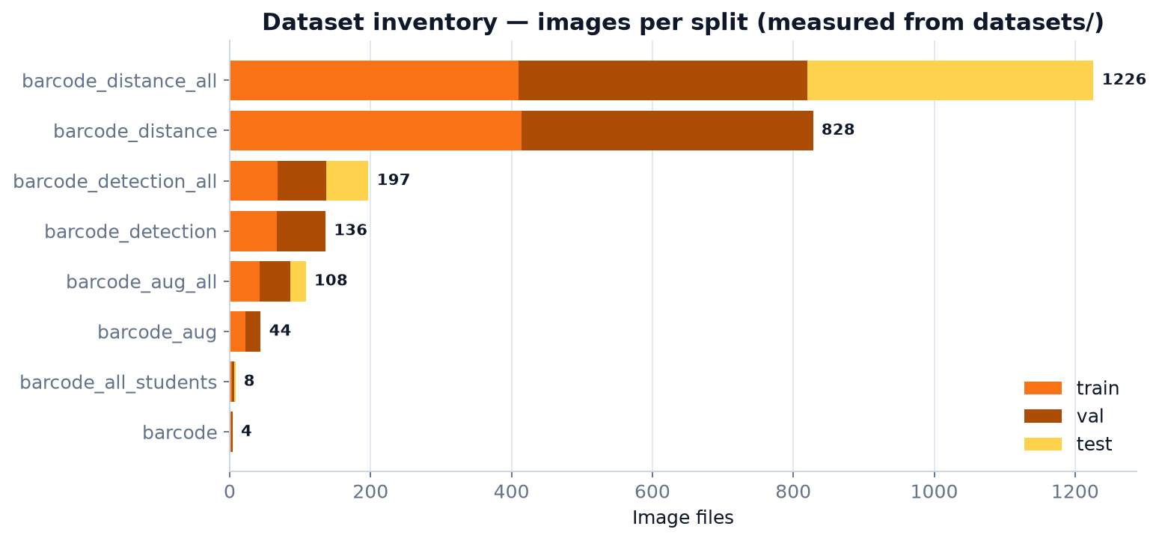
04 · DATASET
Eight dataset variants, one measured inventory
A filesystem scan of datasets/ counted images, labels, boxes and negative samples. Nothing is estimated from a data.yaml comment.
Variant | Images | Boxes
barcode | 4 | 2
barcode_all_students | 8 | 6
barcode_aug | 44 | 42
barcode_aug_all | 108 | 106
barcode_detection | 136 | 134
barcode_detection_all | 197 | 195
barcode_distance | 828 | 812
barcode_distance_all | 1,226 | 1,218
Total | 2,551 | 2,515
2.77 GB · 36 negative images · 43 distinct resolutions
barcode_distance_all is the largest pool; barcode_distance is the variant named by the active model's data.yaml.
WIT Barcode Student Information System · Technical Presentation · October 2026
29 / 35
Notes:
The eight variants are generations of the same problem, not eight independent datasets. The count that matters for the active model is barcode_distance: 828 images, 812 boxes and 16 negatives, all at one resolution. The larger distance_all pool adds a held-out test split that the active training did not use.

Slide 29
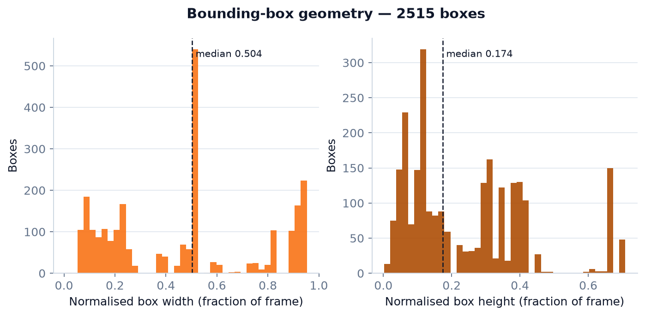
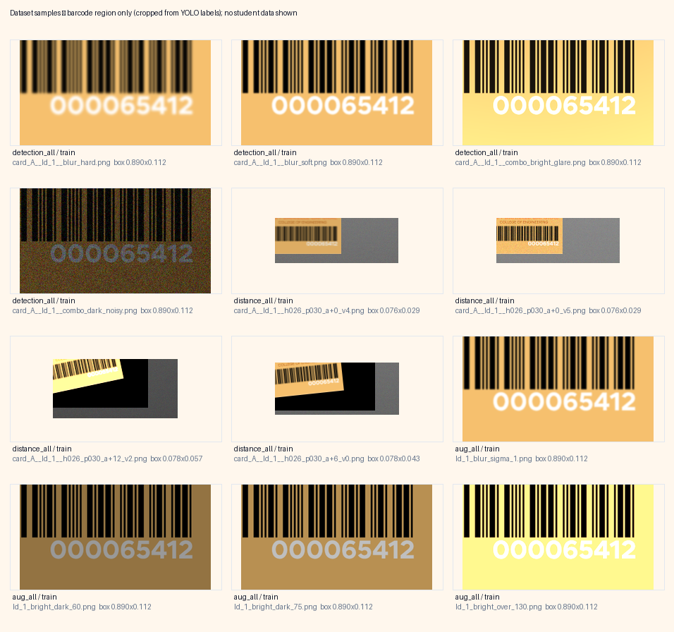
04 · DATASET QUALITY
Labels are clean; the split strategy is not
Zero missing label files and zero malformed boxes, but the core training variant has no test split and eight duplicate files.
Clean signals
• 0 missing labels · 0 invalid boxes
• 1 class, 2,515 boxes
• 36 deliberate negatives teach 'no barcode here'
• median box 50.4% × 17.4% of frame
Risk signals
• barcode_distance has 0 test images — selection used validation only
• 8 duplicate files inside barcode_distance
• 43 resolutions, so scale variance is high
• 20 near-identical distance frames per source card inflate the count
Box geometry from all 2,515 labels. Gallery crops the annotated region only; no student data is shown.
WIT Barcode Student Information System · Technical Presentation · October 2026
30 / 35
Notes:
The clean-label result is genuine: every image has a label file and every box is well formed. The red panel is the part a model card would normally omit. A validation-only selection is not a held-out test, and the distance dataset is built from many near-identical frames, so its image count overstates independent evidence.

Slide 30
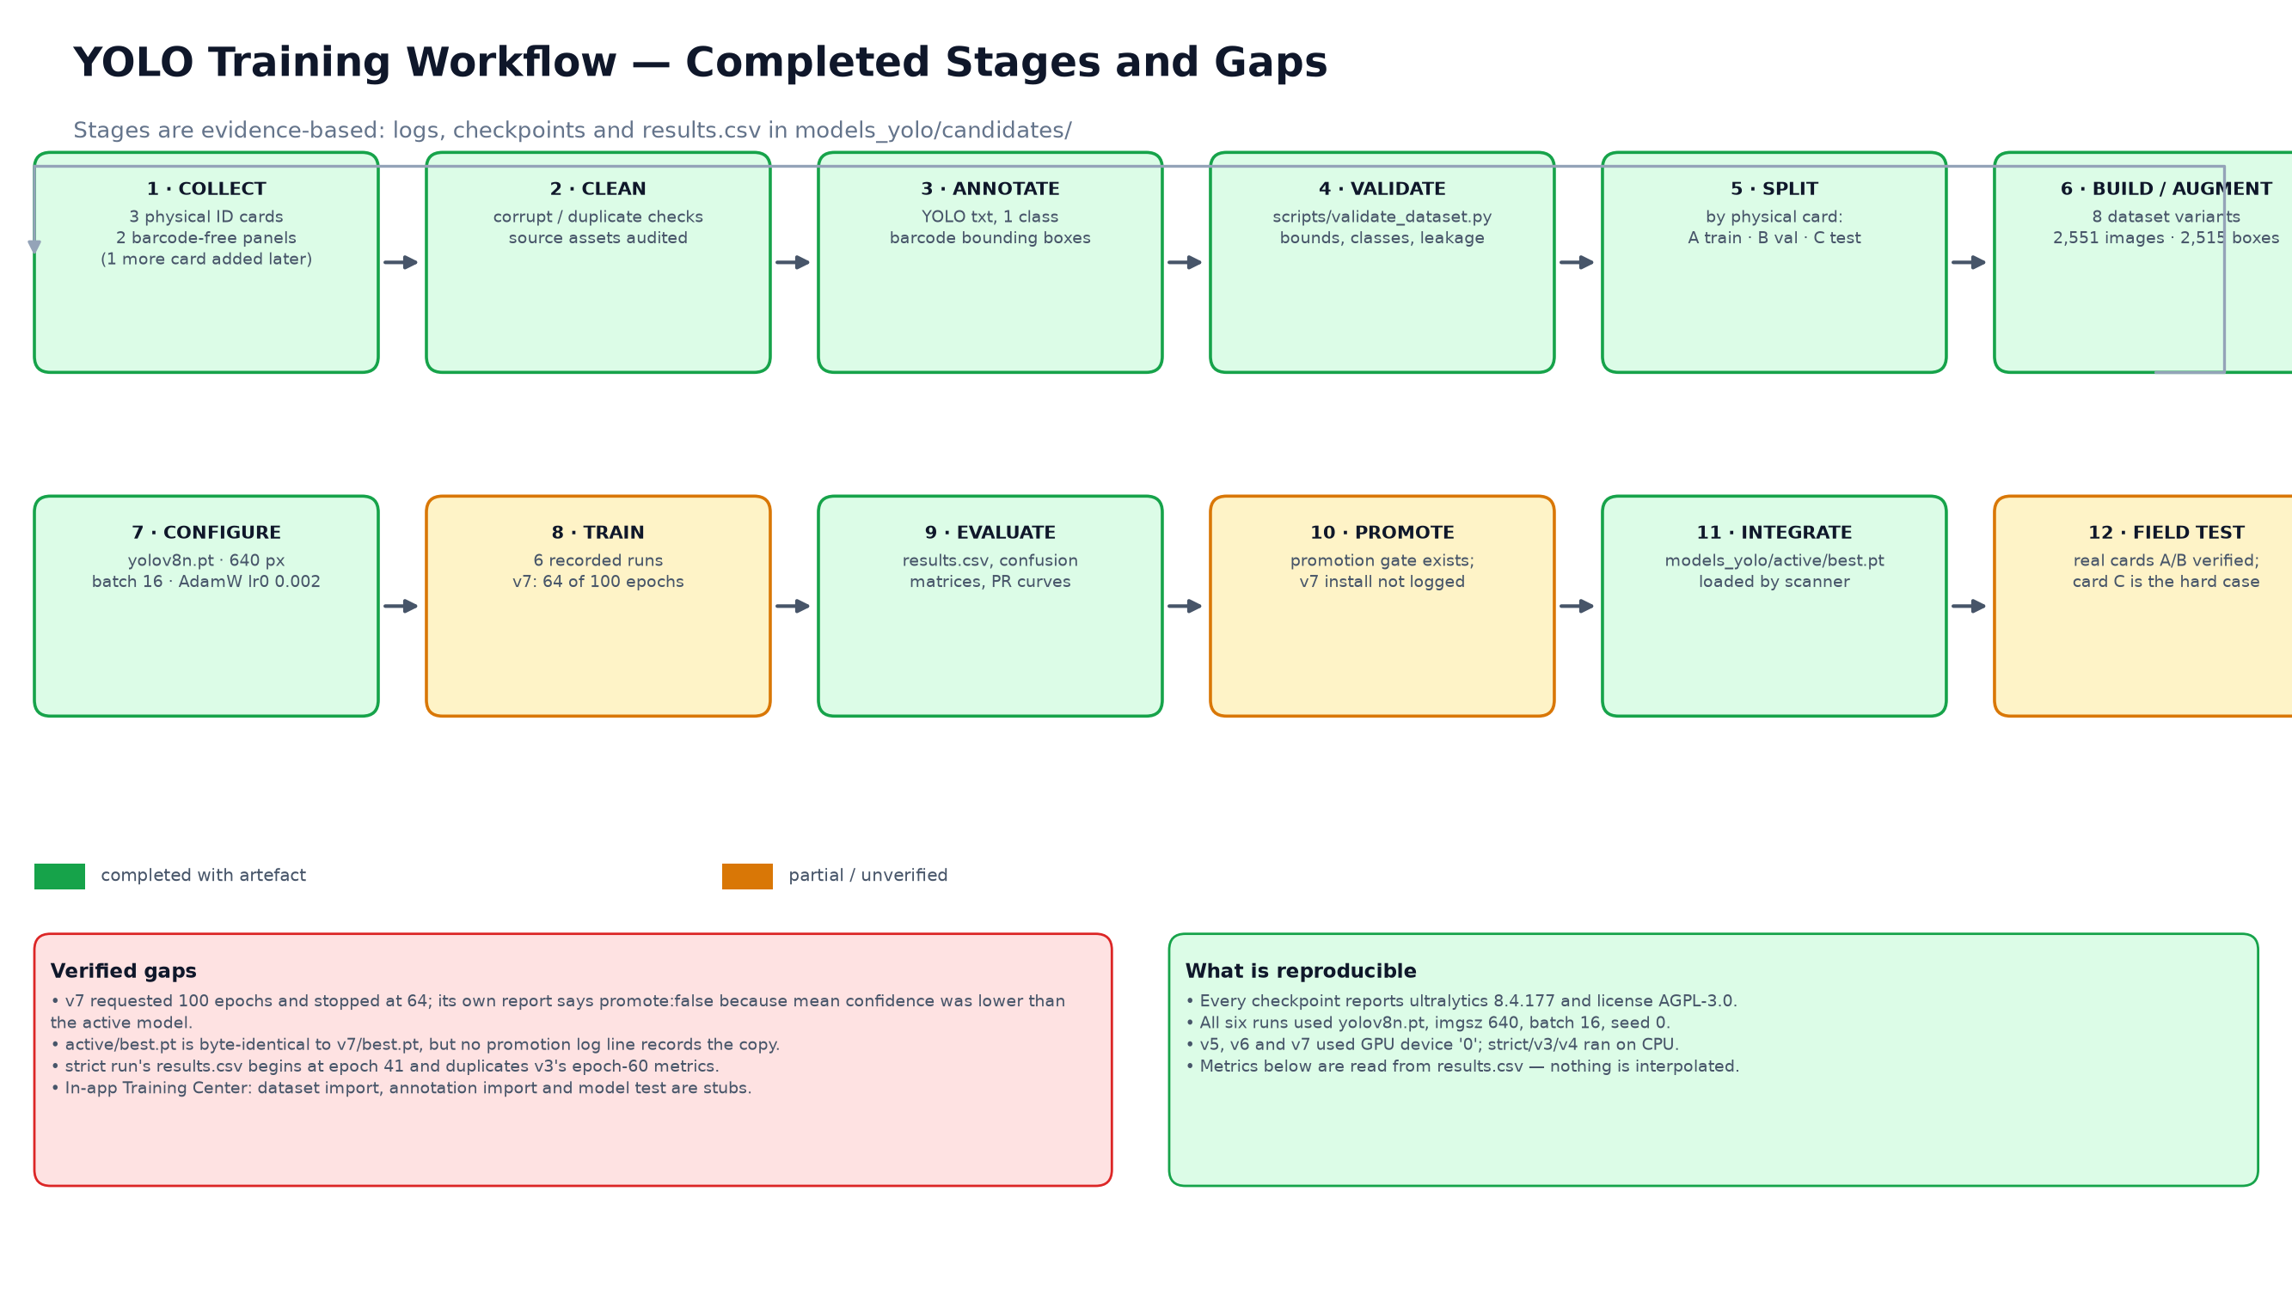
04 · TRAINING
Training pipeline and recorded configuration
Six candidate runs were kept. The active checkpoint is the v7-distance run, trained at 640 px on the distance dataset.
100 epochs requested
64 recorded
batch 16
imgsz 640
AdamW · lr0 0.002
patience 30
device CUDA:0
Configuration read from best.pt train_args and results.csv. The run stopped after 64 recorded epochs; the checkpoint is the best epoch (34), not the last.
WIT Barcode Student Information System · Technical Presentation · October 2026
31 / 35
Notes:
The pipeline diagram shows the real build sequence: source cards and frames, annotation, augmentation, dataset variants, training, validation and promotion to active/best.pt. The active run's train_args are stored inside the checkpoint, which is how the 100-epoch request and 64-epoch outcome were verified.

Slide 31
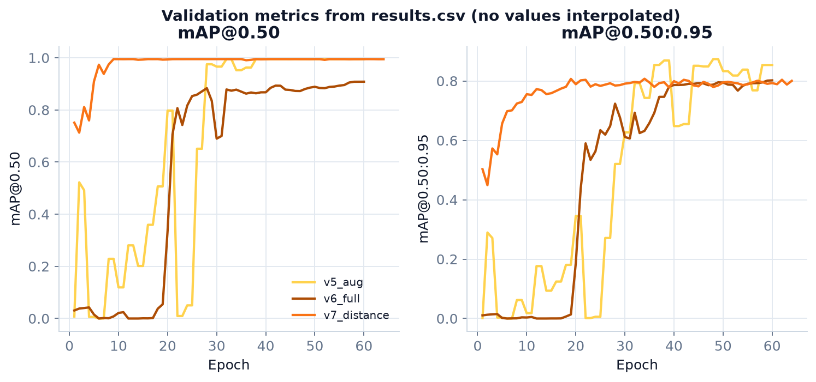
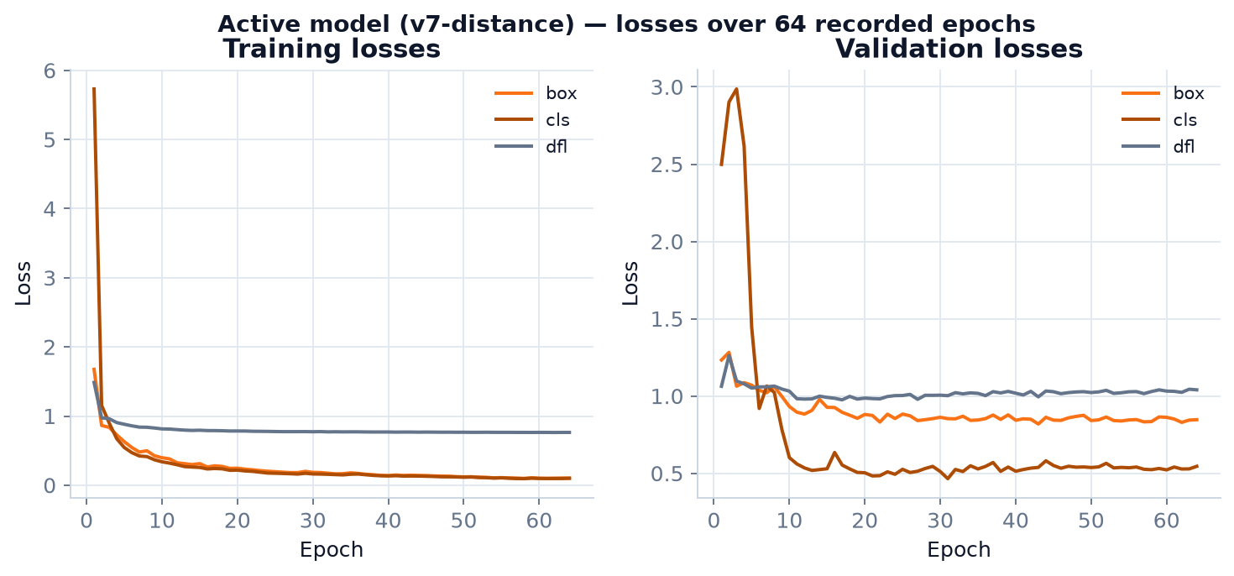
04 · TRAINING
Validation curves and the active model's scores
The v7-distance run reaches mAP50 0.995 and mAP50-95 0.8075 at its best epoch, with precision 0.9975 and recall 0.9987.
Active checkpoint (v7)
Metric | Value
Best epoch | 34 / 64
Precision | 0.9975
Recall | 0.9987
mAP@0.50 | 0.9950
mAP@0.50:0.95 | 0.8075
Losses fall smoothly through the run. The strict run is excluded from comparison: its log records only epochs 41–60 and duplicates v3's metrics, so it is not independent evidence.
Source: results.csv + best.pt train_metrics
Curves are plotted directly from results.csv; no smoothing or interpolation. Validation uses the same label set for every run.
WIT Barcode Student Information System · Technical Presentation · October 2026
32 / 35
Notes:
The active model's scores are high because the task is narrow: one class, a printed symbol, and a validation set drawn from the same generation process as training. The deck does not claim that 0.995 mAP generalises to every camera, distance or lighting condition. That is what the distance variants were meant to probe.

Slide 32
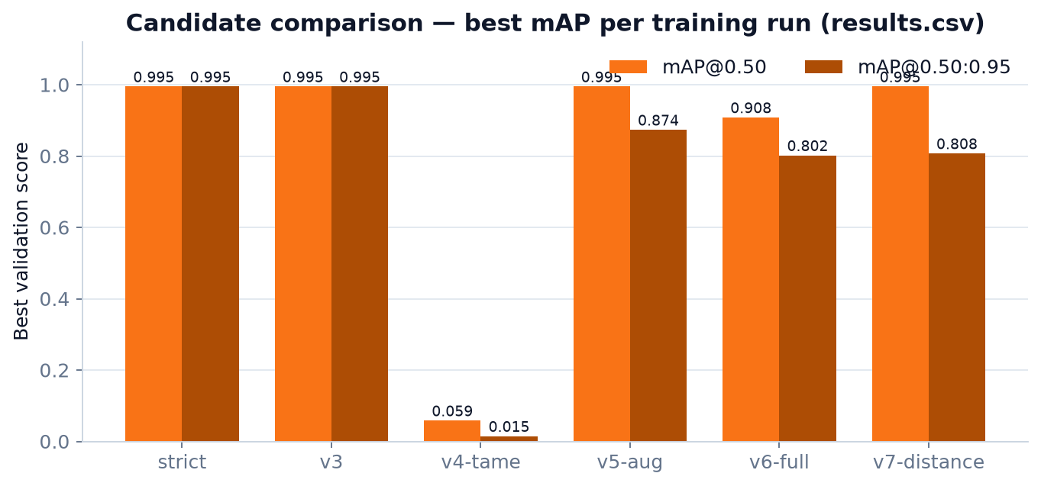
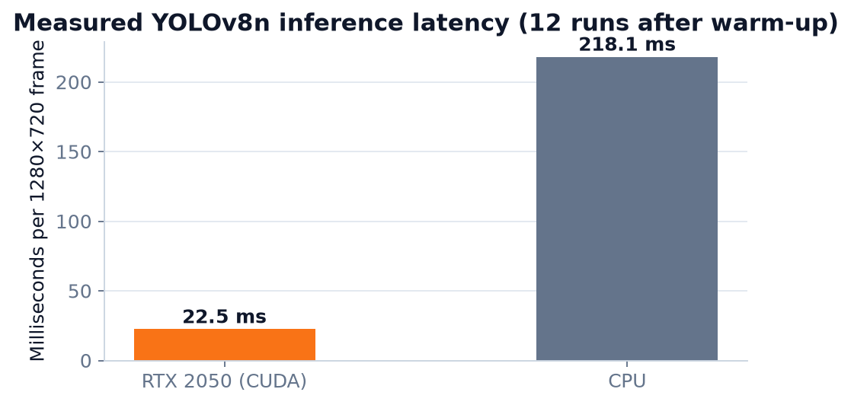
04 · MODEL SELECTION
Six runs compared; GPU inference is 17× faster than CPU
Best validation scores per run from results.csv, plus a 12-run latency measurement on a 1280×720 frame.
Measured latency
17.22 ms GPU mean
302.39 ms CPU mean
HOW TO READ THIS
• v5-aug and v7-distance both reach mAP50 0.995; v5 has the higher mAP50-95 (0.8736 vs 0.8075).
• v7 was promoted for the distance dataset, not because it wins every metric.
• v4-tame collapsed to 0.0585 mAP50; it is kept as evidence of an unsuccessful augmentation strategy.
12 frames after warm-up; p95 18.93 ms GPU, 622.24 ms CPU. At the 12 FPS preview target (83 ms/frame), only the GPU has comfortable headroom.
Latency includes detector pre/post-processing, not camera capture or decode. CPU variance was high (172–992 ms).
WIT Barcode Student Information System · Technical Presentation · October 2026
33 / 35
Notes:
The model comparison is included because it shows the selection was made from evidence, and because it contains a failure (v4-tame) rather than only winners. The latency chart explains why the app requests CUDA and falls back to CPU: on CPU the pipeline is slower than the preview target, so the interface will feel choppy even though detection still works.

Slide 33

05 · VERIFICATION
Tests, visible defects and technical debt
531 of 553 tests pass. The 22 failures are concentrated in one post-scan workflow file and are not hidden behind an aggregate percentage.
531
22
553
PASSED
FAILED
COLLECTED
183.66 s runtime
all in post-scan workflow
pytest 9.1.1
Reproduced product defects
• Dashboard table: TypeError — set_cell() got an unexpected keyword argument 'family'.
• ID-card preview: UnboundLocalError — QImage is referenced before assignment.
• Rendered card barcode: re-decode returns nothing, so the service's own verification fails.
The dashboard screenshot at right is the real failure state: the UI labels a Python TypeError as “Cannot reach the database”, which is itself a misleading error contract.
None of the 531 passing tests exercises the ID-card decode-back check or the dashboard table.
Test failures and debt
• 22/22 failures are in tests/test_scan_post_scan_workflow.py (panel state, history insert, latch, async records).
• Training Center shows 0 images while 2,551 files exist, because it reads dataset_images (0 rows).
• Unrouted generator; stub logout; no auth; core dataset lacks a test split.
Command: venv/bin/python -m pytest tests/ -q. Full log: presentation/tools/pytest_output.txt.
WIT Barcode Student Information System · Technical Presentation · October 2026
34 / 35
Notes:
This slide is the credibility check. The pass rate is 96.0%, but the absolute failure count matters more. The failures are not random: they cluster in the post-scan session contract, which is the same area where the scanner page has the most state. The dashboard screenshot shows both the broken table and the misleading database error label.

Slide 34
05 · ROADMAP
What to fix first, and what the system already proves
The core is demonstrable today. The remaining work is bounded, testable and mostly UI-level.
NOW · correctness
NEXT · completeness
LATER · operations
• Fix dashboard set_cell(family=...) call
• Fix ID-card preview QImage initialisation
• Make the rendered card barcode decode at 300 DPI
• Reconcile or quarantine the 22 post-scan tests
• Route BarcodeGeneratorPage in the sidebar
• Replace logout stub with authentication
• Wire Training Center to the filesystem or populate dataset_images
• Add a real held-out test split before claiming generalisation
• Role-based access and audit user rows
• Packaged installer + migrations
• Camera/lighting field trial across distances
• Backup, retention and privacy review
The defensible claim: a local, inspectable student-information system that turns a physical card into a verified database identity and then into enrollment, fees and documents — with its failures written down.
Source reports: WIT_Project_Analysis_Report.md · WIT_Dataset_Analysis_Report.md · WIT_Presentation_References.md
WIT Barcode Student Information System · Technical Presentation · October 2026
35 / 35
Notes:
Close on the distinction between what works and what is finished. The system proves the identity-to-record path and the document layer. It does not yet prove authentication, print-scannable ID cards or generalisation beyond the collected distance set. The roadmap is ordered by risk, not by novelty.

