Slide 1

KWARA STATE CIVIL SERVICE COMMISSION
2026 Promotion Evaluation CBT Examination
Candidate Step-by-Step Orientation & System Interface Walkthrough
Official Briefing for All Civil Service Promotion Candidates • Batch 2026
Notes:
FACILITATOR SCRIPT:
'Good day, distinguished officers and candidates of the Kwara State Civil Service. Welcome to today's orientation session for the 2026 Promotion Evaluation Computer Based Test (CBT). The Civil Service Commission has structured this digital assessment to ensure merit, transparency, and seamless execution. In the next few minutes, we will walk you through every single screen and button you will encounter, the anti-cheating regulations, and what to expect on your test workstation. Please pay close attention to every detail.'

Slide 2
EXAMINATION OVERVIEW
Core Ground Rules & Evaluation Structure
Overview
⏱️
20 MINUTES
STRICT TIMING
Each candidate has exactly 20 minutes to complete the evaluation. A live countdown clock is always visible on screen.
📝
40 QUESTIONS
MULTIPLE CHOICE
Each paper consists of exactly 40 objective questions (1 mark each). All 40 questions should be attempted.
🔒
ZERO SCORE ON SCREEN
CONFIDENTIALITY
In accordance with Civil Service rules, marks are NEVER displayed on workstation screens upon submission.
🛡️
3-STRIKE POLICY
PROCTOR SECURITY
Switching apps, minimizing the browser, or taking screenshots triggers automated violation strikes.
⚠️ MANDATORY REQUIREMENT BEFORE ENTERING THE HALL
• Bring your printed Photocard Registration Slip showing your Public Service Number (PSN) and Code 1.
• Ensure you know your assigned Examination Batch and scheduled time slot.
• If using a smartphone, ensure your battery is at least 80% charged and turn off background notifications.
Kwara State Civil Service Commission (CSC) • 2026 Promotion Evaluation CBT Examination Guide
Notes:
FACILITATOR SCRIPT:
'Before we examine the screens, remember these four pillars:
1. Timing: You have strictly 20 minutes for 40 questions. That is an average of 30 seconds per question.
2. Structure: 40 questions, objective multiple choice. Answer every single question.
3. Result Policy: Do not expect a score on the computer when you finish. Scores are confidential and delivered to your MDA.
4. Anti-cheating: The system detects tab switches and background applications. Three strikes terminate your exam.'

Slide 3
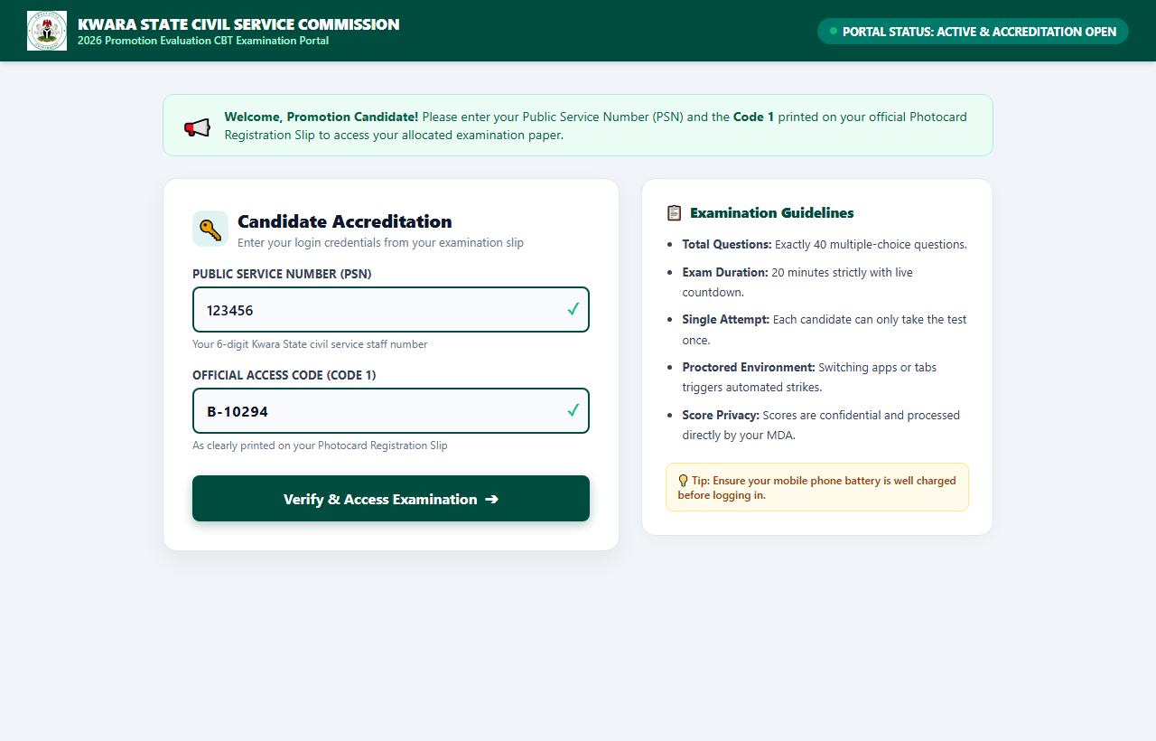
STAGE 1 OF 7
Candidate Portal Login & Accreditation
Stage 1
🔑 HOW TO LOG IN
• Step 1: Check Portal Status: Verify that the top status bar displays 'ACTIVE & ACCREDITATION OPEN'.
• Step 2: Enter Public Service Number (PSN): Type your official 6-digit Kwara State civil service number (e.g. 123456).
• Step 3: Enter Official Code 1: Enter the exact Examination Code 1 printed on your Photocard Slip (e.g. B-10294). This code is case-sensitive.
• Step 4: Click 'Verify & Access': Click the dark green button to authenticate your candidate record.
💡 PRO TIP FOR CANDIDATES:
Do not share your Code 1 with anyone. Each code can only be activated once for your specific examination paper.
Kwara State Civil Service Commission (CSC) • 2026 Promotion Evaluation CBT Examination Guide
Notes:
FACILITATOR SCRIPT:
'Here on Slide 3 is the exact login screen you will see on your computer or mobile screen.
Look at your Photocard Slip. In the top right corner, you have your 6-digit PSN and your Code 1.
Enter your PSN in the first box. Enter your Code 1 in the second box. Make sure you include any letters and hyphens.
Then click 'Verify & Access Examination'. Do not click multiple times—wait 2 seconds for the accreditation window to load.'

Slide 4
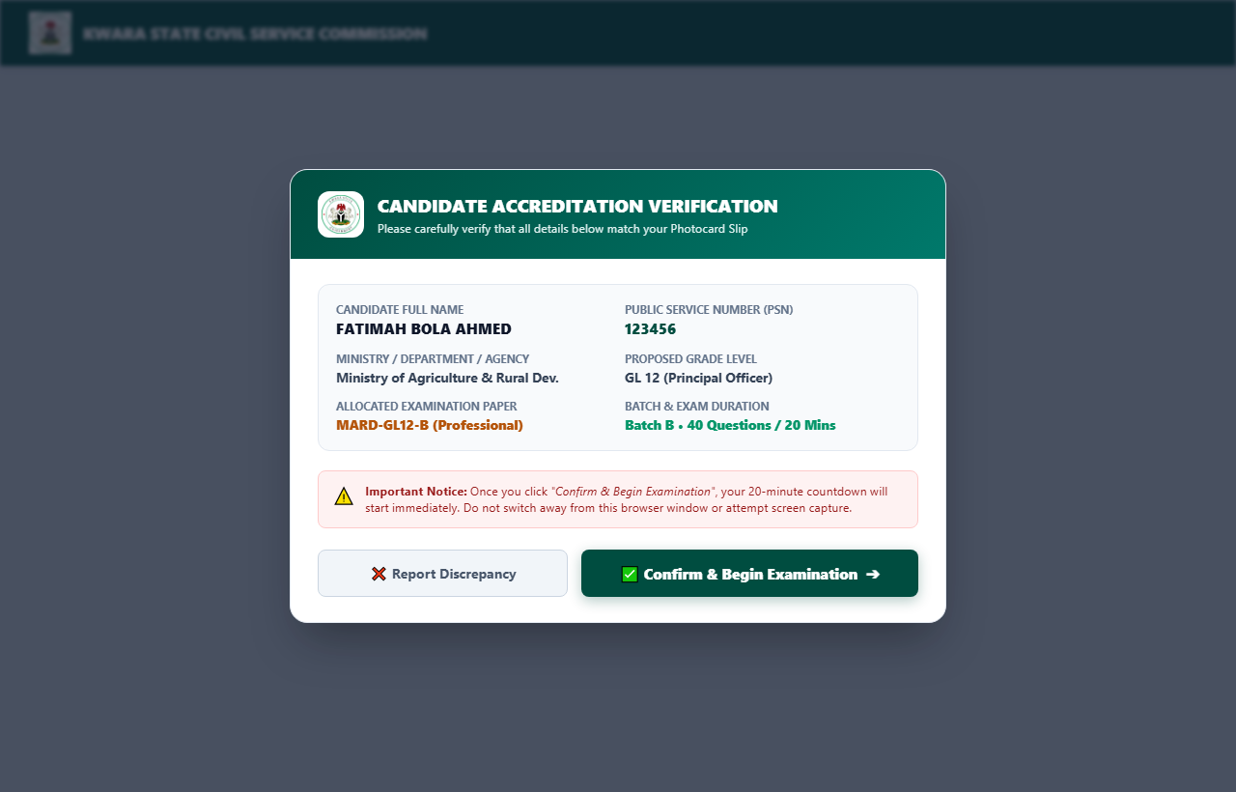
STAGE 2 OF 7
Candidate Bio-Data & Paper Allocation Verification
Stage 2
📋 VERIFY BEFORE YOU BEGIN
✔ Full Name & PSN: Ensure the name displayed matches your civil service record exactly.
✔ Ministry / Department: Verify your current posting/MDA is accurately reflected.
✔ Grade Level & Cadre: Confirm your proposed promotional rank and cadre.
✔ Allocated Paper Code: Check the paper code (e.g. MARD-GL12-B). This determines the questions presented.
✔ If Everything is Correct: Click the dark green 'Confirm & Begin Examination' button to launch the exam clock.
✔ If You Notice an Error: Click 'Report Discrepancy' immediately and alert the hall supervisor BEFORE starting.
⚠️ CRITICAL WARNING:
Once you click 'Confirm & Begin Examination', your 20-minute timer begins counting down and CANNOT be paused or reset!
Kwara State Civil Service Commission (CSC) • 2026 Promotion Evaluation CBT Examination Guide
Notes:
FACILITATOR SCRIPT:
'When you authenticate, this verification pop-up appears.
Do NOT rush to click 'Confirm & Begin'. Take 30 seconds to read every field.
Is that your name? Is that your PSN? Is that your Ministry? Is that your allocated paper?
If there is any discrepancy whatsoever, raise your hand immediately and inform the supervisor.
Once you click 'Confirm & Begin Examination', the system locks your paper and starts the countdown.'

Slide 5
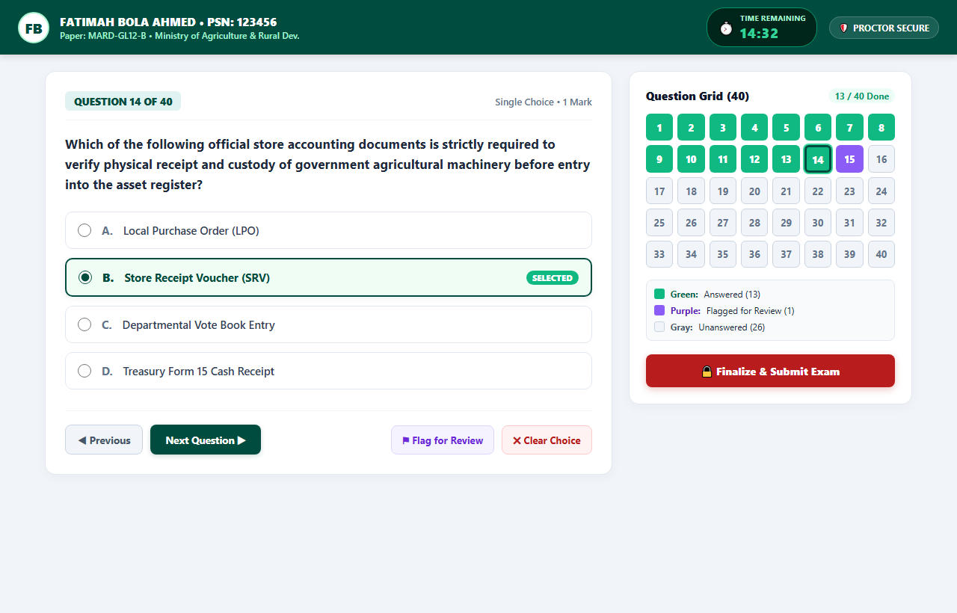
STAGE 3 OF 7
The Active Examination Screen & Top Header
Stage 3A
🖥️ EXAM SCREEN ELEMENTS
• Candidate Profile Header: Displays your name, PSN, paper code, and profile initials so you always know you are in your authorized session.
• Live Countdown Timer: Shows your remaining time in minutes and seconds (e.g. 14:32). Changes to amber at 5 minutes and red at 1 minute.
• Proctor Protected Shield: Indicates the background anti-cheating monitor is actively securing your test.
• Question Display Card: Clear, high-contrast question text with single-choice radio options (A, B, C, D).
• Instant Auto-Save: Every time you click an option, it is instantly recorded in browser memory and local cache.
⏱️ TIMER BEHAVIOR:
When time reaches 00:00, the system automatically finalizes and submits all chosen answers. You will never lose any answer you selected.
Kwara State Civil Service Commission (CSC) • 2026 Promotion Evaluation CBT Examination Guide
Notes:
FACILITATOR SCRIPT:
'Now examine Slide 5: this is your examination workspace.
At the top, keep your eye on the timer. It counts down continuously from 20:00.
You do not need to press any 'Save' button. As soon as you click an option, the system marks it as answered.
Even if your network disconnects for a second, your selections are saved securely in your browser cache.'

Slide 6
STAGE 3 (CONT.)
Question Grid (40) & Navigation Controls
Stage 3B
🎯 PALETTE COLOR CODES & BUTTONS
🟩 GREEN SQUARE (Answered Question): Indicates that you have successfully selected an option for that question number.
🟪 PURPLE SQUARE (Flagged for Review): Bookmarked so you can quickly return to it before submitting.
⬜ GRAY SQUARE (Unanswered Question): Indicates questions you have not yet answered. You must aim to turn all 40 squares green!
🔘 JUMP TO QUESTION (Direct Grid Navigation): Click ANY number (1 to 40) on the grid to jump directly to that question instantly.
✖ CLEAR CHOICE (Remove Selection): Allows you to deselect your answer if you want to leave it unselected.
⚑ FLAG FOR REVIEW (Mark Difficult Questions): Bookmarks the question so you can move forward and return later.
Kwara State Civil Service Commission (CSC) • 2026 Promotion Evaluation CBT Examination Guide
Notes:
FACILITATOR SCRIPT:
'Look closely at the right-hand side of your screen: the Question Grid with 40 boxes.
Remember these colors:
- GREEN means you have answered.
- PURPLE means you flagged it for review.
- GRAY means you have NOT answered yet.
You do not need to click 'Next' 30 times to get to question 30. Simply tap 30 on the grid!
If you change your mind and want to clear an answer, click 'Clear Choice'.'

Slide 7
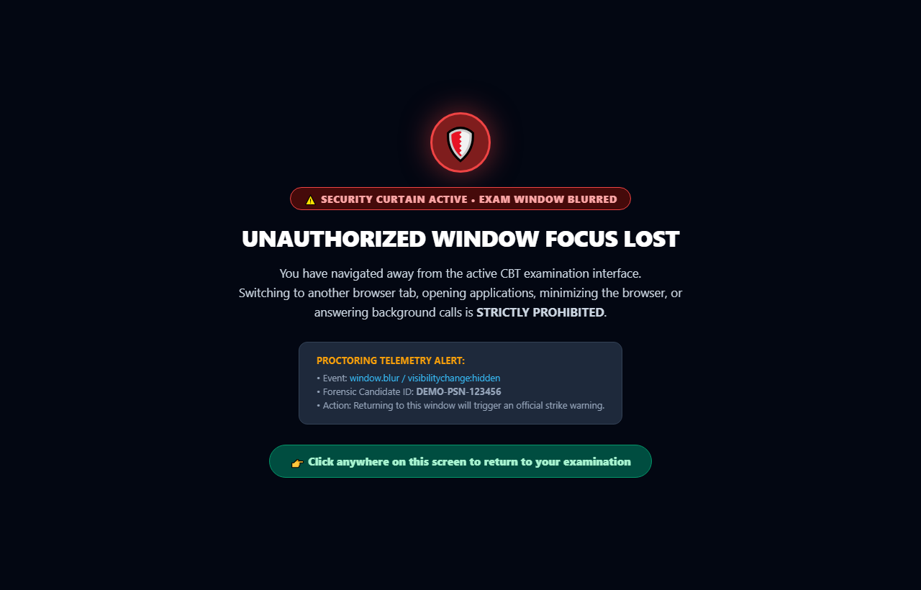
STAGE 4 OF 7
Anti-Cheating & Proctored Blackout Curtain
Stage 4
🛡️ THE BLACKOUT CURTAIN
• What Triggers the Curtain?: Switching to another browser tab, opening another app, minimizing the browser window, or answering phone calls.
• What Happens Instantly?: The exam interface is immediately blacked out. Questions are hidden to prevent external viewing or search.
• How to Recover?: Click anywhere on the black curtain to refocus the exam window immediately.
• Consequence of Curtain Activation?: Refocusing will trigger the official Security Violation Warning Modal.
🚫 STRICTLY PROHIBITED SHORTCUTS:
PrintScreen, Win+Shift+S, Cmd+Shift+3/4, Ctrl+P (Print), Ctrl+S (Save), F12 (DevTools), right-click, and text copying are locked and permanently logged.
Kwara State Civil Service Commission (CSC) • 2026 Promotion Evaluation CBT Examination Guide
Notes:
FACILITATOR SCRIPT:
'Candidates, this is a crucial security rule:
If you minimize your browser, switch to WhatsApp, open Google, or try to take a screenshot, your screen will immediately go pitch black as shown on this slide.
The system considers this an unauthorized window blur.
Clicking back into the screen will resume the exam, but it will register an infraction against you.
Keep your focus solely on the CBT window throughout the 20 minutes.'

Slide 8
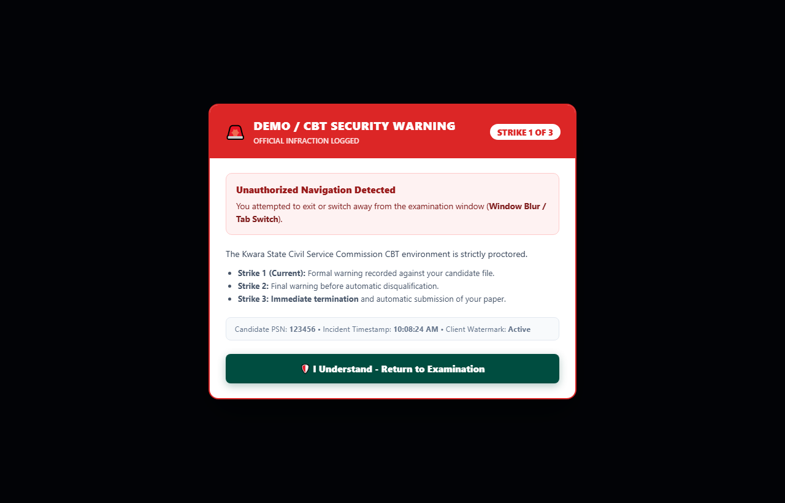
STAGE 5 OF 7
Security Violation Warnings (3-Strike System)
Stage 5
🚨 THE 3-STRIKE PROGRESSION
• STRIKE 1: Formal Warning: The warning modal pops up. Your incident is recorded with a timestamp on the server. You must click 'Return to Examination'.
• STRIKE 2: Final Warning: A high-urgency red alert appears: 'You have only ONE warning remaining!'. Any further infraction will terminate the exam.
• STRIKE 3: IMMEDIATE TERMINATION: Your test session ends instantly! The system auto-submits your answers and flags your file as 'DISQUALIFIED / TERMINATED'.
🛡️ WATERMARK AUDIT:
A forensic watermark with your PSN and timestamp is overlaid across the exam page. Attempting to photograph your screen with a second phone will be traced directly to your PSN.
Kwara State Civil Service Commission (CSC) • 2026 Promotion Evaluation CBT Examination Guide
Notes:
FACILITATOR SCRIPT:
'The Civil Service Commission has implemented a strict 3-Strike policy:
- Strike 1: You get an official warning pop-up.
- Strike 2: You get a final warning in bold red.
- Strike 3: The system terminates your test immediately, locks your answers, and submits your paper with a proctor violation flag.
Do not risk your promotion. Stay on the examination page until you finish.'

Slide 9
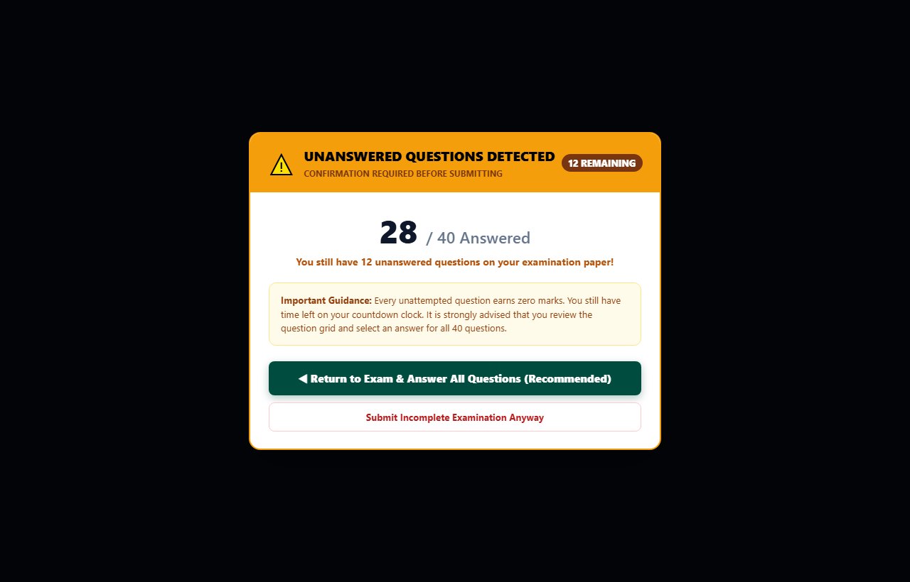
STAGE 6 OF 7
Incomplete Examination Check Before Submitting
Stage 6
⚠️ ANSWER ALL 40 QUESTIONS
• Incomplete Submission Modal: If you click 'Submit' while any question is still gray (unanswered), this dialog warns you immediately.
• No Negative Marking: There is no penalty for guessing. An unanswered question receives zero marks, whereas an educated attempt could earn you a full mark.
• Check the Palette: Look for any remaining gray squares. Tap on each gray square to answer it.
• Recommended Action: Click 'Return to Exam & Answer All Questions' to maximize your score potential before your 20 minutes expire.
💡 GOLDEN RULE:
Never leave any question blank! Turn all 40 boxes GREEN before clicking Submit.
Kwara State Civil Service Commission (CSC) • 2026 Promotion Evaluation CBT Examination Guide
Notes:
FACILITATOR SCRIPT:
'Before submitting, the computer performs an automated safety check.
If you have unanswered questions, it will stop you with this warning showing exactly how many you missed.
There is no negative marking in Kwara Civil Service CBT exams! A blank question is a guaranteed zero. An attempted question gives you a chance of scoring. Always click 'Return to Exam' and attempt all 40 questions.'

Slide 10
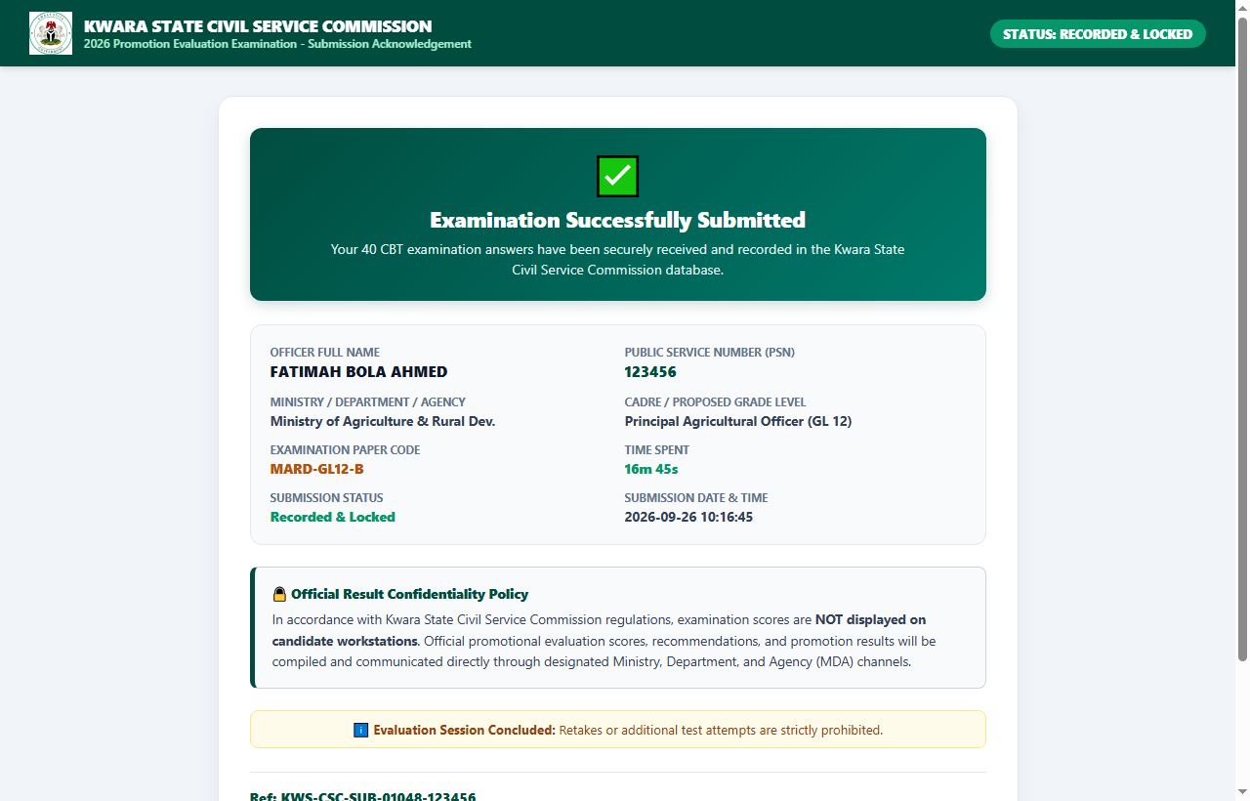
STAGE 7 OF 7
Official Submission Acknowledgement Slip
Stage 7
📄 WHAT YOUR SLIP SHOWS
✔ Recorded & Locked Status: Confirms that your 40 answers have been securely received in the Commission database.
✔ Candidate Audit Details: Displays Officer Name, PSN, MDA, Grade Level, Paper Code, Time Spent, and exact Submission Date & Time.
✔ Electronic Reference Code: A unique tracking code (e.g. Ref: KWS-CSC-SUB-01048-123456) verifying your submission integrity.
✔ Print Acknowledgement Slip: Click the green 'Print Acknowledgement Slip (PDF)' button to save or print a copy for your records.
✔ Session Concluded: Your access code is deactivated. Retakes or additional attempts are strictly prohibited.
🔒 ZERO SCORES DISPLAYED:
Notice that no numerical score or percentage appears on this slip. This is by design per Commission policy.
Kwara State Civil Service Commission (CSC) • 2026 Promotion Evaluation CBT Examination Guide
Notes:
FACILITATOR SCRIPT:
'When you click final submit, this is what appears on your screen: your Submission Acknowledgement Slip.
It provides official proof that your test was successfully recorded.
Check your electronic reference code at the bottom.
You can click 'Print Acknowledgement Slip' to save it as a PDF or print it.
Once you see this slip, your test is safely completed. You may close your browser and exit quietly.'

Slide 11
COMMISSION POLICY
Result Confidentiality & Official MDA Processing
Policy
🔒
WORKSTATION PRIVACY
• Examination scores are NOT displayed to candidates on the computer or mobile screen upon completion.
• This eliminates hall distractions, emotional reactions, and peer pressure during active batches.
• Ensures equal confidentiality across all candidate cadres and ministries.
🏛️
MDA CHANNEL DISPATCH
• All candidate responses and telemetry logs are securely encrypted and transferred to the CSC central server.
• Master scores are compiled by the Civil Service Commission alongside seniority, APER scores, and interview results.
• Official promotion results are communicated formally through your parent MDA's Director of Personnel Management (DPM).
⚖️
INTEGRITY & AUDIT TRAIL
• The Admin Portal allows authorized CSC Commissioners to audit test timestamps, time spent, and proctoring telemetry.
• Any candidate with logged security strikes is reviewed by the examination malpractice committee.
• Complete data protection guarantees that no unofficial result leaks occur.
Kwara State Civil Service Commission (CSC) • 2026 Promotion Evaluation CBT Examination Guide
Notes:
FACILITATOR SCRIPT:
'We want to emphasize this policy very clearly:
Many candidates ask: 'Why didn't I see my score when I finished?'
Civil Service promotion is a holistic evaluation. The CBT score is combined with your Annual Performance Evaluation Report (APER), your seniority, and promotional guidelines.
Scores are not displayed on workstations to prevent unrest, hall disorder, or premature conclusions.
Your official results will reach you through your Ministry, Department, or Agency through the proper administrative channels.'

Slide 12
TECHNICAL ADVISORY
Best Practices for Mobile Phone / Tablet Candidates
Mobile Guide
🔋 BATTERY PREPARATION
Charge your mobile device to at least 80% before reporting to the CBT center. Avoid low-power mode dimming during your test.
🔕 DO NOT DISTURB (DND)
Enable 'Do Not Disturb' or airplane mode with Wi-Fi only. Incoming phone calls minimize the browser and trigger security strikes!
📱 WIDE / LANDSCAPE MODE
Rotate your phone to landscape mode if you prefer seeing both the question card and the 40-question grid side-by-side.
👆 NO 3-FINGER SWIPES
Do not perform 3-finger swipe gestures on your screen. The proctoring system intercepts this as a screenshot attempt and blocks your screen.
🛡️ SCREEN WAKE-LOCK ACTIVE
The CBT portal automatically keeps your phone screen awake so your device will not sleep during the 20 minutes.
🌐 STABLE BROWSER
Use modern Google Chrome, Microsoft Edge, or Safari. Avoid third-party mini browsers (like Opera Mini) that compress layout.
Kwara State Civil Service Commission (CSC) • 2026 Promotion Evaluation CBT Examination Guide
Notes:
FACILITATOR SCRIPT:
'For candidates taking the CBT on mobile devices or tablets, these 6 technical tips are essential:
Number one: Put your phone on 'Do Not Disturb'. If your relative or colleague calls you during the exam, the incoming call overlay minimizes the CBT page, and the system registers a Strike 1 violation!
Number two: Do not attempt 3-finger screenshot gestures. It will trigger a screen blackout.
Number three: Keep your screen clean and use standard Google Chrome or Edge.'

Slide 13
EXAM DAY CHECKLIST
Golden Checklist & Final Instructions for Candidates
Checklist
✅ WHAT YOU MUST DO
✔ Bring your printed Photocard Slip with your PSN & Code 1.
✔ Arrive at your allocated CBT Hall 30 minutes before your batch time.
✔ Carefully verify your Name, MDA, and Paper Code before clicking Begin.
✔ Keep your eye on the 20-minute countdown clock.
✔ Attempt all 40 questions — ensure all boxes turn GREEN.
✔ Print or save your Submission Acknowledgement Slip upon completion.
❌ WHAT YOU MUST NEVER DO
✖ NEVER switch to another browser tab or application (Strike trigger).
✖ NEVER attempt screen capture (PrintScreen, Snipping tool, shortcuts).
✖ NEVER leave questions unanswered (each blank question is 0 marks).
✖ NEVER click 'Submit' prematurely without double-checking your grid.
✖ NEVER expect or demand a numerical score on your workstation.
✖ NEVER attempt a second login after submitting (Single attempt rule).
🌟 The Kwara State Civil Service Commission wishes all promotion candidates success in their evaluation!
Kwara State Civil Service Commission (CSC) • 2026 Promotion Evaluation CBT Examination Guide
Notes:
FACILITATOR SCRIPT:
'To conclude our briefing today:
Remember your golden checklist on Slide 13.
Be calm, read each question carefully, manage your 20 minutes, answer all 40 questions, and print your acknowledgement slip when you submit.
Are there any questions before we take candidates to the practice demo?'

