Slide 1
CSV User Manager
A focused dashboard for CSV-backed identity and host access management
Project overview and operational workflow

Slide 2
Project goals
Make small-scale identity and access administration predictable, visible, and repeatable.
• Manage users and machine-groups from one authenticated PHP dashboard.
• Keep CSV files human-readable and easy to review or version.
• Generate deployment-ready passwd and group blocks from source data.
• Apply changes deliberately through explicit, manual Ansible playbooks.
• Protect unrelated host membership data when one user assignment changes.

Slide 3
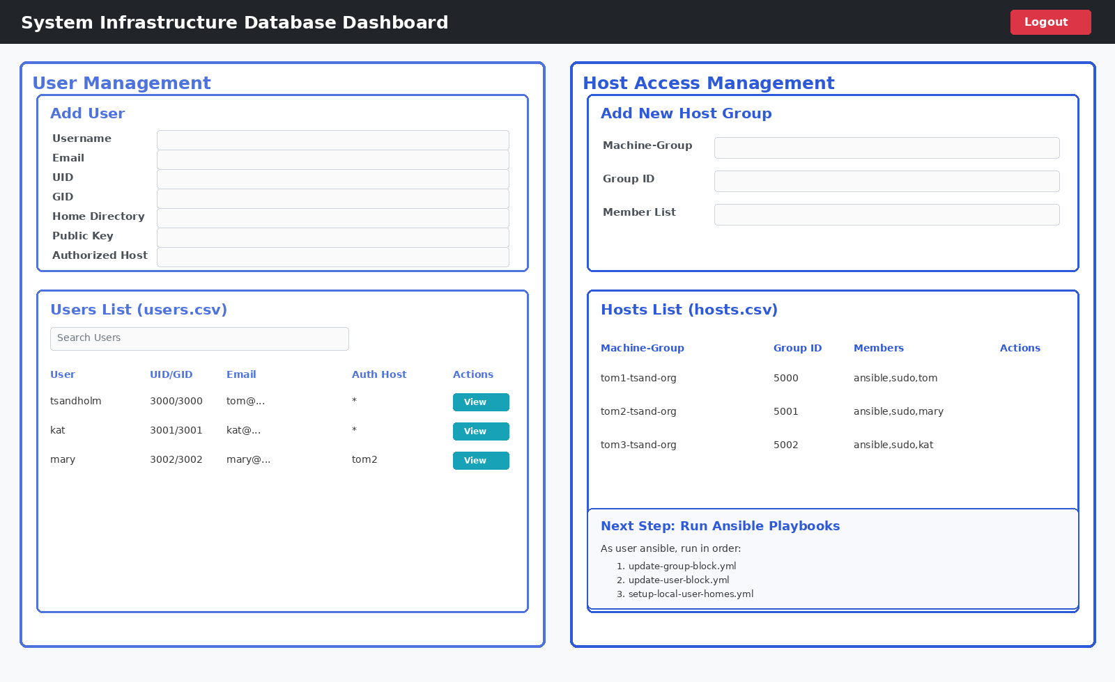
Dashboard at a glance
The UI separates user identity management from host access management.

Slide 4
Core features
User management
Host management
Raw file controls
Add, edit, delete, search, and inspect complete user records. Assign a specific Auth Host or all hosts.
Maintain machine-groups, IDs, and member lists while preserving existing members during targeted updates.
View or edit source CSVs and generated blocks in authenticated, readable pages.
Safe publishing
Operational safeguards
Usable layout
Publish hosts-block.txt separately from users-block.txt and groups-block.txt; publishing never runs Ansible.
Password hashing, locked raw-file writes, escaped output, atomic user-block generation, and backups.
Side-by-side management areas, searchable lists, internal list scrolling, and page-level scrolling.

Slide 5
Project structure
Small, explicit files keep the application easy to deploy and understand.
Web application
Source data
Generated artifacts
`index.php` handles authentication, CSV operations, synchronization, publishing, and raw views. `view.php` renders the dashboard.
`users.csv` stores identity records. `hosts.csv` stores machine-groups and member lists.
`users-block.txt`, `groups-block.txt`, and `hosts-block.txt` translate dashboard data into system-file formats.
Remote automation
Controller automation
`update-group-block.yml` and `update-user-block.yml` update remote `/etc/group` and `/etc/passwd` on `virt` hosts.
`setup-local-user-homes.yml` runs only on localhost to create homes and install SSH public keys.

Slide 6
Data-to-system flow
Source files remain the authority; generated blocks are reviewed before manual application.
1
Edit CSVs
2
Publish blocks
3
Deploy files
4
Apply remotely
5
Prepare controller
>
>
>
>
Dashboard or raw editor
Generate passwd/group files
`make push` to /var/www/html
Ansible with check/diff
Homes and authorized keys

Slide 7
Ansible playbooks and order
Run as user `ansible` from the controller; preview with `--check --diff` first.
1. update-group-block.yml
2. update-user-block.yml
3. setup-local-user-homes.yml
Target: remote `virt` hosts
Reads `hosts-block.txt` and updates the managed section of `/etc/group` with backups and privilege escalation.
Target: remote `virt` hosts
Creates primary groups, updates the managed `/etc/passwd` section, and runs `pwconv`.
Target: `localhost` only
Creates `/share/home` directories and `.ssh/authorized_keys` with correct ownership and permissions.
Recommended order (run as user ansible):
update-group-block.yml -> update-user-block.yml -> setup-local-user-homes.yml

Slide 8
Advantages and operating principles
• Simple deployment model: PHP, CSV, generated blocks, and playbooks can live in `/var/www/html`.
• Human-readable inputs support review, backup, and straightforward recovery.
• Manual Ansible execution keeps production changes intentional and observable.
• Targeted host synchronization preserves unrelated members instead of rebuilding lists.
• Generated files use standard `/etc/passwd` and `/etc/group` formats.
• Authentication and one-way password hashing protect dashboard access.

Slide 9
Quick start
1. Start the dashboard
php -S 127.0.0.1:8000
The dashboard provides the data and review surface; Ansible performs the controlled system changes.
2. Edit and publish
Save users/hosts, then publish hosts-block.txt and users-block.txt.
3. Apply in order
update-group-block.yml
update-user-block.yml
setup-local-user-homes.yml

